Slide 1
OECD EDU – September 18, 2012
RUSSIA STRATEGY 2020:
NEW SCHOOL AND TERTIARY EDUCATION
Yaroslav Kuzminov, Rector of the Higher School of Economics, co-chair of the Expert Group “Labor market, Professional Education, and Migration Policy”
Isak Froumin, Director of the HSE Institute of Education, co-chair of the Expert Group “New school”

Slide 2
STRATEGY 2020:
EDUCATION AND SOCIALIZATION FOR CHILDREN

Slide 3
There is no catastrophe in education
one of the biggest coverage of general education in the world;
leading positions in quality of education in primary school;
good positions in quality of education in areas of mathematics and natural sciences;
high level of teachers’ formal education;
increasing quality of infrastructure;
commitment and persistence of educated parents;

Slide 4
Alarming signs of problems in education
high rate of pupils, who do not achieve satisfactory level of functional literacy;
considerable gap between the least successful and the most successful groups of learners;
growing gap in quality of education throughout different schools and regions;
insufficient development of social competence and positive social attitude among school graduates;
constantly low PISA results (ability to apply received knowledge and skills);
decline of motivation to study among pupils

Slide 5

Problems: Outdated quality of Russian education
Percentage of students who have not achieved the second level of PISA reading literacy
Percentage of students who have scored highest in three competence fields
OECD
Russia
Leaders
OECD
Russia
One fifth of Russian students constantly score below the threshold level of reading literacy
Percentage of “advanced” pupils is lower than the OECD average and much lower than in leading countries

Slide 6
Problems: Educational inequality – “weak schools”
Groups of students | Resource limitations and educational technologies

Slide 7
Russia
OECD
Linear (Russia)
Linear (OECD)
Notes:
Добавить 2009 Толя –не могу, таких данных пока нет

Slide 8
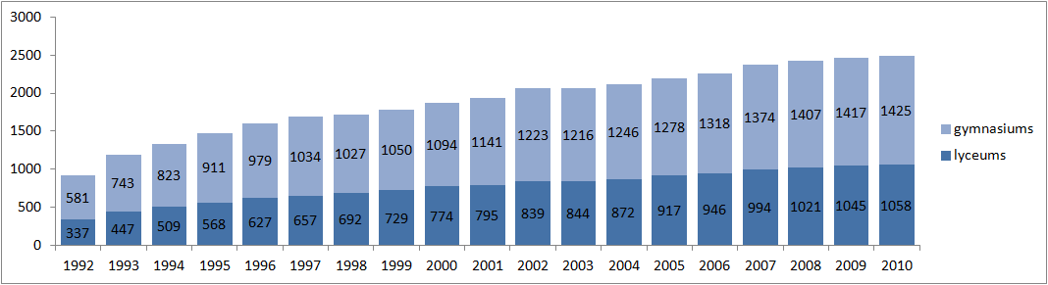
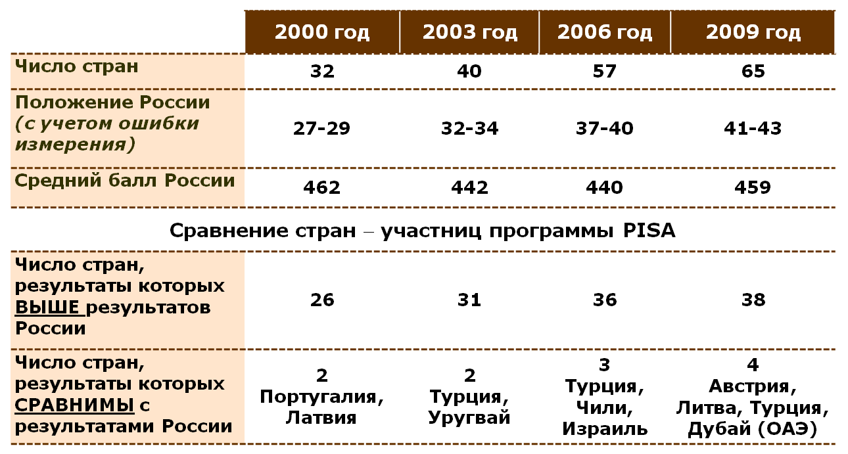
Problems: educational inequality – selective schools
Quantity of selective schools in Russia, by year
Gymnasiums
Lyceums
Quantity of countries
The position of Russia (considering measurement errors)
Average score in Russia
PISA results of Russian students, by year
Comparison of PISA member states
Quantity of countries where the results are higher than the Russian ones
Quantity of countries where the results are comparable with the ones in Russia

Slide 9
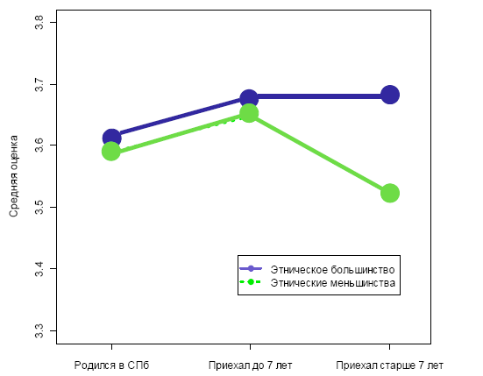
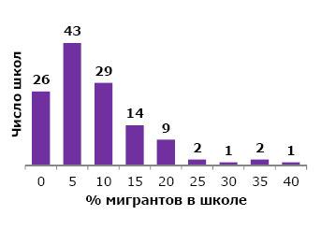
Problems: migrants’ children
Poll’s results in six municipal districts in Moscow region and Saint Petersburg:
Migrants’ children who moved to Russia after the age of 7 show considerably lower academic progress than their coevals
Number of schools
Ethnic majority
Ethnic minority
% migrants at school
born in St. Petersburg
came before the age of 7
came after the age of 7

Slide 10
Problems: Access to pre-school education
Educational institutions for children aged 5-7 get most attention and financial support. Preschool education coverage for children of ages 1 till 3 is only 32.5%.
фото
фото
Total urban aria rural area
фото
Preschool education coverage for children aged 1-6 is steadily growing, but is still lower than in 1991, when it was 63%.
фото
фото
Высшая школа экономики, Москва, 2011

Slide 11
Causes of aggravating problems:
General
Limited offer of services for preschool education Degradation of teaching staff Network of educational establishments does not correspond to changing patterns of settlement Scale and quality of extracurricular activities is declining Outdated educational content and methods
Management
Limited management capacity on regional, municipal and school levels Institutional reforms are not complete (quality assurance system is not established)

Slide 12
Causes: teaching staff
Teaching staff is aging: percentage of teachers with less than 10 years of work experience is constantly declining.

Slide 13
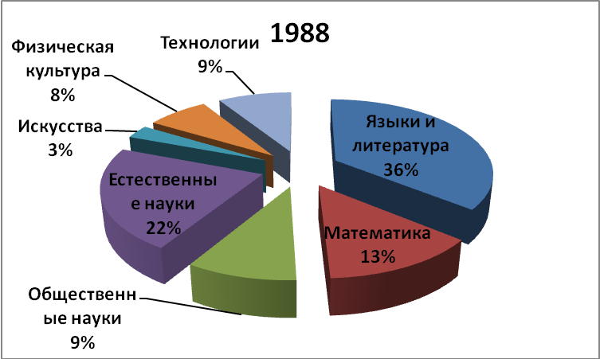
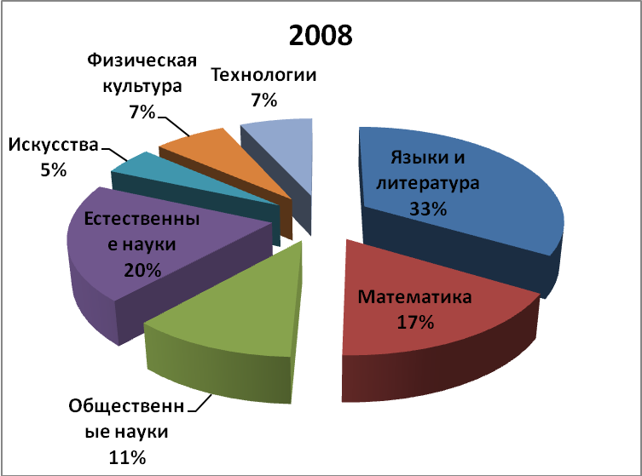
Causes: Outdated educational content
The structure of basic curriculum

Slide 14
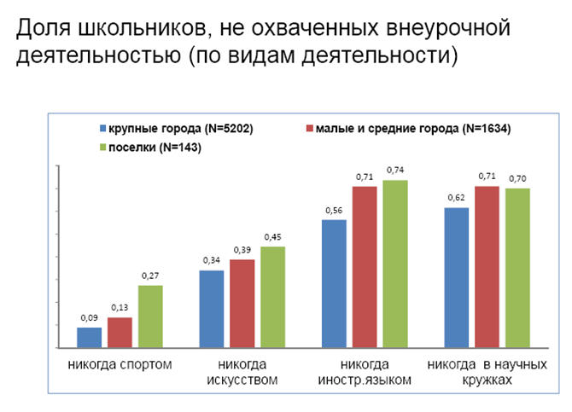
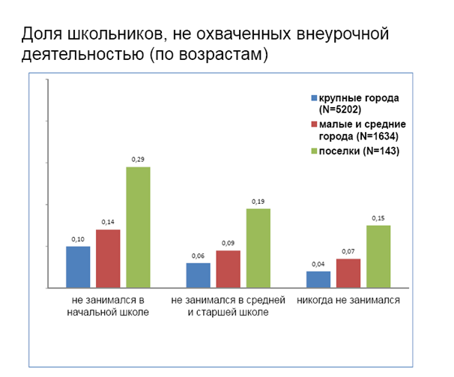
Causes: Declining extracurricular activities
Percentage of pupils not involved in extracurricular activities (types of activities)
Percentage of pupils not involved in extracurricular activities (age groups)
Large cities
medium and small towns
rural areas
Large cities
medium and small towns
rural areas
were not involved in extracurricular activities in elementary school
in secondary and high school
have never been involved in extracurricular activities
sport never
arts never
Foreign languages never
scientific hobby groups never
Percentage of children aged 5-18 involved in supplementary education is 49.1%. On average, only 52% of families in Russia have never paid for supplementary education.

Slide 15
Purposes of the new development stage in education should be formulated as follows:
Ensuring positive socialization and educational successfulness for each child;
Children have to acquire modern skills.
Thus it is necessary
to stop negative trends;
to modernize the sphere of education in accordance with challenges of changing cultural, social and technical environment.

Slide 16
The object of educational policy should be perceived not simply as the system of schools and preschool educational establishments, but as the complex sphere of education and socialization for the young generation.

Slide 17
New development resources:
Interest and energy of families.
Creativity of some schools and innovative networks.
Potential of higher education for high school students.
Out-of-school forms: supplementary education, “industries for children”, internet.
Timing (overall educational time in Russia is 25% lower than in OECD).
17

Slide 18
Major areas for changes:
Access to preschool education.
Ensuring equal opportunities for all students.
Renewal of teaching staff.
New quality of content and methods of teaching (breakthrough in spheres of potential leadership and catching up with the backlogs).
Out-of-school education and socialization.
New network of schools
Data collection and evidence-based management

Slide 19
Raising access to preschool education:
Federal support to building nursery schools in regions with significant deficit of preschool institutions (deficit of places not less than 10%, where the coverage of children is lower than 70%).
Stimulating the sector of non-government flexible services for young kids through the system of tax remissions and deductions.
Elaborating mechanisms for establishing separate groups of preschool education as independent organizations in specially suited premises; creating external centralized system of management and outsourcing services for childcare.

Slide 20
Ensuring success of each child
Creating revealing and record keeping systems for special groups of children in sphere of education (children in difficult situations, migrants’ children, children with disabilities, gifted and talented children).
Support to educational institutions working with the most difficult groups of students and implementation of programs of integration of social and educational integration.
Support to inclusive educational programs for children with disabilities and gifted children in an educational institution and municipal network; preserving and developing special educational organizations.
Support to educational programs of sociocultural integration for migrants’ children (including learning Russian).

Slide 21
Renewing teaching staff and teachers’ skills
Raising salaries for teachers in exchange to new contractual duties (effective contract).
Modernization of professional development system.
Modernization of pension system for teachers.
Incentives for young teachers.
Qualification exam for graduates of pedagogical universities and specialists without pedagogical education willing to work in an educational organization.

Slide 22
Modernization of pedagogical education
Introducing minimal Unified State Exam score limitations to enter a university with major in pedagogics.
Federal support and delegating a part of functions of professional retraining to non-government and non-specialized institutions of higher education, employing new programs, models of training, and utilizing modern educational technologies, forms, etc.
Introducing compulsory year-long internship in the graduate school, based on results of which educational license should be issued.

Slide 23
Modernization of content and methods of teaching
New flexible mechanism for renewing the content of education.
Development of educational content and methods in the following areas: “Technology”, “Social sciences” and “Foreign languages”, aimed at achieving new level of learning achievements.
Support to projects of forming new technological environment in the system of education (“digital school”, web 3.0, digital hypertext textbooks), including providing schools with high-speed wireless network access.
Moving Russian mathematical education into leading positions in the world.

Slide 24
Developing the sphere of out-of-school education and socialization:
Implementing the mechanism of competition-based financing for programs of supplementary education, summer leisure, and improvement of children’s and young people’s health.
Support to development of municipal social infrastructure and cultural environment for children and young people (exploratoriums, outdoor play sets, playgrounds, social networks, etc.).
Support to integrated media-social projects (TV; Internet; play, documentary, and animated films) aimed at formation of social competences and targets; gaining experience of positive social attitudes and civic values.

Slide 25
Modernization stages:
2012-2015
  Centralized promotion of basic standards and new regulatory framework, their implementation (including “new contact”).
  Support to leading regions’ pilot projects of implementing federal policies through catalytic subsidies.
  Launching Federal projects of open education and socialization.
2016-2020
  Educational policy decentralization, support to regional initiatives.
  Development of non-government sector of socialization and education.

Slide 26
STRATEGY 2020:
TERTIARY EDUCATION

Slide 27
Key Labor Market Challenges in 2020
Up to 25% of the able-bodied population cannot “find their place on the market” due to the gap between their ambitions, competences and the job offers available
Creative workforce and highly-qualified employees are flowing out of the country (the new generation of workers are more mobile and have modern language skills)
The migrant workers coming from the Far East and Asian republics tend to seek permanent residence at a new place rather than work temporarily (just like in the European countries during the 80s and 90s)

Slide 28
Structural maneuvering and internal economizing are plausible
in the field of education
фото
фото
фото
2020
Growth in the number of children of school age:
by 22%
Decrease in the number of people aged 17-20:
almost by 30%
фото
фото
Высшая школа экономики, Москва, 2011
28
Notes:
28

Slide 29
University Enrollees and Graduates Structured Flows in 2009 (mln. of people)
0.04
Pre-school age children
1.07
Grade 1 to 4
Grades 5 to 9
0.29
Higher education
0.24
Prim.education
0.02
0.76
Grades 10,11, (12) (Complete sec. school education)
0.08
Sec.education
фото
0.22
0.54
0.023
0.21
0.63
Not catered to by the daycare centers
0.34
1.29
0.95
0.63
1.41
0.03
0.01
0.49
0.14
0.42
0.17
1.37
0.64
фот
Labor market, military service, other countries
Further education opportunities for adults
фото
29
Notes:
29

Slide 30
Funds Allocated for Financing Secondary and Higher Education in Russia and Other Countries of the World
(Per Capita Expenses)

Slide 31
Structural Changes in Learner Cohorts (During the Last 2 Decades)
Sudden growth in the number of university students in 2000-2010*
фото
фото
*Sample data provided by the Federal State Statistics Service
Высшая школа экономики, Москва, 2011
31
Notes:
31

Slide 32
Educational Program Participants
Student cohort structure in the US publicly-funded HEIs in 2009 | Student cohort structure in Russia
фото
Applied skills and competences obtained
фот
62.1%
34.4%
фото
Высшая школа экономики, Москва, 2011
32
Notes:
32

Slide 33
Psychological Aspect
in Obtaining a University Degree
How important is it for you today to obtain a university degree?
фото
фот
фото
Высшая школа экономики, Москва, 2011
33
Notes:
33

Slide 34
The Value of Higher Education and the University Graduates’ Qualifications
Young people who obtained a degree from a HEI
The share of employers who think the educational establishments’ graduates need further training
(as at 2006)
фото
Number of educational establishments’ graduates at the labor market, mln. of people
фот
фото
Высшая школа экономики, Москва, 2011

Slide 35
Up to 25% of the First-Year Students Do Not Possess Even the Basic Competences for Continuing Their Education Successfully
Enrollees’ minimal USE points (incl. only the competing students whose tuition fee is covered by the public funds)
фото
фото
фот
фот
фото
фото
Высшая школа экономики, Москва, 2011
35
Высшая школа экономики, Москва, 2011
Notes:
35

Slide 36
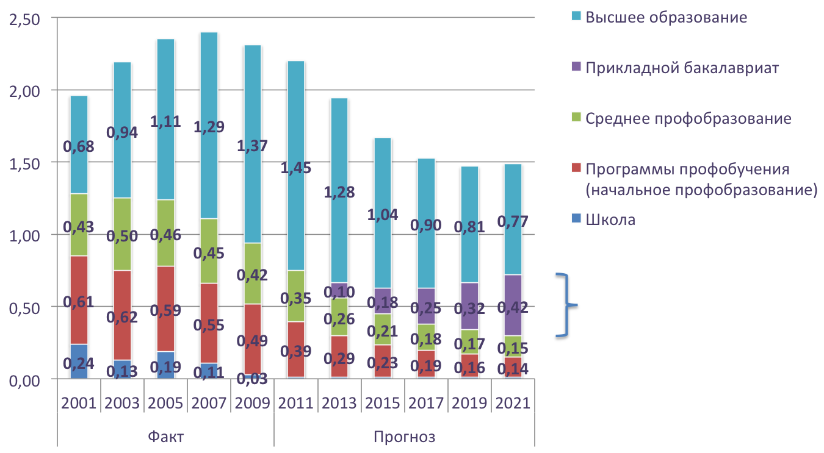
Graduates entering the labor market, including the introduction of applied baccalaureate degree programs, millions of people
Higher education
Applied baccalaureate degree programmes
Secondary-level vocational education
Vocational training programmes (primary-level vocational education)
School
фото
фото
фото
фот
фот
фот
In 2021, the share of applied bachelor-degree programme graduates is expected to amount to 28.4% of the employment market.
фото
фото
фото
Высшая школа экономики, Москва, 2011
36
Высшая школа экономики, Москва, 2011
Высшая школа экономики, Москва, 2011
Notes:
36

Slide 37
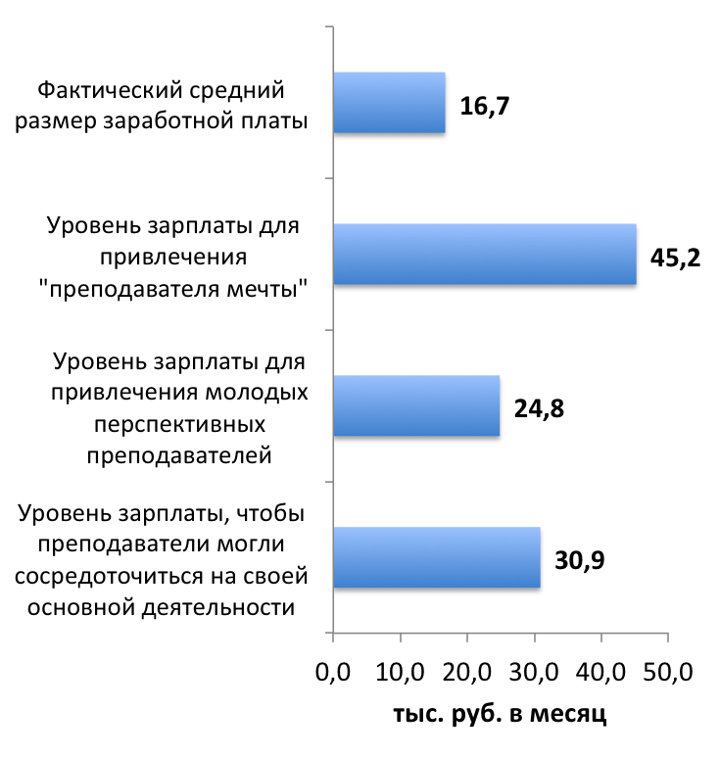
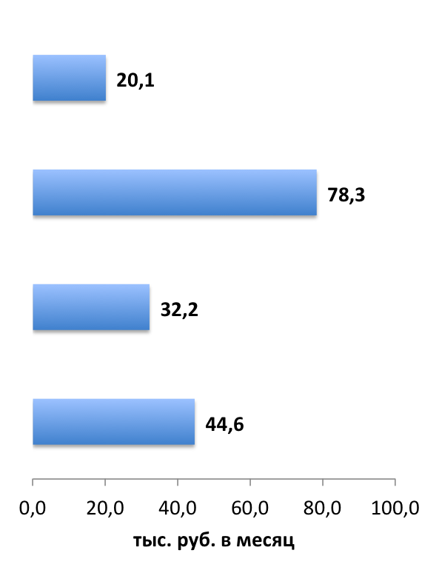
Performance-based contracting for teachers
Secondary vocational education | Higher education
Actual average level of wages
Level of wages needed to attract a target profile teacher (“dream teacher”)
Level of wages needed to attract young promising teachers
Level of wages required to ensure that teachers can stay focused on their main professional activity
According to HSE “Monitoring of education markets and organizations (MEMO)”: December 2010
in thousands of rubbles
37
Notes:
37

Slide 38
Inertia scenario issues
Low prestige of the primary- and secondary-level vocational education
Education programmes lag behind their international counterparts; “provincialism”
Poor level of the student body education profile, low motivation to study
Low quality of fee-based education programmes = higher education “underprivileged trap”
Insufficient transparency of the higher education system for customers and for the government
Low level of adults involvement in further education programmes
Low level of wages and unsatisfactory quality of the teaching faculty body
38
Notes:
38

Slide 39
Key measures:
tertiary education
Additional financial support required
PERFORMANCE-BASED CONTRACTING FOR TEACHERS SUPPORT AND DEVELOPMENT OF INTERNATIONAL AND NATIONAL-LEVEL RESEARCH INSTITUTIONS NATIONAL OPEN UNIVERSITIES STUDENT LOANS FOR EDUCATION MAINTENANCE ALLOWANCES FOR UNDERPRIVILEGED STUDENTS AND STUDENTS LIVING AWAY FROM HOME, TO THE AMOUNT OF THE MINIMUM MONTHLY WAGE
No additional financial support required from the budget
APPLIED BACCALAUREATE DEGREE PROGRAMS SHORT-TERM PROGRAMMES TO DEVELOP QUALIFIED SKILLS IN APPLIED AREAS INTRODUCTION OF THE MINIMUM EDUCATION REQUIREMENTS FOR THOSE ENTERING STATE-SUBSIDIZED PROGRAMMES INDEPENDENT STATE CERTIFYING EXAMINATION VOLUNTARY PROFESSIONAL CERTIFYING EXAMINATION «MONEY FOLLOWS THE STUDENT» APPROACH THE COST SET FOR FEE-BASED EDUCATION PROGRAMMES CANNOT BE LOWER THAN THE REGULATORY STANDARDS FOR PROGRAMMES FUNDED FROM THE STATE/PUBLIC BUDGET(S) ENSURE TRANSPARENCY OF EDUCATION INSTITUTIONS AND PROGRAMMES MONITORING OF ALUMNI CAREER DEVELOPMENT AND INCOME MODERNIZATIONS OF THE EDUCATIONAL INSTITUTIONS NETWORK IN THE REGIONS

Slide 40
Bridging the labor market and tertiary education
To develop regulatory documents to enable implementation of education programmes for adult students by for-profit organisations to provide officially-certified advanced/further professional training; also, to enact regulations that enable these organisations to compete with educational institutions for public contracts.
To develop mass entrepreneurial education/training programmes for small- and medium-sized businesses (including voucher co-funded educational and training courses for new entrepreneurs in high-priority industries, such as telecommunications, biotechnology, power production etc.)
To establish an educational/training centres network in the countries supplying the labour force to Russia (NIS countries), to ensure their integration into the Russian vocational education system in order to improve the skills and qualifications of migrant workers.
To establish a voucher co-funded professional education and training system for disadvantaged populations, including the unemployed, retired, and ethnic minorities (including, alongside with migrant workers, indigenous populations of the Russian North and Far East).
To allocate state subsidies to provide retraining for the unemployed youth (representatives of the “excessive higher education” generation)
To enable foreign educational providers to have a limited regulated access to the adult education system in technological fields where Russia notably lags behind.
40
Notes:
40

