Slide 1
Least-squares imputation of missing data entries
I.Wasito
Faculty of Computer Science
University of Indonesia
Notes:
1/5

Slide 2
Faculty of Computer Science (Fasilkom), University of indonesia at a glance
Initiated as the Center of Computer Science (Pusilkom) in 1972, and later on was established as a faculty in 1993
Fasilkom and Pusilkom now co-existed
Currently around 1000 students and is supported by 50 faculty members

Slide 3
Current Enrolment
No | Study Program | Student body (Dec 2008) | Graduates (cumulative)
1 | B.Sc in CS | 476 | 1019
2 | B.Inf.Tech (joint with UQ-Australia) | 40 | 13
3 | B.Sc in IS | 128 | -
4 | B.Sc in IS (Ext) | 67 | -
5 | M.Sc in CS | 45 | 211
6 | M.Sc in IT | 256 | 697
7 | Ph.D | 18 | 13
 | Total | 1030 | 1953

Slide 4
Research labs
Digital Library & Distance Learning
Formal Methods in Software Engineering
Computer Networks, Architecture & HPC
Pattern Recognition & Image Processing
Information Retrieval
IT Governance
E-Government
Enterprise Computing
Unifying theme:
Intelligent Multimedia Information Processing

Slide 5
Services & Venture
Center of Computer Service as the academic venture of Faculty of Computer Science
It provides consultancies and services to external stakeholders in the areas of:
IT Strategic Planning & IT Governance
Application System integrator and development
Trainings and personnel development
Annual revenue (2008): US$.1 Million

Slide 6
Background
Missing problem:
- Editing of Survey Data
- Marketing Research
- Medical Documentation
- Microarray DNA Clustering/Classification

Slide 7
Objectives of the Talk
To introduce nearest neighbour (NN) versions of least squares (LS) imputation algorithms.
To demonstrate a framework for setting experiments involving: data model, missing patterns and level of missing.
To show the performance of ordinary and NN versions of LS imputation.

Slide 8
Principal Approaches for Data Imputation
Prediction rules
Maximum likelihood
Least-squares approximation

Slide 9
Prediction Rules Based Imputation
Simple:
Mean
Hot/Cold Deck (Little and Rubin, 1987)
NN-Mean (Hastie et. al., 1999, Troyanskaya et. al., 2001).
Notes:
9

Slide 10
Prediction Rules Based Imputation
Multivariate:
Regression (Buck, 1960, Little and Rubin, 1987, Laaksonen, 2001)
Tree (Breiman et. al, 1984, Quinlan, 1989, Mesa et. al, 2000)
Neural Network (Nordbotten, 1999)

Slide 11
Maximum Likelihood
Single Imputation:
EM imputation (Dempster et. al, 1977, Little and
Rubin, 1987, Schafer, 1997)
Full Information Maximum Likelihood
(Little and Rubin, 1987, Myrveit et. al, 2001)

Slide 12
Maximum Likelihood
Multiple Imputation:
Data Augmentation
(Rubin, 1986, Schafer, 1997)

Slide 13
Least Squares Approximation
Iterative Least Squares (ILS)
Approximation of observed data only.
Interpolate missing values
(Wold, 1966, Gabriel and Zamir, 1979, Shum et. al, 1995, Mirkin, 1996, Grunge and Manne, 1998)

Slide 14
Least Squares Approximation
Iterative Majorization Least Squares (IMLS)
Approximation of ad-hoc completed data.
Update the ad-hoc imputed values (Kiers, 1997, Grunge and Manne, 1998)

Slide 15
Notation
Data Matrix X; N rows and n columns.
The elements of X are x_{ik} (i=1,…,N; k=1,…,n).
Pattern of missing entries M= (m_{ik}) where m_{ik} = 0 if X_{ik} is missed and m_{ik} = 1, otherwise.

Slide 16
Iterative SVD Algorithm
Bilinear model of SVD of data matrix :
p=number of factors.
Least Squares Criterion:

Slide 17
Rank One Criterion
Criterion
PCA Method (Jollife, 1986 and Mirkin, 1996), Power SVD Method (Golub, 1986).

Slide 18
L₂ Minimization
Do iteratively : (C,Z) ⇒ (C′, Z′)
until (c,z) stabilises. Take the result as a factor and change X for X-zc^{T}. Note: C’ is normalized.

Slide 19
ILS Algorithm
Criterion:
Formulas for updating:

Slide 20
Imputing Missing Values with ILS Algorithm
Filled in x_{ik} for m_{ik}=0 with z_{i} and c_{k} those to be found such that:
Issues:
Convergence: missing configuration and starting
point (Gabriel-Zamir, 1979).
Number of Factors: p=1→NIPALS algorithm (Wold,
1966).

Slide 21
Iterative Majorization Least Squares (IMLS)
Complete X with zeros into X′.
Apply Iterative SVD algorithm with
Check a stopping condition.
Complete X to X′ with the results of 2. Go to 2.
The extension of Kiers Algorithm (1997)→p=1 only.

Slide 22
Imputation Techniques with Nearest Neighbour
Related work:
Mean Imputation with Nearest Neighbour (Hastie et. al., 1999, Troyanskaya et. al., 2001).
Similar Response (Hot Deck) Pattern Imputation (Myrveit, 2001).

Slide 23
Proposed Methods ( Wasito and Mirkin, 2002)
1. NN-ILS →ILS with NN
2. NN-IMLS → IMLS with NN
3. INI -> Combination of global IMSL and NN-IMLS

Slide 24
Least Squares Imputation with Nearest Neighbour
NN version of LS imputation algorithm A(X,M)
Observe the data, if there is no missing entries, end.
Take the first row that contains missing entry as the target entity, X_{i}.
Find K neighbours of X_{i.}
Create data matrix X which consists of X_{i} and K selected neighbours.
Apply imputation algorithm A(X,M), impute missing values in X_{i} and go back to 1.

Slide 25
Global-Local Least Squares Imputation (INI) Algorithm
Apply IMLS with p>1 to X and denote the completed data as X*.
Take the first row of X that contains missing entry as the target entry X_{i}.
Find K neighbours of X_{i} on matrix X*.
Create data matrix X_{c} consisting of X_{i} and rows of X corresponding to K selected neighbours.
Apply IMLS with p=1 to X_{c} and impute missing values in X_{i} of X.
If no missing entry, stop; otherwise back to step 2.

Slide 26
Experimental Study of LS Imputation
Selection of Algorithms:
NIPALS: ILS with p=1.
ILS-4: ILS with p=4.
GZ: ILS with Gabriel-Zamir Initialization.
IMLS-1: ILS with p=1.
IMLS-4: IMLS with p=4.
N-ILS: NN based ILS with p=1.
N-IMLS: NN based IMLS with p=1.
INI: NN based IMLS-1 with distance from IMLS-4.
Mean and NN-Mean.

Slide 27
Rank one data model

Slide 28
NetLab Gaussian Mixture Data Models
NetLab Software (Ian T. Nabney, 1999)
Gaussian Mixture with Probabilistic PCA covariance matrix (Tipping and Bishop, 1999).
Dimension: n-3.
First factor contributes too much.
One single linkage clusters.

Slide 30
Scaled NetLab Gaussian Mixture Data Model
The Modification:
Scaling covariance and mean for each class.
Dimension=[n/2].
More structured data set .
Contribution of the first factor is small.
Showing more than one single linkage cluster.

Slide 31
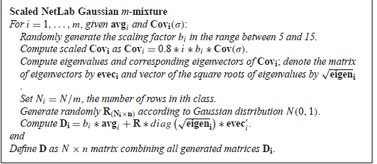

Slide 32
Experiments on Gaussian Mixture Data Models
Generation of Complete Random Missings
Random Uniform Distribution
Level of Missing: 1%, 5%, 10%, 15%, 20% and 25%
Evaluation of Performances:

Slide 33
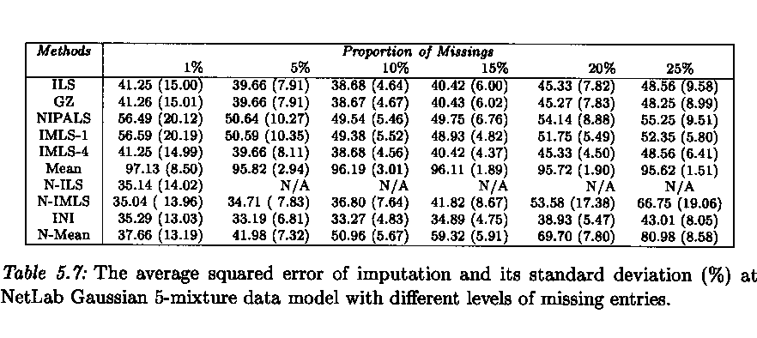
Results on NetLab Gaussian Mixture Data Model

Slide 34
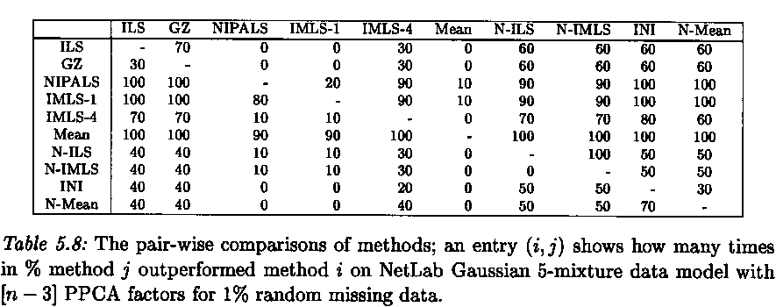
Pair-Wise Comparison on NetLab GM Data Model with 1% Missing

Slide 35
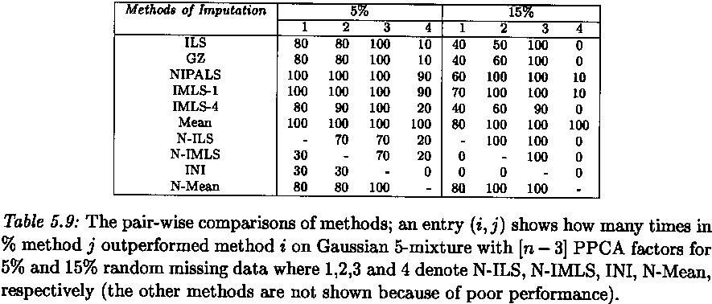
Pair-Wise Comparison on NetLab GM Data Model with 5% and 15% Missing

Slide 36
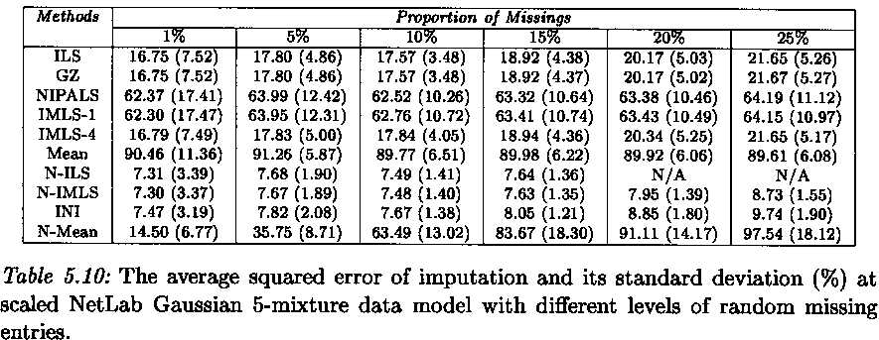
Results on Scaled Netlab GM Data Model

Slide 37
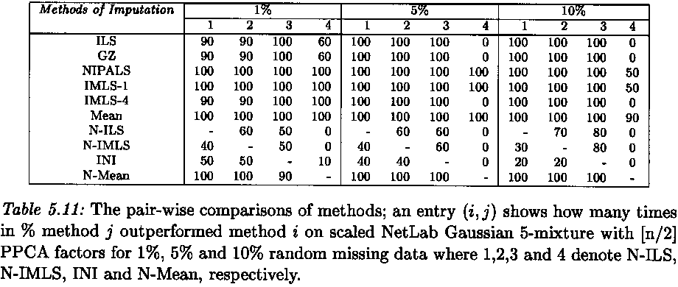
Pair-Wise Comparison with 1%-10% Missing

Slide 38
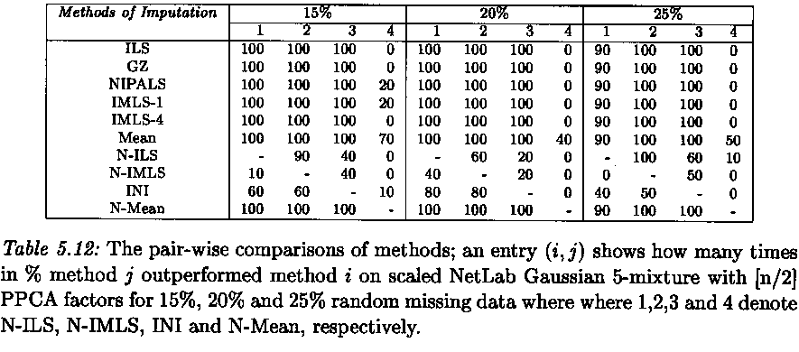
Pair-Wise Comparison with 15%-25% Missing

Slide 39
Publication
I. Wasito and B. Mirkin. 2005. Nearest Neighbour Approach in the Least Squares Data Imputation. Information Sciences, Vol. 169, pp 1-25, Elsevier.

Slide 40
Different Mechanisms for Missing Data
Restricted Random pattern
Sensitive Issue Pattern:
Select proportion c of sensitive issues (columns).
Select proportion r of sensitive respondents (rows).
Given proportion p of missing s.t p < cr:
10% < c < 50% , 25% <r <50% for p=1%.
20% < c < 50%, 25% < r <50% for p=5%.
30% < c <50%, 40% < r <80% for p=10%.

Slide 41
Different Mechanisms for Missing Data
Merged Database Pattern
Missing from one database
Missing from two databases:
Observed
Observed

Slide 42
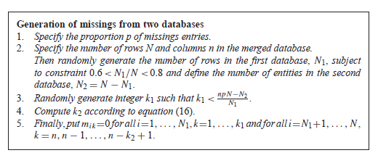

Slide 43
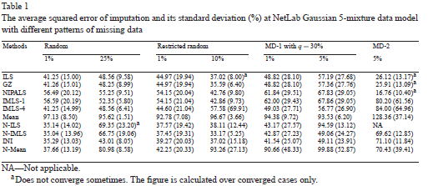

Slide 44
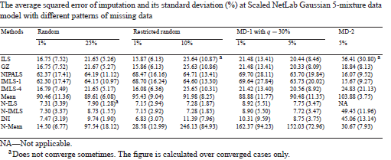

Slide 45
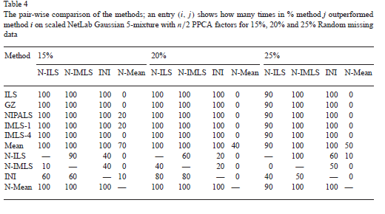

Slide 46
Results on Random Patterns
Complete Random:
NetLab GM: INI for all level of missings
Scaled NetLab GM: 1%-10% -> INI
15%-25% -> N-IMLS
Restricted Random Pattern:
NetLab GM: INI
Scaled NetLab GM: N-IMLS

Slide 47
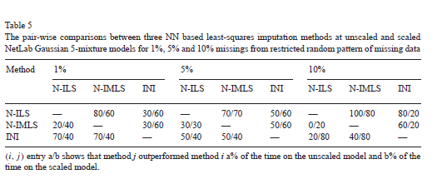

Slide 48
Sensitive Issue pattern
Sensitive Issue:
NetLab GM: 1% -> N-IMLS
5% -> N-IMLS and INI
10% -> INI
Scaled NetLab GM: 1% ->INI
5%-10% -> N-IMLS

Slide 49
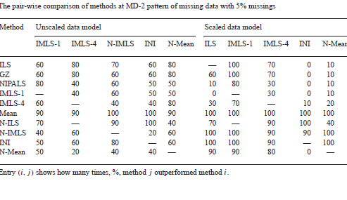

Slide 50
Merged Database Pattern
Missing from One Database:
NetLab GM: INI
Scaled NetLab GM: INI/N-IMLS
Missing from Two Databases:
NetLab GM: N-IMLS/INI.
Scaled NetLab GM: ILS and IMLS→the only one
NN-Versions lose.

Slide 51
Publication
I. Wasito and B. Mirkin. 2006. Least Squares Data Imputation with Nearest Neighbour Approach with Different Missing Patterns. Computational Statistics and Data Analysis, Vol. 50,pp. 926-949., Elsevier.

Slide 52
Experimental Comparisons on Microarray DNA Application
The goal: to compare various KNN based imputation methods on DNA microarrays gene expression data sets within simulation framework.

Slide 53
Selection of algorithms
1.KNNimpute ( Troyanskaya, 2003)
2. Local Least Squares ( Kim, Golub and Park, 2004)
3. INI (Wasito and Mirkin, 2005)

Slide 54
Description of Data Set
Experimental study in identification of diffuse large B-cell lymphoma [Alizadeh et al, Nature 403 (2000) 503-
511].

Slide 55
Generation of Missings
Firstly, the rows and columns containing missing values are removed.
From this ”complete” matrices, the missings are generated randomly
On the original real data set at 5% level of missings.

Slide 56
Samples generation
This experiment utilizes 100 samples (size: 250x 30) which each rows and columns are generated

Slide 57
Evaluation of Results

Slide 58
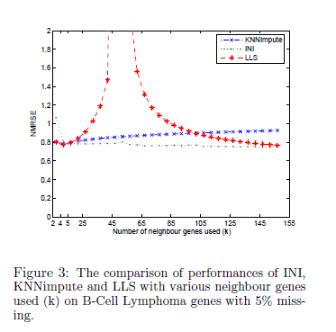

Slide 59
Conclusions
Two Approaches of LS Imputation:
ILS -> Fitting available data only.
IMLS -> Updating ad-hoc completed data.
NN versions of LS surpass the global LS except in missing from two databases pattern with Scaled GM data model.

Slide 60
Thank You for your attention

