Slide 1
Mixed Tools for Markets Graph Analysis

Slide 2
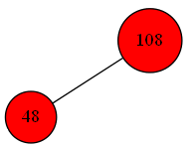
Notations
A vertex – a stock on a certain market
Two stocks are colored in the same color if they belong to the same cluster (the star)
A vertex’s text color is white if the stock is a median (a center of the cluster)

Slide 3
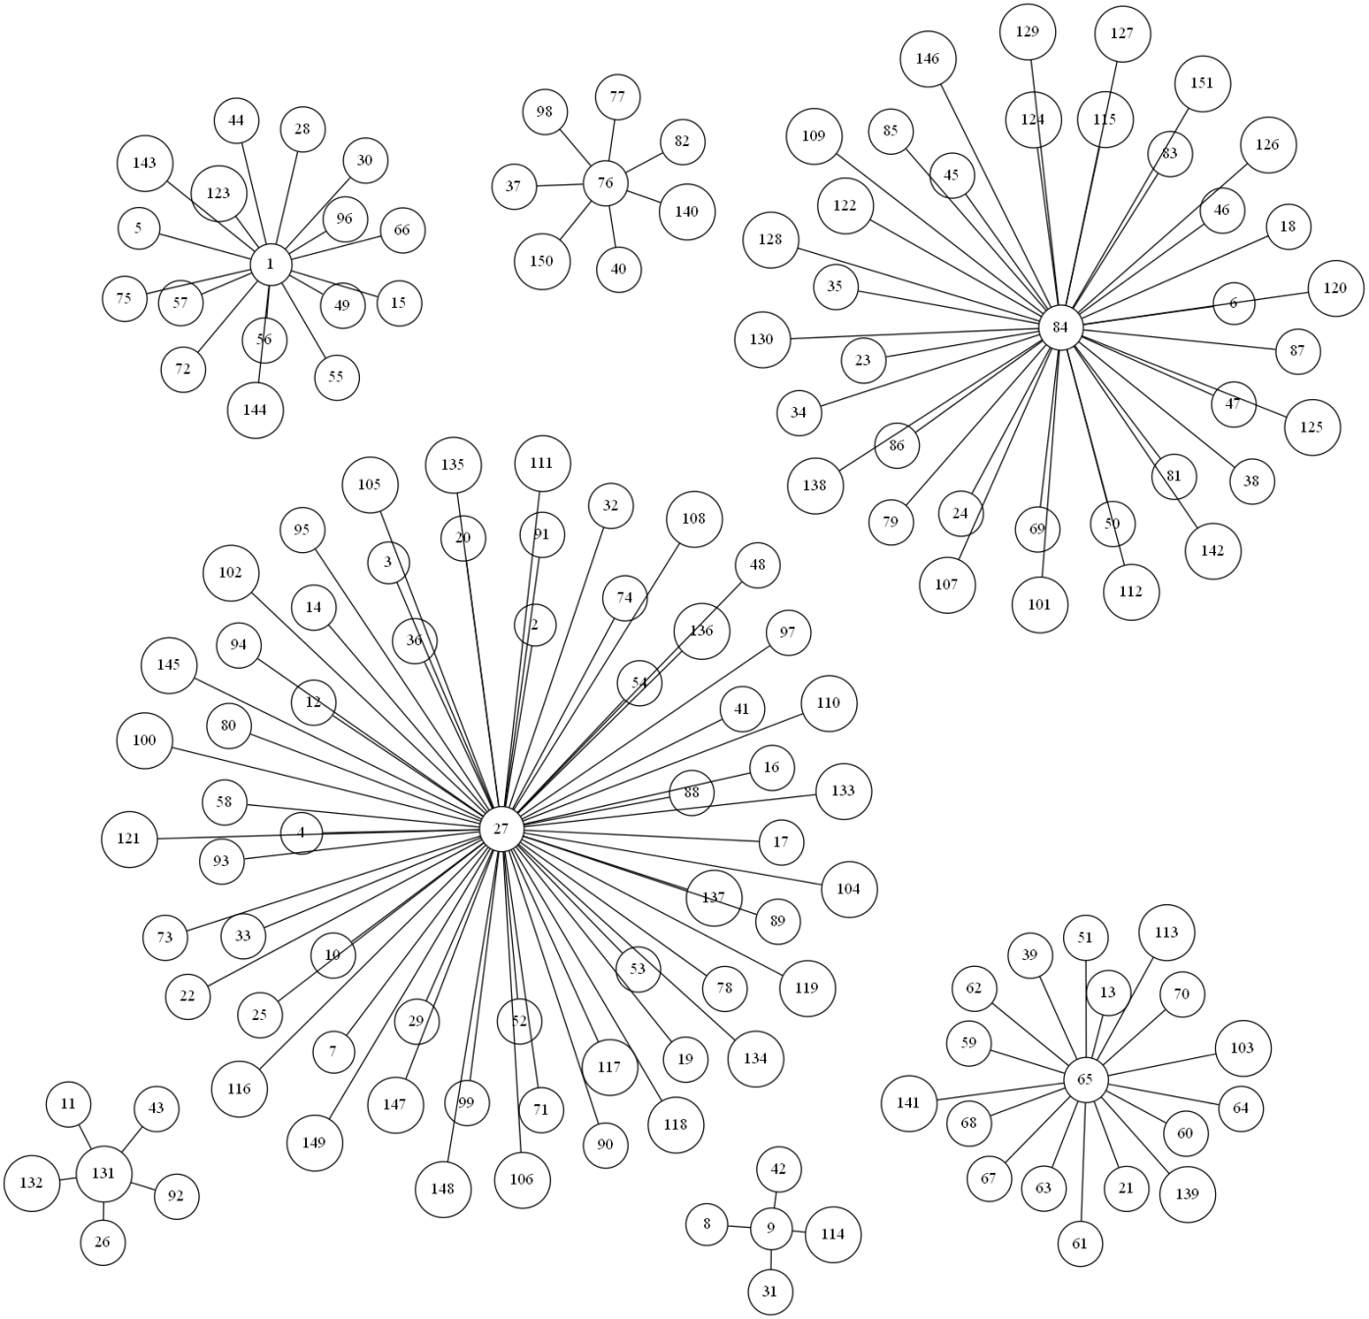
7 clusters for Russian market
1 – AFKS – AFK “Sistema" – Investment
9 – AVAZ – AVTOVAZ – Automobile production
27 – GAZP – GAZPROM – Oil & Gas
65 – MRKU – MRSK Urala – Power industry
76 – NKNCP – Nizhnekamskneftechim – Chemistry
84 – OGKB – OGK-2 – Power industry
131 – TORSP – Tomskaya paspr. Kompania – Power industry
Includes 2 big clusters corresponding to energy industry
The cluster with the 1st stock as a centre is an unstable one because it’s not presented among trees of MSF

Slide 4
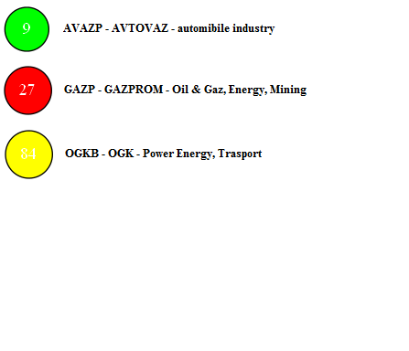
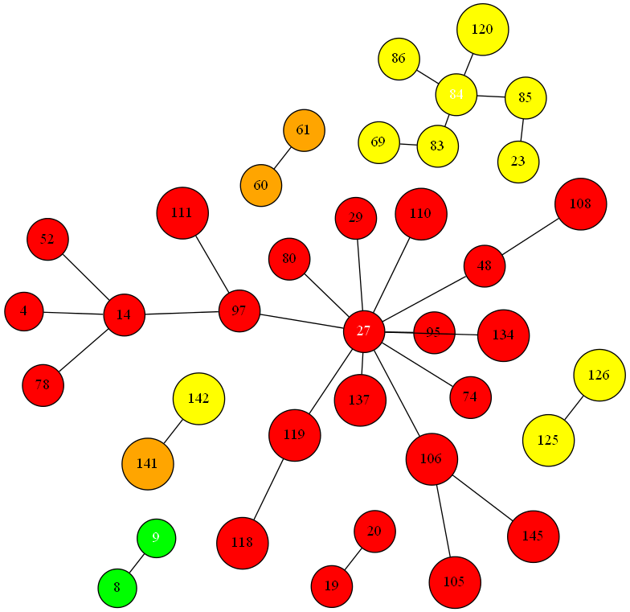
Minimum Spanning Forest of 7 Trees for 7 Medians
Almost all trees correspond exactly to one star
One tree connects two stars

Slide 5
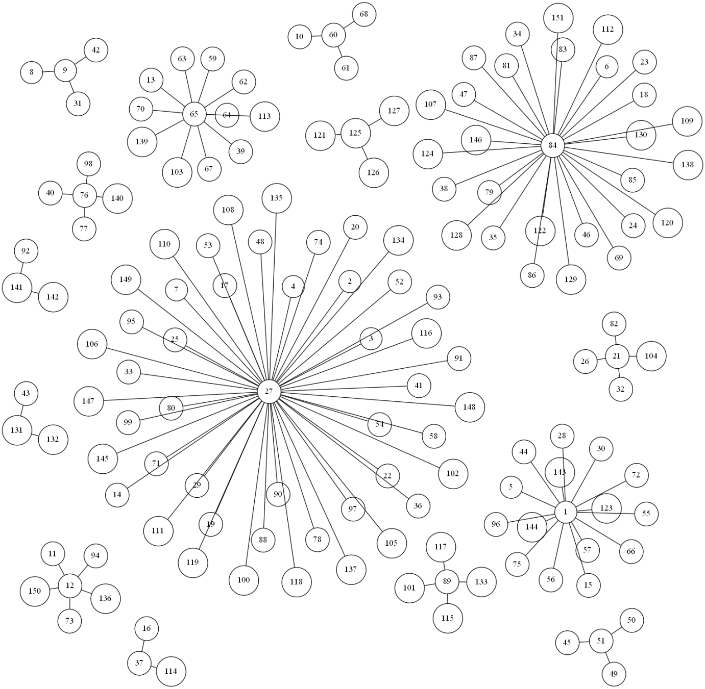
15 clusters for Russian market
Stable clustering
Two large strong clusters presented Oil & Gas and power industries
1 – AFKS – AFK “Sistema" – Investment
9 – AVAZ – AVTOVAZ – Automobile production
12 – BLNG – Belon – Building materials
21 – DIXY – DIXY Group – Retail trade
27 – GAZP – GAZPROM – Oil & Gas
37 – KBSB – Kubanenergosbut – Power industry
51 – LSRG – Gruppa LSR – Building
60 – MRKHP – Holding MRSK – Power industry
65 – MRKU – MRSK Urala – Power industry
76 – NKNCP – Nizhnekamskneftechim –Chemistry
84 – OGKB – OGK-2 – Power industry
89 - PIKK - Companies Group PIK Building
125 TGKE - TGK-5 Power industry
131 – TORSP – Tomskaya paspr. Kompania –Power industry
141 VRAOP - RAO ES Vostoka Power industry

Slide 6
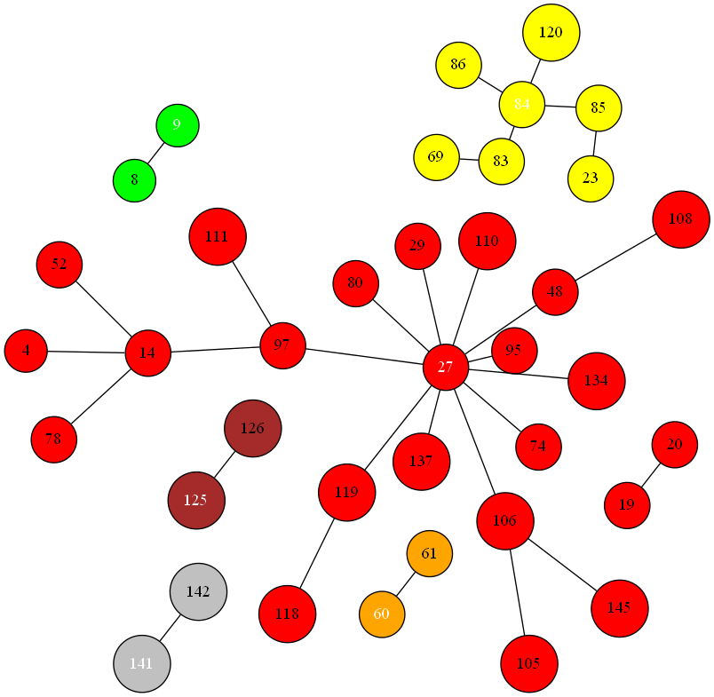
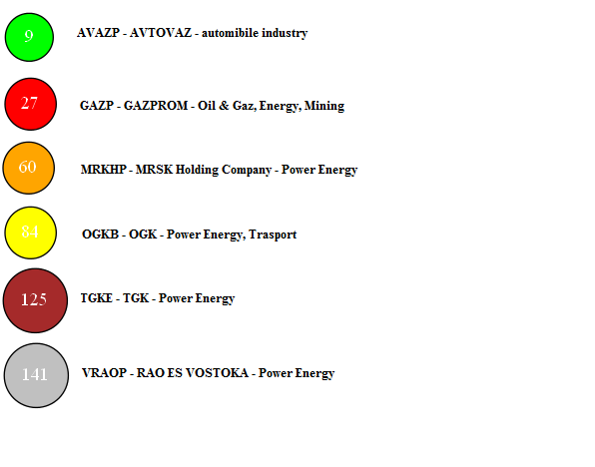
Minimum Spanning Forest of 7 Trees for 15 Medians
Every tree corresponds to one star
Almost all trees include medians
7-tree MSF and 15-Medians Clustering are good characteristics for Russian market

Slide 7
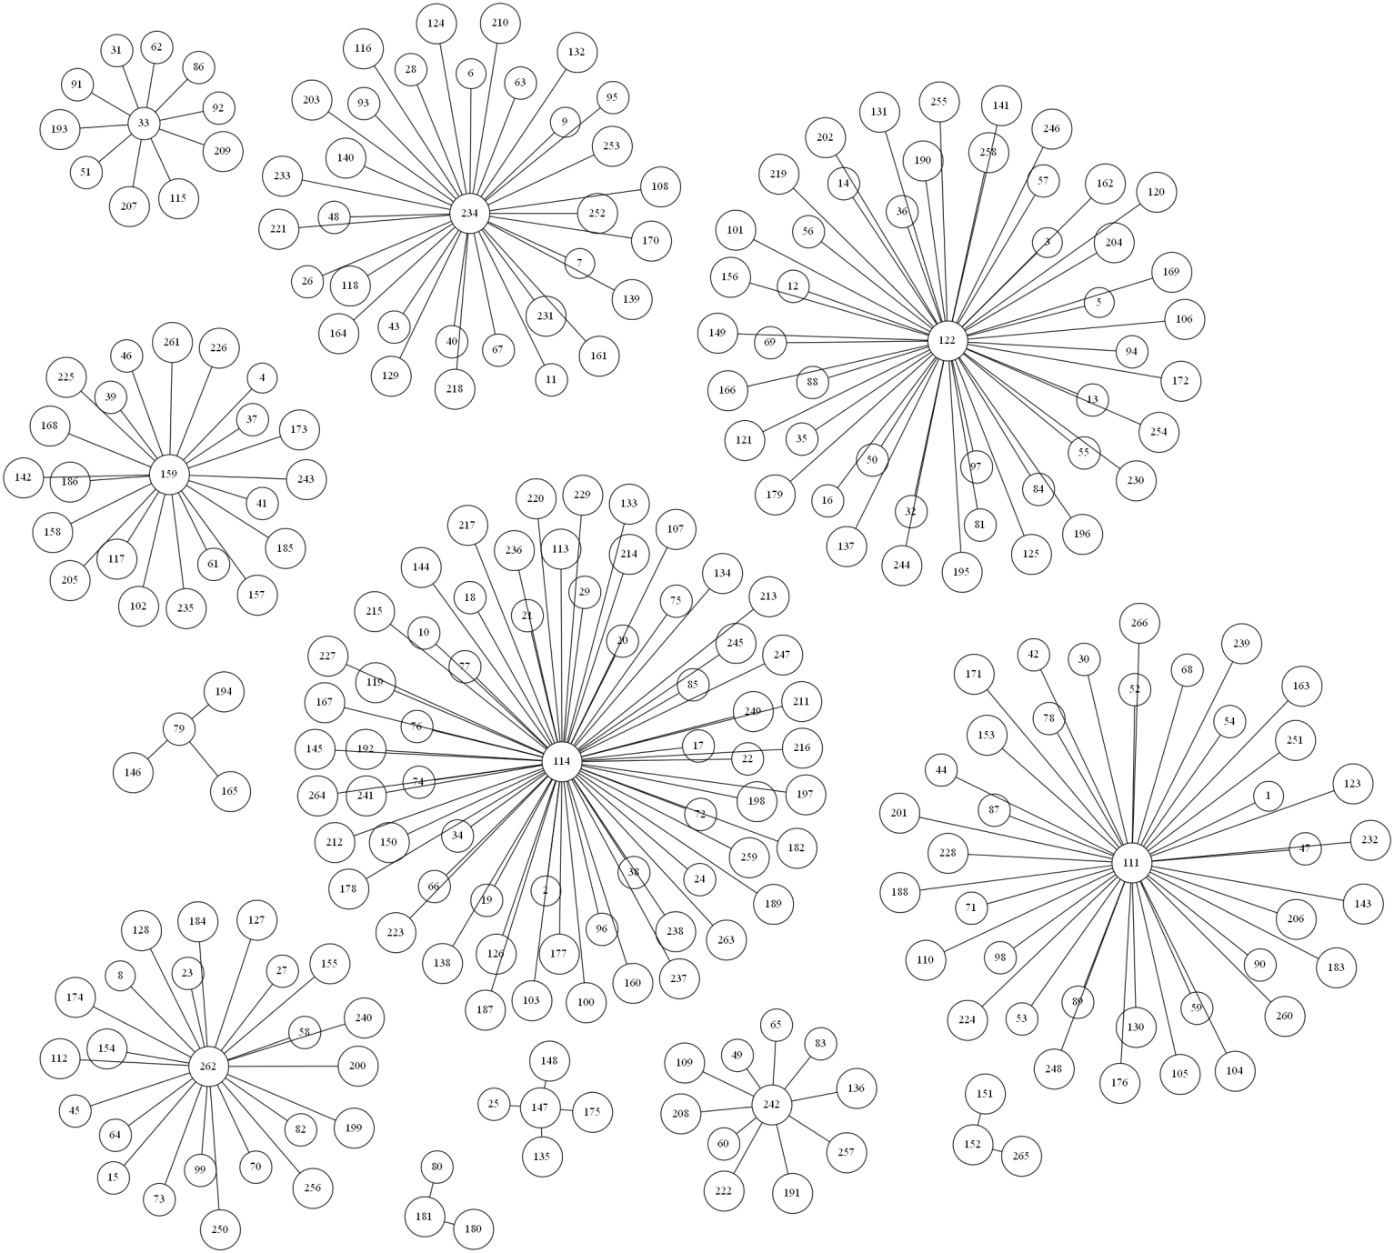
12 clusters on Swedish market
Stable clustering
Many big clusters
Difference in clusters’ size is not so large like on Russian market
Any cluster doesn’t belong to a certain industry sector
Companies present a large number of different industries
33 – Bili-A.st – Bilia AB – Automobile production
79 – Fag.st – Fagerhult, AB – Electronics
111 – Indu-C.st – IND.VAERDEN
114 – Inve-B.st Investor AB – Investments
122 – Kinv-B.st – Investment AB Kinnevik - Investments
147 – Mson-A.st – Midsona A – Pharmaceutics
152 – Mtro-SDB-B.st – Metro International S.A. – Media
159 – NCC-B.st – NCC AB – Building
181 – Orti-B.st – Ortivus AB – Medical equipment
234 – SSAB-B.st – SSAB Swedish Steel AB – Ferrous metallurgy
242 – Svol-B.st – Svolder AB – Investments
262 – Vnil-SDB.st – Vostok Nafta Investment Ltd. – Oil&Gas

Slide 8
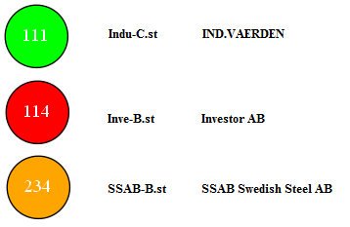
MSF of 10 Trees for 12 clusters
A simple structure of trees
Only 3 of the biggest clusters are presented here
These 3 clusters are the strongest on Swedish market

Slide 9
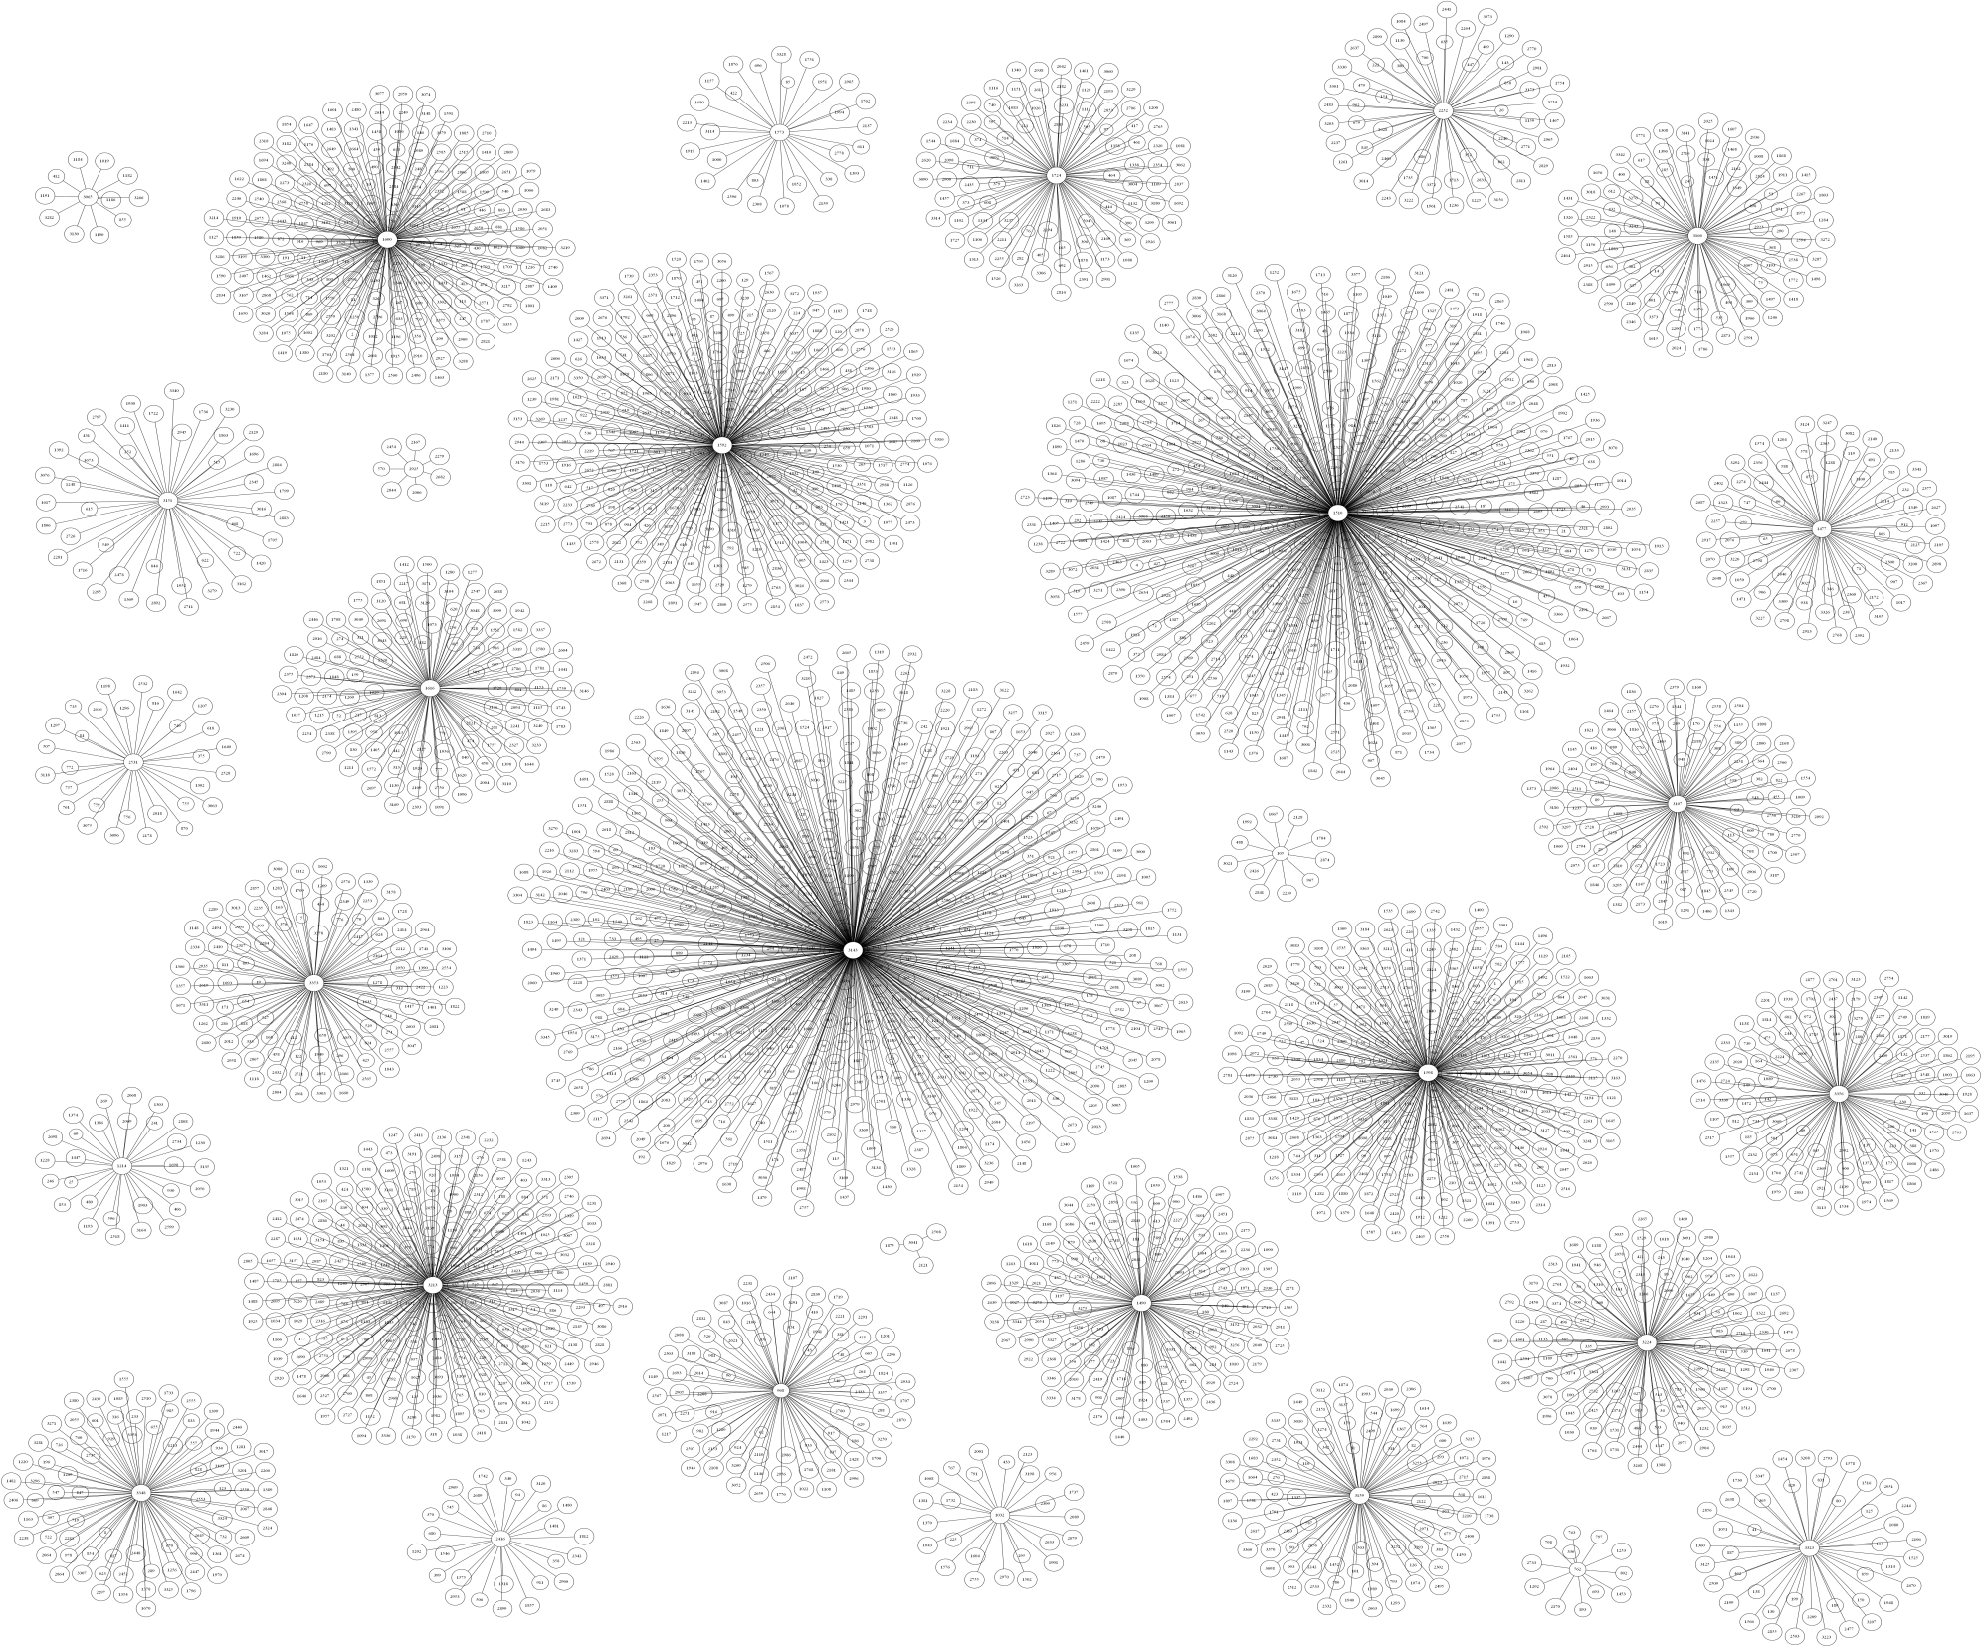
Stable clustering for the USA market

Slide 10
Median’ information on the USA market sorted by the cluster’s size
Stock number | Stock Name | Name | Type | Clustter Size
3143 | VB | Vanguard Small-Cap | Fund | 505
1510 | IJS | iShares S&P SmallCap 600 Value Index | Fund | 431
1592 | IWC | iShares Russell Microcap Index | Fund | 268
1598 | IWP | iShares Russell Midcap Growth Index | Fund | 249
3213 | VT | Vanguard Total World Stock Index ETF | World Fund | 220
1600 | IWS | iShares Russell Midcap Value Index | Fund | 192
1490 | IGE | iShares S&P North Amer Natural Resources | Fund | 128
3224 | VWO | Vanguard MSCI Emerging Markets ETF | Fund | 117
1616 | IYJ | iShares Dow Jones US Industrial | Fund | 116
3356 | XSD | SPDR S&P Semiconductor | Fund | 103
3353 | XRT | SPDR S&P Retail | Fund | 101
3107 | URE | ProShares Ultra Real Estate | Fund | 99
1724 | KRE | SPDR S&P Regional Banking ETF | Fund | 93
3166 | VHT | Vanguard Health Care ETF | Fund | 91
3159 | VFH | Vanguard Financials ETF | Fund | 89
3348 | XOP | SPDR S&P Oil & Gas Exploration & Prod | Fund | 84
968 | ENP | Encore Energy Partners LP | Company | 82
1477 | IDU | iShares Dow Jones US Utilities | Fund | 71
2252 | PBW | PowerShares WilderHill Clean Energy | Fund | 58
3151 | VDC | Vanguard Consumer Staples ETF | Fund | 45
3323 | XBI | SPDR S&P Biotech | Fund | 45
2531 | RJI | ELEMENTS Rogers Intl Commodity ETN | Fund | 31
1214 | GDX | Market Vectors Gold Miners ETF | Fund | 30
1573 | ITB | iShares Dow Jones US Home Construction | Fund | 29
2416 | PST | ProShares UltraShort 7-10 Year Treasury | Fund | 27
1032 | EWJ | iShares MSCI Japan Index | Fund | 26
762 | DBP | PowerShares DB Precious Metals | Fund | 13
3065 | UDN | PowerShares DB US Dollar Index Bearish | Fund | 12
105 | AIQ | Alliance Healthcare Services, Inc | Company | 12
2925 | TFI | SPDR Nuveen Barclays Capital Muni Bond | Fund | 8
3041 | TWM | ProShares UltraShort Russell2000 | Fund | 4

Slide 11
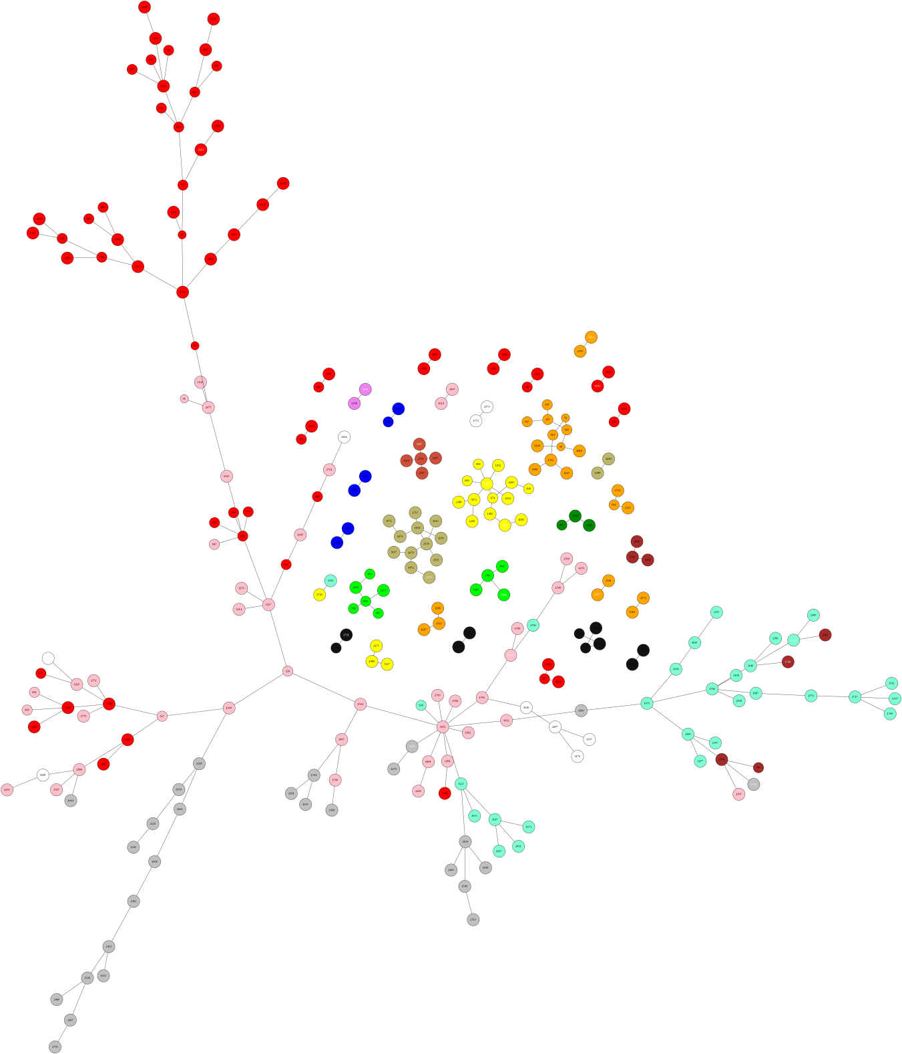
MSF of 35 Trees for 31 clusters
Medium trees are homogeneous
The biggest tree connects biggest clusters
It includes very long paths

