Slide 1
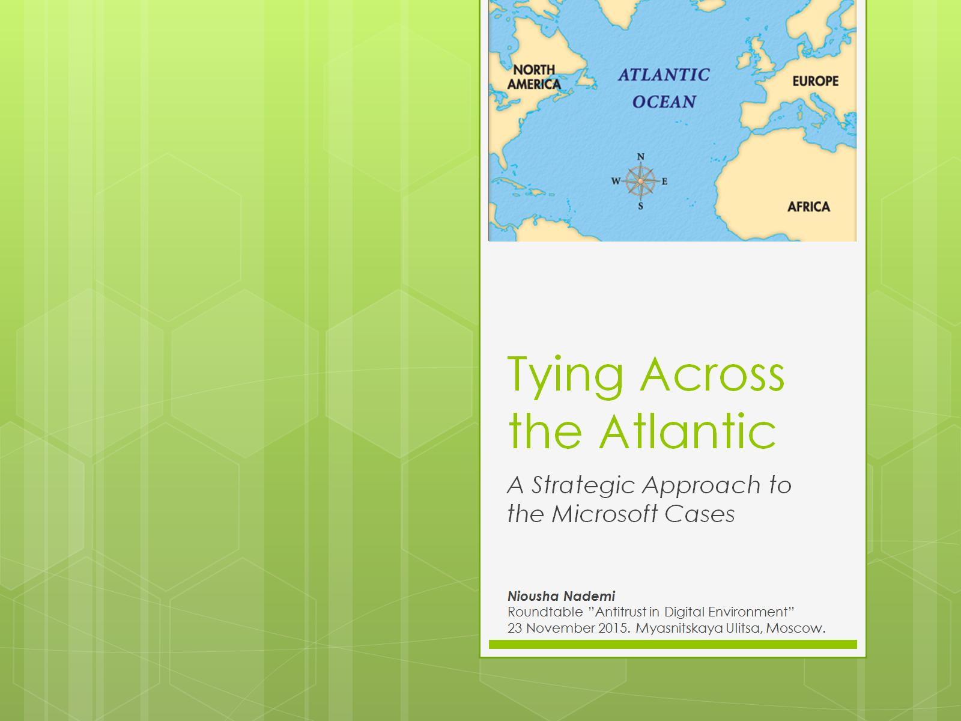
Tying Across the Atlantic

Slide 2
Overview

Slide 3
Background

Slide 4
US vs EU: Unilateral conduct

Slide 5
US vs EU: Legislation

Slide 6
Tying

Slide 7
IE and WMP

Slide 8
IE and WMP

Slide 9
Strategic Approach

Slide 10
Strategic Approach

Slide 11
Conclusions

Slide 12
Contacts

