Slide 1
Teaching Europe
A thankless task in the UK ?
UBB, Cluj 2012

Slide 2
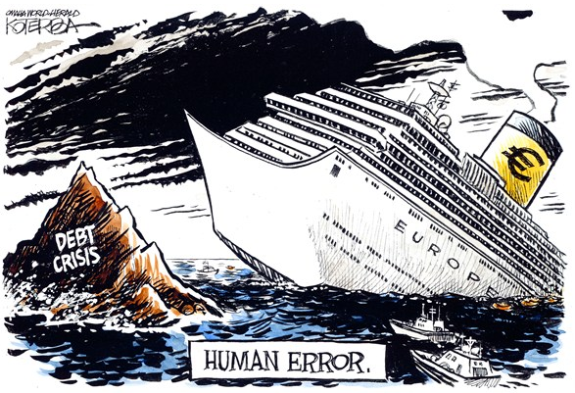
Europe’s brave adventure

Slide 3
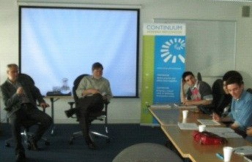

Slide 4
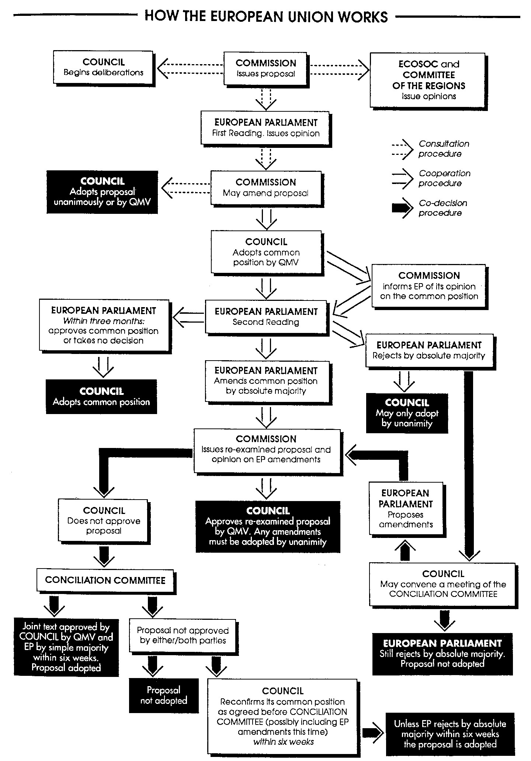
How not to teach Europe

Slide 5
Citizenship Education
Part of National Curriculum
“European and Global Issues”
National Foundation for Educational Research produced a study of CE from 2001 - 2010

Slide 6
CELS study
Best results were when CE was “embedded”
33% of surveyed teachers describe themselves as “not at all confident” about teaching:
Economy, government, European and Global Issues”
This figure has not changed since 2004

Slide 7
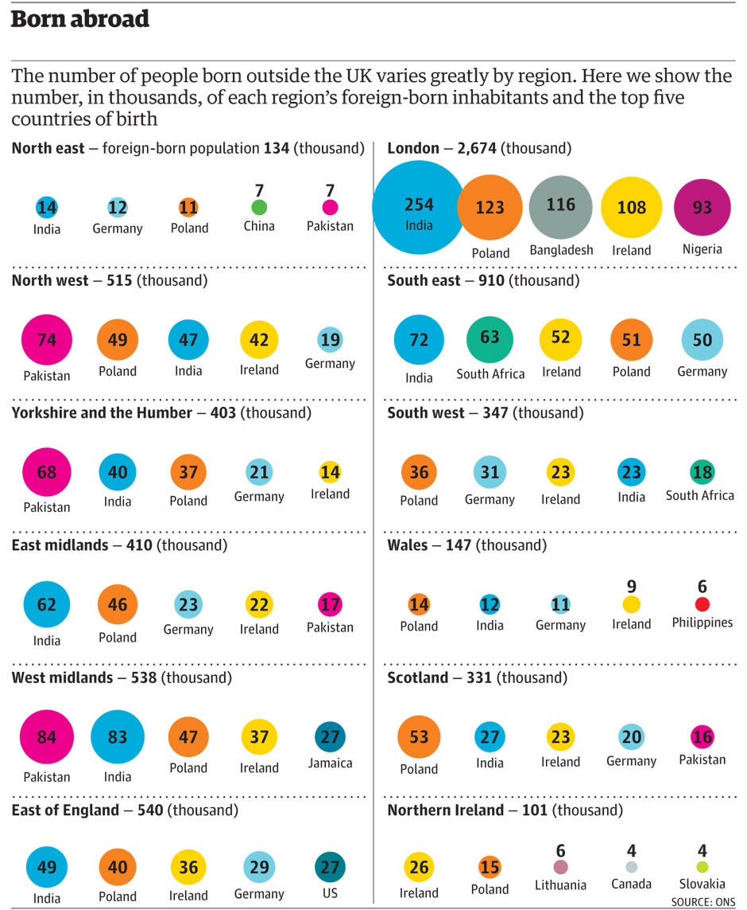
Who is British and are all Britons Europeans ?

Slide 8
“Fog in channel, Continent isolated”
EU is not seen as “answer” to UK problems
UK sees itself as a “world power” rather than a “European power”
More and more of the world speaks English
Scepticism versus idealisation

