Slide 1
Politics of EU Integration
Perm 2012
Michael Hindley
www.michaelhindley.co.uk

Slide 2
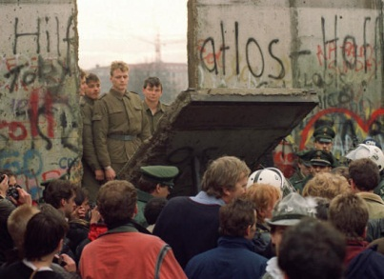
Another new beginning ?

Slide 3
A divided Europe
Yalta
Treaty of Rome and an ever-closer union
1989. The end of the Cold War

Slide 4
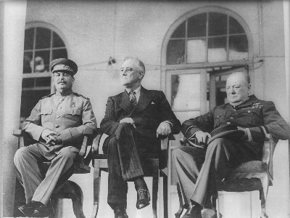
A new world ?

Slide 5
A New Dawn ?
COPENHAGEN Criteria 1993
Stability of institutions guaranteeing democracy
Functioning market economy
Obligations of membership “Acquis communitaire”

Slide 6
An ever-higher hurdle
Trade Agreement and access
Candidate status
Negotiations –explicit human rights conditionality since 1999
Accession treaty
Ratification

Slide 7
Problems
Bureaucrats rule
Retrospective justification
Brussels the problem not the solution
Clear stages but a variable timetable

