Slide 1
СИСТЕМНАЯ ДИНАМИКА
Исаак Летат
Университет Мельбурна
BA Construction Management
MA Property

Slide 2
Simulation in Manufacturing and Business: A Review
Mohsen Jahangirian, Tillal Eldabi, Aisha Naseer, Lampros K. Stergioulas, Terry Young (2010)
Application of Simulation techniques to different sectors
Simulation 2nd most popular across industries (#1 is Modelling)

Slide 3
Simulation in Manufacturing and Business: A Review
Decisions made at one level will impact others.
Simulation reviews tend to be limited to single techniques or application areas.
Aim to investigate papers with:
  Wider literature coverage;
  Broader scope &;
  Real world applications.

Slide 4
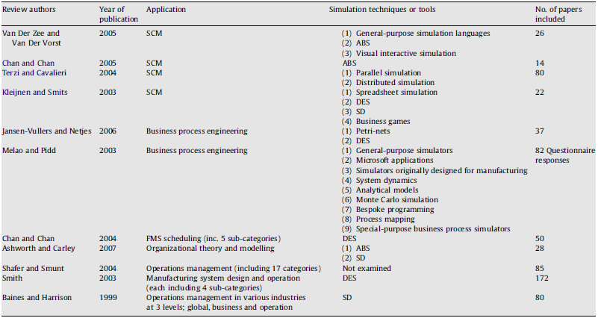
Simulation in Manufacturing and Business: A Review
Literature Review:
  Melao and Pidd (2003)
Figure 1

Slide 5
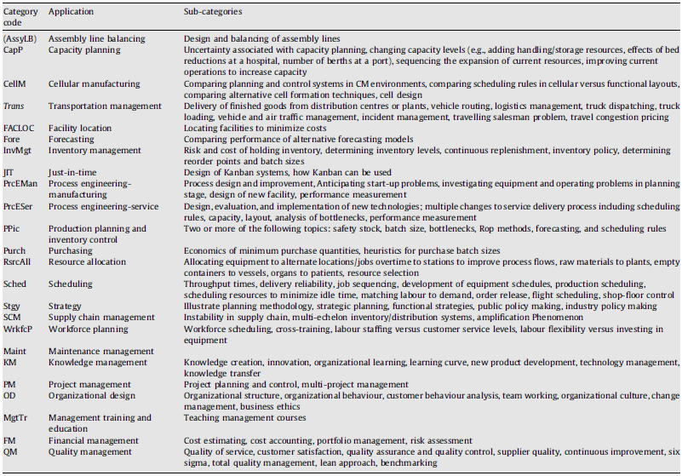
Simulation in Manufacturing and Business: A Review
Property and Construction – Development Management
Figure 2

Slide 6
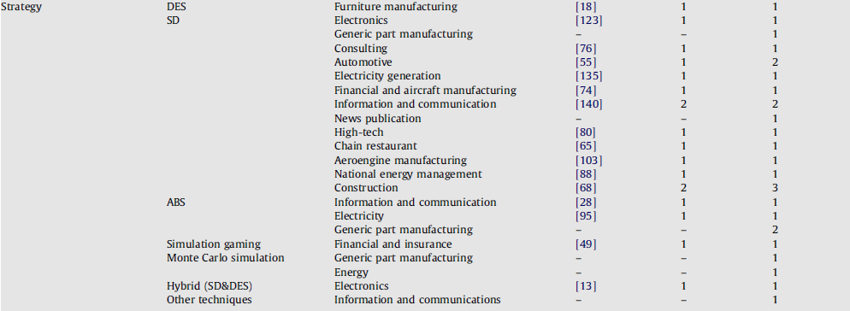
Simulation in Manufacturing and Business: A Review
SD
Figure 3

Slide 7
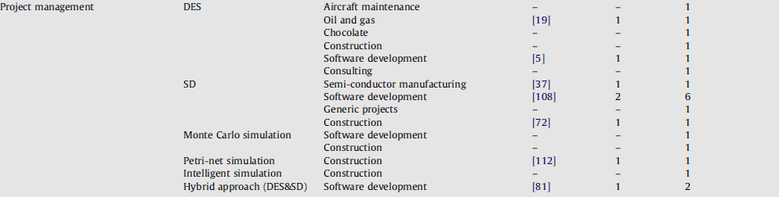
Simulation in Manufacturing and Business: A Review
DES
SD
MC
PN
IS
Figure 4
MC
Figure 5
System Dynamics; Discrete Event Simulation; Monte Carlo Simulation; Petri-nets Simulation; Intelligent Simulation

Slide 8
Industry Specific Journal Papers
Dynamic Planning and Control Methodology for Strategic and Operational Construction Project Management (Lee et al., 2005)
Determining the Casual Structure of Rework Influences in Construction (Love et al., 2010)
Quality and Change Management Model for Large Scale Concurrent Design and Construction Projects (Lee et al., 2005)
A System Dynamics Model of Cyclical Office Oversupply (Kummerow, 1999)
A System for Early-warning and Forecasting of Real Estate Development (Huang et al., 2004)

Slide 9
References
Simulation in manufacturing and business: A review. M. Jahangirian, T. Eldabi, A. Naseer, L. Stergioulas, T. Young. European Journal of Operational Research 203 (2010) 1-13.
Dynamic Planning and Control Methodology for Strategic and Operational Construction Project Management. S. Lee, F. Pena-Mora, M. Park. Automation in Construction 15 (1) (2006) 84-97.
Determining the Casual Structure of Rework Influences in Construction. P. Love, P. Manual, H. Li. Construction Management and Economics 17 (4) (1999) 505-517.
Quality and Change Management Model for Large Scale Concurrent Design and Construction Projects. S. Lee, F. Pena-Mora, M. Park. Journal of Construction Engineering and Management 131 (8) (2005) 890-902.
A System Dynamics Model of Cyclical Office Oversupply. M. Kummerow. The Journal of Real Estate Research 18 (1) (1999) 233-255.
A System for Early-warning and Forecasting of Real Estate Development. F. Huang, F. Wang. Automation in Construction 14 (2005) 333-342.
Business Dynamics – Systems Thinking and Modelling for a Complex World. J.Sterman (2000). The McGraw-Hill Companies, Inc. USA. Part 1, Ch.1 & 2, 1-82.
Figure 1. Simulation in manufacturing and business: A review. M. Jahangirian, T. Eldabi, A. Naseer, L. Stergioulas, T. Young. European Journal of Operational Research 203 (2010) pp.2.
Figure 2. Simulation in manufacturing and business: A review. M. Jahangirian, T. Eldabi, A. Naseer, L. Stergioulas, T. Young. European Journal of Operational Research 203 (2010) pp.3.
Figure 3. Simulation in manufacturing and business: A review. M. Jahangirian, T. Eldabi, A. Naseer, L. Stergioulas, T. Young. European Journal of Operational Research 203 (2010) pp.6.
Figure 4 & 5. Simulation in manufacturing and business: A review. M. Jahangirian, T. Eldabi, A. Naseer, L. Stergioulas, T. Young. European Journal of Operational Research 203 (2010) pp.7.

Slide 10
Questions

