Slide 1
Lessons from Randomized experiments in education
Dr. Eric Bettinger, Stanford University, 20 Sep 2011

Slide 2
Trends in Educational Research
Over the last decade, educational research has begun to focus on more rigorous quantitative methods.
This trend toward greater rigor has emphasized statistical models which help us identify causal relationships.
Randomization is the most simple of these causal models requiring the easiest statistics and the fewest assumptions.
Randomization has been called the “gold standard” in identifying causal relationships.

Slide 3
Randomization and its Imperfections
Randomization is not perfect.
There are many ethical (and legal) issues with running randomized experiments.
Randomization can often focus too much on the method that the research questions lose their foundation in social science policy and theory.
Randomization often can not tell us the mechanism by which effects occur.

Slide 4
Students’ success in higher education
My research agenda focuses on understanding why students’ succeed in college.
Throughout the last few years, I have conducted a number of randomized experiments to help us learn more about student success.
For today’s presentation, I hope to share results from two of these experiments.

Slide 5
Context for these experiments
US Higher Education is unhealthy.
College attendance in the United States has consistently increased over the last four decades
True for both students attending part-time and students attending full-time
Large gaps exist in attendance patterns by income.
College completion has not.
Yesterday, the OECD announced that the US has fallen to 16th in international rankings of college completion.
Russia was 4th.

Slide 6
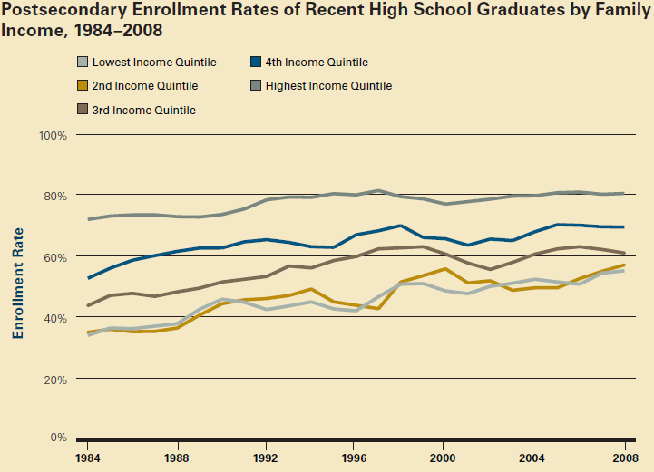
SOURCE: The College Board.

Slide 7
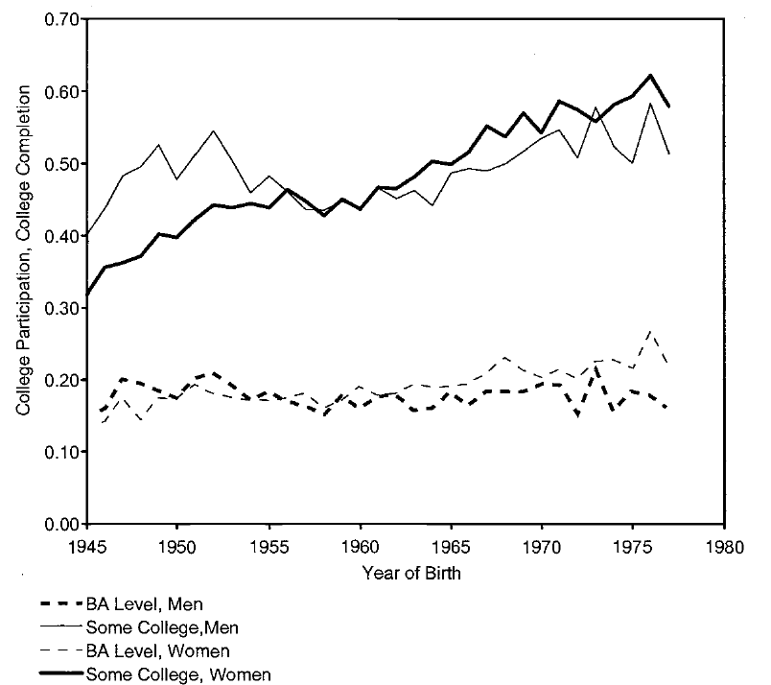
College Completion vs. Attendance
SOURCE: Turner 2004.

Slide 8
Why do students not complete college?
Simple economic model claims that an individual weighs the expected benefits and costs of educational alternatives.
Costs and benefits include monetary and non-monetary elements.
Non-monetary costs can represent many costs identified in other social science disciplines (e.g. cost of separation from social group, cost of learning).

Slide 9
Today’s research focuses on two costs
What is the effect of complexity and bad information on students’ likelihoods of attending college?
In the US, students pay large amounts for higher education.
Financial aid can help the students pay the costs, but the forms are very difficult.
Can customized mentoring help students stay in college?
Mentoring might help students realize more benefits and might lower non-monetary costs of transition.

Slide 10
Concerns about the Current U.S. Financial Aid System
(1) Misinformation (& lack of info) among families
Individuals, particularly low-income students, often greatly overestimate the cost of higher education (Horn, Chen, and Chapman 2003)
(2) Low Visibility of the FAFSA (aid application)
Key gatekeeper to federal, state, and institutional aid
In 2000, approx. 850,000 college students who were eligible for aid did not complete the forms (ACE 2004)
Many who were likely eligible did not attend at all
(3) Late Information
Do not learn about aid eligibility until a few months before attending college

Slide 11
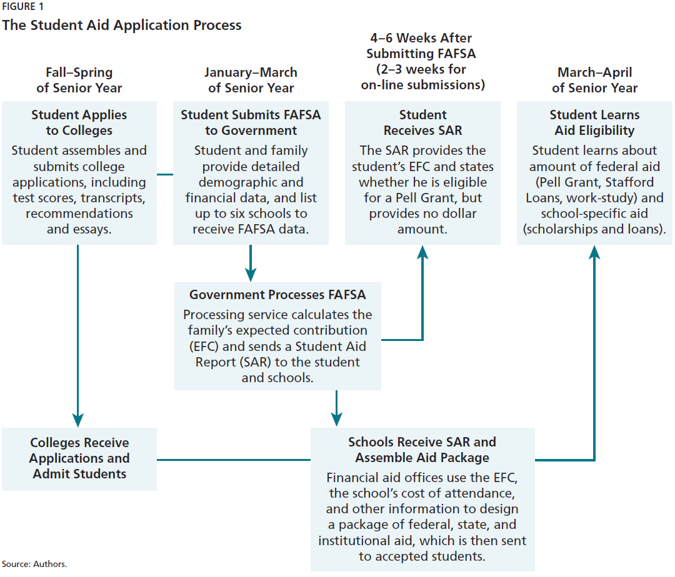
The Student Aid Application Process
11
Source: Dynarski & Scott-Clayton (2007).

Slide 12
Concerns about the Current U.S. Financial Aid System
(4) Missed Deadlines
Fact: Apply early to maximize aid
ACE (2004) found that more than half of 1999-2000 filers missed the April 1st deadline to be eligible for additional state and institutional aid
(5) FAFSA Complexity and Time
“The FAFSA, at five pages and 128 questions, is lengthier than Form1040EZ (one page, with 37 questions) and Form 1040A (two pages, with 83 questions). It is comparable to Form 1040 (two pages, with 118 questions).” (Dynarski and Scott-Clayton 2006)

Slide 13
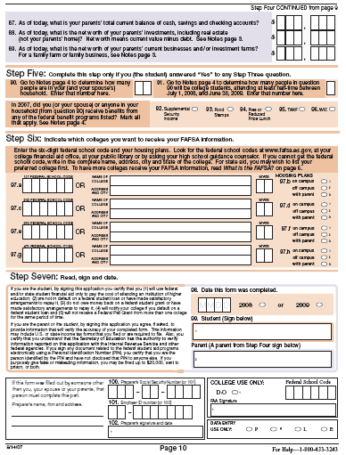
The FAFSA
(minus instructions)

Slide 14
Our experiment
Almost 70 percent of data required on financial aid forms are also required on annual income tax forms submitted by families.
Low-income families typically use professional tax preparers to complete income tax forms.
Our goals:
Partner with high profile tax preparation service
Automate the financial aid form after taxes are complete
Simplify the submission process
Provide correct information

Slide 15
Flow of the Randomized Trial
HRB completes regular tax services
Software screens to see if likely eligible
Complete consent & basic background questions
RANDOMIZATION
Treatment #1
FAFSA Simplification, Assistance, & Information
Treatment #2
Information Only
(to test effect on
submission)
Control
Group
Notes:
Remind Tax Pros that clients are randomly assigned to these levels of assistance ---
They do not need to do anything but follow prompts and follow paperwork instructions
Information=College Bound

Slide 16
The Treatment Groups
FAFSA Treatment group:
Transfers relevant tax info already collected into appropriate FAFSA cells (“pre-population”)
Streamlined and automated interview used to collect remaining info (personal assistance protocol)
Calculate an individualized estimate of aid eligibility and info on local college options (information)
Submit FAFSA on the person’s behalf
Information-only Treatment Group: Eligibility information but no pre-population or FAFSA help
Notes:
They could not complete it in the office because:
(a) they elected to leave the interview early (but early exits were very rare);
(b) they did not have all the information handy;
(c) they were a complicated case (had special income that only the Call Center asked about)
(d) ran out of time with the interview (Lisa said this very rarely happened)
Why they did not file the FAFSA:
(a) They elected to receive the paper FAFSA and never submitted it themselves
(b) The Call Center could not get in touch with them (and so they were sent a partially-completed paper FAFSA)
(c) They did not have all the information needed
Footnote 13 in the paper:
"Most often, FAFSAs were not completed in the office because the family needed to supply additional information, such as other sources of income like child support. Among independent students with no prior college experience, 54 percent completed their FAFSAs in the office and another 24 percent were completed with the help of the Call Center (for a total completion rate of 78 percent). Among dependent students, 11 percent completed the FAFSA by the end of the Call Center outreach process and another 66 percent nearly completed the form (having at least 91 of the 103 FAFSA items). FAFSAs with missing fields may still have been deemed complete enough to submit.

Slide 17
Outcomes of Interest
Likelihood of filing financial aid forms
Data from the US Department of Education
Attendance in college
Data from the National Student Clearinghouse (NSC)
Persistence in college
Data from NSC
Typically I would show that our randomization yielded similar control and treatment groups. In the interest of time, I will only assert this fact.

Slide 18
Outcome #1: Intention to Treat Effect on Filing the FAFSA
Notes:
Info-only is statistically different from FAFSA treatment estimate

Slide 19
Summary: Impact on FAFSA Submission (application for aid)
Assistance with the FAFSA increased the likelihood of submitting the aid application substantially
39% for HS seniors
186%(from 14 to 40%) among independent students who had never been to college
58% for independent students who had previously attended college
Compared to the control group, FAFSA's were filed over one month earlier for HS seniors and almost three months earlier for independent students

Slide 20
Outcome #2: Intention to Treat Effect on College Attendance

Slide 21
Outcome #3: Effects on Aid Receipt

Slide 22
Summary: Impact on College Enrollment & Aid Receipt
The FAFSA Treatment significantly increased enrollment among graduating HS seniors
Substantial increase of 7 percentage points in college going (34% compared to 27% for the control group)
Among older, independent students who had not previously attended college , there was also an effect
Enrollment effect was 21% (near significant)
The effect seems to be concentrated among those with incomes less than $22,000
For other independents, there was an effect on aid receipt (addressing problem of eligible college students not getting aid)

Slide 23
Addressing Current Concerns and Broader Implications
The “Problems”
The HRB Intervention
Avg Interview: 8 minutes
DOE reported rejection rate was lower than normal
Increase in FAFSA Filing
Enrollment and Persistence Effects
Increased Receipt of Aid
Complexity/Time
Misinformation
Low Visibility
Late Information
Missed Deadlines
Simplification & personal assistance can increase take-up (the sign-up process matters greatly)
Only receiving (late) information about benefits may not help
Notes:
Prof. Bridget Terry Long
23

Slide 24
College Mentoring or “Coaching”
What is coaching?
Individualized instruction aimed at helping students overcome barriers
Why coaching?
Help students to build study skills
“Nudge” students to complete complex tasks
Provide information related to college success

Slide 25
InsideTrack
Student coaching service
Business model focuses on being an external, third-party advising service
Claim to build an economy of scale for counseling services
Coached over 250,000 students since 2000-01
Partners with all types of institutions
Most students are studying in vocational tracks.
This is an outside evaluation. Researchers have no financial interest in InsideTrack.

Slide 26
InsideTrack’s Coaching
Emphasis on training and hiring coaches
Coaching takes place via phone, email, and text.
Trained coaches work in phone banks.
Proprietary algorithms guide prioritization and software tracks student contacts and progress.
Systems are integrated with participating universities to the extent that it is possible.
E.g. Coaches can observe student attendance, performance, and upcoming deadlines where possible.
Coaching is “Active” not “Passive”
Our key goal is to identify the effects of this coaching on student retention.

Slide 27
Methodology
InsideTrack wanted to “prove” itself to college partners. They used randomized trials to show colleges their impact.
Randomization facilitates rigorous evaluation.
In 2004 & 2007, InsideTrack conducted 17 “lotteries.” These 17 cohorts spanned eight public, private not-for-profit, and for-profit colleges.
Broad spectrum of colleges and times suggests generalizeability.

Slide 28
Age Distributions

Slide 29
SAT Scores

Slide 30
High School GPA

Slide 31
Significant Differences by Lottery?
Lottery | # Charac-teristics | # Significant Diff (90%)
1 (n=1583) | 2 | 0
2 (n=1629) | 2 | 0
3 (n=1546) | 2 | 0
4 (n=1552) | 2 | 0
5 (n=1588) | 2 | 0
6 (n=552) | 3 | 0
7 (n=586) | 3 | 0
8 (n=593) | 3 | 0
9 (n=974) | 9 | 0
Lottery | # Charact-eristics | # Significant Diff
10 (n=326) | 6 | 0
11 (n=479) | 6 | 0
12 (n=400) | 2 | 0
13 (n=300) | 1 | 0
14 (n=600) | 1 | 0
15 (n=221) | 3 | 1
16 (n=176) | 14 | 0
17 (n=450) | 12 | 0

Slide 32
Baseline Results
Model | 6-month retention | 12-month retention | 18-month retention | 24-month retention
Control Mean | .580 | .435 | .286 | .242
Baseline
Treatment Effect (std error) | .052*** (.008) | .053*** (.008) | .043*** (.009) | .034** (.008)
Lottery Controls | Yes | Yes | Yes | Yes
N | 13,552 | 13,553 | 11,149 | 11,153

Slide 33
Four-year Degree Completion Rate
Degree completion information come from 3 lotteries
Definition of degree is generally four-year degree. It could include some two-year degrees.
Control Group Graduation Rate = 31.2%
Treatment Effect = 4.0% with standard error of (2.4%)

Slide 34
Returning to our facts
Key Research Question: Can student coaching improve college retention and completion?
Effects on retention during program intervention
8-9 percent relative effect after 6 months; 12 percent after 12 months
Effects after program intervention
12 percent relative increase in persistence after 24 months
In 3 cohorts, 12 percent relative increase in degree completion after 4 years

Slide 35
Everyone Needs a Nudge. . .
Notice the “behavioral” component in these interventions that have proved most successful.
In the FAFSA study, tax preparers nudged individuals to make decisions about college.
Simplification helped make the nudge easier.
In the coaching study, coaches nudged students to set and accomplish goals for themselves.

Slide 36
Key results and conclusion
Simplification and personal assistance improved college attendance and retention.
About a 20 percent relative increase in attendance and completion.
Easy to scale the program up to the population.
College coaching can improve student retention.
About a 12 percent effect on persistence.
Persisted even after intervention ended.
Policies can improve US record at the margin.

