Slide 1
Litigating a dispute at the WTO: What can be challenged, which procedures apply and why bring a dispute?
Alan Yanovich, Senior Counsel
Akin Gump, Strauss, Hauer & Feld
Geneva, Switzerland
International Annual WTO Forum
Kaliningrad State Technical University
20 - 22 March 2014

Slide 2
Main Features of the WTO DSM
Compulsory jurisdiction
State-to-State mechanism
Automaticity
Quasi-judicial mechanism with diplomatic origins
Challengeable measures
Types of claims
  “As such”
  “As applied”
  “Ongoing conduct”
Two-stage adjudication process
Binding decisions
The role of “precedent”
Right to retaliate in cases of non-compliance
Multilateral surveillance

Slide 3
Main stages of the dispute settlement process
Consultations
Panel
Appeal
Implementation

Slide 4
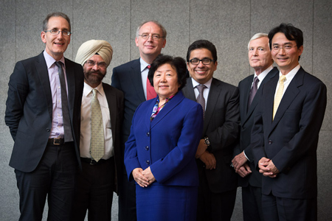

Slide 5
Objectives of bringing a dispute to the WTO
Market access (removal of border or regulatory barrier)
Change the future conduct of the respondent country
Clarify the interpretation of the WTO agreements
Dissuade other countries from pursuing similar conduct
“Unclog” the bilateral agenda
Two-pronged strategy together with investment dispute
Other strategic reasons

Slide 6
Source: WTO Secretariat

Slide 7
Russia’s participation in WTO DSM
As complainant
  European Union — Cost Adjustment Methodologies and Certain Anti-Dumping Measures on Imports from Russia (DS474)
As respondent
  Russian Federation – Recycling Fees on Motor Vehicles (DS462 – EU; DS463 – Japan)
As third party- (10 cases) Some examples:
  EC – Seal Products (DS400 – Canada; DS401 – Norway);
  China – Rare Earths (DS431 – United States; DS432 – EU; DS433 – Japan);
  US – Countervailing Measures (China) (DS437);
  US - Countervailing and Anti-Dumping Measures (China) (DS449);
  China – HP SSST (Anti-Dumping Duties on High-Performance Stainless Steel Tubes) (DS454 – Japan; DS460 – EU)

Slide 8
Some WTO disputes relating to natural resources
Dispute | Complainants | Status
China - Raw Materials | Mexico, United States, EU | China has announced compliance.
Canada – Feed-in Tariff Program / Canada – Renewable Energy | EU, Japan | AB reports adopted 6 May 2013.
China – Rare Earths | Japan, EU, United States | Circulation of panel report expected in March.
European Union — Cost Adjustment Methodologies and Certain Anti-Dumping Measures on Imports from Russia | Russian Federation | Consultations.
India — Certain Measures Relating to Solar Cells and Solar Modules | United States | Consultations.
European Union and Certain Member States — Certain Measures Affecting the Renewable Energy Generation Sector | China | Consultations.
European Union — Anti-Dumping Measures on Biodiesel from Argentina | Argentina | Consultations.

