Slide 1

Is It So Bad
That We Cannot Recognize Black Swans?
Fuad Aleskerov
(joint work with Lyudmila Egorova)
National Research University
Higher School of Economics
XVI April International Academic Conference
on Economic and Social Development,
April 9, 2015

Slide 2
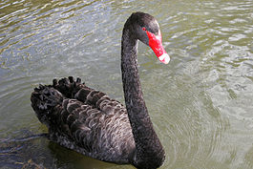
Introduction
«The central idea of this book concerns our blindness with respect to randomness, particularly the large deviations: Why do we, scientists or nonscientists, hotshots or regular Joes, tend to see the pennies instead of the dollars? Why do we keep focusing on the minutiae, not the possible significant large events, in spite of the obvious evidence of their huge influence?»
Nassim Nicolas Taleb
«The Black Swan. The Impact of The Highly Improbable»

Slide 3
Taleb’s view on Economics
«In orthodox economics, rationality became a straitjacket. Platonified economists ignored the fact that people might prefer to do something other than maximize their economic interests. This led to mathematical techniques such as “maximization,” or “optimization,” on which Paul Samuelson built much of his work… It involves complicated mathematics and thus raises a barrier to entry by non-mathematically trained scholars. I would not be the first to say that this optimization set back social science by reducing it from the intellectual and reflective discipline that it was becoming to an attempt at an “exact science.”» (p. 184).
And, finally, «…those who started the game of “formal thinking,” by manufacturing phony premises in order to generate “rigorous” theories, were Paul Samuelson, Merton’s tutor, and, in the United Kingdom, John Hicks. These two wrecked the ideas of John Maynard Keynes, which they tried to formalize (Keynes was interested in uncertainty, and complained about the mind-closing certainties induced by models). Other participants in the formal thinking venture were Kenneth Arrow and Gerard Debreu. All four were Nobeled… All of them can be safely accused of having invented an imaginary world, one that lent itself to their mathematics.» (p. 283).

Slide 4
Introduction
introduction
The classical models of portfolio allocation like Markowitz’s ‘mean-variance’ model [Markowitz 1952], CAPM model [Sharpe 1964], APT model [Ross 1976] and their extensions have certain limitations:
  assumption of trader’s rationality,
  need to assess the probability distribution of random variable (i.e. future price or return of securities),
  computational complexity in case of many securities taken into account

Slide 5
Introduction
introduction
The classical models of portfolio allocation like Markowitz’s ‘mean-variance’ model [Markowitz 1952], CAPM model [Sharpe 1964], APT model [Ross 1976] and their extensions have certain limitations:
  assumption of trader’s rationality,
  need to assess the probability distribution of random variable (i.e. future price or return of securities),
  computational complexity in case of many securities taken into account
The methods for probability distribution assessment like regression models, stochastic differential equations, neural networks, etc. also have limitations:
  sophisticated procedures of parameter estimation for many models,
  need of long and stable time series to estimate parameters of that probability distribution.

Slide 6
Introduction
introduction
Classical investment models cannot help individual traders and investment funds to reach their goals:
  the stocks individual investors buy subsequently underperform those they sell [Odean 1999],
  Individual traders mostly cannot outperform the market portfolio [Barber and Odean 2008],
  Substantial proportion of hedge funds failed to survive, the survived mostly they have returns lower then market return and for those funds, who succeed in beating the market portfolio, their success is not persistent [Malkiel and Saha 2005],
  only 56.8% of expert recommendations on selling or buying stocks of Russian companies were profitable [Proskurin and Penikas 2013],
  the forecasts of economic analysts perform worse than naive forecasts (the historical mean) [Soderlind 2008]

Slide 7
Problem
We will model economic fluctuations representing them as a flows of events of two types:
Q-event reflects the “normal mode” of an economy;
R-event is responsible for a crisis.
The number of events in each time interval has a Poisson distribution with constant intensity.
λ is the intensity of the flow of regular events Q.
μ is the intensity of the flow of crisis events R.
λ>>μ holds (that is, Q-type events are far more frequent than the R-type events).

Slide 8
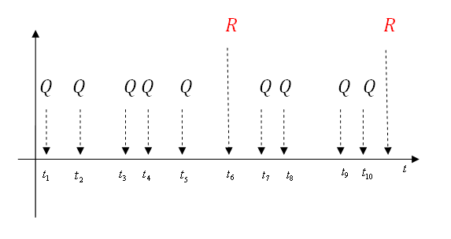
Problem

Slide 9
Problem
Q
X
State of nature
Unknown
R
The problem of correct identification (recognition)

Slide 10
Player´s perceived identification of the state of nature
Q
Q
R
X
Q
R
R

Slide 11
Problem
Payoff for correct identification of regular event
Q
a
Q
R
X
Q
R
R

Slide 12
Problem
Q
Q
Incorrect identification of regular event
R
-b
X
Q
R
R

Slide 13
Problem
Q
Q
R
X
R
c
c>>a
R
Q
-d
d>>b

Slide 14
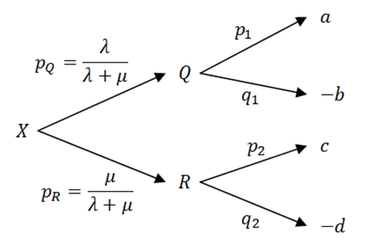

Problem
How large will be the sum of payoffs received up to time t?

Slide 15
Solution
Random value Z of the total sum of the received payoffs during the time t is a compound Poisson type variable.
We give the expression for the expectation of a random variable payoff:
E(Z) = [λ(p₁a – q₁b) + μ(p₂c – q₂d)]t

Slide 16
Application to real data
We consider a stock exchange and events Q and R which describe a ‘business as usual’ and a ‘crisis’, respectively.
The unknown event X can be interpreted as a signal received, e.g. by an economic analyst or by a broker, about the changes of the economy that helps him to decide whether the economy is in ‘a normal mode’ or in a crisis.

Slide 17
Parameters for S&P 500

Slide 18
Parameters for S&P 500
Estimates for indices with the threshold 6%
Index | λ | μ | a, % | -b, % | c, % | -d, %
S&P 500 | 246 | 4 | 0,6 | -0,6 | 2,8 | -2,9
Dow Jones | 246 | 4 | 0,6 | -0,6 | 1,9 | -2,4
CAC 40 | 243 | 7 | 0,8 | -0,8 | 3,0 | -2,5
DAX | 239 | 11 | 0,8 | -0,9 | 2,1 | -2,5
Nikkei 225 | 245 | 5 | 0,8 | -0,9 | 2,6 | -3,2
Hang Seng | 241 | 9 | 0,9 | -0,9 | 2,6 | -3,0

Slide 19
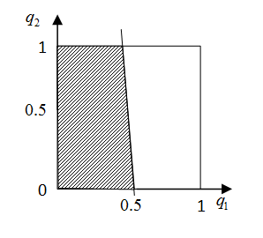
Parameters for S&P 500
In fact, it is enough to identify regular Q-events in half of the cases to ensure a positive outcome of the game.
Probability of incorrect identification of crisis R-event
E(Z)≥0
Probability of incorrect recognition of regular Q-event

Slide 20
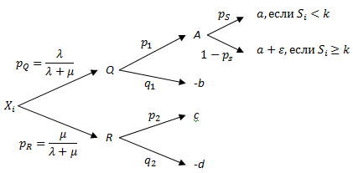

Model with stimulation
if
if

Slide 21

Model with stimulation

Slide 22
Model with decreasing stimulation

Slide 23
Model with decreasing stimulation

Slide 24
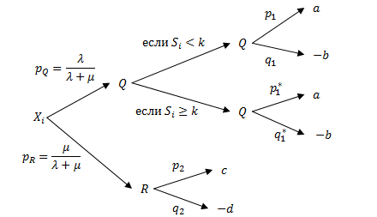

Model with learning
if
if

Slide 25
Model with learning
where

Slide 26
The effectiveness of different trading strategies: analysis via computational simulation

Slide 27
Description of models
Market description and price formation
  Stock indices as a securities prices (S&P500, CAC, DAX, FTSE, Nikkei 225, Hang Seng, all for 2000-2010)
  Traders use only market orders
  Equal initial wealth allocation
  Capital minimum level – a half of the initial wealth
  Margin trading with leverage rate 1:2, 1:5, 1:10

Slide 28
Description of models
Traders and their strategies
  Basic characteristic: p is a probability of correct prediction of the price movement on the next day;
  Follower strategy: repeat leader’s decisions with one step delay;
  ‘Black swan seeker’ strategy: trader tries to predict crisis events with higher possible gains

Slide 29
Description of models
Financial results
  The average wealth of not-bankrupts,
  The fraction of agents with final wealth greater than initial wealth,
  The fraction of bankrupts (at some step the wealth became lower then the half of the initial one).

Slide 30
Results for the basic model
photo

Slide 31
Results for the basic model
 |  | The fraction of bankrupts,%
 | p | Leverage=0 | Leverage=2 | Leverage=5 | Leverage=10
1 | 0.50 | 6.2 | 52.2 | 88.5 | 98.6
2 | 0.51 | 2.7 | 37.5 | 77.6 | 96.2
3 | 0.52 | 0.9 | 20.7 | 60.6 | 90.8
4 | 0.53 | 0.2 | 10.2 | 42.4 | 81.4
5 | 0.54 | 0.0 | 5.0 | 30.3 | 70.5
6 | 0.55 | 0.0 | 2.4 | 21.4 | 59.8
7 | 0.56 | 0.0 | 1.0 | 13.7 | 49.3
8 | 0.57 | 0.0 | 0.7 | 10.9 | 40.8
9 | 0.58 | 0.0 | 0.5 | 7.3 | 32.4
10 | 0.59 | 0.0 | 0.0 | 5.1 | 26.5
11 | 0.60 | 0.0 | 0.0 | 2.7 | 21.8
12 | 0.61 | 0.0 | 0.0 | 1.8 | 17.9
13 | 0.62 | 0.0 | 0.0 | 1.5 | 15.5
14 | 0.63 | 0.0 | 0.0 | 1.4 | 13.3
15 | 0.64 | 0.0 | 0.0 | 0.5 | 9.6
16 | 0.65 | 0.0 | 0.0 | 0.5 | 7.0

Slide 32
Results for the basic model
 |  | Leverage=0
 |  | S&P | CAC | DAX | FTSE | Nikkei | HS
1 | Average wealth of not-bankrupts | 9 584 | 9 464 | 11 098 | 9 667 | 8 929 | 12 719
2 | The fraction of agents with final wealth greater than initial wealth,% | 35.35 | 28.05 | 45.35 | 37.36 | 18.83 | 71.12
3 | The fraction of bankrupts,% | 6.17 | 19.58 | 23.17 | 3.95 | 24.09 | 5.16
 |  | Leverage=2
1 | Average wealth of not-bankrupts | 14 131 | 19201 | 17 348 | 14 110 | 15 637 | 19 606
2 | The fraction of agents with final wealth greater than initial wealth,% | 29.80 | 20.44 | 25.73 | 29.25 | 18.87 | 34.99
3 | The fraction of bankrupts,% | 52.21 | 72.06 | 65.20 | 54.40 | 71.95 | 55.87
 |  | Leverage=5
1 | Average wealth of not-bankrupts | 43 427 | 64 072 | 66 643 | 44 156 | 56 847 | 61 566
2 | The fraction of agents with final wealth greater than initial wealth,% | 10.31 | 5.47 | 7.67 | 10.35 | 5.51 | 9.06
3 | The fraction of bankrupts,% | 88.54 | 93.95 | 91.16 | 88.12 | 93.66 | 89.86
 |  | Leverage=10
1 | Average wealth of not-bankrupts | 2e+05 | 3e+05 | 2e+05 | 3e+05 | 5e+05 | 3e+05
2 | The fraction of agents with final wealth greater than initial wealth,% | 1.32 | 0.21 | 0.67 | 1.26 | 0.47 | 0.89
3 | The fraction of bankrupts,% | 98.62 | 99.79 | 99.27 | 98.63 | 99.51 | 99.09

Slide 33
Results for the ‘follower’ strategy
Leverage = 0
p ~ R[0.4; 0.6]
Leverage = 5
p ~ R[0.4; 0.6]

Slide 34
 | leverage=0 |  |  | leverage=2 |  |  | leverage=5 |  |  | leverage=10
Value of leader’s p | Average wealth of follower | Better wealth of follower | Bankrupts among followers | Average wealth of follower | Better wealth of follower | Bankrupts among followers | Average wealth of follower | Better wealth of follower | Bankrupts among followers | Average wealth of follower | Better wealth of follower | Bankrupts among followers
0.44 | 10 336 | 25.3 | 1.4 | 16 845 | 40.9 | 42.7 | 49 738 | 12.7 | 84.5 | 59 670 | 1.2 | 98.8
0.45 | 10 131 | 23.1 | 1.5 | 17 378 | 32.7 | 48.2 | 52 434 | 18.9 | 79.1 | 163 849 | 1.6 | 98.64
0.46 | 9 926 | 22.2 | 1.9 | 16 780 | 44.5 | 45.5 | 50 334 | 17.3 | 80.9 | 230 542 | 1.4 | 98 .6
0.47 | 9 970 | 21.2 | 2.1 | 15 188 | 38.2 | 44.5 | 85 579 | 8.3 | 89.1 | 18 023 | 1.3 | 98.7
0.48 | 9 946 | 19.8 | 2.3 | 15 383 | 28.2 | 59.1 | 37 389 | 14.8 | 83.6 | 59 015 | 0.7 | 99.3
0.49 | 9 603 | 19.3 | 2.5 | 13 030 | 27.3 | 60.9 | 65 388 | 19.1 | 79.1 | 29 822 | 1.9 | 98.1
0.50 | 9 590 | 17.5 | 3.2 | 13 006 | 31.8 | 50.8 | 39 833 | 10.6 | 87.3 | 28 308 | 2.8 | 97.2
0.51 | 9 559 | 17.0 | 3.1 | 12 995 | 28.2 | 48.2 | 52 156 | 16.1 | 82.7 | 18 291 | 1.5 | 98.5
0.52 | 9 408 | 15.8 | 3.6 | 13 141 | 25.5 | 54.5 | 39 057 | 8.5 | 87.3 | - | 0 | 100
0.53 | 9 443 | 13.9 | 4.4 | 12 949 | 21.8 | 58.2 | 87 119 | 4.5 | 95.5 | 14 227 | 0.1 | 99.9
0.54 | 9 050 | 12.9 | 4.7 | 12 185 | 16.4 | 67.3 | 36 900 | 10.9 | 88.2 | - | 0 | 100
0.55 | 8 839 | 11.7 | 5.1 | 12 551 | 20.9 | 64.5 | 28 826 | 7.3 | 90.9 | 639 577 | 0.9 | 99.1
0.56 | 9 012 | 11.7 | 6.0 | 12 314 | 14.5 | 66.4 | 18 045 | 2.4 | 96.4 | - | 0 | 100
0.57 | 9 069 | 10.0 | 6.8 | 11 164 | 13.6 | 73.6 | 16 397 | 6.4 | 90.9 | 55 243 | 1.4 | 98.6
0.58 | 8 592 | 9.2 | 7.5 | 10 527 | 10.0 | 70.0 | 95 561 | 5.9 | 93.6 | 18 908 | 2.1 | 97.9
0.59 | 8 414 | 8.1 | 8.1 | 10 961 | 8.2 | 81.8 | 28 376 | 1.8 | 97.3 | - | 0 | 100
0.60 | 8 590 | 7.4 | 9.0 | 11 061 | 12.7 | 76.4 | 16 725 | 2.7 | 95.5 | 75 147 | 2.2 | 97.8

Slide 35


Results for the Black Swan seekers’ strategy
Black swan seekers
Ordinary agents

Slide 36
Results
The results of such agent-based simulation can help trader with known probability of correct prediction of future price changes to decide:
  whether it is worse trading on the stock exchange with this probability,
  whether it is profitable to use certain trading strategy
  to use or not to use margin trading and (in case of positive answer) what value of leverage to choose.

Slide 37
Conclusion
We showed in a very simple model that with a small reward for the correct (with probability slightly higher than ½) identification of the routine events (and if crisis events are identified with very low probability) the average player's gain will be positive.
In other words, players do not need to play more sophisticated games, trying to identify crises events in advance.

Slide 38
References
Aleskerov F., Egorova L. Is it so bad that we cannot recognize black swans? // Economics Letters (2012). Vol. 117. №3. P. 563-565.
Barber B., Odean T. Trading is hazardous to your wealth: The common stock investment performance of individual investors // Journal of Finance (2000). Vol. 55. № 2. P.773–806.
Jegadeesh, N., Kim, J., Krische, S., Lee, C. Analyzing the Analysts: When Do Recommendations Add Value? // Journal of Finance. 2004. №59. p. 1083–124.
Jegadeesh, N., Kim, W. Do Analysts Herd? An Analysis of Recommendations and Market Reactions // Review of Financial Studies. 2010. Vol. 23. Issue: 2. P. 901-937.
Malkiel B.G., Saha A. Hedge Funds: Risk and Return // Financial Analysts Journal (2005). Vol. 61. № 6. P.80-88.
Malmendier, U., Shanthikumar, D. Do Security Analysts Speak in Two Tongues? // Review of Financial Studies. 2014. Vol. 27. Issue: 5. P. 1287-1322

Slide 39
References
Markowitz H. Portfolio Selection // Journal of Finance (1952). Vol. VII. №1. P. 77-91.
Odean T. Do investors trade too much? // American Economic Review (1999). Vol. 89. № 5. P. 1279–98.
Penikas H., Proskurin S. How Well do Analysts Predict Stock Prices? Evidence from Russia. Working papers by NRU Higher School of Economics. Series FE "Financial Economics” (2013)
Ross S. The arbitrage theory of capital asset pricing // Journal of Economic Theory (1976). Vol. 13. №3. P. 341–360.
Sharpe W.F. Capital asset prices: A theory of market equilibrium under conditions of risk // Journal of Finance (1964). Vol. 19. №3. P. 425–442.
Soderlind P. Predicting stock price movements: regressions versus economists // Applied Economic Letters (2010). Vol. 17. P. 869-874.

Slide 40
References
Алескеров Ф. Т., Егорова Л. Г. Черные лебеди и биржа // Экономический журнал Высшей школы экономики. 2010. Т. 14. № 4. С. 492-506.
Aleskerov F. T., Egorova L. G. Is it so bad that we cannot recognize black swans? // Economics Letters. 2012. Vol. 117. No. 3. P. 563-565.
Егорова Л. Г. Эффективность торговых стратегий мелких трейдеров // Проблемы управления. 2014. № 5. С. 34-41.
Belenky A.S., Egorova L.G. An approach to forming and managing a portfolio of financial securities by small and medium price-taking traders in a stock exchange // Advances in Intelligent Systems and Computing (выйдет в мае 2015г.)
Egorova L. G. Effectiveness of Different Trading Strategies for Price-takers // Procedia Computer Science. 2nd International Conference on Information Technology and Quantitative Management, ITQM 2014. National Research University Higher School of Economics (HSE) in Moscow (Russia) on June 3-5, 2014 / Науч. ред.: Y. Shi, A. Lepskiy, F. T. Aleskerov. Vol. 31. ELSEVIER, 2014. P. 133-142.
Egorova L. G. The Effectiveness of Different Trading Strategies For Price-Takers / Working papers by NRU Higher School of Economics. Series FE "Financial Economics". 2014. No. WP BRP 29/FE/2014.
Egorova L. G. Распознавание биржевых процессов как пуассоновского потока событий двух типов: модели с поощрением и обучением / Препринты. М.: Высшая школа экономики. Серия WP7 "Математические методы анализа решений в экономике, бизнесе и политике". 2011. No. 02.
Aleskerov F. T., Egorova L. G. Так ли уж плохо, что мы не умеем распознавать черных лебедей? / Препринты. М.: Высшая школа экономики. Серия WP7 "Математические методы анализа решений в экономике, бизнесе и политике". 2010. No. 03.
photo

Slide 41
Thank you!

