Slide 1
Which banks do Russian households (dis-)trust more? dilyara Ibragimova, olga kuzina, andrei vernikov (Higher School of Economics, Moscow)
International Conference on Economic and Social Development, Moscow, Higher School of Economics, April 2-4, 2014

Slide 2
Motivation
Literature on the trust towards financial institutions
Ennew, Sekhon, 2007
Ibragimova, 2012
Literature on the effects of deposit insurance on household savings and the behavior of savers
Anginer, Demirgüç-Kunt, Zhu, 2012
Karas, Pyle, Schoors, 2013
The objective of this study:
To tackle the phenomenon of trust towards financial institutions in Russia
To find out whether Russian households trust their banks and, if so, which ones

Slide 3
Data
The fifth wave (2013) of the monitoring of Russian households’ financial behavior
All-Russian survey, face-to-face interviews at the place of residence in November 2011.
Nationwide representative stratified sample (age, gender, education, residence, federal districts) of adult people (18+).
The survey took place in 42 regions, 140 settlements, N=1600.
Sample error – 3,4%.
Russian banking statistics (CBR; RBK.Ratings)

Slide 4
Trust
Ennew, Sekhon, 2007: Trust has 2 dimensions :
cognitive (based on a sort of rationale);
affective (focused on consumer beliefs) dimensions.
Which type of trust underlies the attitude towards banks in Russia?
We test the influence of financial literacy and capability on the level of trust to banks.
If financial literacy and trust to banks are positively correlated we consider it as a manifestation of cognitive dimension of trust.
If there is a negative relationship, i.e. the high level of trust is conditional on low level of financial literacy, it speaks in favor of affective dimension of trust to banks.
Our hypothesis: Trust to state-controlled banks is mostly affective whereas trust to privately-owned commercial banks is mostly cognitive

Slide 5
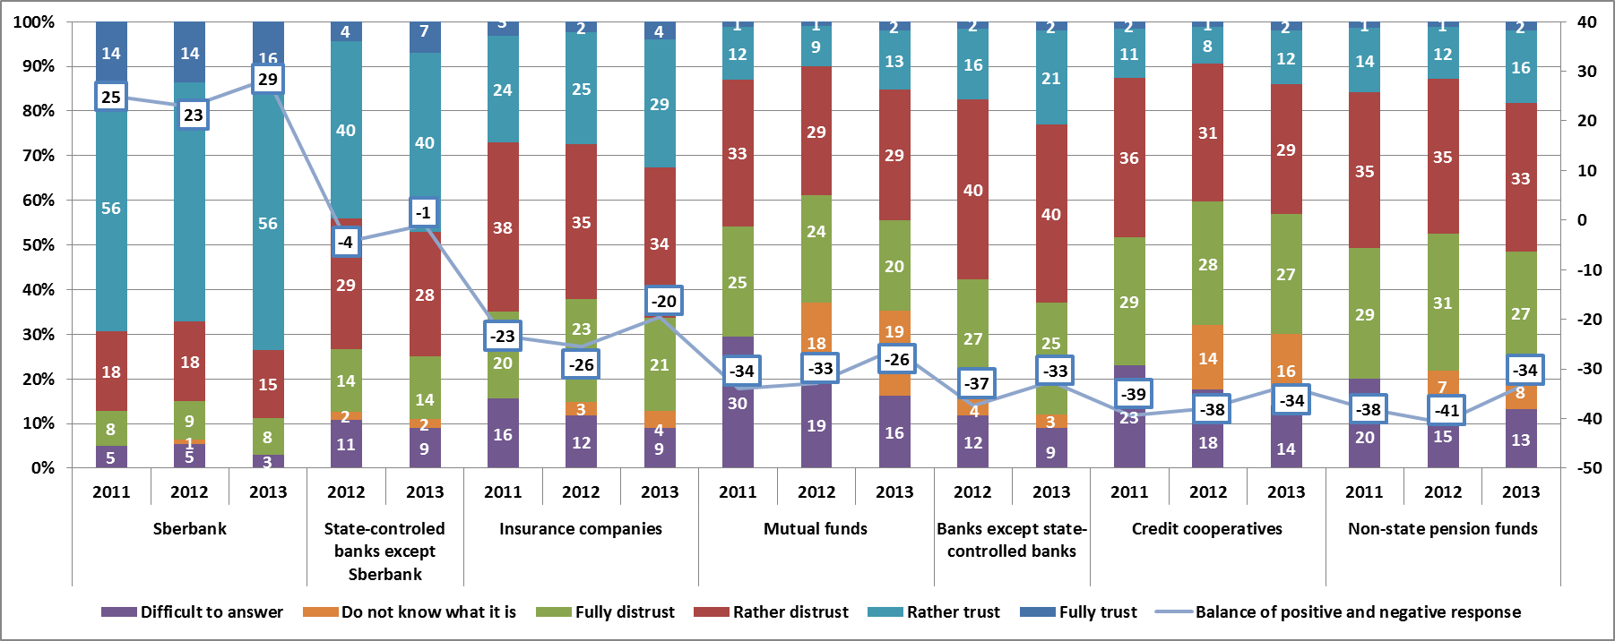
Degree of trust of Russian households towards different types of financial intermediaries

Slide 6
Banking statistics: The market shares of Russian banks (percent of total household deposits)
Source: authors’ calculation; RBC.Ratings

Slide 7
Principal component analysis: Rotated Component Matrix Do you trust or distrust the following institutions (4-fully trust, 3- somewhat trust, 2 - somewhat distrust, 1 - fully distrust)
 | Component
 | 1 | 2 | 3
TV | ,660
Police | ,801
Courts | ,779
Government | ,837
Parliament | ,810
President | ,732
Deposit Insurance Agency |  | ,620
Non-state-controlled banks |  | ,681
Insurance companies |  | ,684
Mutual funds |  | ,838
Credit cooperstives |  | ,870
Private pension funds |  | ,766
Central bank |  |  | ,733
Federal Financial Markets Service |  |  | ,514
Sberbank |  |  | ,841
Other state-controlled banks |  |  | ,694
Variation explained | 28% | 26% | 18%

Slide 8
Trust in institutions across age groups
Younger generations have more trust in financial market institutions

Slide 9
Trust in institutions across types of residence
Citizens of megalopolises have higher trust in state banks and state regulators of financial markets

Slide 10
Trust in institution across users and non-users of financial services
Users of financial services have higher trust in state banks and state regulators of financial markets

Slide 11
Financial literacy index
Financial literacy index = the sum of right answers on 4 questions Financially literate
read and sign the contract only after they clear up all the conditions
keep a written record of incomes and expenditures
know that the state deposit insurance system insures bank deposits
understand that high returns on investments are usually linked to higher risks

Slide 12
Financial literacy as a factor of trust
Financially literate people have higher confidence in state banks and state regulators of financial markets

Slide 13
Those who knows about deposit insurance are more likely to trust private banks
 |  | Which assets are insured by the state? |  | Total
 |  | wrong answer | right answer
respondent | trust state banks | 72 | 63 | 70
 | trust private banks | 28 | 37 | 30
Total |  | 100 | 100 | 100

Slide 14
Financial capability
The methodological approach by the World Bank under the Russia Financial Literacy & Education Trust Fund was used to measure financial capability
Selected variables were first analyzed jointly by conducting a principal component analysis to identify which variables tended to group together.
Then, each set of variables loading most strongly on one component was used in a separate PCA to construct the score for that particular component thus eliminating the effect of other components or variables that loaded weakly on the component.
For components with less than three variables, the component score was calculated as a simple arithmetic mean of the variables.

Slide 15
Financial capability
The component scores were rescaled between extremes formed by the responses of an extremely incapable person (who would score 0) and responses of an extremely capable person (who would score 100).
The rescaling formula is
S* = 100*(S − a)/(b − a),
with S the original component score, a the minimum score, and b the maximum score.
On the basis of all-Russian sample we identified nine key components of financial capability.

Slide 16
Components of financial capability
borrow - generally do not borrow money to buy food or pay their debts back. At the same time the majority of people do not have debts or their debts are not exacting.
learn_info_disciplined – people learn from other people’s mistakes in financial matters, are disciplined and getting information and advice before making important financial decisions
achieve - whether people look for opportunities for improving their situation and have many aspirations
inimpul - people do not do or say things without giving them much thought and do not consider themselves to be impulsive
budgeting - people plan how to spend their money when they receive it and how frequently they keep to the plans they make
know - monitor expenses
save - they try to save money for the future, save regularly, even if it is only a little
unexp_wor - could cover and unexpected expense tomorrow and if not, how worried he/she is about it
time - time preferences/Attitude toward the future

Slide 17
Average component scores

Slide 18
Average component scores across groups with trust in different types of banks

Slide 19
Thank you for your attention! спасибо за внимание ! верников андрей владимирович Ибрагимова диляра ханифовна кузина ольга евгеньевна национальный исследовательский университет «высшая школа экономики», г.Москва
.

