Slide 1
The Teachers Assignment Problem
Katarína Cechlárová
P. J. Šafárik University, Košice, Slovakia

Slide 2
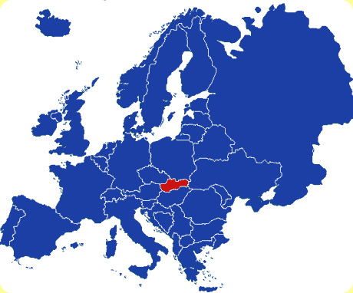
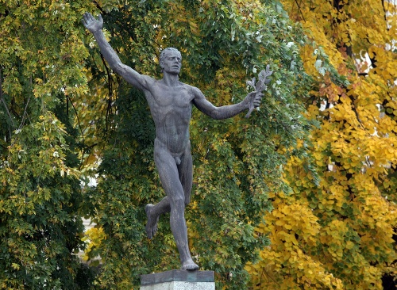
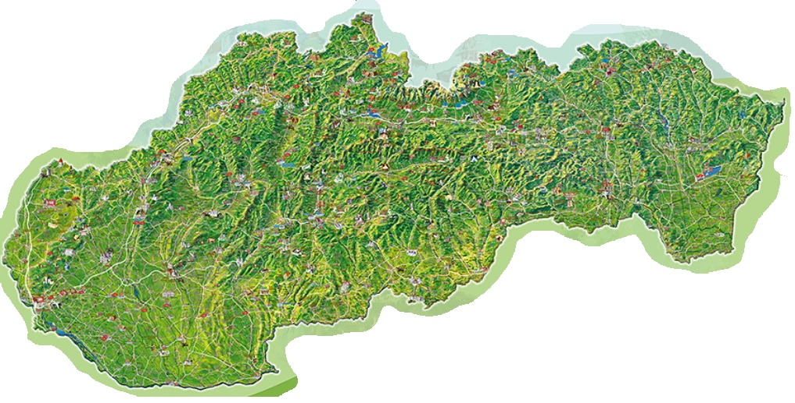
First some geography
Košice

Slide 3
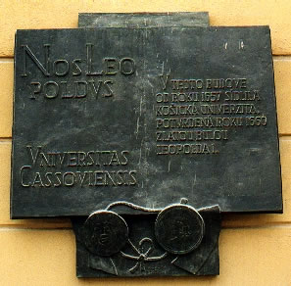
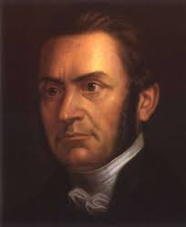
Some history
1657: Universitas Cassoviensis
1776: Academia Regia Cassoviensis
1850-1921 Law Academy
1959: Pavol Jozef Šafárik University
Faculties: Medicine, Law, Public administration, Science, Arts 1501 employees, 8138 students (2013)
1963: Science faculty
326 employees, 1283 students (2013)
originally: only teachers study, first graduates 1967
combination of 2 subjects
Mathematics, Physics, Chemistry, Biology
Informatics (since 1989), Geography (since 2003)
study programmes with Arts faculty (since 2011)
1795- 1861
poet, historian, first scientific Slavist

Slide 4
Numbers of graduates of teachers studies
with Arts Faculty, 19 combinations
31 combinations, biggest group 8 people
13 combinations
plus Geography
plus MCh
plus MB
plus MI
combinations: BCh,FCh,MF

Slide 5
Graduates in combinations with Mathematics and Informatics

Slide 6
Practical placement
Teachers study for upper elementary and lower secondary schools
specialization in two subjects (MF, IB, SjG,...)
practical placements at schools several times during their study
ideally at different types of schools
each student needs an approved supervising teacher for each subject
university/faculty provides a list of teaching schools + teachers
binary preferences: some schools are unacceptable for a student (e.g. because of commuting)
Two types of placements:
A: students divided into groups (4-6) with the same subject
groups visit classes and observe lessons, then analyze with the teacher;
one subject in period 1, second subject in period 2
B: student teaches pupils herself: both subjects simultaneously at the same school
Assignments are made by hand: several days needed

Slide 7
Assignment procedures elsewhere

Slide 8
Assignment procedures elsewhere

Slide 10
Not so successful stories

Slide 11
Not so successful stories

Slide 12
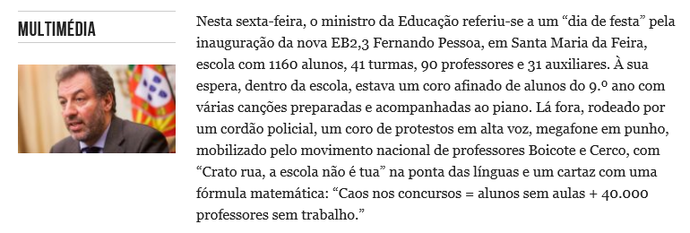
Not so successful stories

Slide 13
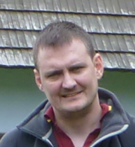
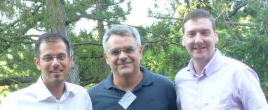
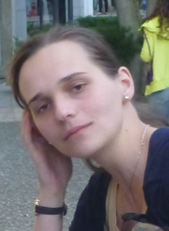
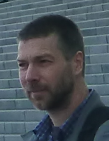
Our task
Create a mathematical model of the teachers assignment problem
Study its structural and algorithmic properties
Create a user-friendly computer program for every-day use
My friends and colleagues involved in the research:
Tamás Fleiner, Budapest
David Manlove, Ian McBride, Glasgow
Pavlos Eirinakis, Yiannis Mourtos, Dimitris Magos, Athens
Eva Oceľáková-Potpinková, Silvia Bodnárová, Michal Barančík - Košice
We also want to thank to COST action IC 1205

Slide 14
Outline of the talk
Maximizing the number of assigned trainee teachers:
placement A and placement B
combinatorial representation and complexity results
results of ILP implementation
approximation algorithms
Two sided preferences - stability
suitable stability notion
complexity results

Slide 15
The talk is based on publications
K. Cechlárová, T. Fleiner, D. Manlove, I. McBride, E. Potpinková: Modelling practical placement of trainee teachers to schools, Central European Journal of Operations Research 23(3), 547-562, 2015.
K. Cechlárová, P. Eirinakis, T. Fleiner, D. Magos, I. Mourtos, E. Oceľáková: Approximation Algorithms for the Teachers A ssignment Problem, Proc. 13th Int. Symposium on Operational Research in Slovenia, 479-484, 2015.
K. Cechlárová, T. Fleiner, D. Manlove, I. McBride: Stable matchings of teachers to schools, arXiv:1501.05547

Slide 16
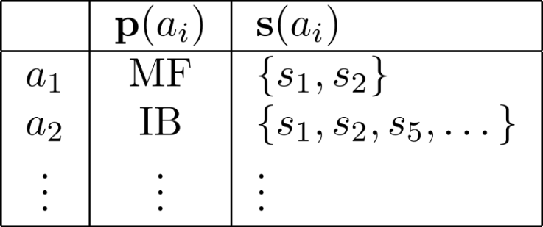
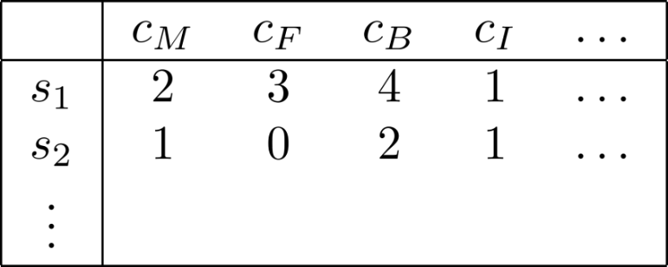
Formal model: TAP
a₁
a₂
a₁
a₂

Slide 17
Separated subjects – network flows
s_{1F}
2c_{F}(s₁)
1
a_{F}
s_{1M}
2c_{M}(s₁)
1
2
a
t
r
2c_{F}(s₂)
a_{M}
s_{2F}
1
2c_{M}(s₂)
s_{2M}

Slide 18
Separated subjects – network flows
s_{1F}
c_{F}(s₁)
1
1
a_{F}
s_{1M}
c_{M}(s₁)
1
a
t
r
c_{F}(s₂)
a_{M}
s_{2F}
1
1
c_{M}(s₂)
s_{2M}

Slide 19
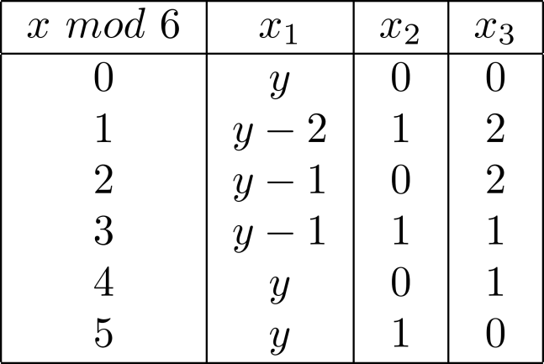
Separated subjects – create groups

Slide 20
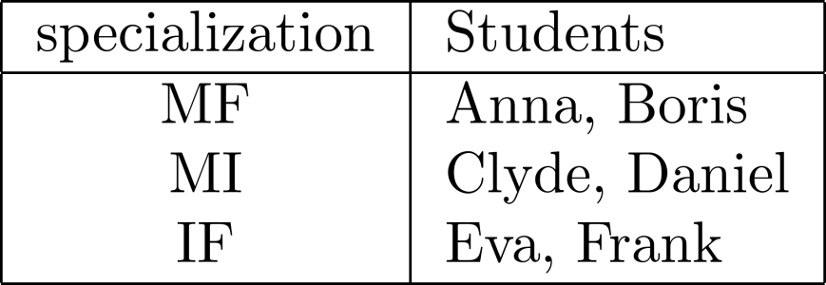
Separated subjects – create groups

Slide 21
Separated subjects – create groups
M
F
Ch
I
G
B

Slide 22
Separated subjects – create groups
M
F
Ch
I
G
B

Slide 23
Separated subjects – create groups
F
I
G
B

Slide 24
Separated subjects – create groups
M
M
F
Ch
Ch
I
G
B

Slide 25
Formal model: TAP
a₁
a₂

Slide 26
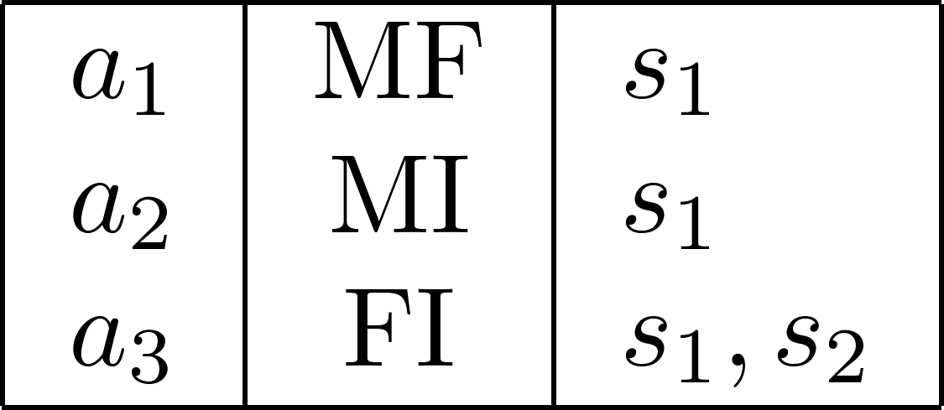
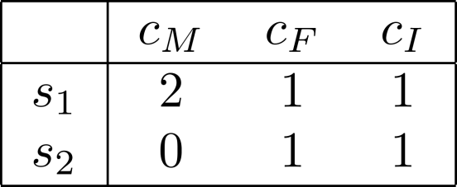
Inseparable subjects
a₁
a₂
a₃

Slide 27
Inseparable subjects
a₃

Slide 28
Computational complexity of TAP

Slide 29
Computational complexity of TAP

Slide 30
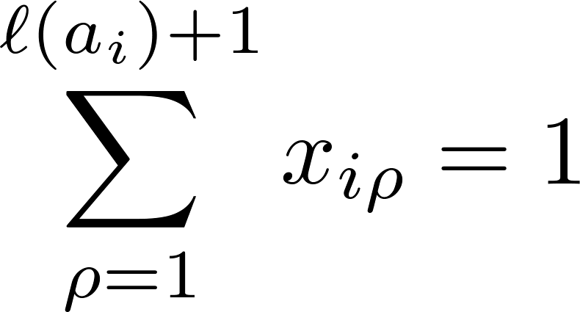
Integer linear program for TAP

Slide 31
P.J.Šafárik university in numbers
Science faculty
Arts faculty
 | M | F | B | Ch | I | G | Sj | Aj | Nj | Lj | Ov | Ps | E | H
# places in KE | 74 | 36 | 50 | 38 | 44 | 31 | 54 | 57 | 35 | 0 | 24 | 2 | 16 | 23
# places total | 288 | 158 | 172 | 142 | 137 | 127 | 243 | 216 | 129 | 3 | 119 | 12 | 80 | 135
# students | 13 | 9 | 43 | 21 | 4 | 35 | 31 | 14 | 22 | 1 | 21 | 22 | 12 | 28

Slide 32
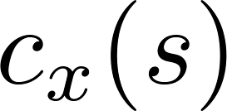
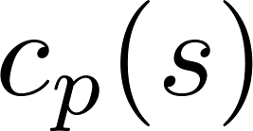
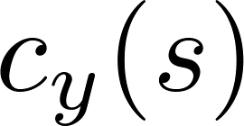
Approximation algorithms
1
a_{px}
s_{x}
1
r
s_{p}
t
1
1
a_{py}
s_{y}

Slide 33
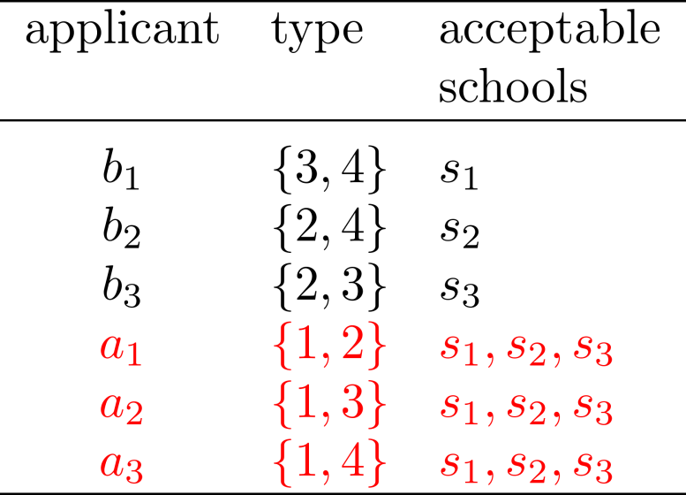
Approximation algorithms: Greedy1

Slide 34
Approximation algorithms: Greedy1

Slide 35
Approximation algorithms: Greedy2

Slide 36
Approximation algorithms: Greedy2

Slide 37
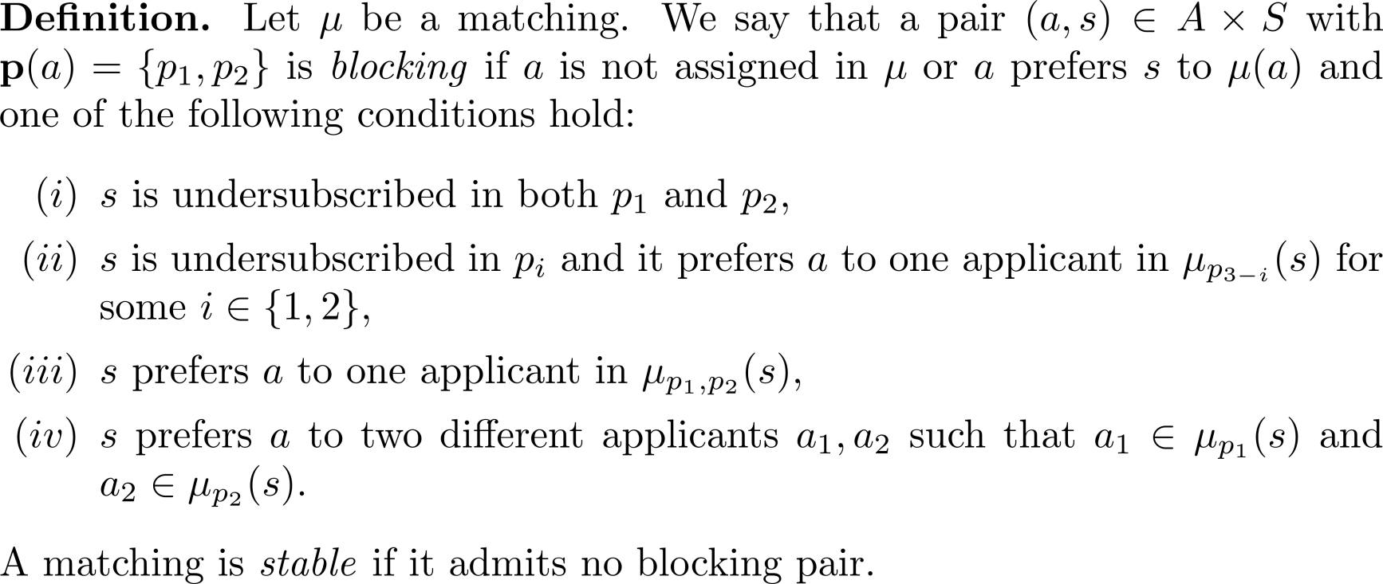
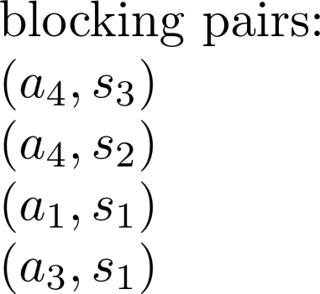
Stability definition

Slide 38
Stability definition

Slide 39
Stability definition

Slide 40
Stability definition

Slide 41
Intractability

Slide 42
Master lists

Slide 43
Master lists

Slide 44
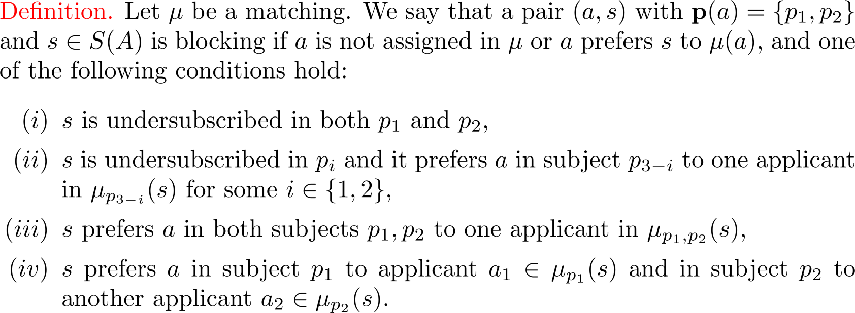
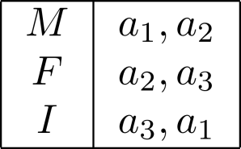
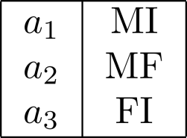
Subject specific preferences

Slide 45
Subject specific preferences

Slide 46
Minimizing instability

Slide 47
