Slide 1
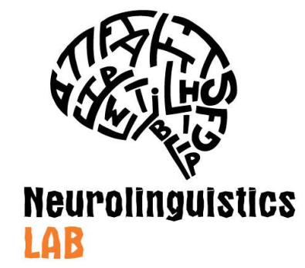
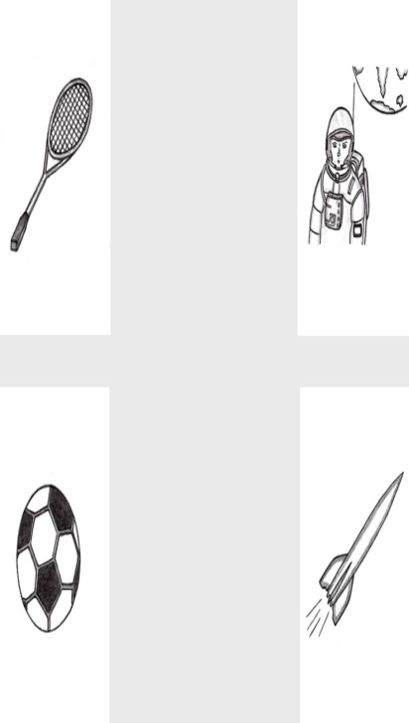
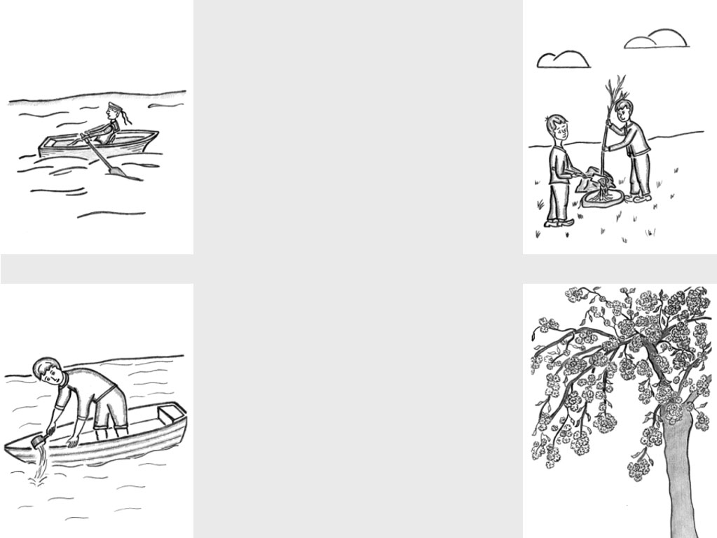
Differences in verb and noun comprehension in aphasia
Soloukhina Olga¹*, Isaev Dmitry², Akinina Yulia¹,³, Ivanova Maria¹
¹National Research University Higher School of Economics, Moscow, Russia
²University of Southern California, Los Angeles, California, USA
³University of Groningen, Groningen, Netherlands
*osoloukhina@hse.ru
Background
The growing evidence that verbs are more difficult to process than nouns (Cappa & Perani, 2002) and that verb retrieval is more commonly affected in aphasia compared to nouns (Jonkers & Bastiaanse, 1998) are largely based on naming and semantic judgment tasks.
The aim of this study was to determine whether relative difficulties of verb processing are modality-general. In this study for the first time we directly compared difficulty of comprehension of verbs versus nouns in Russian in individuals with and without aphasia using a novel instrument – an auditory single-word comprehension test presented on a tablet.
Methods
Participants
32 people with aphasia (PWA): 18 men; mean age: 53.7±11; 7 fluent, 25 non-fluent; months post-onset: 24.8±28.3
20 non-brain-damaged (NBD) individuals: 9 men; mean age: 49.2±13.2
Tasks
Word-to-picture matching task: 1 target and 3 foils (semantic, phonological and irrelevant)
Verbal and visual stimuli from the databases «Verb and action: stimuli database» (Akinina et al., 2015) and «Noun and object: stimuli database» (Akinina et al., 2014)
Nouns: name agreement > 80%, image agreement > 4 points¹; verbs: name agreement > 70%, image agreement > 3.5 points¹
Norming of the extended version (66 verbs and 67 nouns):
45 participants with aphasia and 30 controls different from the final cohort
Final set: 30 nouns and 30 verbs matched on relevant psycholinguistic parameters: subjective visual complexity, familiarity, age of acquisition, imageability, image agreement, frequency
Excluded trials: PWA made no mistakes or NBD made two or more mistakes
Task programmed on a tablet Samsung SM-T525
Instruction: listen to the word and tap the relevant picture with the left hand
Responses and reaction times (RTs) recorded automatically
¹Scale from 1 (the lowest agreement) to 5 (the highest agreement).
Results
PWA and NBD: responses in verb subtest
PWA and NBD: responses in noun subtest
PWA and NBD: RTs for correct responses in both subtests
**
**
**
**
**
**
**
**
**
**
 | Noun subtest
Target | raketa (rocket)
Phonological foil | raketka (racket)
Semantic foil | kosmonavt (astronaut)
Irrelevant foil | myach (ball)
RTs of control group for the verb subtest were higher than for the noun subtest (p = .001), although there was no difference in the proportion of correct responses for the two subtests (p = .096).
People with aphasia demonstrated significant differences between the two subtests in both proportion of correct responses (p < .001) and RTs (p = .005).
RTs in PWA who made no more than one mistake in each subtest and NBD
RTs in PWA with minimal difference in proportion of correct responses between subtests
Individuals with fluent and non-fluent aphasia: accuracy of responses and RTs
 | Verb subtest
Target | tsvesti (blossom)
Phonological foil | gresti (raw)
Semantic foil | sazhat’ (plant)
Irrelevant foil | vicherpyvat’ (bail out)
**
*
**
**
*
* p < .05, ** p < .01
Discussion
The study demonstrated the relative difficulty of verb processing in a comprehension task, supporting the hypothesis that verb processing difficulties are modality-general
PWA made more mistakes in the verb comprehension subtest
Both groups had greater RTs in the verb comprehension subtest
Significantly longer RTs in the verb subtest were observed even in PWA who completed both subtests with similar accuracy
Significant differences in performance between PWA and NBD indicate that the subtests validly index single word comprehension difficulties and that they can be used for the assessment of auditory single-word language deficits in individuals with aphasia
The observed difficulties in verb processing emphasize that it is important to access not only noun comprehension as it may result in underestimation of the full range of the disorder
Tracking RTs detects even subtle comprehension deficits and residual difficulties in language processing when accuracy falls within the normal range
Verbs imply more complex structural information, such as the properties and the number of arguments which should be reflected in the syntactic structure of a sentence (Cappa & Perani, 2003). Potentially, the verb’s complex nature hinders its processing even in a task that does not necessarily require that information to be fully and correctly processed, such as single-word comprehension.
The research is supported by Russian Scientific Foundation for Humanities (grant №14-04-00596).

