Slide 1
К интерпретации коллекций текстов с использованием ключевых понятий
Boris Mirkin
Department of Data Analysis & AI, NRU HSE, Moscow RF
Department of CS, Birkbeck University of London UK
Joint work with T. Fenner (U of London),
S. Nascimento (NU Lisbon),
E. Chernyak, M. Dubov, etc. (NRU HSE)
Supported by
Research and Academic Funds of NRU HSE: «Teacher-student» 2011-14 and Research Lab Decision Choice and Analysis 2010-pr.;
grant of Portuguese Science and Technology Foundation 2007-2011 (to SN & BM)
Plenary talk at “The 16th International Conference on Artificial Intelligence: Methodology, Systems, Applications”, Varna, Bulgaria, 11-13 September 2014

Slide 2
Дано
Коллекция текстов – совокупность стрингов (строк)
Коллекция ключевых понятий (может быть взята из таксономии предметной области)

Slide 3
Промежуточная конструкция: Таблица релевантности Понятие-Текст
Матрица чисел, выражающих степень релевантности ключевых понятий (строки) текстам коллекции столбцы)
Релевантность «ключевое понятие – текст» определяется совпадающими фрагментами как суммарная условная вероятность следующего символа
Вычисляется с помощью аннотированных суффиксных деревьев

Slide 4
Основные конструкции
Рубрикация текстов ключевыми понятиями (Черняк)
Достраивание таксономий по материалам интернета (Википедия) (Черняк)
Граф референций между ключевыми понятиями (Черняк, Дубов)
Анализ графов связи в динамике: суперкластер (Родин)
«Возгонка» (обобщение) в таксономии (Фролов)

Slide 5
Example 1: In-house phrase-to-text similarity score: AST symbol’s averaged conditional frequency
Suffix tree for strings
XABXAC and BABXAC
annotated with substring frequencies, and
the similarity score for string VXACA
Suffix | Match | Score
‘VXACA’ | None | 0
‘XACA’ | ‘X’->’A’->’C’ | 3/12 + 3/3 + 2/3=1 11/12
‘ACA’ | ‘A’->’C’ | 4/12 + 2/4=5/6
‘CA’ | ‘C’ | 2/12
‘A’ | A’ | 4/12

Slide 6
Example II: The 2012 ACM Computing Classification System: ACM-CCS-2012 Hierarchical Taxonomy – 5-6 Layers

Slide 7
Example II: ACM-CCS-2012 Taxonomy – Layer One, 14 categories
Information systems
Security and privacy
Human-centered computing
Computing methodologies
Applied computing
Social & professional topics
Proper nouns: People, technologies and companies
General and reference
Hardware
Computer systems organization
Networks
Software and its engineering
Theory of computation
Mathematics of computing

Slide 8
Example 2: ACM-CCS Taxonomy – Layer two, Maths of computing
Mathematics of computing
Discrete mathematics
Probability and statistics
Statistical paradigms
Queueing theory
Contingency table analysis
Regression analysis
Time series analysis
Survival analysis
Renewal theory
Dimensionality reduction
Cluster analysis
Statistical graphics
Exploratory data analysis
Multivariate statistics
Mathematics of computing (cont.)
Mathematical software
Information theory
Mathematical analysis
Numerical analysis
Mathematical optimization
Differential equations
Calculus
Functional analysis
Integral equations
Nonlinear equations
Quadrature
Continuous mathematics

Slide 9
Interpretation: meaning
To interpret: “to explain or tell the meaning of, that is, present in understandable terms” (Merriam-Webster)
“Explanation” must be “concise.”
Generalization: a special case of interpretation (2a)
Annotation: “a note added by way of comment or explanation”(Merriam-Webster)

Slide 10
Basic Computational Interpretation:
1. Build Theme-to-Element relevance matrix, say,
KeyPhrase-to-Text or Motif-to-ProteinSeq or ResearchSubject-to-ResearchTeam
Element j
High relevance values
Theme k
Query set Q(k)
Annotation A(j) of element
2. Build thematic query sets Q(k) for themes
3. Build thematic annotations A(j) for elements

Slide 11
Interpretation of thematic query sets I: Two types of concepts– themes, elements
Concept granularity
Concept Taxonomy
concept
granularity:
Concept themes
Concept Finer granularity:
Concept elements
Span of phenomena

Slide 12
Interpretation of concept query sets II: Interpretation 1: set of elements by a theme
Concept granularity
Concept
Concept theme
Concept
Concept
elements
Elements of theme Query set
Span of phenomena

Slide 13
Interpretation of concept query sets III: Interpretation 1: set of elements by a theme
Bioinformatics: Q – co-expressed genes,
T– genes of a same
function
T
Q
Taxonomy concept T
Query set Q
Overrepresentation (Robinson 2011)
If P(QT/Q) >> P(T),
annotate Q by concept T

Slide 14
Interpretation of concept query sets IV: Interpretation 2: set of themes by a Concept
Concept granularity
Concept Theme
Concept
Query set
Concept
Concept
Span of phenomena

Slide 15
Interpretation of out-taxonomy concepts 1

Slide 16
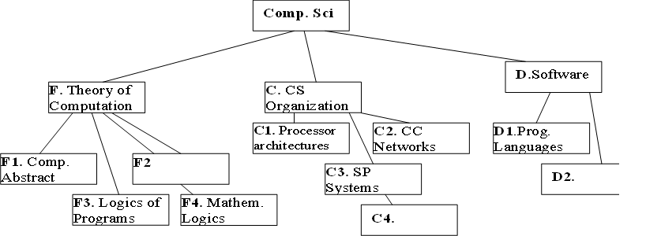
Interpretation in Domain Taxonomy I
Given a T and Out-T-Concept, “intuitionistic programming”
Map OTC as a fuzzy topic set Example

Slide 17
Interpretation in Domain Taxonomy I (a)
Given a T and Out-T-Concept, “intuitionistic programming”
Map O-T-Concept as a fuzzy topic set:
F.1 Computation by abstract devices - 0.60
F.3 Logics and meaning of programs - 0.60
F.4 Mathematical logic and formal languages - 0.50
D.1 Programming languages - 0.17. (Euclidean Normed)

Slide 18
Interpretation in Domain Taxonomy I(b)
Given T and Out-T-Concept “intuitionistic programming”
Map O-T-Concept to Taxonomy as a fuzzy topic set:
{F.1 - 0.60, F.3 - 0.60, F.4 - 0.50, D.1 - 0.17} (Euclidean Norm)
Fragmentary
Not cognition friendly

Slide 19
Interpretation of a thematic cluster by Lifting
thematic cluster:

Slide 20
Interpretation of taxonomy topic clusters by lifting

Slide 21
Algorithmic issues I
Cleaning the taxonomy tree of irrelevant nodes
Ways to extend the fuzzy belongingness values to all the nodes (no effect on the algorithm but on results):
Only 0-1 constraints
Summing to 1 (on same layers)
Euclidean: squares summing to 1 (reminiscent of the wave function in quantum mechanics)

Slide 22
Algorithmic issues II
Proceed recursively bottom-to-top
Summing weighted gain/loss events under each of two different scenarios:
Head Subject has been inherited from parent
Head Subject has not been inherited from parent
and taking that with minimum penalty

Slide 23
Algorithmic issues III

Slide 24
Application cases
(G) Reconstruction of gene histories over an evolutionary tree (E. Koonin, P. Kellam et al. 2003-2007)
(Aa) representation of research activities of organizations over an ontology of the domain (S. Nascimento et al. 2009 - )
(Ac) Resident complaints management (J. Askarova, E. Babkin, et al., 2011-)

Slide 25
(Aa) Representation of a Computer Science Department research activities for strategic control
Similar to:
(i’) District Map: an ontology of Computer Science (CS),
(ii’) Energy maintenance Units: clusters of CS research subjects being developed by members of the department,
(iii’) Mapping of the research onto the ontology

Slide 26
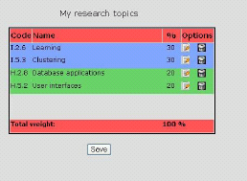
Member of Department ESSA survey output: Fuzzy membership

Slide 27
(Ab) An example of annotating a research project

Slide 28
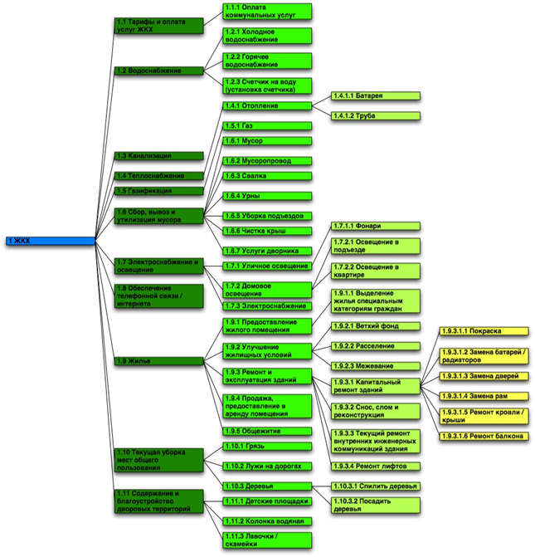
(Ac) Resident complaints management 1
1. Coarse taxonomy refined, semi-manually
using a database of resident complaints in Nizhny Novgorod

Slide 29
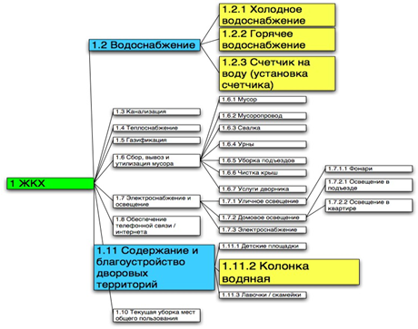
(Ac) Resident complaints management 2
2. Complaint-to-Topic suffix tree based similarity table S
3. Clusters over S with iK-Means (Mirkin 2012) - Anomalous patterns one-by-one
4. Removal of small and large clusters
5. Parsimoniously lifting remaining clusters
Figure caption:
Cluster mapped to 1. Housing services:
1.2.1. Hot water problems
1.2.2. Cold water problems
1.2.3. Water meter problems
(all three are parts of 1.2. Water Supply)
1.11.2. Public water pump
(part of 1.11. Urban landscaping and public amenities)

Slide 30
(Ac) Resident complaints management 3
6. Interpretation and conclusions
Observation: Clusters are mapped to overly high ranks
Since the housing and communal services are structured according to technology (water, electricity, public transportation, etc.),
whereas complaints are structured according to living conditions, the latter are frequently at odds with the former:
Organize municipal centers to listen to residents and form multiple-address solutions
(this already is being organized in Moscow, by themselves: with no our advice)

Slide 31
Conclusion
An attempt at a computational interpretation system: Basic tasks
Annotating a single element
Annotating a granular query set by a single concept
Annotating a query set within a taxonomy
Future work
Building taxonomies
Development of knowledge models
Moving to maximum likelihood (via estimation of probabilities)
Text analysis to use more data (string+grammar+net)
Apply to texts, medicines, documents
Modeling cognitive systems

