Slide 1
Master of International Business (MIB)
Program
Head of the program – Irina G. Kratko
Ph.D, Associate Professor
Higher School of Economics, Moscow, 2017
www.hse.ru

Slide 2
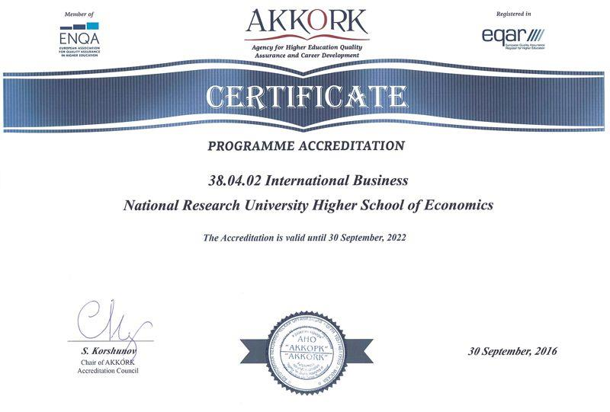
MIB International Accreditation from AKKORK
On September 30, 2016 Master of International Business program received the accreditation certificate from the Agency for Quality Assurance in Higher Education and Career Development (AKKORK), for the first time at HSE
pho74to77
photo
photo
Higher School of Economics, Moscow, 2017

Slide 3
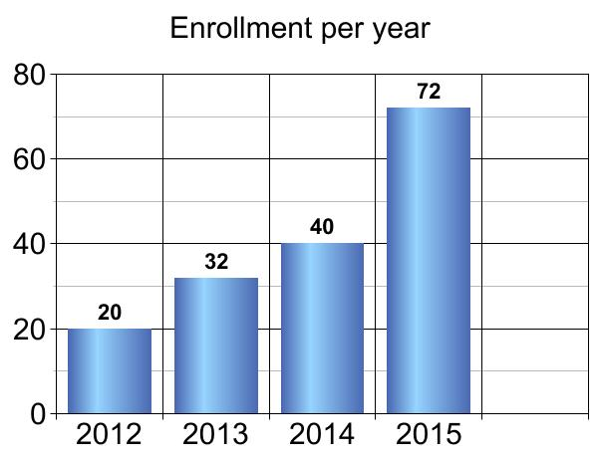
MIB Development Milestones
Number of students
75
pho74to77
photo
2016
Year
2 groups since 2015
Higher School of Economics, Moscow, 2017

Slide 4
MIB Program Features
Balanced mix of a business degree and an international affairs degree
equip students with both the traditional business skills and the knowledge in political, economic, legal and socio-cultural aspects of the global marketplace
This program is the first of its kind in Russia. The curriculum and the core aspects of the program meet the requirements of the world's most advanced MIB programs
The program is taught in English
Classes are scheduled in the evenings and on Saturdays
Admission requirements – Portfolio
Tuition-based program
photo
2-year program
120 ECTS credits
photo
Higher School of Economics, Moscow, 2017

Slide 5
Many Identified Benefits
Students can effectively combine work and study
Students get valuable practical experience, working on real-life projects offered during the International Business Consulting course
Some courses are taught by experienced business executives
Classes feature various guest speakers from relevant fields of business
Most classes are interactive and are run in small student teams
Career Development class
Program is practice-oriented
photo
MIB Double Degree with the University of South Carolina (USA) and LUISS University (Rome)
photo
Opportunity to build extensive networks for future career
One semester exchange study at one of the partner universities abroad
Higher School of Economics, Moscow, 2017

Slide 6
MIB Double Degree Program USC
HSE students have an option to earn two masters degrees – MIB HSE and MIB USC
photo
University of South Carolina (USC), Darla Moore School of Business, MIB program
Internationally recognized leader in international business education
Ranked #1 Graduate International Business Degree (U.S. News & World Report)
photo
Terms and conditions
- one semester study at USC
- 12 MIB HSE credit hours apply toward the MIB USC
- HSE students take 18 credits at USC
- 3 credit hours are tuition-free for HSE students
- competitive GMAT/GRE score for application
photo
Higher School of Economics, Moscow, 2017

Slide 7
MIB Double Degree Program LUISS
HSE students have an option to earn two masters degrees – from HSE and from LUISS University (Rome)
photo
LUISS University (Rome, Italy)
Master in Management (major in International Management)
A private University accredited by the Italian Ministry of Education and controlled by CONFINDUSTRIA, the Association of Italian industries
Business School accredited by EQUIS, ISO 9001, ASFOR
Master’s programs taught in English
photo
Terms and conditions
- first year at HSE, second year at LUISS
- NO extra tuition fee at LUISS
1 master thesis, 2 research advisors (HSE, LUISS), 2 defenses (HSE, LUISS)
IELTS 6,5/ TOEFL IBT 79-80 for application
photo
Higher School of Economics, Moscow, 2017

Slide 8
MIB Other Partner Universities
The Fletcher School of Law and Diplomacy at Tufts University, the USA
the world’s oldest and most prestigious school of international affairs and international business, famous for its Master of International Business (MIB) program
Higher School of Economics is the first and the only institutional partner of the Fletcher School in Russia
University of Luxembourg
San Diego State University, the USA
photo
photo
photo
Higher School of Economics, Moscow, 2017

Slide 9
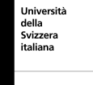
MIB Other Partner Universities
University of Parma, Italy
Norwegian School of Economics,
Norway
Maastricht University,
the Netherlands
University of Lugano, Switzerland
photo
photo
Higher School of Economics, Moscow, 2017

Slide 10
MIB Business Partners
American Chamber of Commerce
Unilever
PepsiCo
METRO Cash&Carry
Henkel
Michelin
ГК Волга-Днепр (GC Volga-Dnepr)
Mondelēz International
SimpleWine
photo
photo
photo
Higher School of Economics, Moscow, 2017

Slide 11
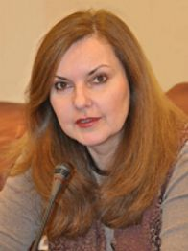
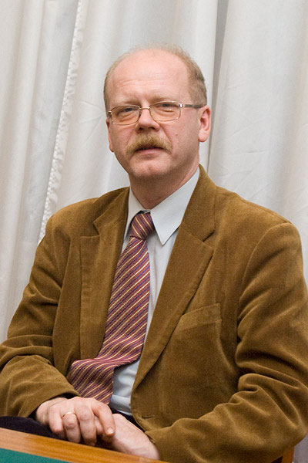
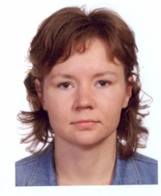
MIB Instructors
Irina G. Kratko
Head of MIB Program, Associate Professor at the FWEIA,
Visiting Professor in numerous universities around the world,
Entrepreneur of the Year, USA, 2009
by The Corridor Business Journal
International Business Research
International Business Consulting
International Entrepreneurship
Research Seminar
Maxim Braterskiy
Professor, Faculty of World Economy and International Affairs
World Economy
Global Political Economy and Interaction between Business and Politics
International Relations
photo
photo
Alexandra Zhukova
Senior Lecturer, Faculty of Economic Sciences
Foundations of Managerial Economics
Ekaterina Entina
Associate Professor, Faculty of World Economy and International Affairs
Political Aspects of International Business
photo
Higher School of Economics, Moscow, 2017

Slide 12
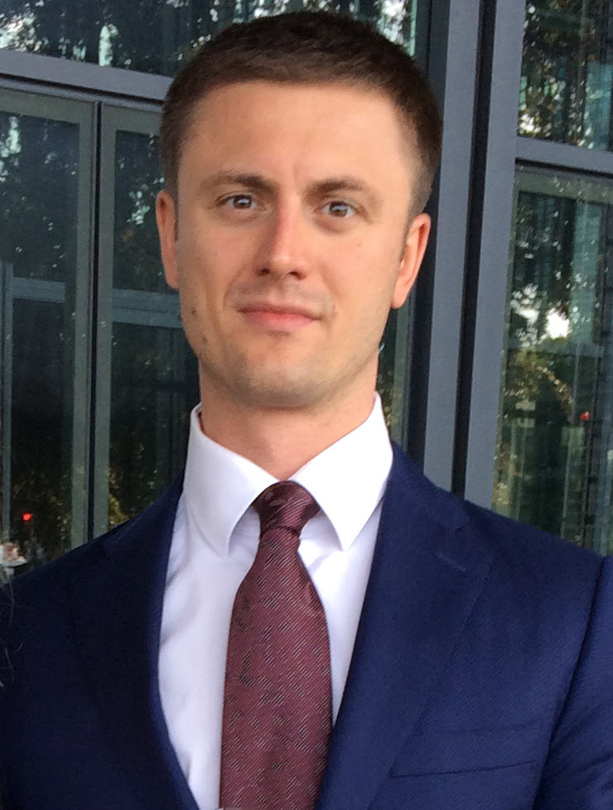
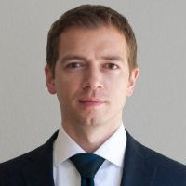
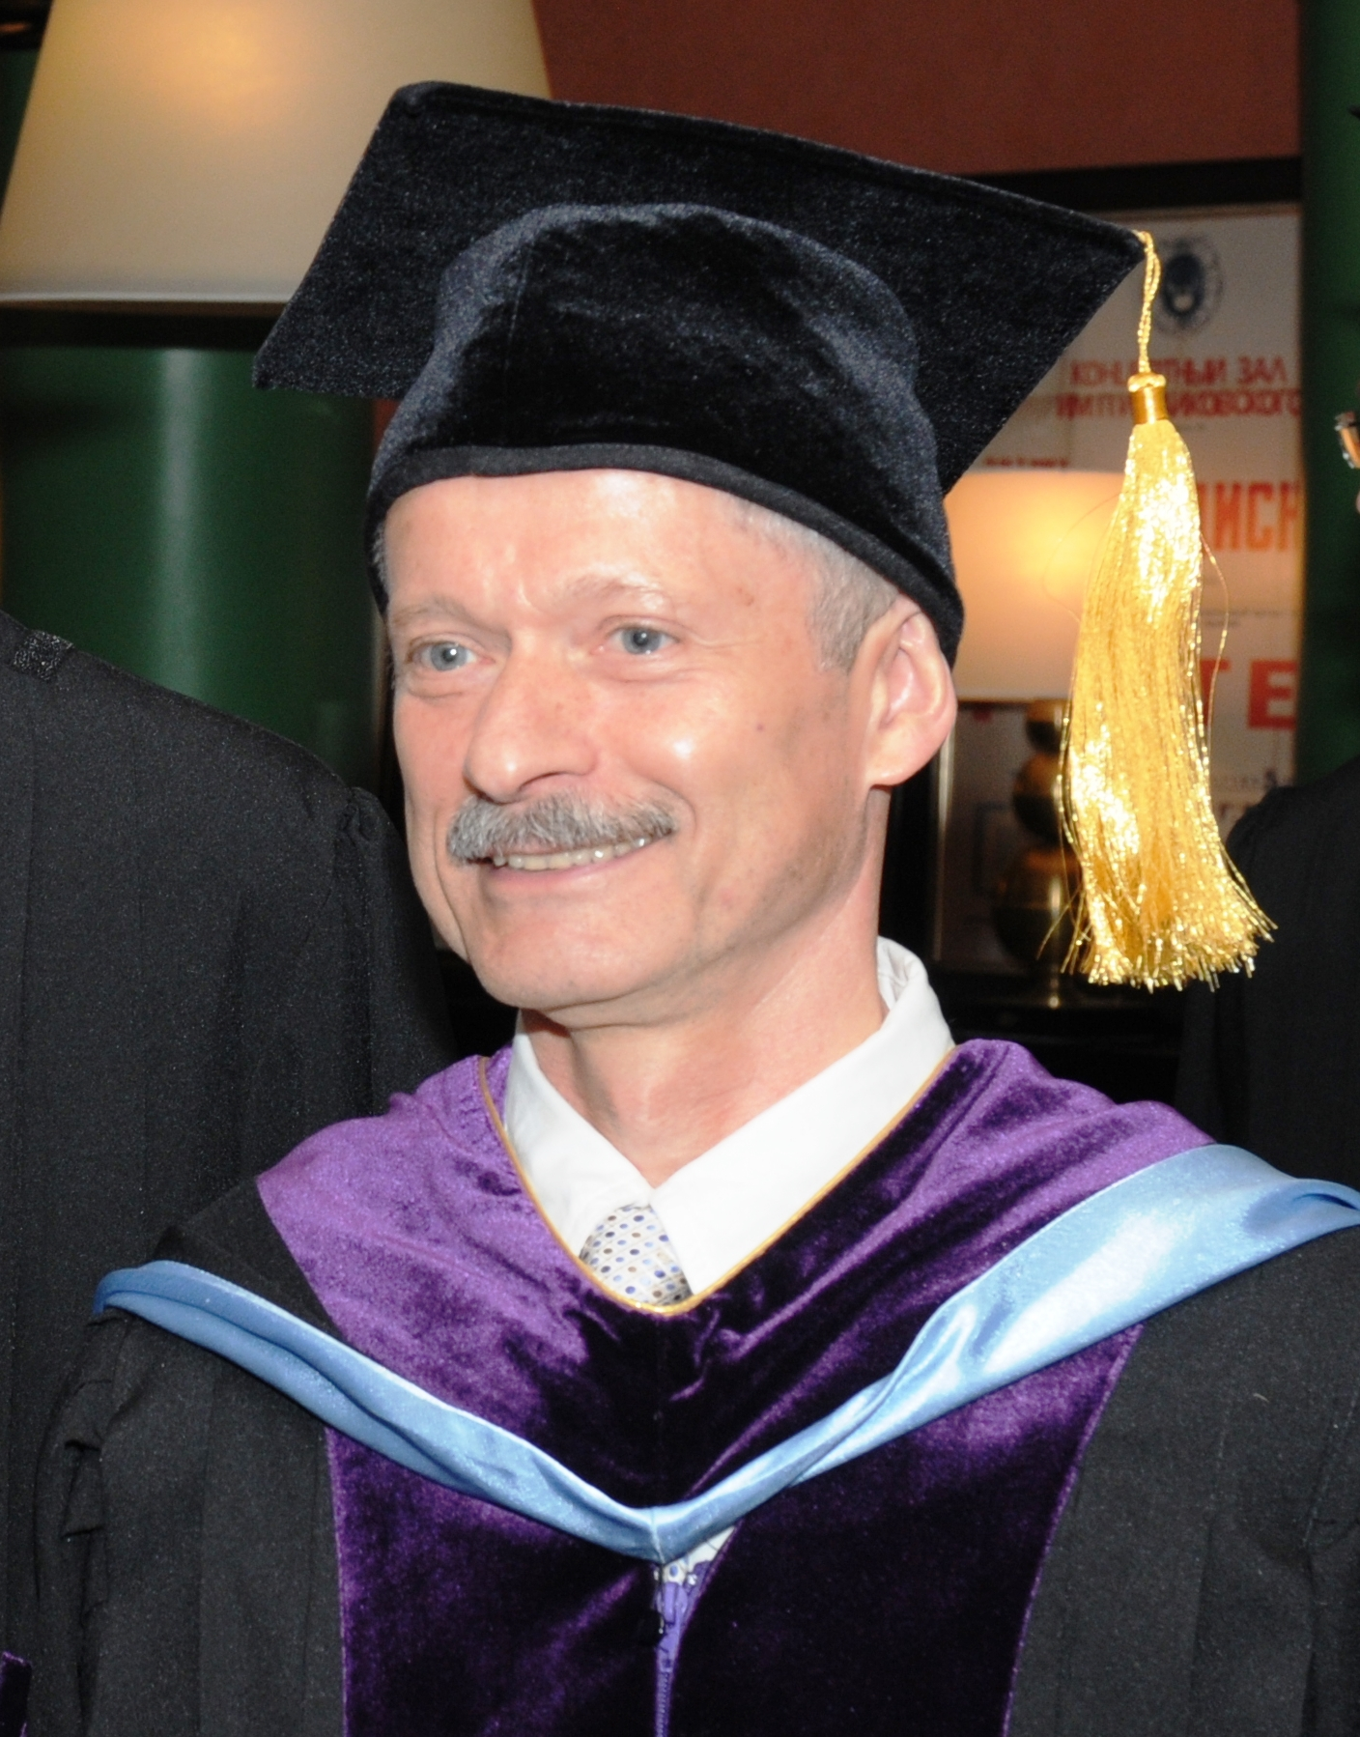
MIB Instructors
Vyacheslav Buevskiy
Director, Strategy and Deals Advisory Department, PwC
International Marketing
International Marketing Strategies
International Market Research and Analysis
Arkadiy Vershebenyuk
Director, Uber Ukraine
Strategic Management of International Companies
Career Development
photo
photo
Maxim Shevchenko
Marketing Director, SC Johnson
International Marketing
Vladimir Lissnyak
President, ANO “PERICLES”™
International Business Negotiations
photo
Higher School of Economics, Moscow, 2017

Slide 13
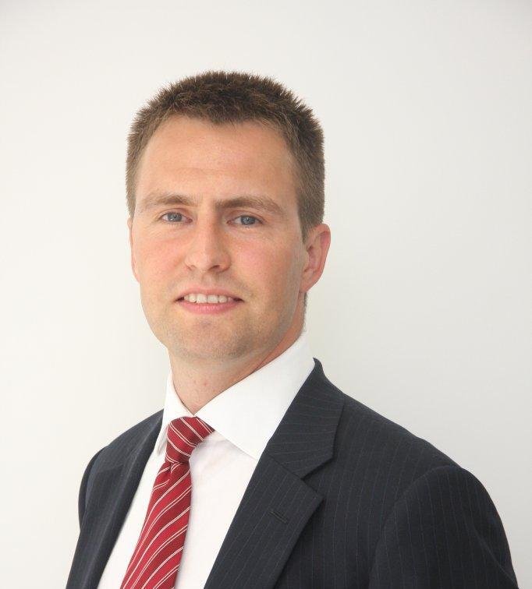
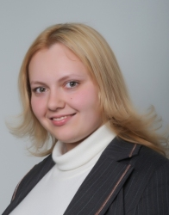
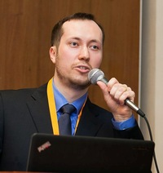
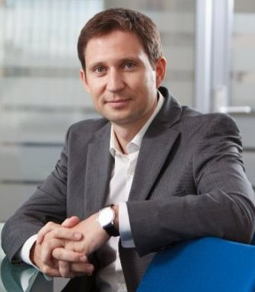
MIB Instructors
Sergey Krokhalev
Partner, Baker & McKenzie
International Business Transactions
Anastasiya Stepanova
Associate Professor, Faculty of Economic Sciences
International Corporate Finance
International Financial Management
photo
Artyom Loginov
Marketing Director, Michelin
International Marketing (Advanced)
photo
Alexey Blinov
Finance Director, Mondelēz International (Eastern Europe)
International Corporate Finance
photo
Higher School of Economics, Moscow, 2017

Slide 14
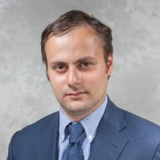
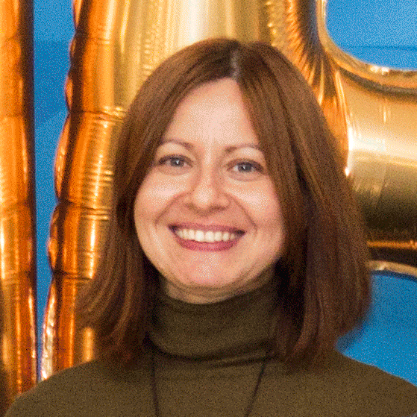
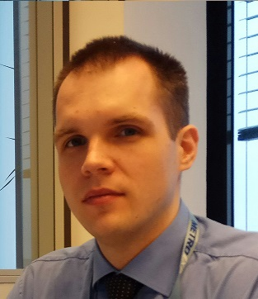
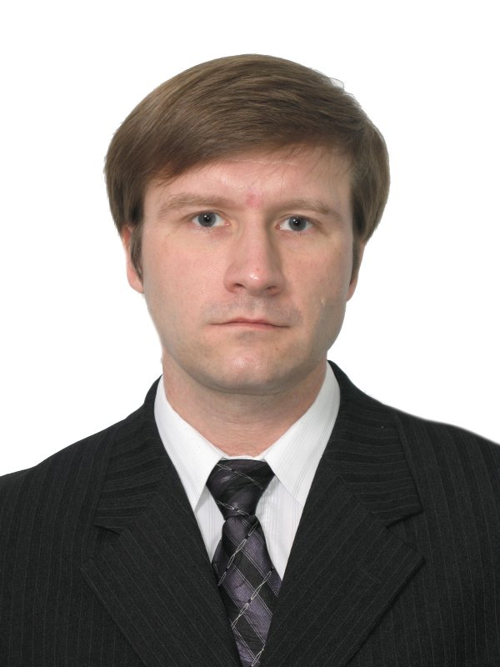
MIB Instructors
Dmitry Khokhlov
Managing Director, DIGITALIZM branch in Moscow
International Advertising
Maria Shevtsova
Senior Auditor, Severstal
Introduction to Financial and Managerial Accounting
Corporate Governance in International Companies
photo
Yuriy Gavrilyuk
Project Manager, Supply Chain Department, METRO Cash&Carry
International Operational and Supply Chain Management
Alexander Tatarko
Professor, Faculty of Social Sciences
World’s Business Cultures
photo
photo
Higher School of Economics, Moscow, 2017

Slide 15
MIB Learning Outcomes
Our goal is to train cross-functional executives, managers, experts and analysts with global thinking and proactive mind
Students can create a specialized, flexible curriculum in order to expand their previous knowledge or acquire new skills
Graduates are prepared to work in the global arena as executives, managers and consultants in international companies and their foreign subsidiaries, and to start their own foreign business
photo
photo
photo
Higher School of Economics, Moscow, 2017

Slide 16
MIB Program Contents
Adaptational courses:
World Economy & International Relations
Core study block:
International Business Research
Strategic Management of International Companies
Foundations of Managerial Economics
Introduction to Financial and Managerial Accounting
International Corporate Finance
International Marketing
World’s Business Cultures
International Business Negotiations
International Business Consulting
photo
photo
photo
Higher School of Economics, Moscow, 2017

Slide 17
MIB Program Contents (cont’d)
Elective courses:
Global Political Economy and Interaction between Business and Politics (required for double degree)
Political Aspects of International Business (required for double degree)
International Business Transactions
Legal Aspects of International Business
International Entrepreneurship
Corporate Governance in International Companies
International Operational and Supply Chain Management
International Financial Management
International Finance (Advanced)
International Marketing Strategies
International Marketing (Advanced)
International Market Research
International Advertising
Doing Business in Asia
photo
photo
photo
Higher School of Economics, Moscow, 2017

Slide 18
9/11 Myasnitskaya, office 308, Moscow, Russia
Phone: +7(495) 772-95-90 ext. 22848, 22244, 12279, 12272
E-mail: mib@hse.ru
http://we.hse.ru/inbus/, http://we.hse.ru/en/inbus/, www.hse.ru
Program managers:
Aishat Magomedova amagomedova@hse.ru
Marina Petrashkevich mpetrashkevich@hse.ru
Higher School of Economics, Moscow, 2017

