Slide 1
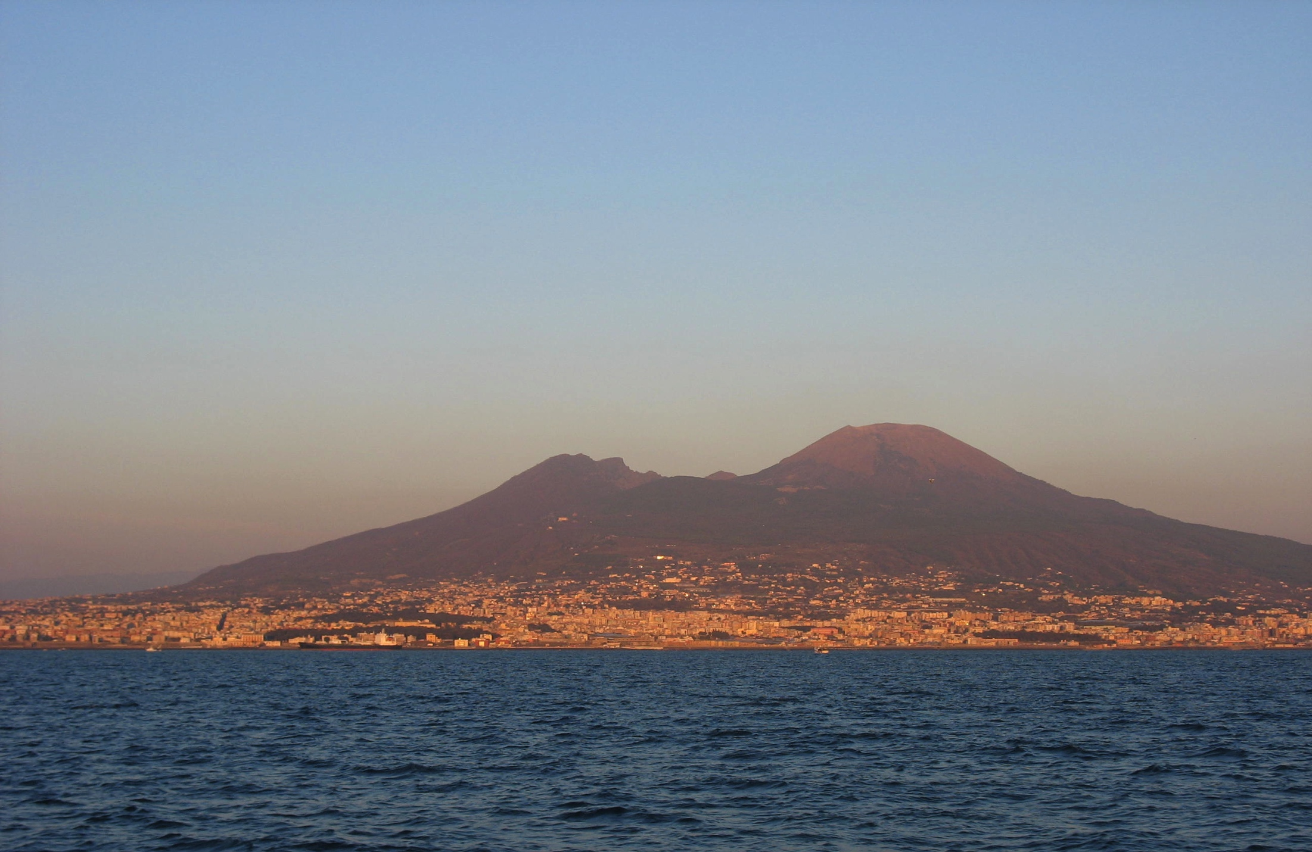
Data Analytics Using WEKA
Mario.Guarracino@cnr.it Computational and Data Science Laboratory National Research Council, Italy

Slide 2
Introduction
We live in a digital world where data are accumulating at an unprecedented speed.
Existing data analysis techniques need to take into account data is big and with many variables.
Today we will talk about machine learning and its relevance in data analytics.
In particular, we will introduce some algorithms for supervised/unsupervised learning and feature selection.

Slide 3
Definition
Data analytics is the process to acquire knowledge from the information contained in data, with the aid of specialized algorithms, methods and software.
Data analytics is widely used in industries to make informed business decisions and by scientists and researchers to verify (or disprove) scientific theories and hypotheses.

Slide 4
Information engineering
Comp. science
Data analytics
Statistics
Applied Math/Operation Research

Slide 5

Outline
Introduction/definition
Supervised learning
Performance validation
Feature selection
How to make money with DA&WEKA

Slide 6
Supervised learning
Supervised learning refers to the capability of a system to learn from examples (training set)
The trained system is able to provide an answer (output) for each new question (input)
Supervised means the desired output for the training set is provided by an external teacher
Binary classification is among the most successful methods for supervised learning

Slide 7
Problem position
Data: Objects {X_{i}, Y_{i}}(i=1,…,n) i.i.d. from joint distribution {X, Y}. Each object X_{i} is associated with a class label Y_{i}∈{1,…,K}.
Method: Develop a classification function C(X) that predicts the class label Y with low error rate. ( error rate: #{i: Y_{i}≠C(X_{i})} )
We want the classifier learned from the training data to generalize (predict) to the label of a new example.
Goal: Find a classifier C(X) with high generalization ability.
In the following discussion, only consider binary classification (K=2).

Slide 8
Disease subtypes classification
Gene2
– ALL
–
–
+ AML
–
–
–
–
–
–
–
–
–
–
–
–
+
–
–
+
+
+
+
+
+
+
+
+
+
+
+
+
Gene1

Slide 9
Disease subtypes classification
Gene2
– ALL
–
–
+ AML
–
–
?
–
–
–
–
–
–
–
–
–
–
+
–
–
+
+
+
+
+
+
+
+
+
+
+
+
+
Gene1

Slide 10
Nearest Neighbor Classification
Based on a measure of distance between observations (e.g. Euclidean distance or one minus correlation)
k-nearest neighbor rule (Fix and Hodges, 1951) classifies an observation X as follows:
finds the k observations in the learning set closest to X
predicts the class of X by majority vote, i.e., choose the class that is most common among those k observations.
The number of neighbors k can be chosen by cross-validation (more on this later)

Slide 11
Disease subtypes classification
Gene2
– ALL
–
–
+ AML
–
–
–
–
–
–
–
–
–
–
–
?
–
+
–
–
+
+
+
+
+
+
+
+
+
+
+
+
+
Gene1

Slide 12
Disease subtypes classification
Gene2
– ALL
–
–
+ AML
–
–
–
–
–
–
–
–
–
–
–
–
+
–
–
?
+
+
+
+
+
+
+
+
+
+
+
+
+
Gene1

Slide 13
Disease subtypes classification
Gene2
– ALL
–
–
+ AML
–
–
–
–
–
–
–
–
–
–
–
–
+
–
–
+
+
+
+
+
+
+
+
+
+
+
+
+
Gene1

Slide 14
Disease subtypes classification
Gene2
– ALL
–
–
+ AML
–
–
–
–
–
–
–
–
–
–
–
–
+
–
–
?
+
+
+
+
+
+
+
+
+
+
+
+
+
Gene1

Slide 15
Disease subtypes classification
Gene2
– ALL
–
–
+ AML
–
–
–
–
–
–
–
–
–
–
–
–
+
–
–
?
+
+
+
+
+
+
+
+
+
+
+
+
+
Gene1

Slide 16
Disease subtypes classification
Gene2
– ALL
–
–
+ AML
–
–
–
–
–
–
–
–
–
–
–
–
+
–
–
+
+
+
+
+
+
+
+
+
+
+
+
+
Gene1

Slide 17
Disease subtypes classification
Gene2
– ALL
–
–
+ AML
–
–
–
–
–
–
–
–
–
–
–
–
+
–
–
+
+
+
+
+
+
+
+
+
+
+
+
+
Gene1

Slide 18
Support Vector Machines
Find the plane x’ω+b=0 which maximizes the margin between the two classes
||
ω
||
2
–
–
min
–
–
–
x’ω+b=+1
x’ω+b=-1
≠
–
–
–
ω
0
2
–
–
–
–
–
B
–
+
B
A
–
+
s
.
t
.
A
ω
+
b
≥
e
A
–
–
+
+
+
ω
+
<
−
B
b
e
+
+
+
+
+
+
+
+
+
+
+

Slide 19
Support Vector Machines
Find the plane x’ω+b=0 which maximizes the margin between the two classes
||
ω
||
2
–
–
x’ω =b
min
–
–
–
–
ω
≠
0
2
–
–
–
–
–
–
–
B
–
+
B
A
–
+
s
.
t
.
A
ω
+
b
≥
e
A
–
–
+
+
+
ω
+
<
−
B
b
e
+
+
+
+
+
+
+
+
+
+
+
Only few points are needed to compute the plane (support vectors)
V. Vapnik, The Nature of Statistical Learning Theory. 1995

Slide 20
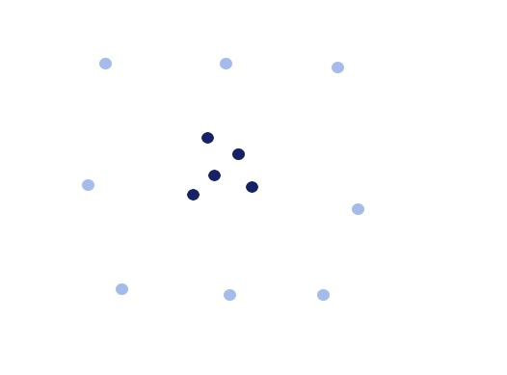
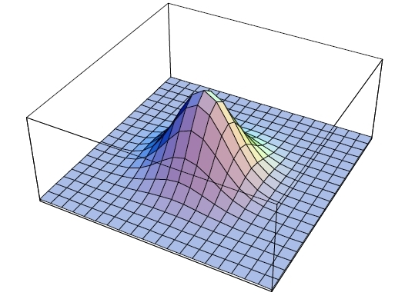
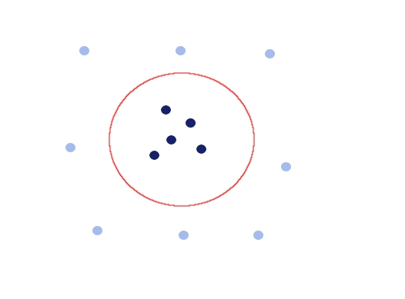
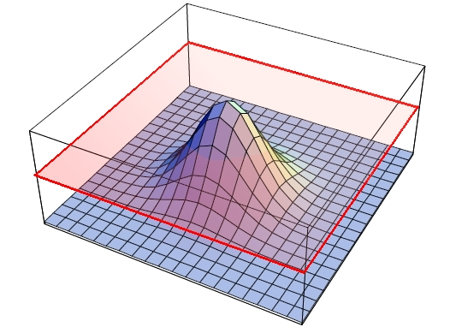
The kernel trick
To obtain greater separation between classes, nonlinearly embed points into a higher dimensional space

Slide 21
SVM classification
The robustness of SVM relies in the strong fundamentals of statistical learning theory
The training relies on optimization of a quadratic convex cost function, for which many methods are available
Available packages for R, Matlab, Weka include SVM-Lite and LIBSVM
These techniques can be extended to the nonlinear discrimination, embedding the data in a nonlinear space using kernel functions

Slide 22
A different approach: ReGEC
A binary classification problem can be formulated as a generalized eigenvalue problem (ReGEC)
Find x’w₁=γ₁ the closest to A and the farthest from B:
–
||
A
ω
−
e
γ
||
2
–
–
–
min
–
ω,
γ
≠
0
||
B
ω
−
e
γ
||
2
–
–
–
–
–
–
–
B
–
B
A
–
?
+
A
–
–
+
+
+
+
+
+
+
+
x’w₁=γ₁
+
+
+
+
+
O. Mangasarian, E. Wild Multisurface Proximal Support Vector Classification via Generalized Eigenvalues. IEEE PAMI 2006.

Slide 23
A different approach: ReGEC
A binary classification problem can be formulated as a generalized eigenvalue problem (ReGEC)
Find x’w₁=γ₁ the closest to A and the farthest from B:
–
||
A
ω
−
e
γ
||
2
–
–
–
min
–
ω,
γ
≠
0
||
B
ω
−
e
γ
||
2
–
–
–
–
–
–
–
B
–
+
B
A
–
?
+
A
–
–
+
+
+
+
+
+
+
+
x’w₁=γ₁
+
+
+
+
+
O. Mangasarian, E. Wild Multisurface Proximal Support Vector Classification via Generalized Eigenvalues. IEEE PAMI 2006.

Slide 24
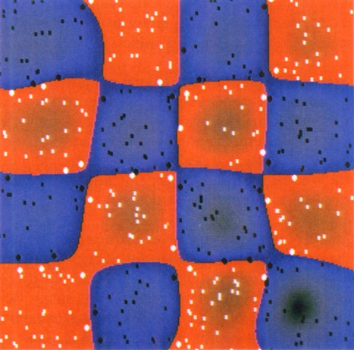
The kernel trick for ReGEC
The nonlinear embedding can be obtained with a RBF kernel function:
Each element of kernel matrix is:
Γ=[A^{T} B^{T}]^{T}
And the model becomes:
||
x
−
x
||
2
−
i
j
K
(
x
,
x
)
=
e
σ
i
j
||
A
−
Γ
||
2
−
i
j
K
(
A
,
Γ
)
=
e
σ
ij
||
K
(
A
,
Γ
)
u
−
e
γ
||
2
min
u
,
γ
≠
0
||
K
(
B
,
Γ
)
u
−
e
γ
||
2

Slide 25
ReGEC
||
K
(
A
,
Γ
)
u
−
e
γ
||
2
||
[
K
(
A
,
Γ
)
−
e
]
T
[
u
′
γ
]
′
||
2
min
=
min
Let
the equation becomes:
Rayleigh quotients of Gz = λHz.
u
,
γ
≠
0
||
K
(
B
,
Γ
)
u
−
e
γ
||
2
u
,
γ
≠
0
||
[
K
(
B
,
Γ
)
−
e
]
T
[
u
′
γ
]
′
||
2
G
=
[
K
(
A
,
Γ
)
−
e
]
T
[
K
(
A
,
Γ
)
−
e
],
H
=
[
K
(
B
,
Γ
)
−
e
]
T
[
K
(
B
,
Γ
)
−
e
],
z
=
[
u
′
γ
]'.
z
′
Gz
min
z
∈
R
n
+
1
z
′
Hz

Slide 26
Why another method?
ReGEC scales up with training set dimension
ReGEC is based on a generalized eigenvalue problem and its implementation is straight forward in many programming languages (Java, C++, C, Fortran…)
ReGEC reduces to 1 line of code in many problem solving environments! (Matlab, R, Weka,…)
It can be easily parallelized/distributed with existing software (ScaLAPACK, GridSolve,…)
http://www.na.icar.cnr.it/~mariog/regec.html

Slide 27
Tikhonov Regularization
Mangasarian et al. generate the two proximal surfaces:
Solving the regularized problem:
K
(
x
'
,
Γ
)
u
1
−
γ
=
0
K
(
x
'
,
Γ
)
u
2
−
γ
=
0
1
2
||
K
(
A
,
Γ
)
u
−
e
γ
||
2
+
δ
||
[u^{T}
γ ] ^{T}
||
2
min
u
,
γ
≠
0
||
K
(
B
,
Γ
)
u
−
e
γ
||
2
||
K
(
B
,
)
u
−
e
||
2
+
δ
||
[u^{T}
||
2
min
Γ
γ
γ ] ^{T}
u
,
γ
≠
0
||
K
(
A
,
Γ
)
u
−
e
γ
||
2

Slide 28
Approximate Regularization
A different regularization approach is:
K_{A} and K_{B} main diagonals of K(A, Γ) and K(B, Γ)
This approach halves the execution time, still providing similar accuracy results
Regularization is a form of robustification
~
||
K
(
A
,
Γ
)
u
−
e
γ
||
2
+
δ
||
K
u
−
e
γ
||
2
min
~
B
u
,
γ
≠
0
||
K
(
B
,
Γ
)
u
−
e
γ
||
2
+
δ
||
K
u
−
e
γ
||
2
A
~
~
MRG, C. Cifarelli, O. Seref, P. Pardalos. A Classification Method Based on Generalized Eigenvalue Problems, OMS,2007.
MRG, A. Irpino, R. Verde. Multiclass generalized eigenvalue proximal support vector machines, CISIS 2010.

Slide 29
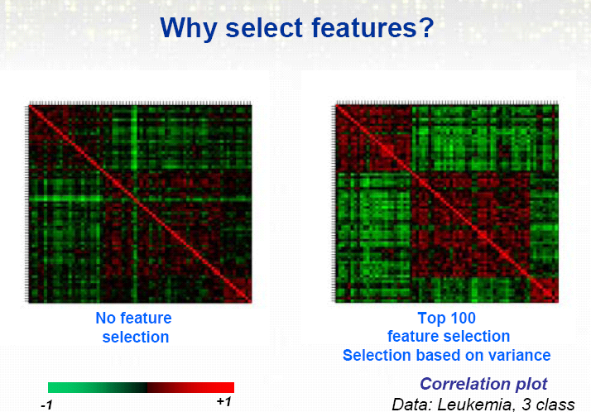
Gene selection

Slide 30
Feature selection types
Filters are based on intrinsic characteristics of features to reveal their discriminating power and do not depend on predictor. These methods select features by ranking.
Embedded do not separate the learning from the feature selection phase, thus embedding the selection within the learning algorithm. At the time of designing the predictor, these methods pick up the relevant features.
Wrappers depend on classifiers. Namely, each candidate subset is evaluated by analyzing the accuracy of a classifier.

Slide 31
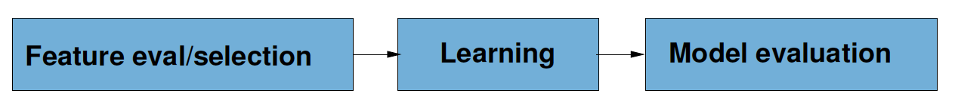
Filter
Variable selection takes place before learning
Selection criteria are independent of the learning algorithm
The method can provide a ranking of the features

Slide 32


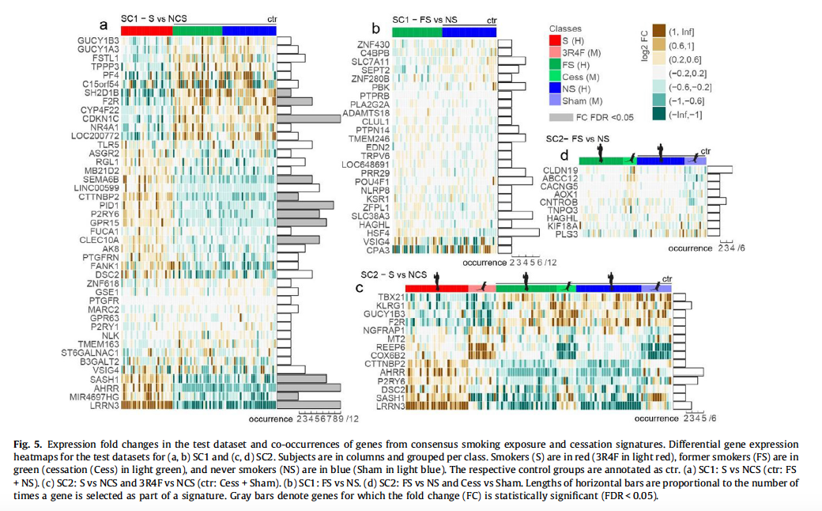
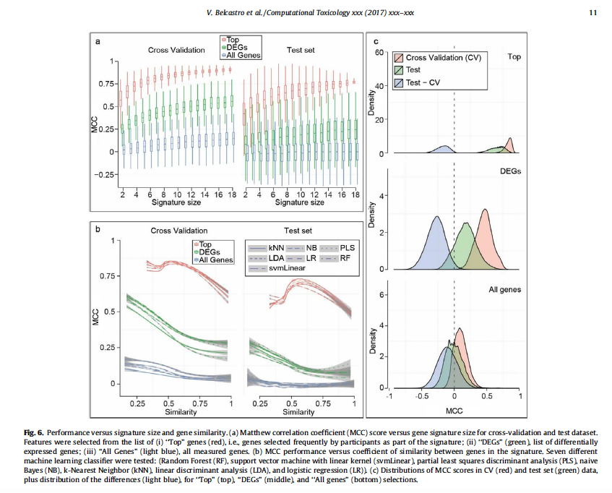
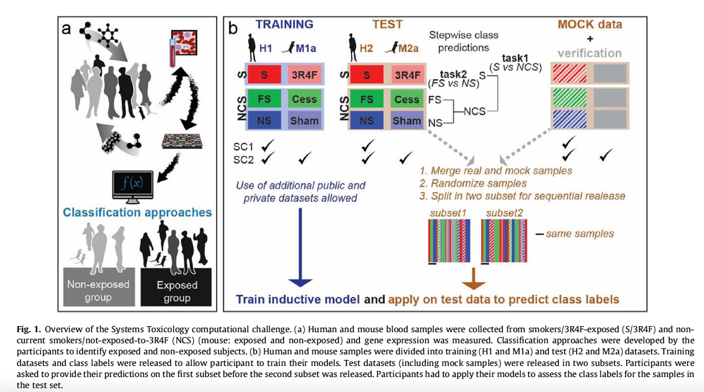

Classification of mRNA data
32

Slide 33
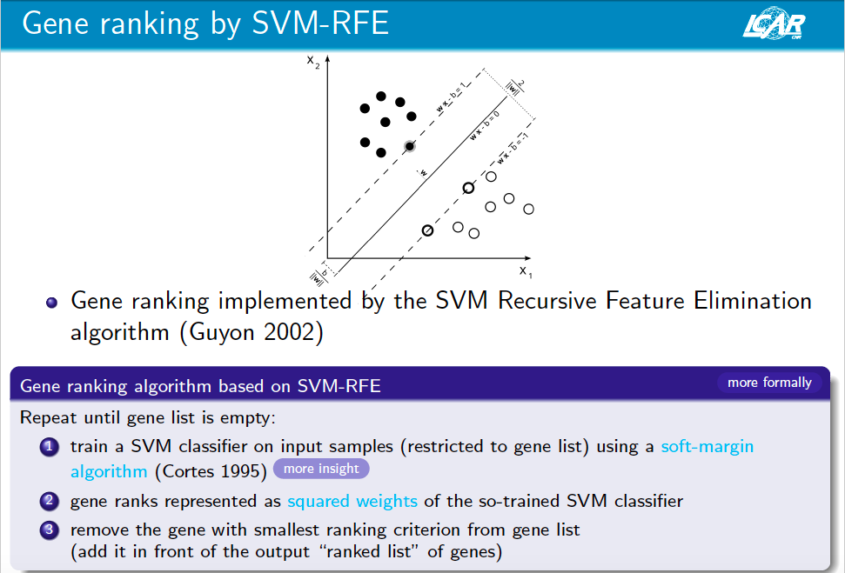

Slide 34
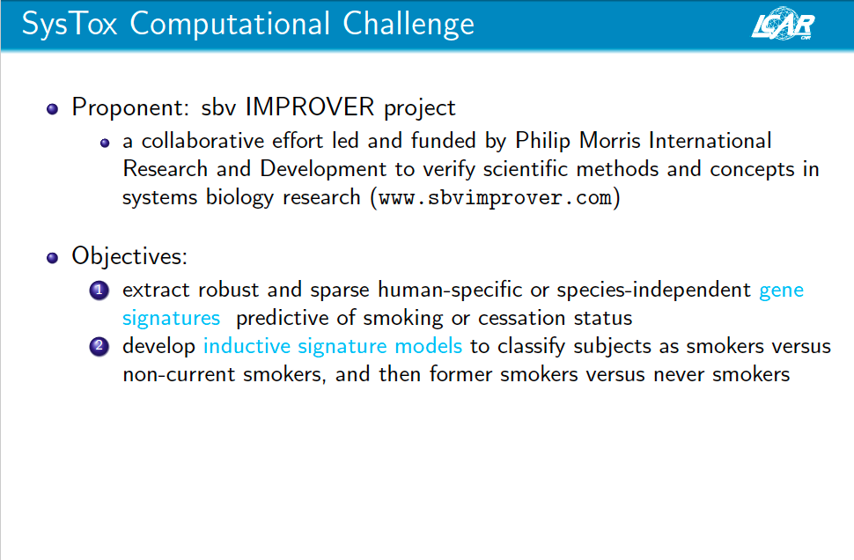

Slide 35
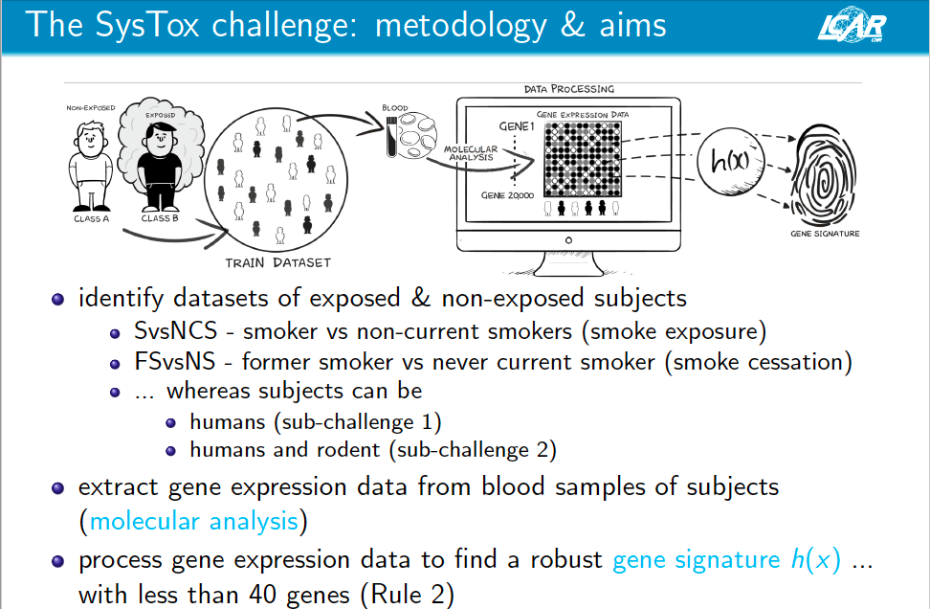

Slide 36
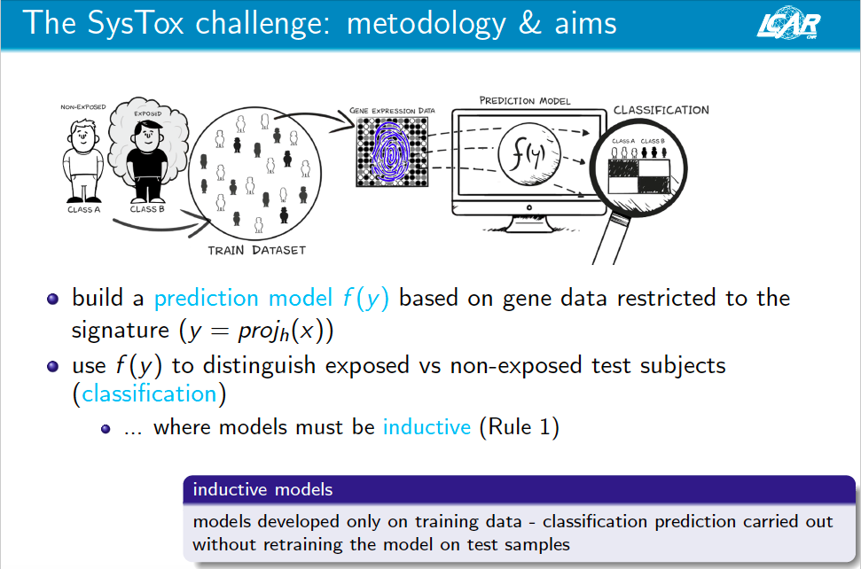

Slide 37
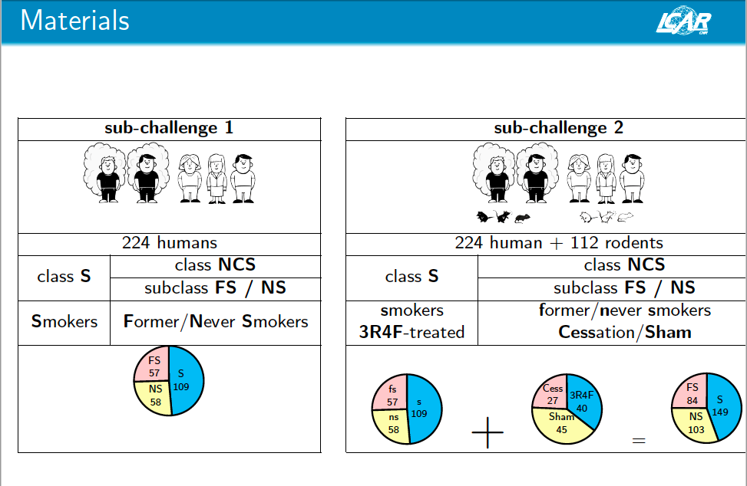

Slide 38
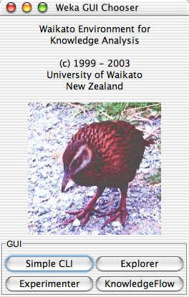
Classification in WEKA
https://tinyurl.com/y9l4x247
Mario.Guarracino@cnr.it

Slide 39
Conclusions
Data analytics is progressing at an unprecedented speed
Scientists and decision makers need new methodologies to have more insight in their data
Classification and clustering methodologies are needed to provide models based on large volumes of data, often noisy and incomplete

