Slide 1
HSE LIBRARY
Higher School of Economics, Moscow, 2014
www.hse.ru

Slide 2
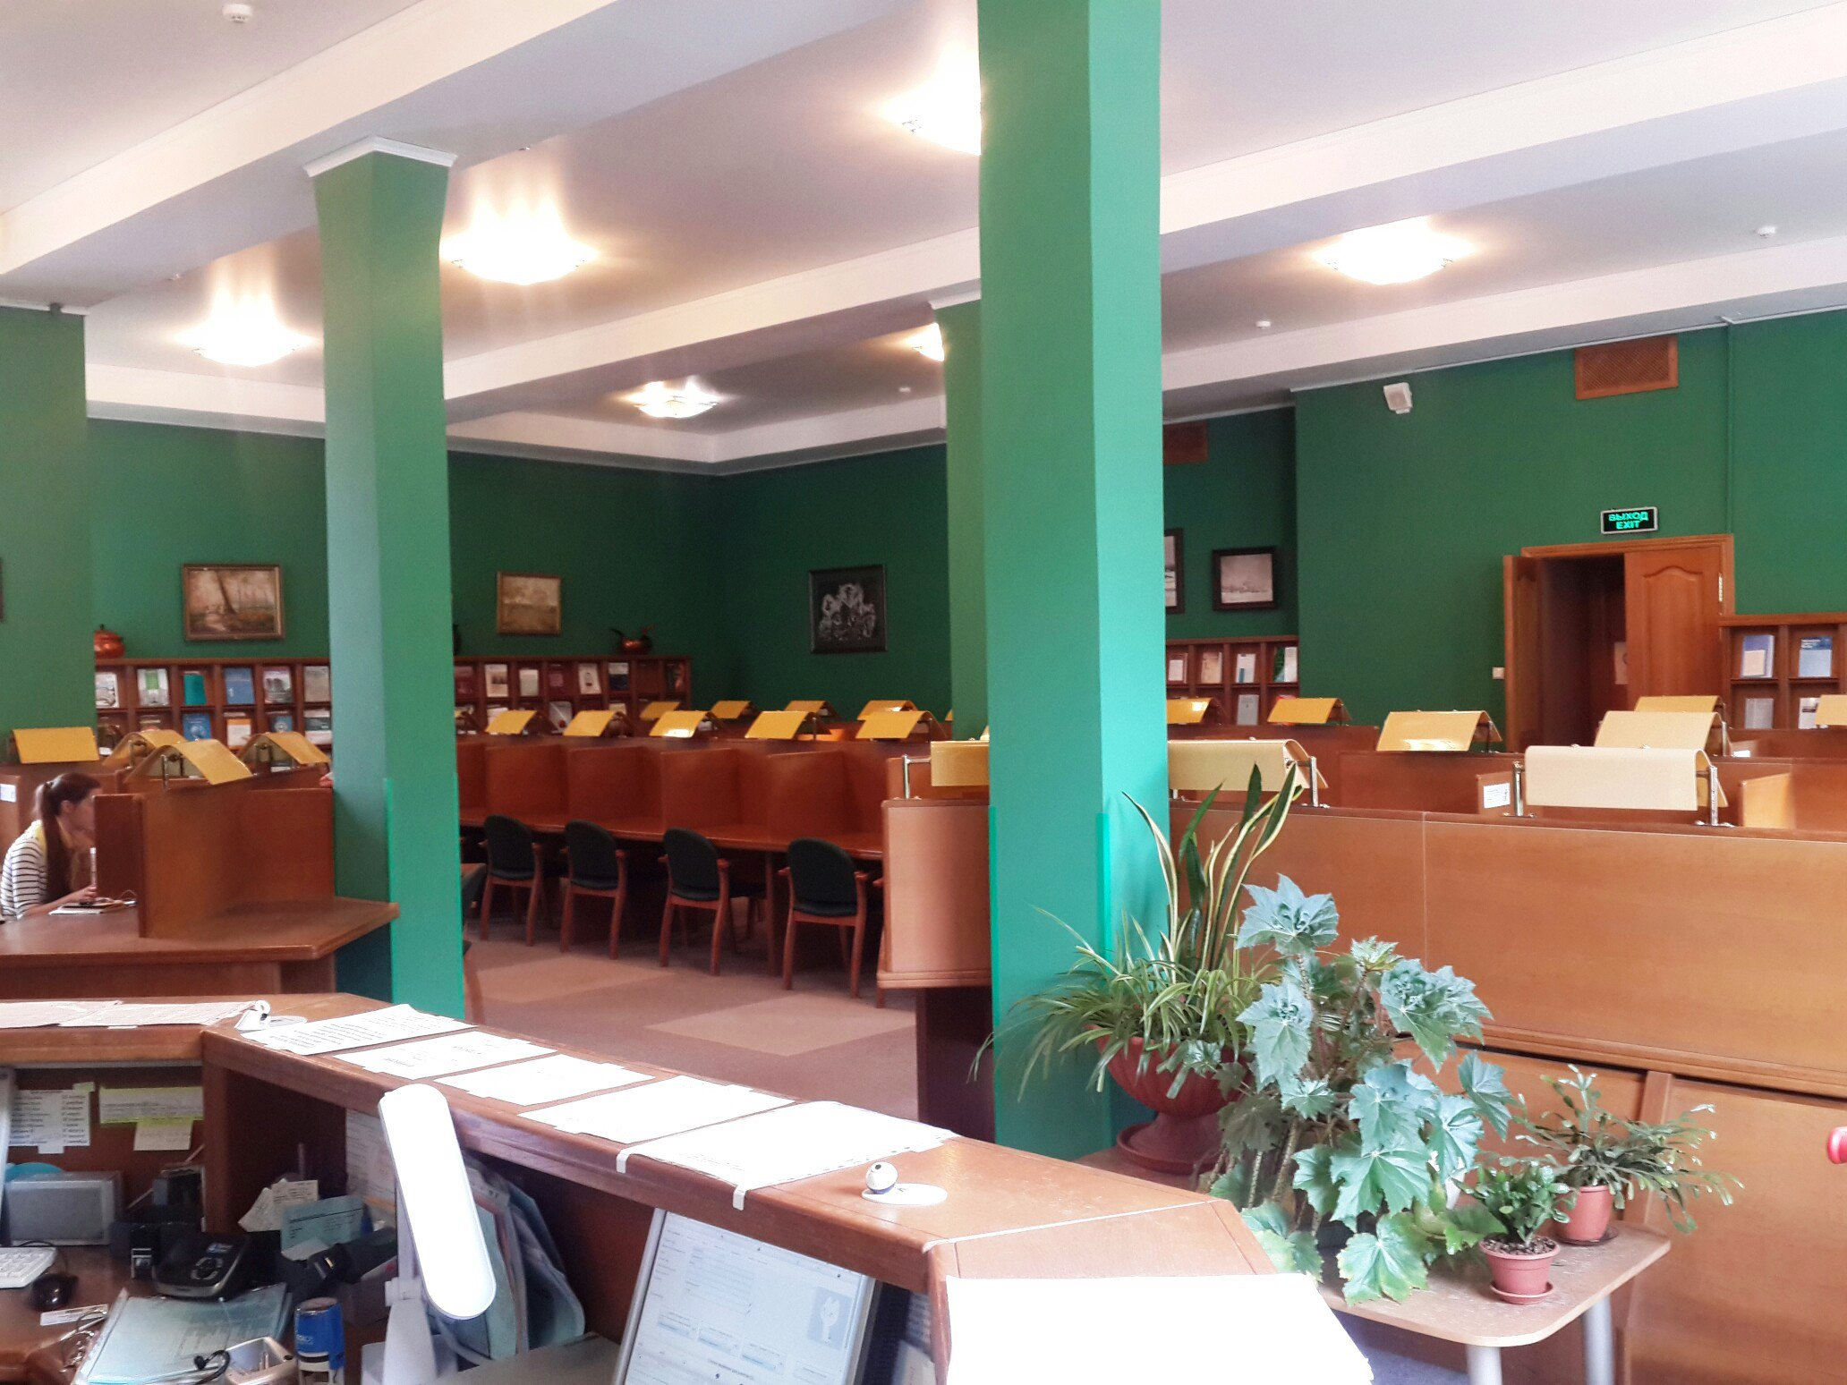
фото
фото
фото
Higher School of Economics, Moscow, 2014

Slide 3
фото
OVERVIEW
фото
фото
Higher School of Economics, Moscow, 2014

Slide 4
HSE LIBRARY’S MISSION
1
Foster education and research at the University through providing access to traditional printed materials, as well as digital publications.
2
Ensure that both the content and scope of the Library’s information resources are in line with relevant areas of research and fields of study in HSE degree programmes.
3
Improve the quality of information resources and library services, as well as boost the users’ overall information culture.
фото
фото
фото
Higher School of Economics, Moscow, 2014

Slide 5
FACTS
2
3
1
4
5
Today, its collection includes over 700,000 titles.
The Library subscribes to approximately 400 Russian periodicals and 130 international journals.
Today, the Library offers access to 30 platforms with electronic resources, including approximately 50,000 online journals and 170,000 ebooks, as well as over one million of full-text theses and dissertations.
The very first books for the HSE Library collection were purchased on May 12, 1993.
7
6
In 2017, the Library registered around 24,000 readers.
Over 800 readers visit the HSE Library every day.
Reading rooms can welcome up to 368 visitors.
The Library’s collections are housed at eight different locations.
фото
фото
фото
Higher School of Economics, Moscow, 2014

Slide 6
HSE LIBRARY ADDRESSES
Central Library
Reading room, Academic collection, Fiction collection, Media Library
20 Myasnitskaya Ulitsa (Lubyanka, Chistye Prudy, Turgenevskaya and Kitai Gorod Metro Stations)
Telephone number: +7 495 628 85 10
Library on Kochnovsky
Study collections of the Faculty of Humanities; Faculty of Economic Sciences; Faculty of World Economy and International Affairs; Faculty of Computer Science; Faculty of Social Sciences (except the Public Policy Department and the School of Psychology).
3 Kochnovsky Proezd (Aeroport Metro Station)
Telephone numbers: +7 499 152 16 61;
+7 499 152 06 01
фото
Library on Kirpichnaya
Reading room; Academic and Study collection of publications in management, logistics, computer engineering and related disciplines, Faculty of Media and Communications (except Fashion and Design Programs)
33/5 Kirpichnaya Ulitsa (Semenovskaya Metro Station)
Telephone number: +7 499 772 9590 ext. 55025
Library on Tryokhsvyatitelsky
3 Bolshoy Tryokhsvyatitelsky Pereulok
(Chistye Prudy and Kurskaya Metro Stations)
Telephone number: +7 (495)772-95-90 ext. 23025
Reading room. Publications in jurisprudence and related disciplines.
Library on Staraya Basmannaya
Reading room, Academic collection of publications in cultural studies, philosophy, logic, philology, linguistics, physics and related disciplines
21/4, Staraya Basmannaya Ulitsa
(Baumanskaya and Krasnye Vorota Metro Stations)
Telephone number: +7(495)7729590 ext. 22066
фото
MIEM Library
Reading room, academic and study collection of publications in computer engineering, mathematics, physics, chemistry and related disciplines
34 Tallinskaya Ulitsa (Strogino Metro Station)
Telephone number: +7(495)772-95-90 ext. 15241
Library on Pionerskaya
Reading room. Publications in arts and design.
12, Pionerskaya Ulitsa (Paveletskaya Metro Station)
Telephone number: +7 (495) 235-32-01
Library on Shabolovka
Reading room, Academic collection
26 Shabolovka Ulitsa, Korpus 3 (Shabolovskaya Metro Station)
Higher School of Economics, Moscow, 2014

Slide 7
OPENING HOURS
Reading
rooms
Monday – Friday: 10 am – 9 pm
Saturday: 10 am – 8 pm
Media Library
Monday - Friday: 12 noon – 8 pm
Academic collection
Monday - Friday: 12 noon – 8 pm
Saturday: 12 noon – 6 pm
Study collection
Monday, Wednesday, Friday: 12 noon – 4 pm
Tuesday, Thursday: 5 pm – 9 pm
Saturday: 10 am – 2 pm
Fiction collection
(Preliminary booking via the user’s personal account in the eCatalogue is required)
Tuesday, Thursday: 12 noon – 6 pm
Registration
Monday - Friday: 12 noon – 8 pm
Saturday: 12 noon – 6 pm
Saturday: 12 noon – 6 pm
фото
фото
фото
All Library subdivisions are closed for routine maintenance on the first Friday of every month.

Slide 8
REGISTRATION
Please take the following steps to register with the HSE Library:
Present your passport and student ID card (doctoral/postdoctoral student certificate, or alumnus/learner card) or staff ID badge;
фото
Make sure to familiarize yourself with the Library Use Policy https://library.hse.ru/en/reg_library
фото
Fill in a registration form (you can fill in your registration form online and print it out in advance, so as to speed up the registration process).
Sign your registration form to acknowledge that you have read and understood the Library Use Policy.
фото
Higher School of Economics, Moscow, 2014

Slide 9
LOAN PERIOD AND THE MAXIMUM NUMBER OF ITEMS THAT CAN BE CHECKED OUT AT ANY ONE TIME
Academic collection
15 days*
5 items
фото
Study collection
Module**
25 items
Fiction collection
15 days*
5 items
фото
* Users can request an extension of the loan period for documents borrowed from the academic and fiction collection personally, by phone or via the user’s personal account in the eCatalogue of the Library, provided that these publications are not requested by other readers.
** Deadlines for returning all documents are as follows:
Module 1 – November 15;
Module 2 – January 25;
Module 3 – April 15;
Module 4 – July 15.
фото
Higher School of Economics, Moscow, 2014

Slide 10
USING BORROWED ITEMS UPON EXPIRY OF THE DUE DATE
*** Starting from the day following the deadline stipulated by the Library, you will have to pay* for using the overdue items, pursuant to the procedure established in the Library Use Policy, unless the documents haven’t been returned in due time for a valid reason supported by relevant evidence. If you lose any Library documents, you will need to replace them with identical editions or other documents deemed as equivalent by the Library. In case of any damage to the document, you will have to cover the expenses for its restoration.
фото
Fiction collection
*30 roubles
1 document / 1 day
фото
Academic collection
*50 roubles
1 document / 1 day
Study collection
*30 roubles
1 document / 1 day
фото
Higher School of Economics, Moscow, 2014

Slide 11
RULES OF CONDUCT ACCORDING TO THE LIBRARY USE POLICY
Dear visitors!
We kindly ask you to:
фото
Leave your bags in the storage room, and outerwear in the cloakroom
Show your library card at the checkpoint upon entering the Library
Observe silence
Treat the Library’s premises, furniture and equipment with due care
фото
Keep the Library’s reading rooms and other facilities clean and tidy
Use mobile phones in specially designated areas only
фото
Higher School of Economics, Moscow, 2014

Slide 12
HSE Library
E-Catalogue
фото
Higher School of Economics, Moscow, 2014

Slide 13
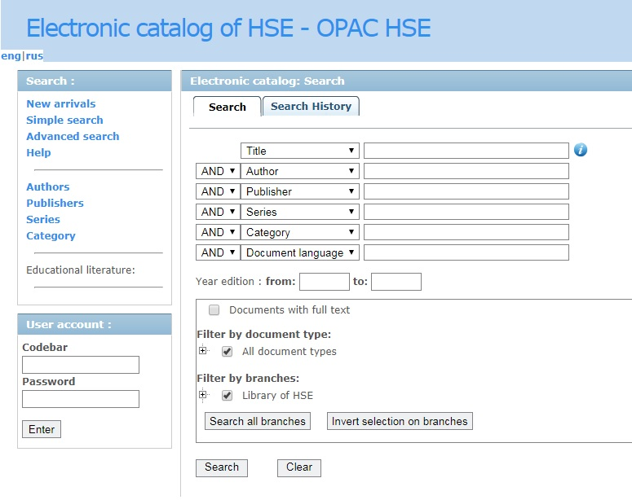
HSE Library eCatalogue
You can search relevant items, book publications and access your personal account via the eCatalogue on the Library’s web-site http://opac.hse.ru/absopac/.
фото
фото
фото
Higher School of Economics, Moscow, 2014

Slide 14
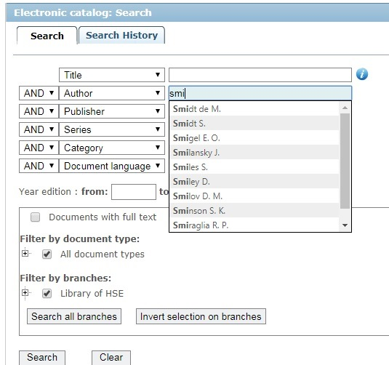
SEARCH QUERIES
You can use the following criteria to search for publications:
Title
Author
Publisher
Series
Category
Language
Furthermore, you can specify the year of publication, type of a document or a place of storage at the Library. When you start typing your query, up to 10 options may pop up.
фото
фото
фото
Higher School of Economics, Moscow, 2014

Slide 15
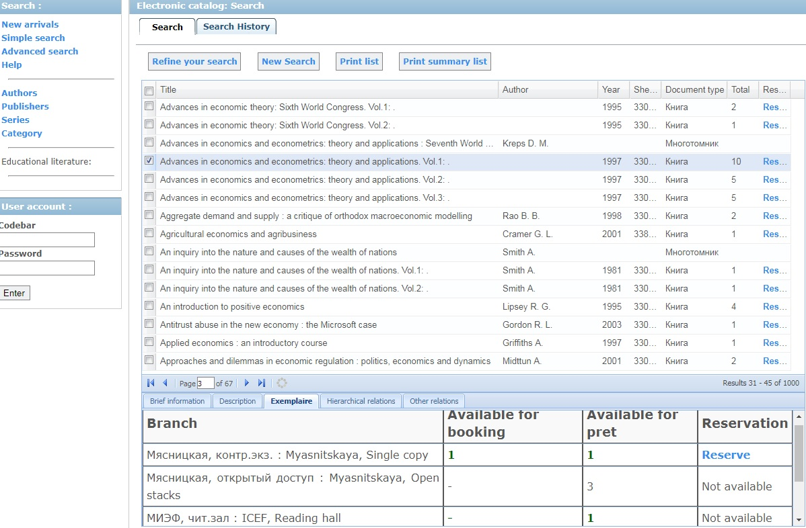
SEARCH QUERIES
DOCUMENTS FOUND IN THE SEARCH RESULTS
фото
фото
Higher School of Economics, Moscow, 2014

Slide 16
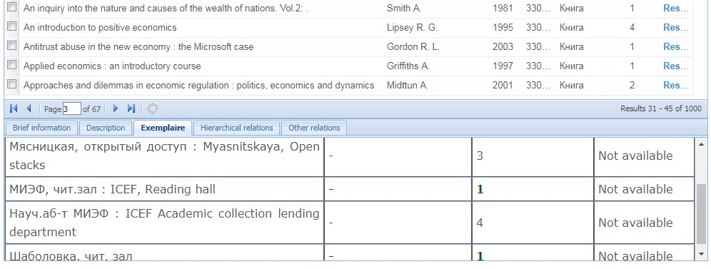
SEARCH QUERIES
DOCUMENTS FOUND IN THE SEARCH RESULTS
Select the required publication and click on the “Exemplaires” tab to see where the publication is stored. Home loan option is available for publications from the academic, fiction and study collections.
фото
фото
фото
Higher School of Economics, Moscow, 2014

Slide 17
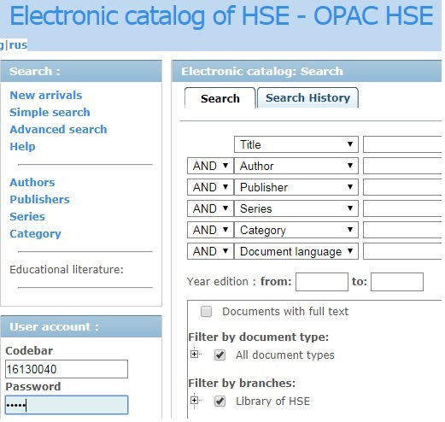
SEARCH QUERIES
DOCUMENTS FOUND IN THE SEARCH RESULTS
If only one copy of a book is available at the Library, it should be booked in advance. Type the number of your library card (barcode) and your name (as it appears on your library card in Russian). The same information shall be used to access your Personal account in the eCatalogue.
фото
фото
фото
Higher School of Economics, Moscow, 2014

Slide 18
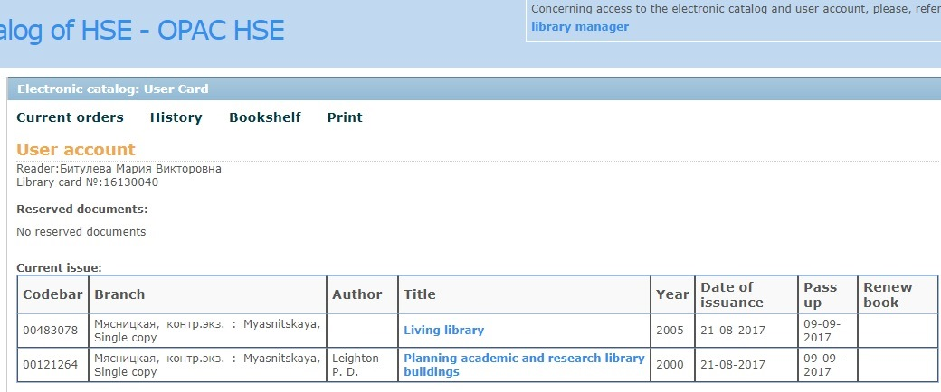
PERSONAL ACCOUNT
You can use your personal account to:
Learn the date when you are expected to return the borrowed publications;
View the list of your borrowed books;
Submit a request for extension of your home loan period.
фото
фото
фото
Higher School of Economics, Moscow, 2014

Slide 19
Website
Access to
Electronic resources
фото
фото
фото
Higher School of Economics, Moscow, 2014

Slide 20
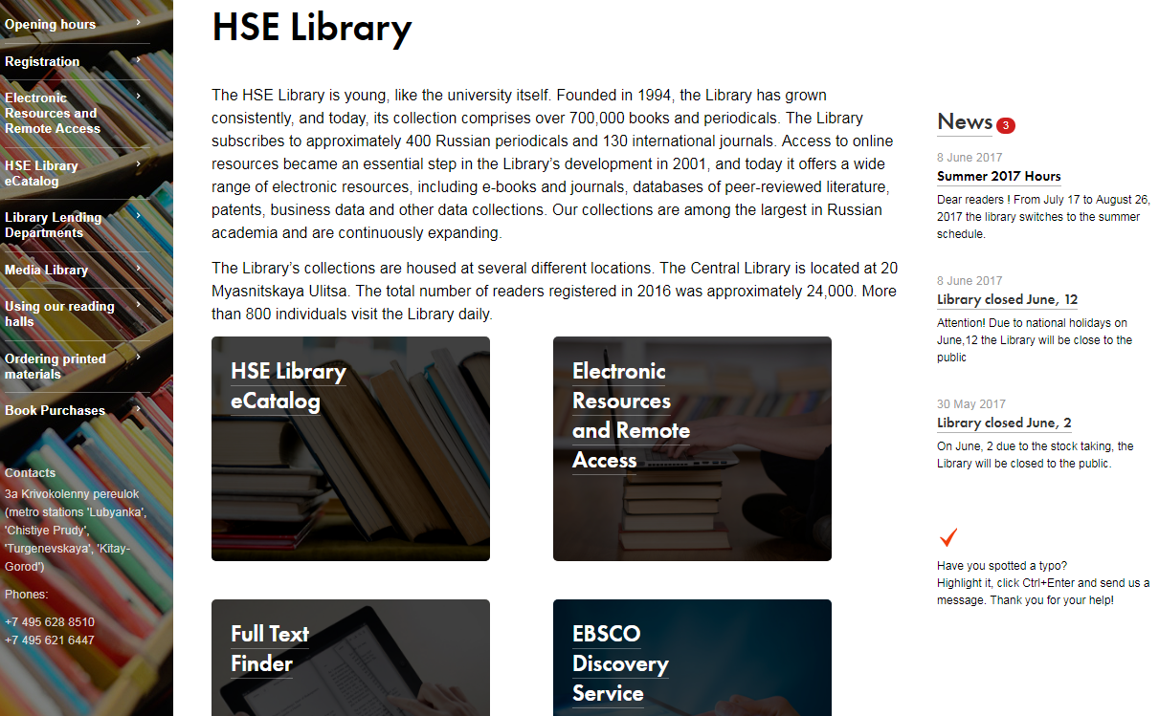
WEB-SITE
http://library.hse.ru/EN
Information on all HSE Library subdivisions
фото
Access to the HSE Library’s electronic resources
фото
Access to the eCatalogue
фото
Higher School of Economics, Moscow, 2014

Slide 21
HSE LIBRARY ELECTRONIC RESOURCES
Approximately 50,000 online scientific, popular science and industry-specific journals
фото
Over 170,000 ebooks
фото
Over one million of full-text theses and dissertations
фото
Higher School of Economics, Moscow, 2014

Slide 22
HSE LIBRARY ELECTRONIC RESOURCES: JOURNALS
(The full list is available on the Library’s web-site)
Over 1,700 journals published by Elsevier in all subject areas, including publications in Economics, Business, Social Sciences, Psychology, Mathematics, Informatics, Engineering, Physics, etc. The scope varies from one publication to another, most titles have been published since 2000 to the present day; many publications are available in “deep archives”, since 1994 back to the very first issue.
Over 200 journals published by Oxford University Press in a whole range of subject areas (approximately 100 publications in social sciences and humanities). Offers publications from the very first issue (full archives) to the present day.
Over 120 current and several dozens archived (discontinued) journals published by the Emerald publishers (former MCB University Press). Emerald is known as the leader in the market of professional periodicals in business and management, including, in particular, the well-known European Journal of Marketing and TQM Journal. Most journals are featured from the very first issue to the present day, without embargo.
фото
Over 350 journals published by the Cambridge University Press in a whole range of subject areas (approximately 110 titles in social sciences and humanities). Offers publications from the very first issue (full archives) to the present day.
Journals published by the American Economic Association, including the well-known American Economic Review, Journal of Economic Literature, Journal of Economic Perspectives. This is the only database that offers the most recent AEA journals issues , without embargo.
фото
Higher School of Economics, Moscow, 2014

Slide 23
HSE LIBRARY ELECTRONIC RESOURCES: E-BOOKS
(The full list is available on the Library’s web-site)
фото
Approximately 110 ,000 full-text books in various disciplines, with a special focus on social sciences, economics and business. Furthermore, publications in applied informatics, political science, sociology, and philology are available, as well as fiction. Most books have been published in the most recent 7-9 years by major academic publishers: Cambridge University Press, John Wiley & Sons, Palgrave MacMillan, Routledge, Elsevier Science, etc.
Around 3,000 volumes of full-text books published by Elsevier, including publications in finance (over 150 books), business and management (over 500 books), computer science (over 870 books), mathematics (over 1020 books) and psychology (over 360 books). Furthermore, publications include 29 multi-volume handbooks in different areas of economics and encyclopedias in psychology, social sciences, education and archeology.
Four collections of full-text books in business, finance, information technologies and technical sciences, in total, over 29,000 publications. Materials of the leading publishers (including Elsevier, John Wiley & Sons, IBM Press, Cisco Press, OUP, CUP ,etc.) are also available.
фото
The Oxford Reference Online Premium encyclopaedias contain electronic versions of approximately 220 Oxford encyclopaedias, reference books and dictionaries. Books collection also includes linguistic dictionaries and reference books dedicated to the Internet, informatics, history, literature, medicine, political science, mathematics and statistics, etc.
Over 8,000 books by the Oxford University Press, in the following categories: economics and finance, business and management, political science, law, mathematics, psychology, philosophy, religious studies and history. All books are available in full-text format, and over fifty percent of all books have been published in the recent six years.
Over 340 reference books in the Oxford Handbooks series give a comprehensive overview of various subject areas, provide relevant background, conceptual framework and related challenges, as well as current discussions and prospects for said subject areas. They resemble encyclopaedic articles presented as books. Reference books in business and management, economics and finance, political science, psychology, law, philosophy and religious studies are available.
фото
Higher School of Economics, Moscow, 2014

Slide 24
ACCESS TO ELECTRONIC RESOURCES
Access to all electronic resources is available without a login and password from any HSE-based personal computer operating via local network or Wi-Fi.
фото
All electronic resources are available without a login and password on HSE Media Library computers at 20, Myasnitskaya Ulitsa.
фото
To get remote access to electronic resources, please get a login and password (see below)
фото
Higher School of Economics, Moscow, 2014

Slide 25
REMOTE ACCESS TO ELECTRONIC RESOURCES
IN ORDER TO GET REMOTE ACCESS TO THE LIBRARY’S ELECTRONIC RESOURCES:
фото
you must be registered at the Library and have no overdue items
go to page Electronic Resources on the Library’s website and click the link “Remote Access to Electronic Resources”
read the Regulations for Obtaining Remote Access and submit your registration form
фото
You will then receive an email with your login, password and relevant instructions for your account activation. If you used the same email for your registration at the Library and in your e-resource registration form, your account will be activated automatically. Otherwise, in order to activate your account, please visit the office specified in the email you received from the Library and present your passport and library card.
фото
Higher School of Economics, Moscow, 2014

Slide 26
ELECTRONIC RESOURCES USER GUIDE
Users must refrain from: making copies of all materials (i.e., all articles in a journal issue, all chapters of an e-book or all search query results), or create large volumes of copied materials (including electronic library contents) on electronic or printed media.
фото
Using bots (i.e., programmes capable of performing automatic or scheduled actions similar to those of a user, including searches, opening or downloading materials from e-library websites).
Using an electronic library resources and their contents for purposes outside of research, analysis, preparation of publications, articles and other materials (i.e., sale/resale of downloaded materials or deriving any other commercial benefits).
фото
Making e-library content publicly available on the Internet, in social media and on other websites without permission of the copyright holders and other providers;
Sending materials via e-mail, etc., to persons without access to HSE’s e-library.
.
Users in violation of the requirements set forth in these Procedures shall be liable for their actions in accordance with Russian legislation and HSE’s bylaws.
фото
Higher School of Economics, Moscow, 2014

Slide 27
фото
FREQUENTLY ASKED QUESTIONS
фото
фото
Higher School of Economics, Moscow, 2014

Slide 28
WHAT SHALL I DO IF…
You have lost
your library card
You can ask the Library to issue a duplicate of your library card. To that end, you must present your student ID card (your passport, if you are a student of HSE Lyceum), doctoral/postdoctoral student certificate, or alumnus/learner card) or staff ID badge.
фото
You have lost a book
Contact the Library’s department where you borrowed the lost book/publication and make arrangements for replacing it with an equivalent publication, upon the Library’s consent.
Make sure to promptly replace the lost book/publication, because you will be charged a fee for using materials after the expiry of the due date for returning your books.
You cannot find a book
Ask a librarian for help.
фото
Requested study materials are not available
Ask the lecturer to submit an application for acquisition of the required materials.
Study materials shall be purchased pursuant to the established requirements for the acquisition of books at universities - 0.25 copies per student (for books included in the list of mandatory study materials of the course syllabus).
фото
Higher School of Economics, Moscow, 2014

Slide 29
Please feel free to contact the Library staff for more information, or send your enquiries by e-mail to mbituleva@hse.ru Tel.: 8(495)772 9590 ext. 12569 Maria Bituleva
фото
фото
фото
Higher School of Economics, Moscow, 2014

