Slide 1
International Laboratory of Decision Choice and Analysis, HSE
DEA for the Assessment of Regions Ability to Cope with Disasters
F. Aleskerov, S. Demin
Kalamata, 2019

Slide 2
International Laboratory of Decision Choice and Analysis, HSE
Structure
Motivation
Problem statement
Models:
Basic DEA model
DEA model with exclusion
Best tube DEA
Pareto DEA
Application
Conclusion

Slide 3
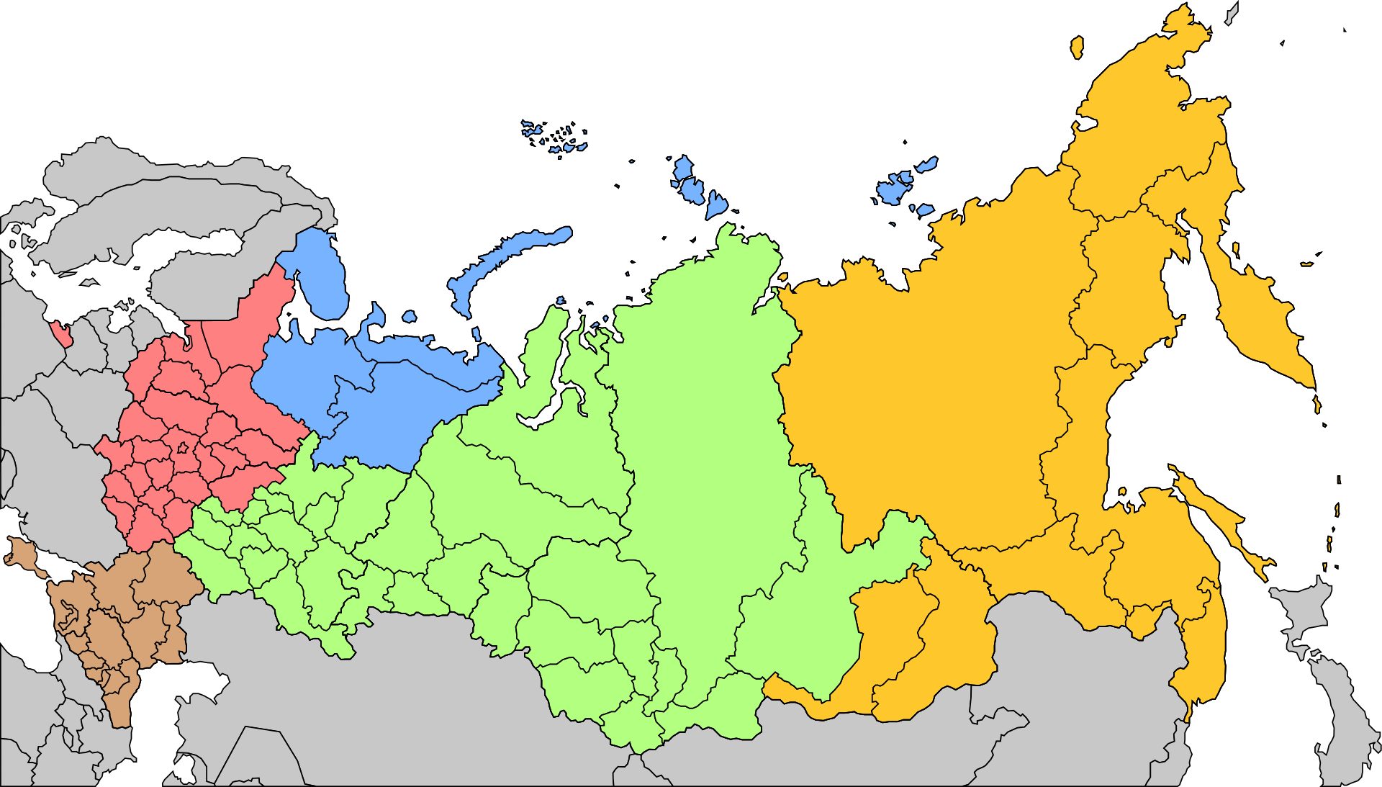
International Laboratory of Decision Choice and Analysis, HSE
Motivation

Slide 4
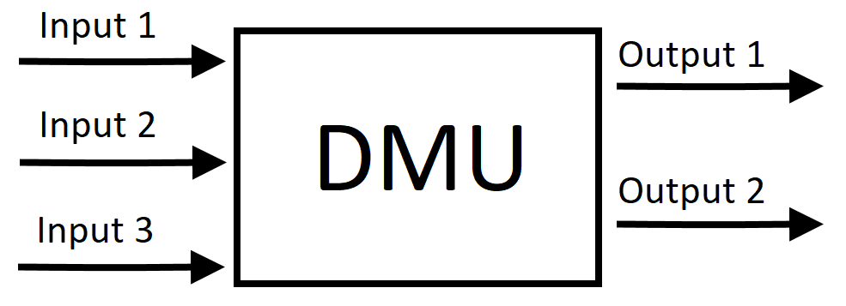
International Laboratory of Decision Choice and Analysis, HSE
Problem statement
Efficiency?

Slide 5
International Laboratory of Decision Choice and Analysis, HSE
Basic DEA model
$$\max_{u_{i},v_{j}}\left(e_{k}=\frac{\sum_{i=1}^{M}{u_{i}x_{ik}}}{\sum_{j=1}^{N}{v_{j}y_{jk}}}\right)$$
$$\left\{\begin{aligned}\frac{\sum_{i=1}^{M}{u_{i}x_{ik}}}{\sum_{j=1}^{N}{v_{j}y_{jk}}}≤1, k=1,…,R \\ u_{i}>0 ∀i \\ v_{j}>0 ∀j\end{aligned}\right.$$
$e_{k}$ – efficiency of k-th decision making unit (DMU)
$u_{i}, v_{j}$ – weight coefficients, that illustrate the importance of appropriate parameters
$x_{ik}$ – output parameters, which show achieved results
$y_{jk}$ – input parameters, which show spent resources
$M$ – number of output parameters; $N$ – number of input parameters; $R$ – number of DMUs

Slide 6
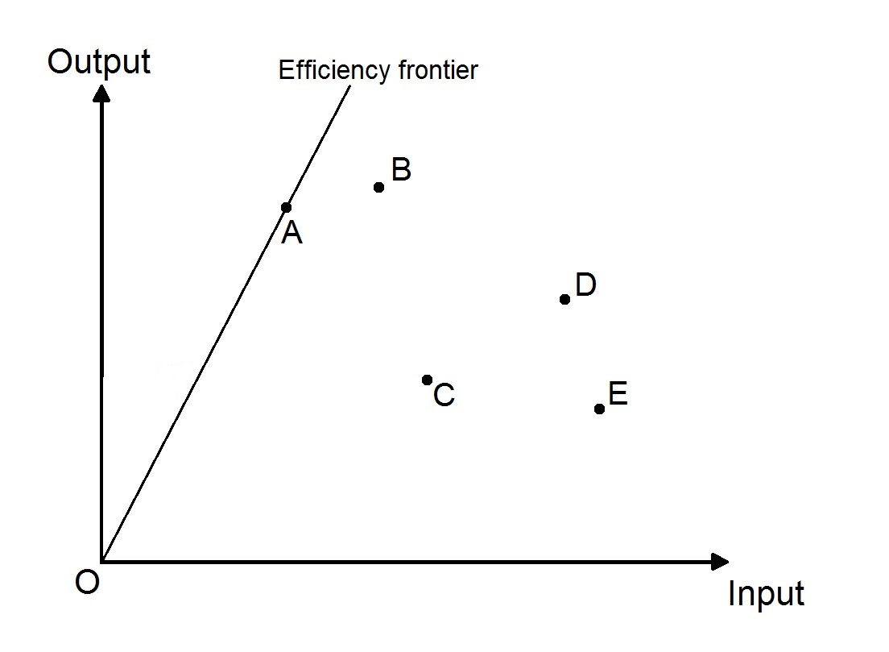
International Laboratory of Decision Choice and Analysis, HSE
Basic DEA model

Slide 7
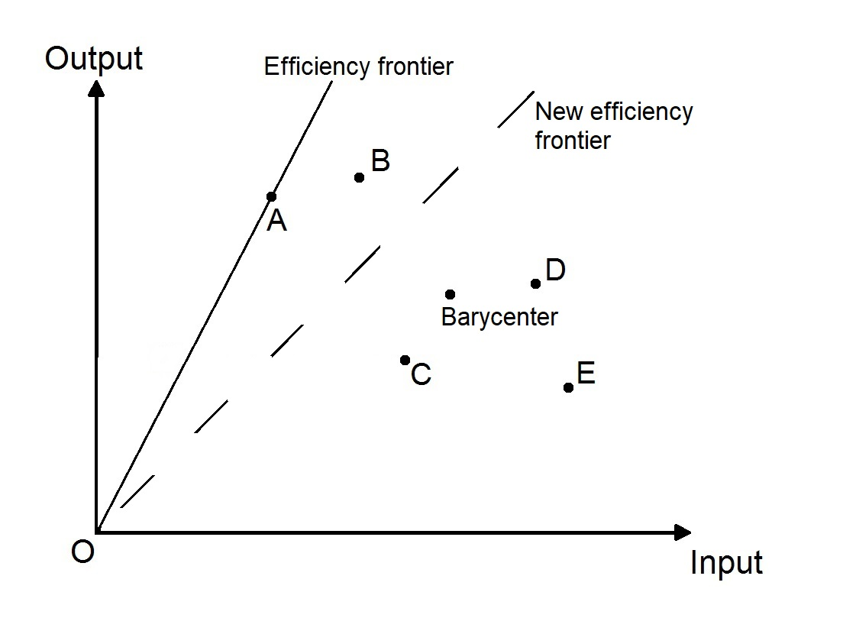
International Laboratory of Decision Choice and Analysis, HSE
DEA model with exclusion
Each iteration of assessment consists of 3 steps:
Finding the barycenter
Choosing the new efficiency frontier (NEF)
$$NEF=µ∗Barycenter+\left(1−µ\right)∗EF$$
Calculating efficiency

Slide 8
International Laboratory of Decision Choice and Analysis, HSE
Uncertainty in data

Slide 9
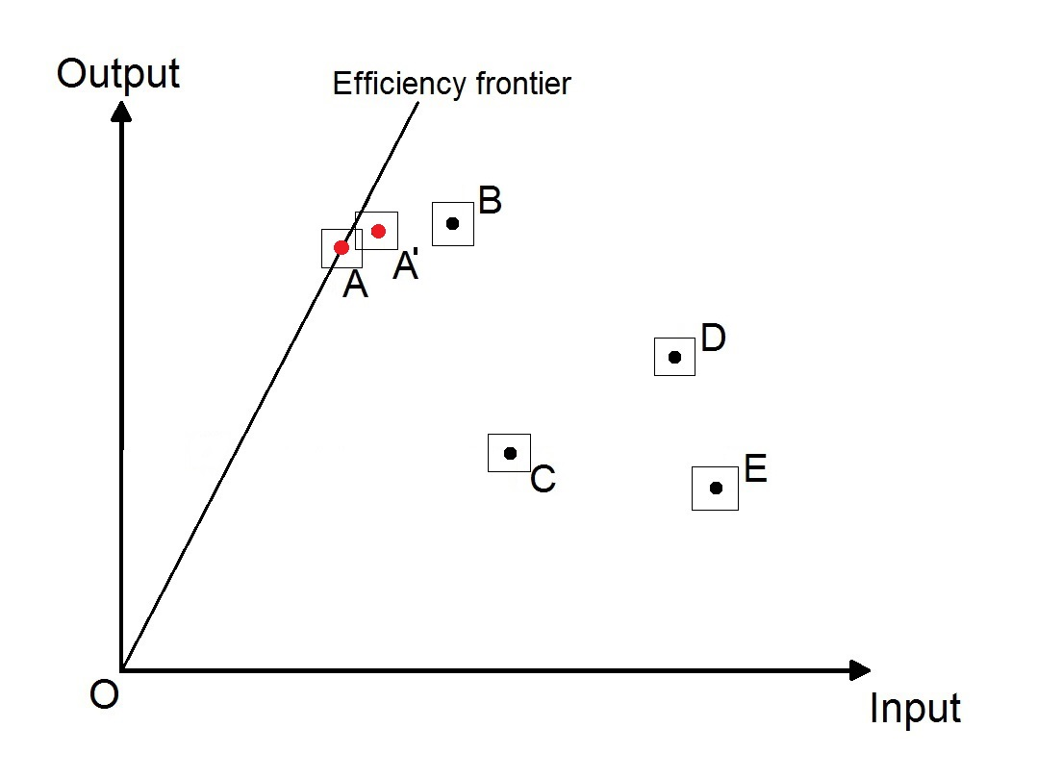
International Laboratory of Decision Choice and Analysis, HSE
Best tube DEA
First step – elimination of best and incompatible with them DMUs
Second step – basic DEA (might be applied DEA modification with exclusion of elements)

Slide 10
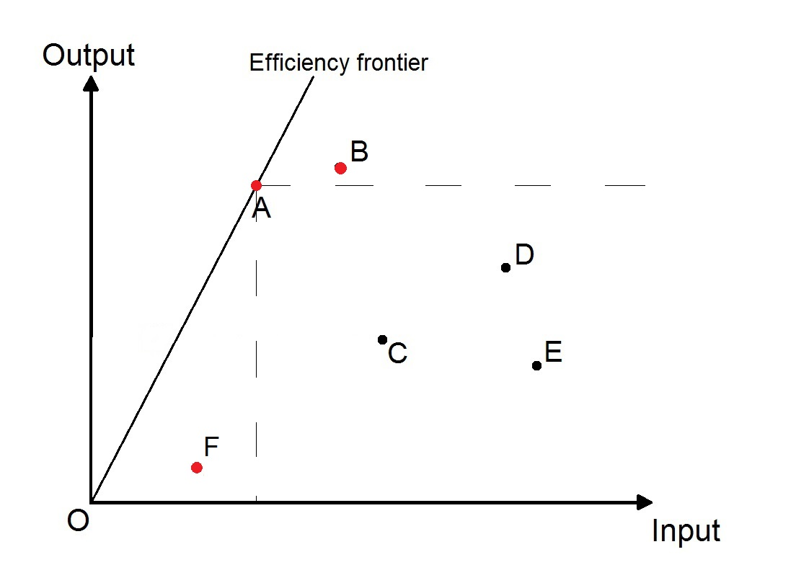
International Laboratory of Decision Choice and Analysis, HSE
Pareto DEA
First step – elimination of Pareto-optimal DMUs
Second step – basic DEA (might be applied DEA modification with exclusion of elements)

Slide 11
International Laboratory of Decision Choice and Analysis, HSE
Application
Inputs:
Expenditures for the new technologies
Expenditures for the security provision
Outputs:
Number of wildfires
Area covered with wildfires
Number of accidents on plants

Slide 12
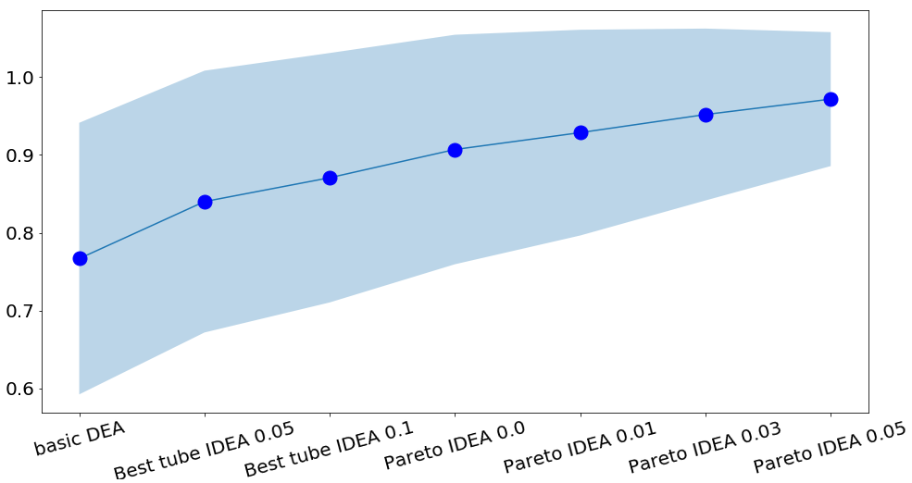
International Laboratory of Decision Choice and Analysis, HSE
Application (no exclusion)

Slide 13
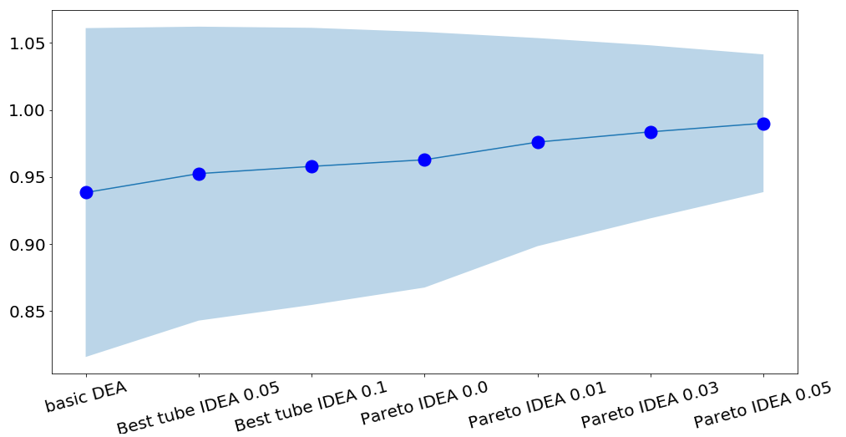
International Laboratory of Decision Choice and Analysis, HSE
Application (with exclusion)

Slide 14
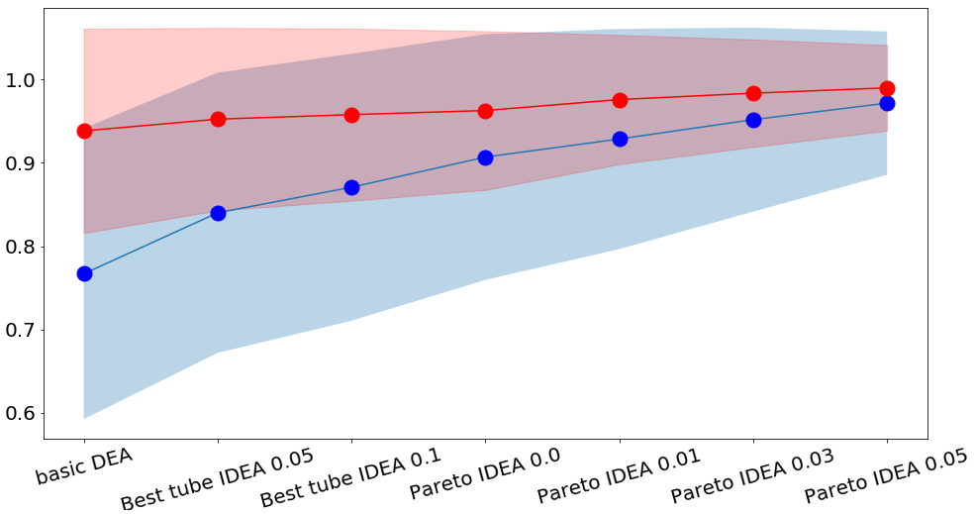
International Laboratory of Decision Choice and Analysis, HSE
Application

Slide 15
International Laboratory of Decision Choice and Analysis, HSE
Conclusion
Proposed interval modifications of DEA help to assess the efficiency of the decision-making units (DMUs) in case of uncertainties in the data.
Proposed methods pay more attention to the distribution of the data (DMUs’ features). As a result, the efficiency assessment is more “polite”.
Increasing the uncertainty in the data leads to improvement of the efficiency assessment according to the proposed interval methods.

Slide 16
Thank you
for your attention!
www.hse.ru/DeCAn/

