Slide 1
Department of Foreign Languages
Teaching Life Hacks (from ICELT Cambridge Approach)
Perm, 2 November, 2019

Slide 2
Department of Foreign Languages
Plan
Some Teaching Approaches
Factors Affecting Learning
What is valuable for a good practical class?
Soft skills development
Note taking methods
Questions
Conclusion

Slide 3
Some Teaching Approaches
Teacher Fronted Approach
Test-Teach-Test
Guided discovery
4. Skill-oriented Approach

Slide 4
Department of Foreign Languages
.
Factors Affecting Learning
Outside Learners (the learning environment, teaching methods, teaching material, other students, the teacher, other factors)
Inside Learners (reasons for learning/motivation, student’s learning preferences, student’s personality, gender, background, student’s previous experience, student’s attitude to the subject, other factors)

Slide 5
Department of Foreign Languages
What is valuable for a good class?
Practical (students’ involvement)
Supported
Meaningful
Purposeful
Enjoyable
Social
https://mm.tt/1352743346?t=AxmApEzNE3

Slide 6
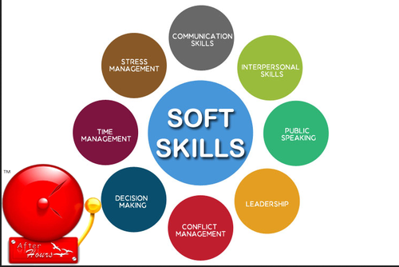
Department of Foreign Languages
Soft skills development
Engage students (pictures, video, reading, listening, prediction, brainstorming, games, etc.)
Support Students for generating ideas
Provide feedback on the achievement of the task

Slide 7
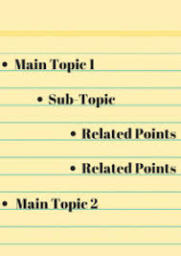
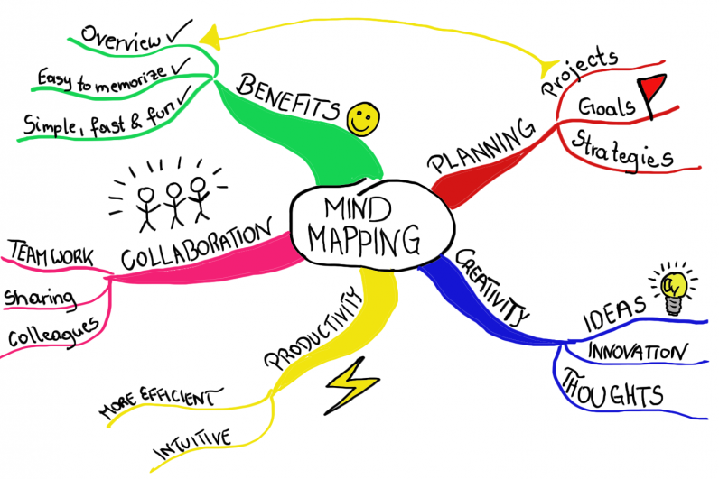
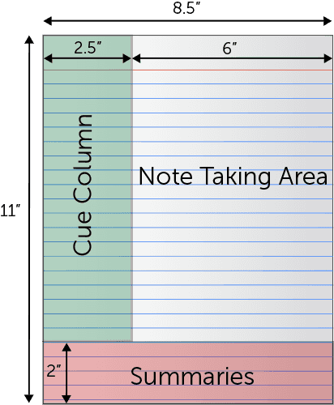
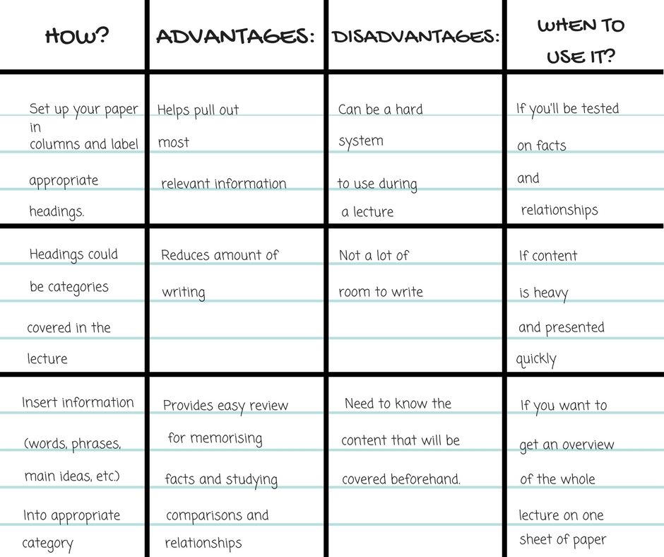
Department of Foreign Languages
Note Taking methods
Mind map
Outlining method
Cornell method
Charting method

Slide 8
Department of Foreign Languages
Questions
Why is pair/group work important?
What is important when you give instructions?
What is eliciting? Why do we do it? (CCQs)
How do we create a feeling of pace and progression?

Slide 9
Thank you for your attention!
Phone.: +7 912 313 69 10
okaramalak@hse.ru

