Slide 1
Does government support of leading universities affect the entire higher education system? Evidence from the Russian University Excellence Initiative
Andrey Lovakov, Anna Panova, Ivan Sterligov, Maria Yudkevich
CInSt Research Seminar 27.02.2020

Slide 2
The main question
What are the effects of excellence initiative on the national system?
Targeted government intervention: small number of universities and huge budget.
Even though lots of research has been done on direct effects of the excellence academic initiatives, still little is known about impact on the national systems. (Kehm, 2014; Shin&Jang, 2012; Cremonini et al., 2013)

Slide 3

Russian University Excellence Initiative
The goal of this project is to improve the competitive position of a group of leading Russian universities in the global research and education market. (2013-2020).
significant impact on the leading Russian universities
(Turko et al., 2016, Poldin et al., 2017, Guskov et al., 2018,… )
impact on the other universities ????
new growth point or just redistribution of resources?

Slide 4
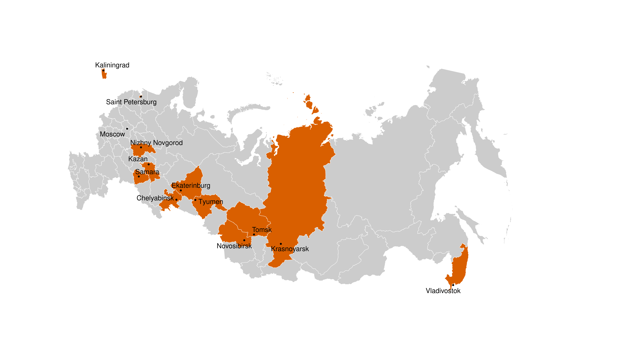

Regions and cities with universities from the RUEI

Slide 5
Region level
Universities compete for students and faculty.
Universities are under the influence of the same regional authorities.
Leading universities could change (potentially) the regional academic environment.

Slide 6
Methodology
Treatment group:
institutions outside RUEI from cities that have an institution included in this program
Control group:
institutions outside the program RUEI from regions that have only institutions not included in the program
Excluded:
local branches, private higher education institutions, regions with institutions from second wave of RUEI, regions that differ significantly from the treatment group in terms of economic and educational quality before 2013, Moscow and Moscow region, St Petersburg and Leningrad region, Kaliningrad, the Crimea.
Treatment | 54
Control | 191

Slide 7
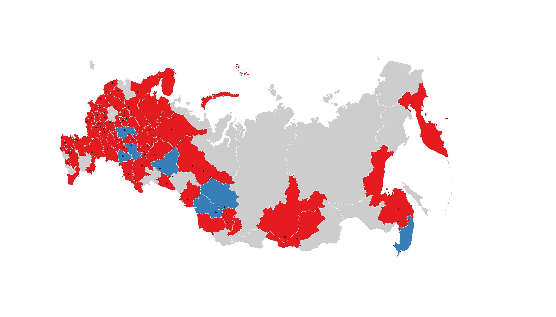
Regions and cities with universities from the treatment and control groups
treatment - blue
control - red

Slide 8
Data
Monitoring of the Performance of Higher Education Institutions (2012-2016)
Russian Index of Science Citation (2012-2017) RISC
Web of Science (2012-2017)

Slide 9
Specification

Slide 10
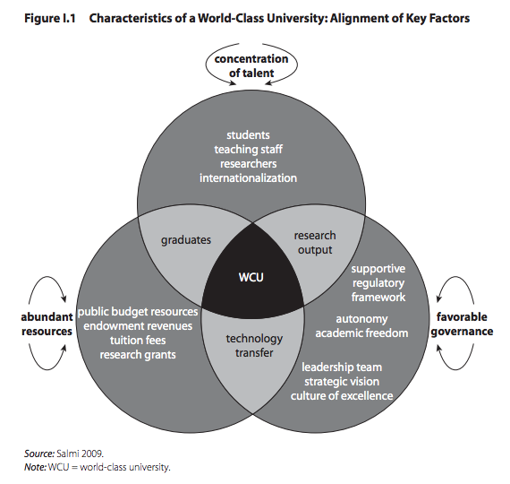
Indicators
Students:
Quality (average USE score)
Faculty:
Staff rejuvenation (percentage of young academics)
Quality (publications):
      RISC
      RISC Core
      WoS Core Collection (including ESCI)
      WoS Core Collection (excluding ESCI)
      Q1
      Q4
  Collaboration:
      National
      International

Slide 11
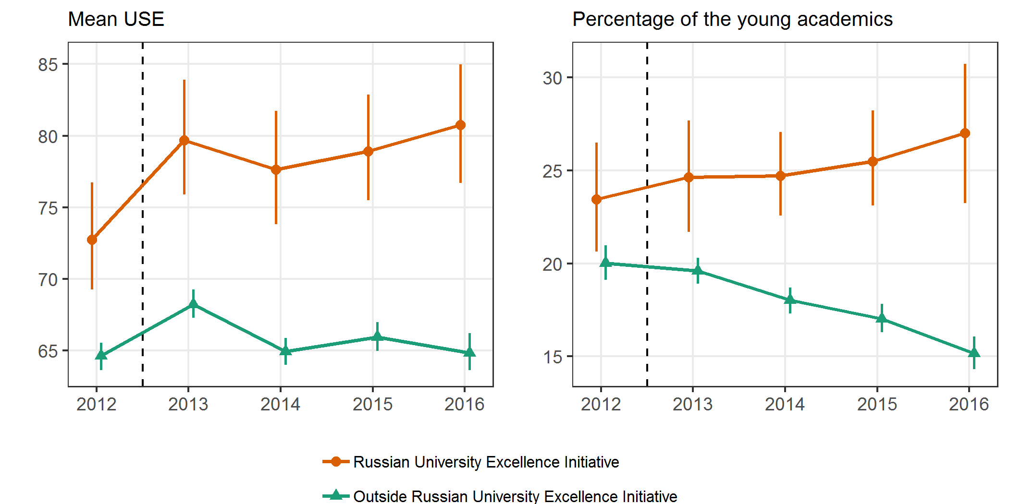
Inside and outside RUEI (1)

Slide 12
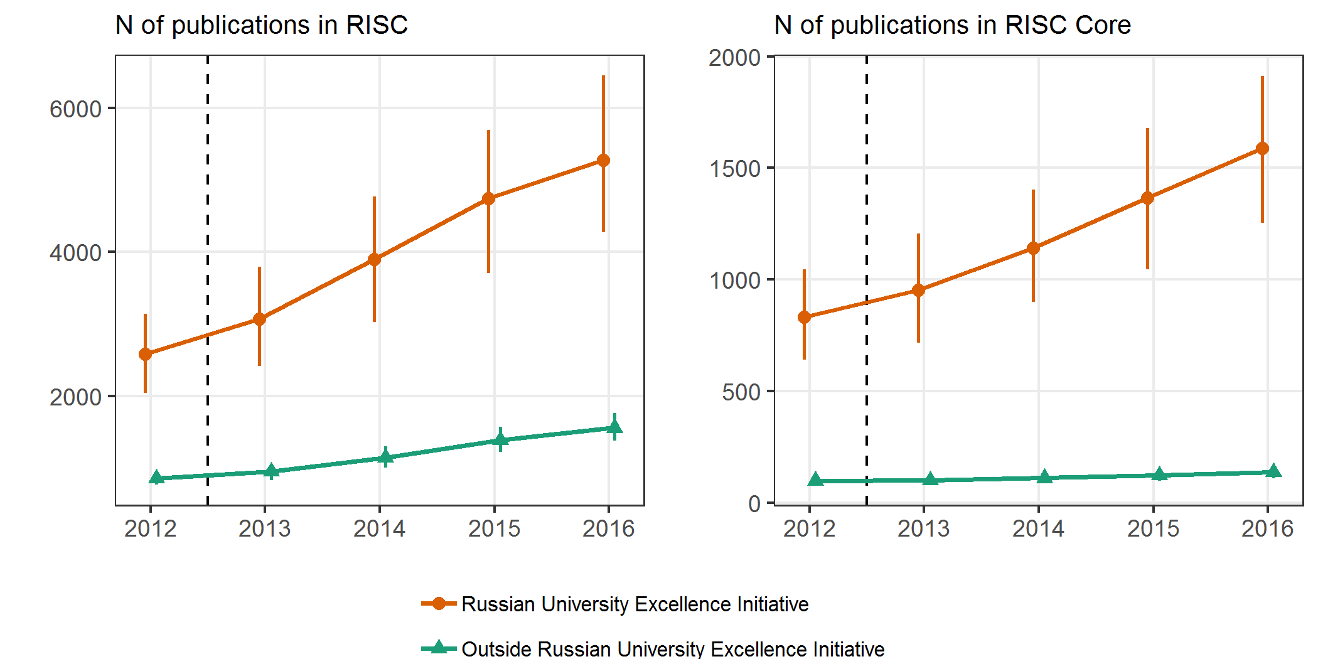
Inside and outside RUEI (2)

Slide 13
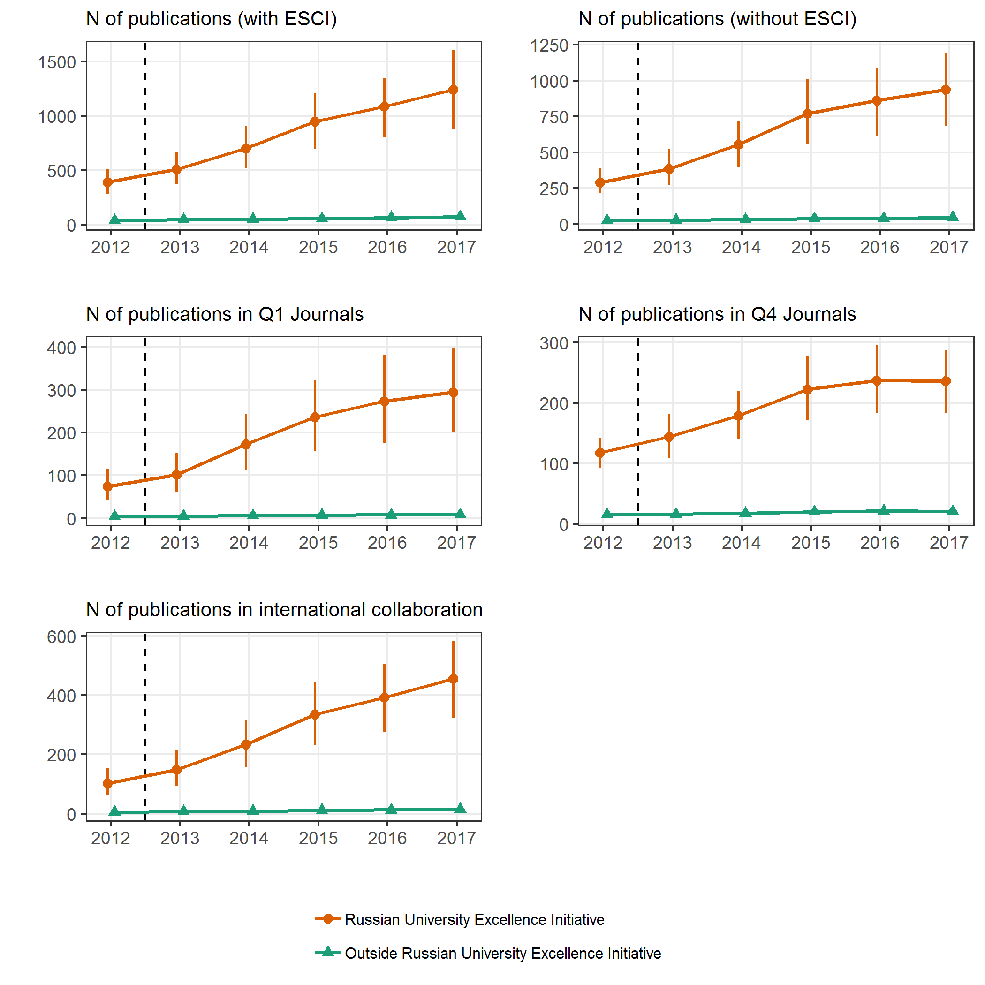
Inside and outside RUEI (3)

Slide 14
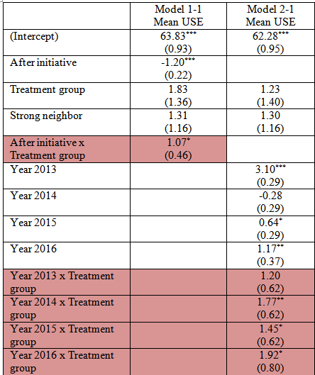
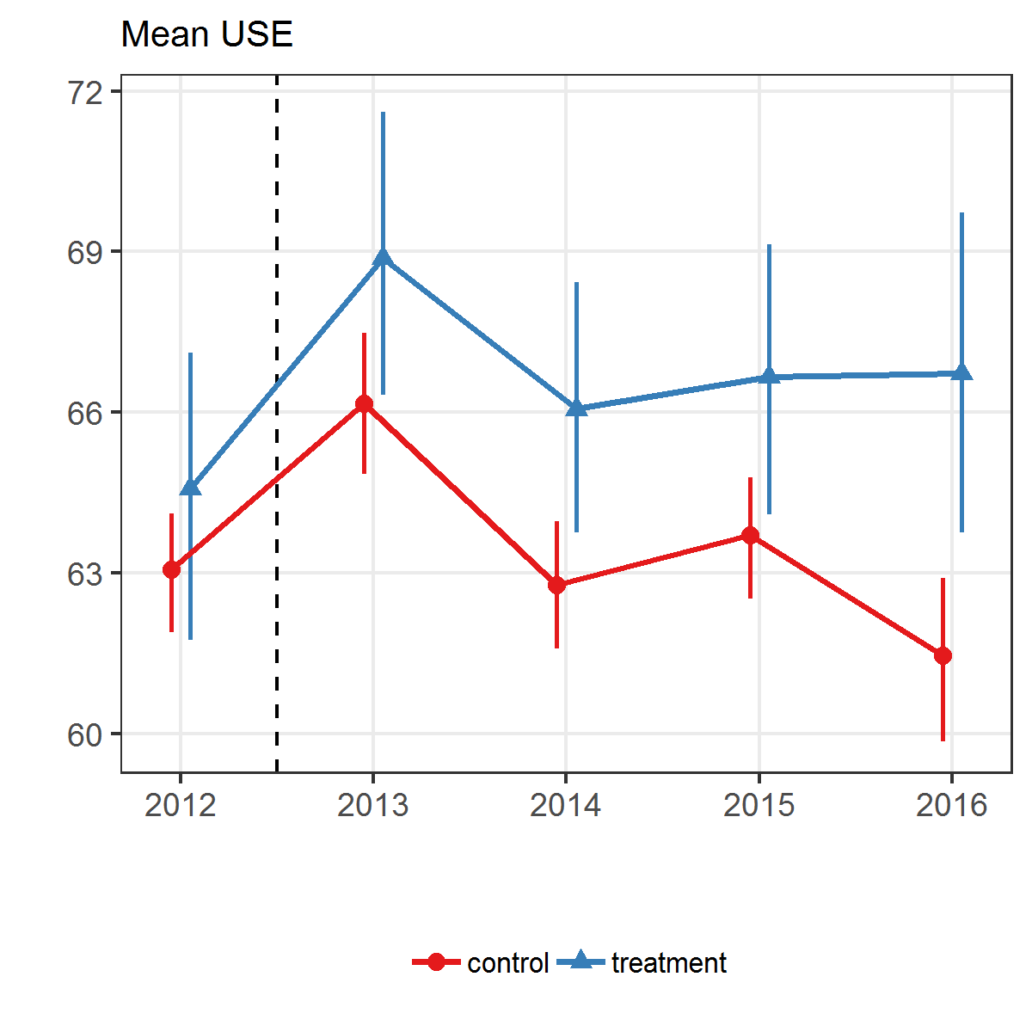
Results. Quality of student intakes (positive effect)

Slide 15
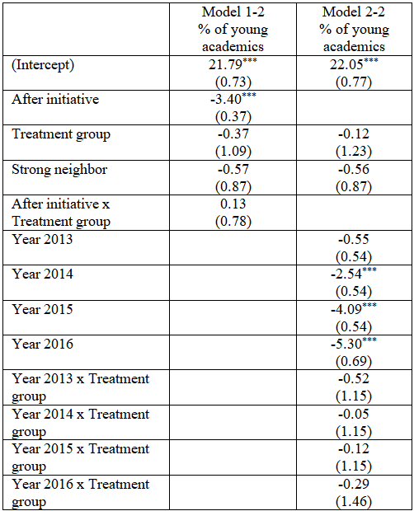
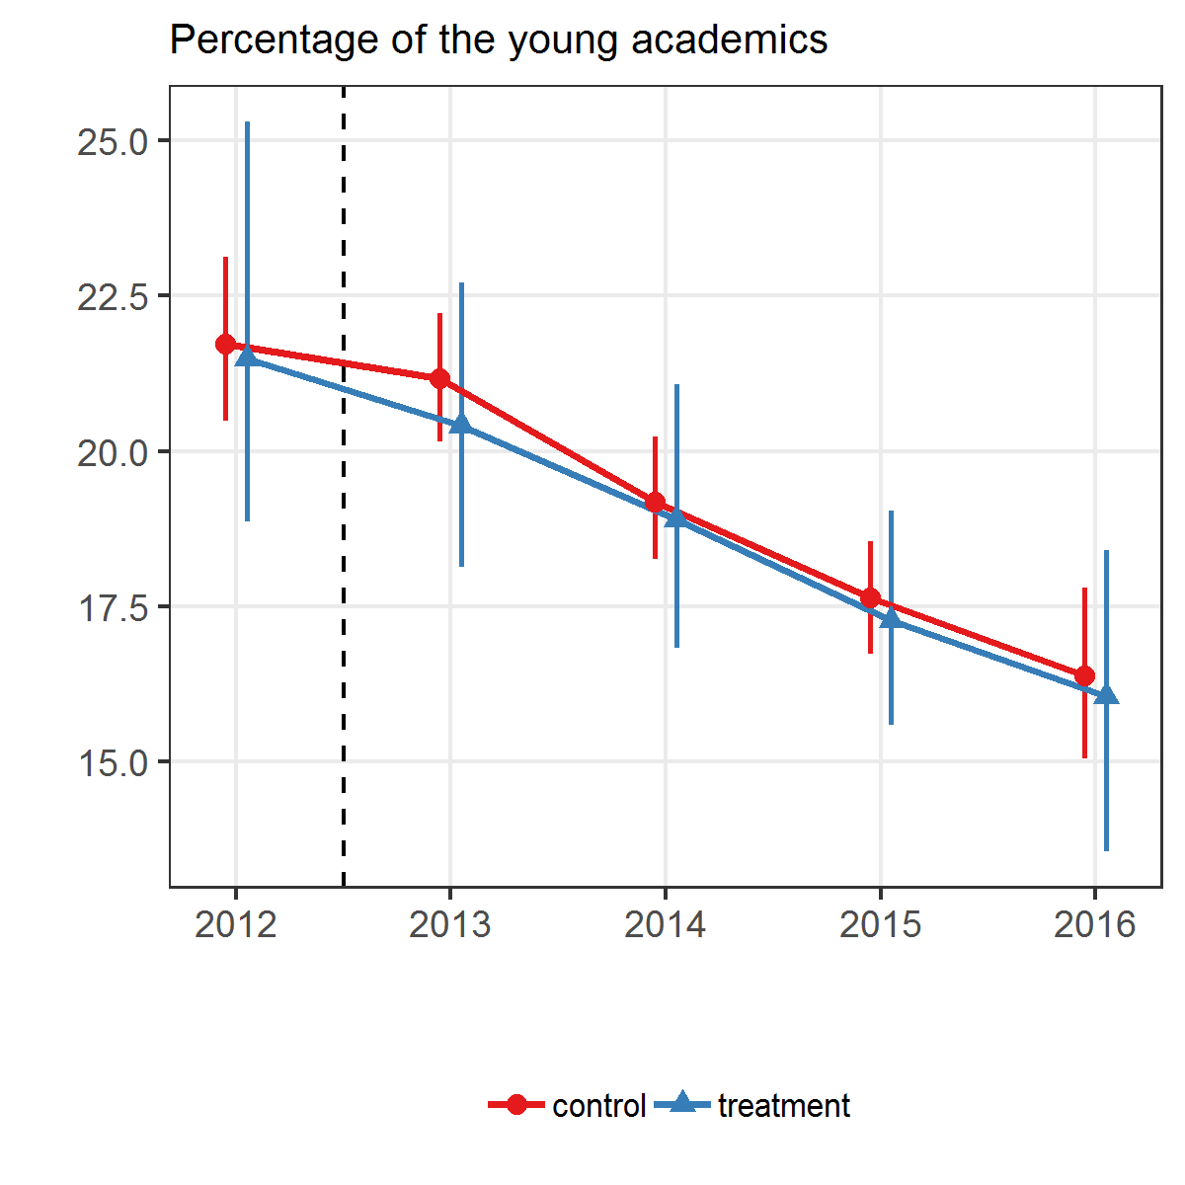
Results. Young academics (no effect)

Slide 16
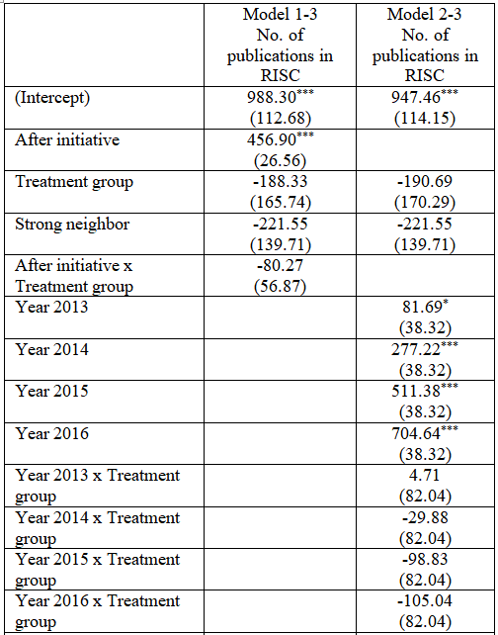
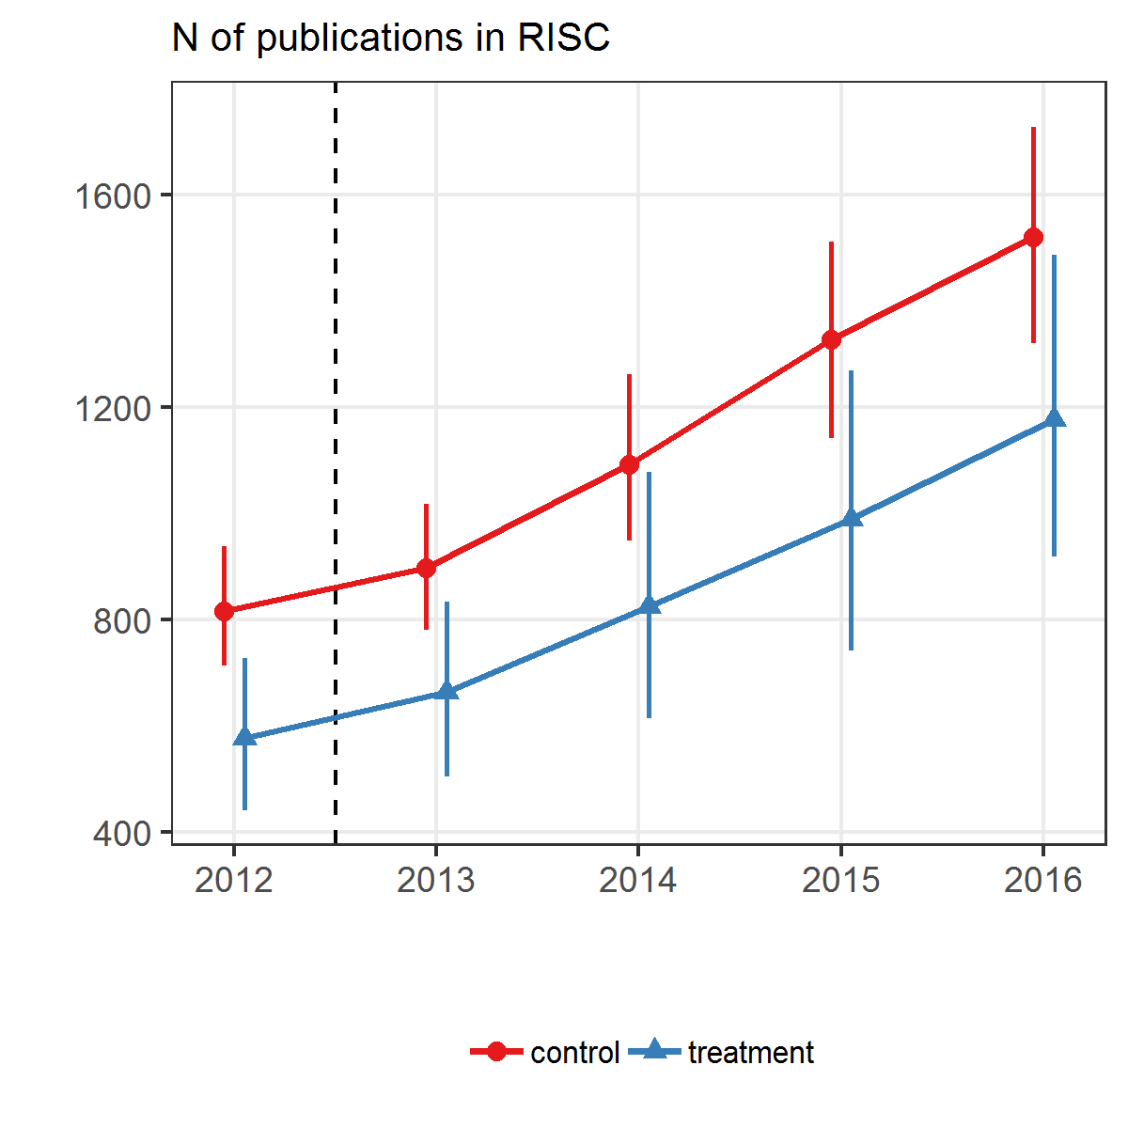
Results. Publications. RISC. (no effect)

Slide 17
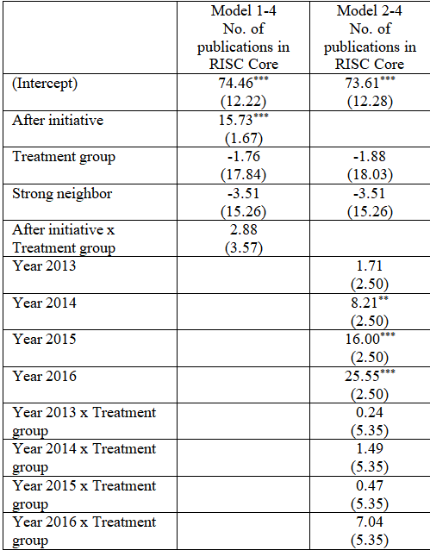
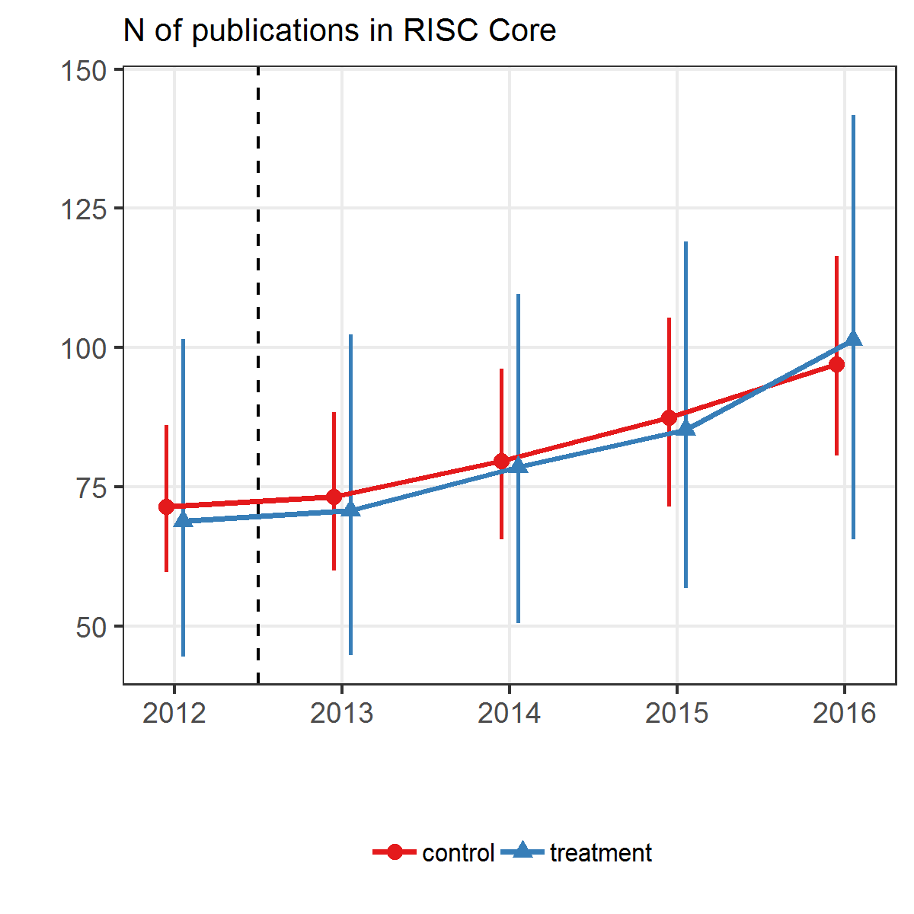
Results. Publications. RISC Core. (no effect)

Slide 18
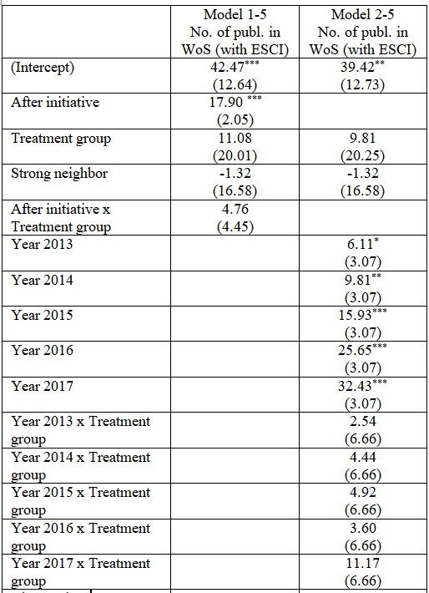
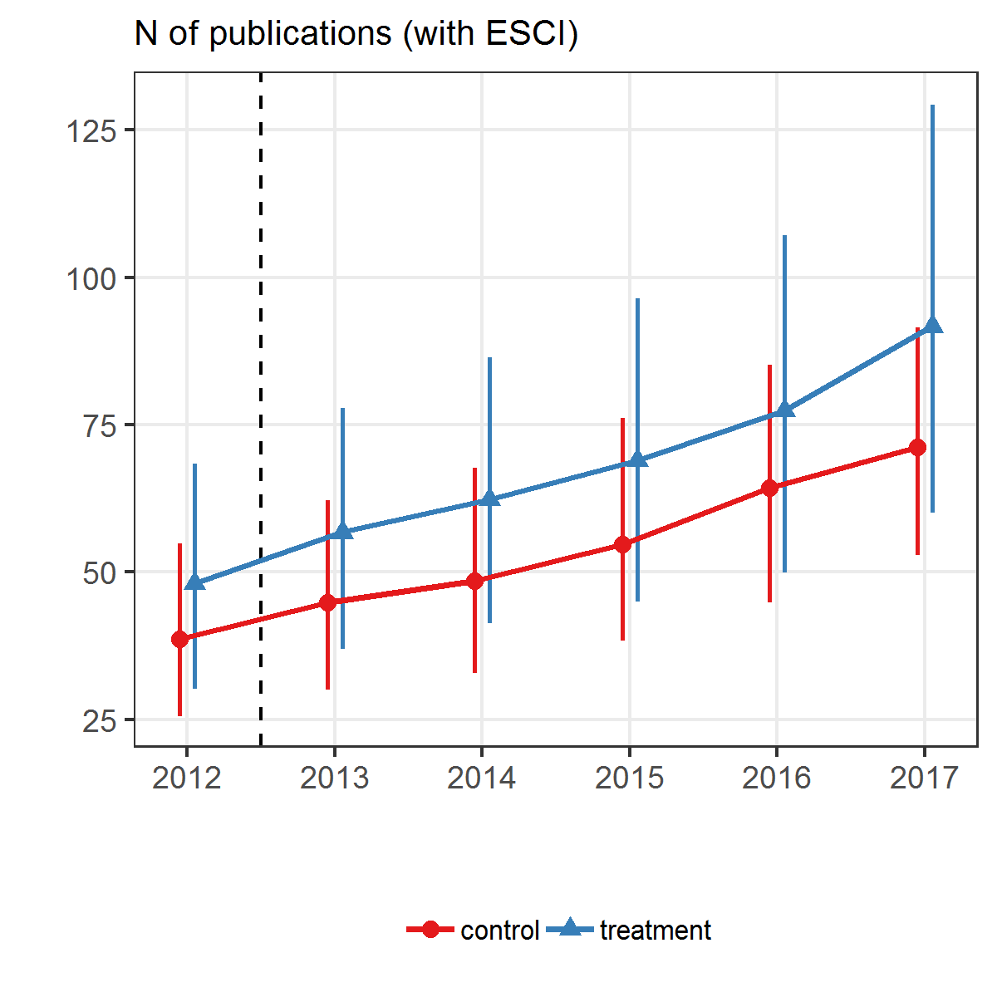
Results. Publications. Web of Science with ESCI (no effect)

Slide 19
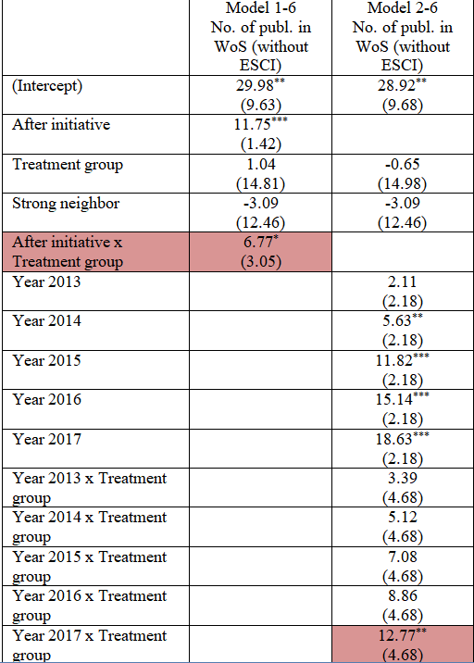
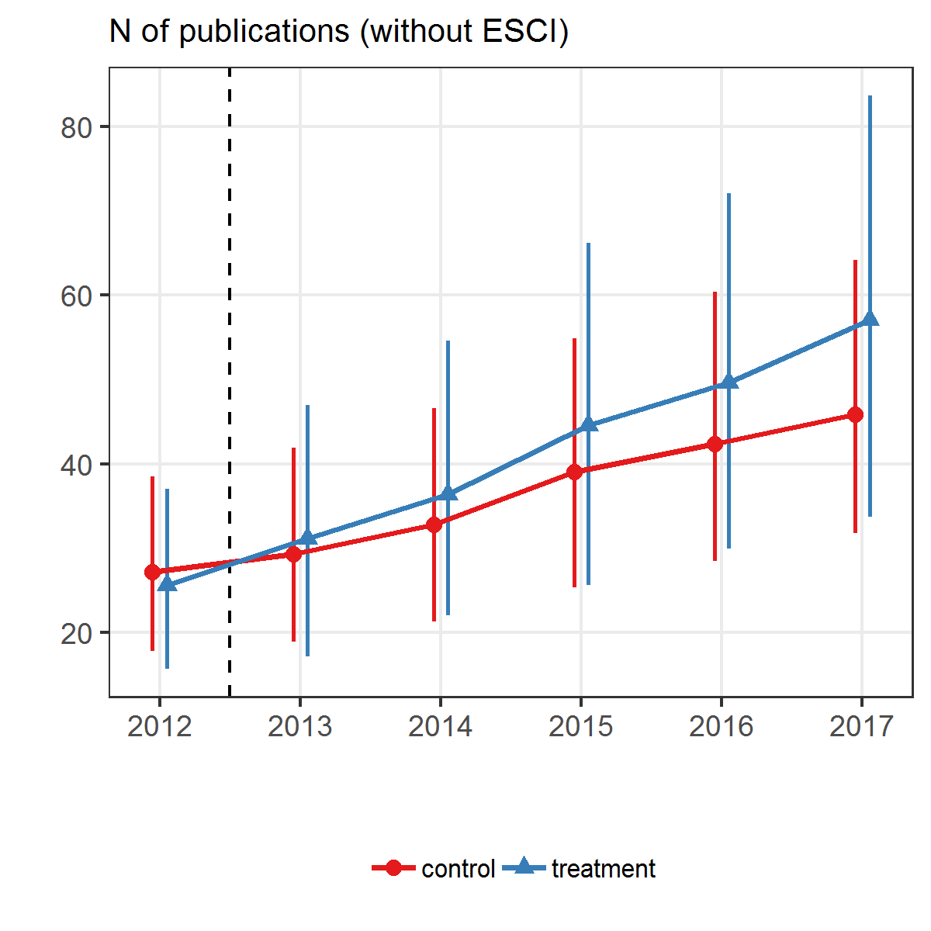
Results. Publications. Web of Science without ESCI. (small effect)

Slide 20
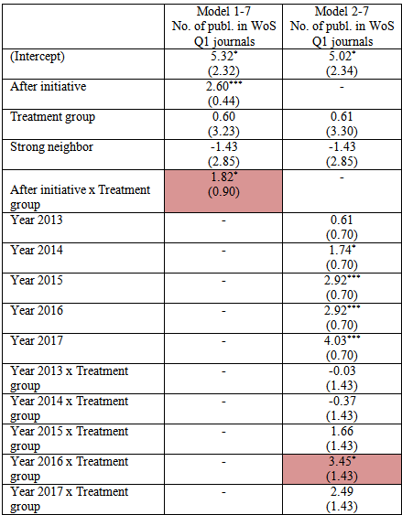
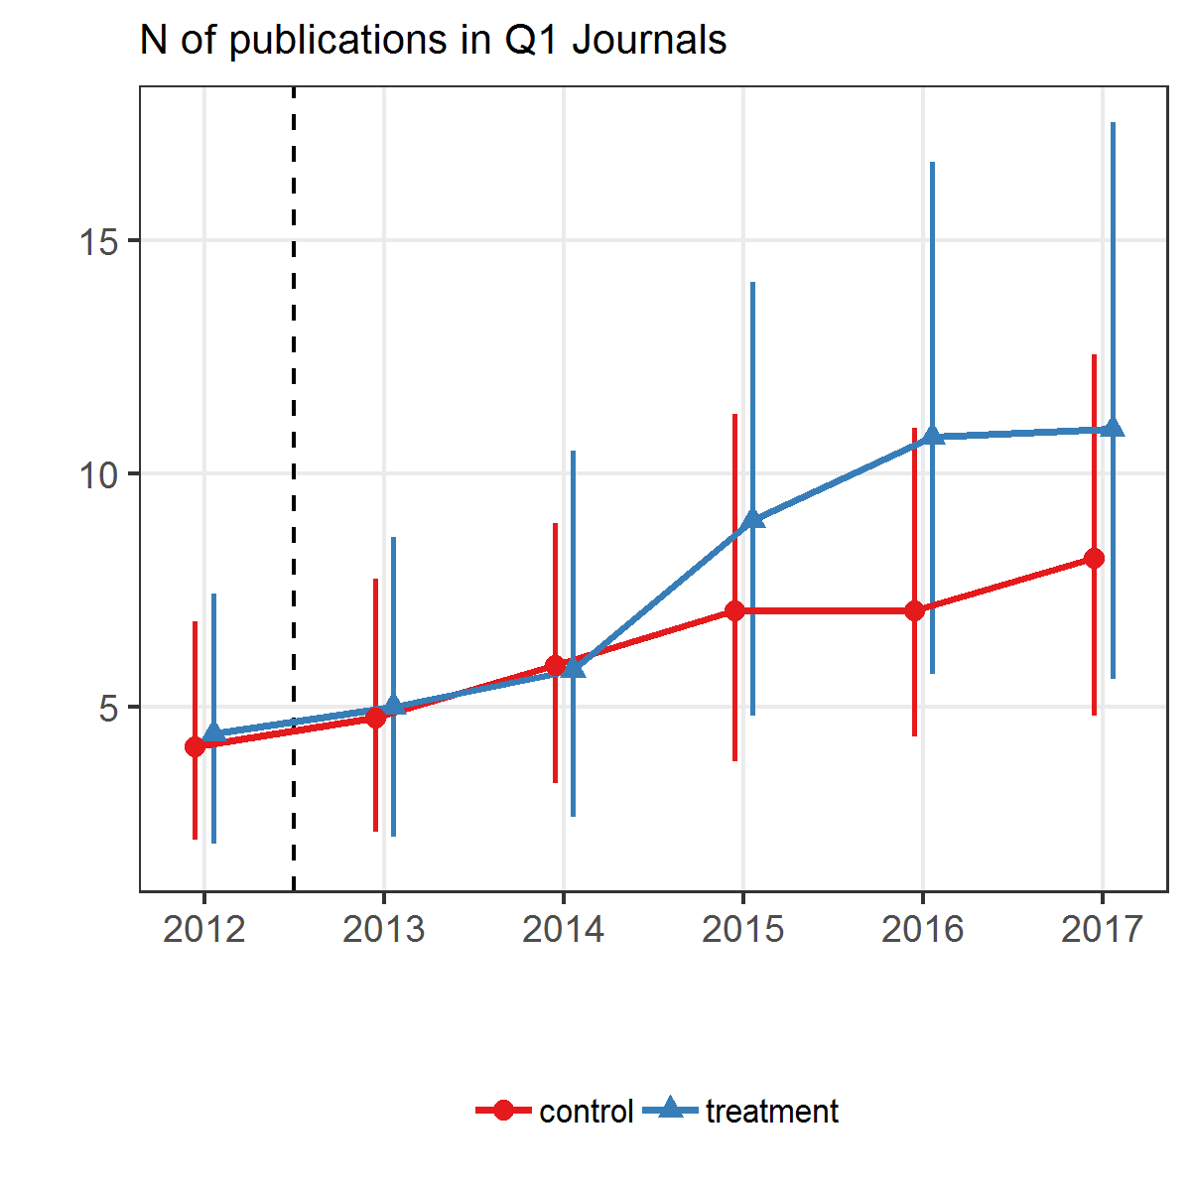
Results. Publications in Q1. (small effect)

Slide 21
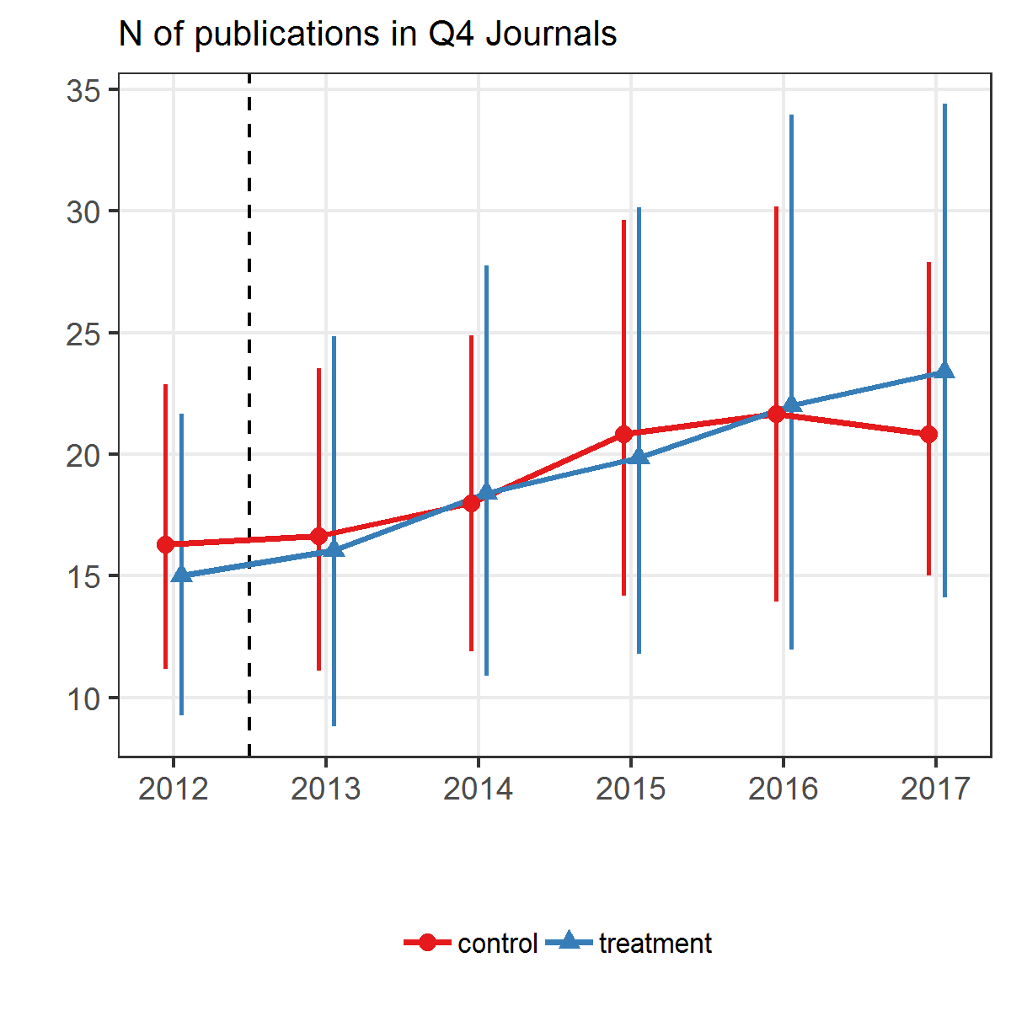
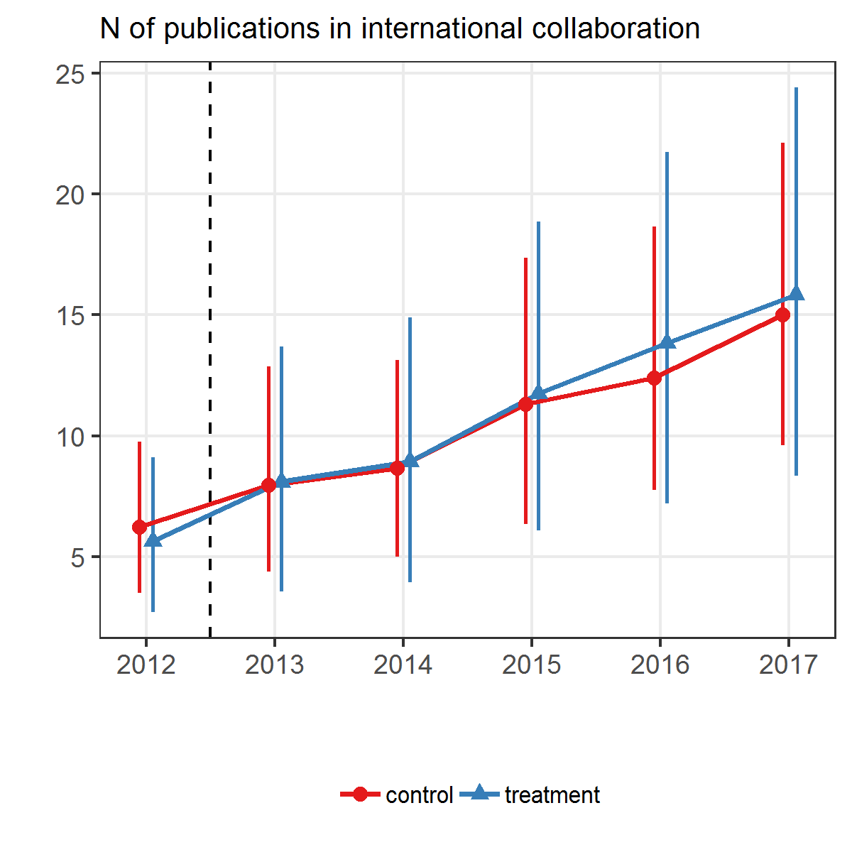
Results. Publications in Q4 & International Collaborations (no effect)

Slide 22
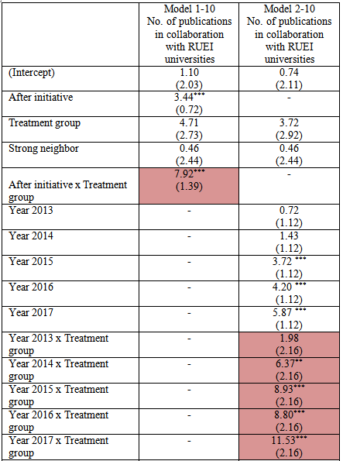
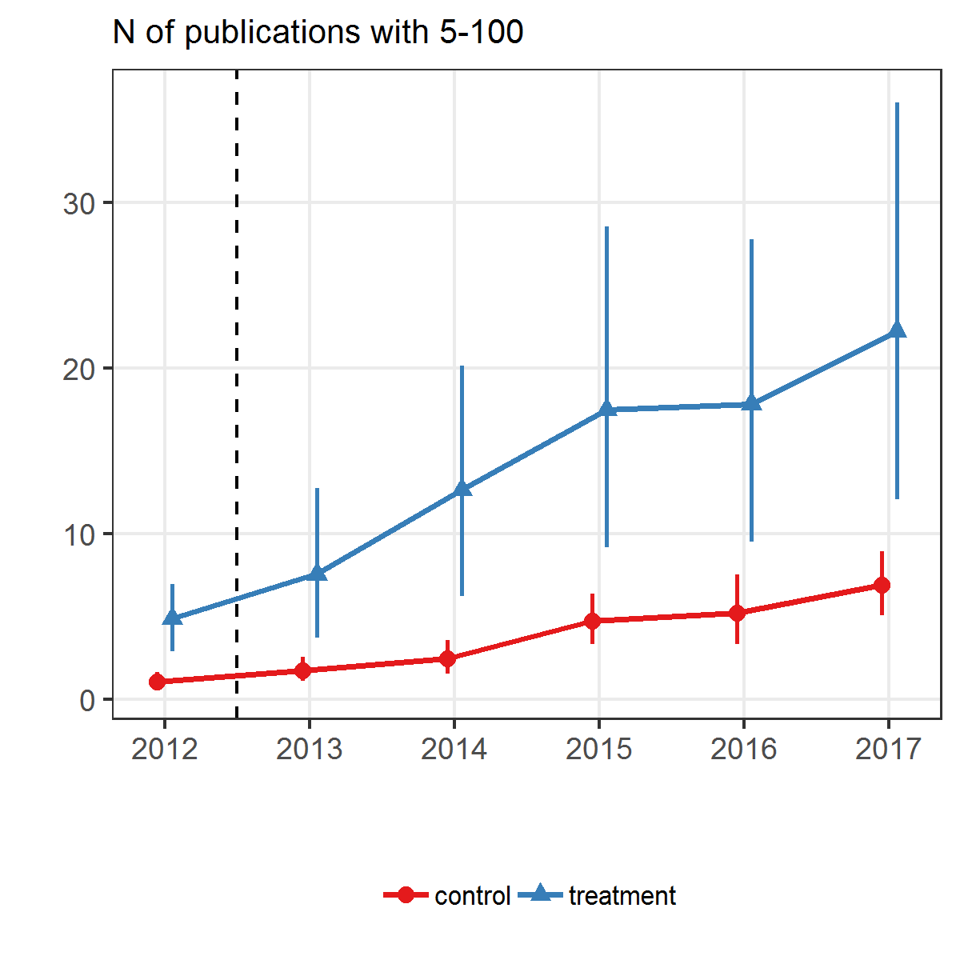
Results. Collaboration with RUEI (positive effect)

Slide 23
Summary
The RUEI can influence neighboring universities that are not part of this program. ⇒ Potential impact of an excellence initiative on the rest of the academic system should be considered when developing its design and implementation.
Positive spillover effects exist.
RUEI has impact on:
Students (yes)
Publications (first signs)
Young faculty (no)
Collaboration (national – yes, international – no)
Direction for further research:
Impact on governance structure

Slide 24
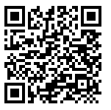
Thank you for your attention!
Andrey Lovakov, Anna Panova, Ivan Sterligov, Maria Yudkevich
apanova@hse.ru

