Slide 1


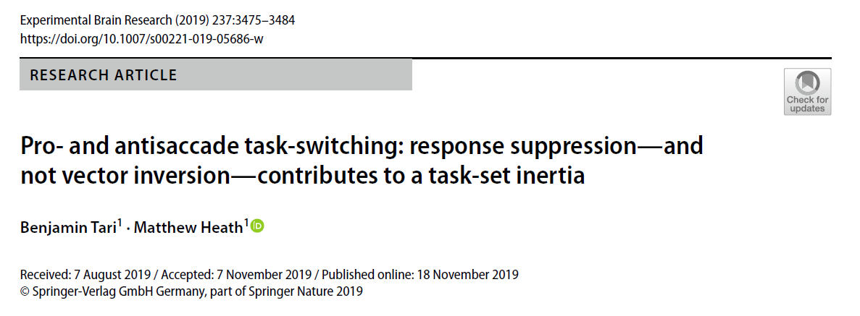
Sofia Krasovskaya
Joint Lab meeting
May 29, 2020

Slide 2
SD - stimulus-driven saccade – saccade to target at target onset
MD – minimally delayed saccade – saccade to target at target offset
Task-set inertia – lingering neural activity; interference from the previous task
SR (stimulus response) decoupling – here, vector inversion

Slide 3
Overview
RTs for standard SD prosaccades increase when preceded by non-standard antisaccade, but not vice-versa. Such an effect is independent of: (1) whether task-types are presented in predictable (i.e., AABB: A = prosaccade, B = antisaccade) or unpredictable (i.e., AABABB….) trial sets and, (2) the number of antisaccades that preceded a task-switch prosaccade.
The RT cost is attributed to task-set inertia, but what exactly contributes to the RT cost: response suppression or vector inversion, or both?
The present study sought to determine whether the executive demands of response suppression and/or SR decoupling contribute to an oculomotor switch-cost, and determine whether such a switch-cost is expressed only when a stimulus-driven and standard response is preceded by a non-standard response.

Slide 4
Prosaccades: standard task, a goal-directed eye movement to a veridical target location. The overlapping SR spatial relations of prosaccades render motor output via direct retinotopic projections from the superior colliculus (SC) (Wurtz and Albano 1980) that operate largely independent of executive planning mechanisms (Pierrot-Deseilligny et al. 1995).
Antisaccades: non-standard executive task; inhibition of a prosaccade (i.e., response suppression); SR decoupling for vector inversion. Antisaccades produce longer RTs (Hallett 1978) and increased endpoint error (Dafoe et al. 2007; Gillen and Heath 2014) than prosaccades and these behavioural ‘costs’ relate to the activation of an extensive frontoparietal executive network (for review, see Munoz and Everling 2004).

Slide 5
Methods
N = 20 (10 F, 19-25 years)
Right-hand dominance
Normal/corrected to normal vision
2 experiments: (MD pro/antisaccades; MD antisaccades/SD prosaccades)
All participants participated in both experiments
Dell 3007WFP LCD monitor 60 Hz, 8ms rr
Eyelink 1000 Plus at 1000Hz, left eye
Black background (1 cd/m2)

Slide 6
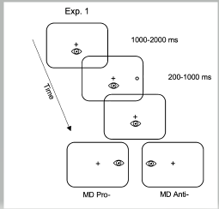
Exp 1: MD prosaccades and antisaccades
Colour of fix cross inidicated type of saccade
Response suppression in both conditions
1 block, 160 trials(80 task-switch, 80 task-repeat, 1st trial randomised), AABB paradigm

Slide 7
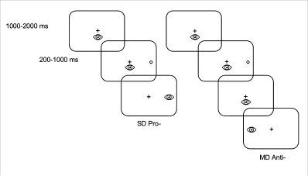
Exp 2: MD antisaccades and SD prosaccades
Colour of fix cross inidicated type of saccade
Response suppression only in MD
1 block, 160 trials(80 task-switch, 80 task-repeat, 1st trial randomised), AABB paradigm

Slide 8
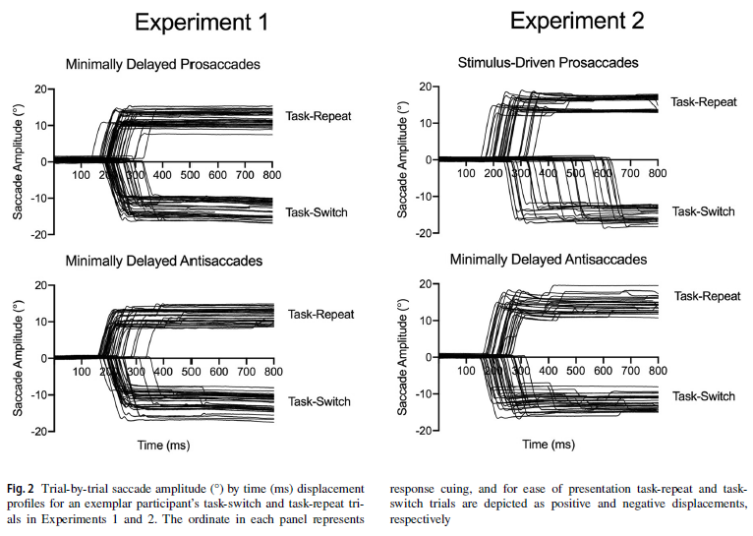
Results: selective switch-cost for SD prosaccades

Slide 9
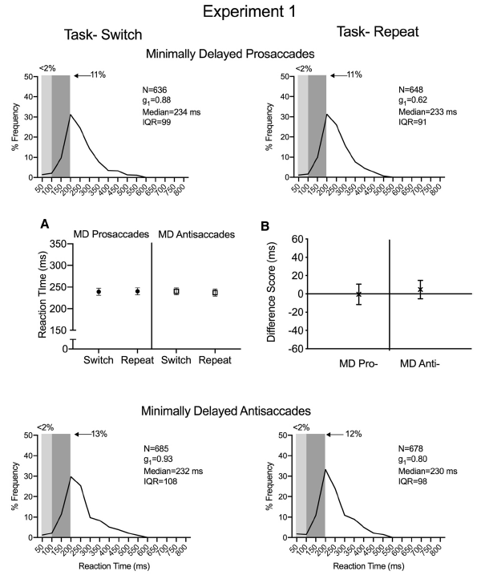
Fig. 3 Experiment 1 The main panels show reaction time (RT: ms) percent frequency histograms for minimally delayed (MD) pro- (top panels) and antisaccade (bottom panels) task-switch and task-repeat trials. The light and dark grey rectangles in each main panel denote anticipatory (i.e., < 100 ms) and short-latency (i.e., 100–200 ms) responses, respectively. The left inset panel (3a) shows group mean RTs for MD task-switch and task-repeat pro- and antisaccades with error bars representing 95% within-participant confidence intervals. The right inset panel (3b) shows RT difference scores (task-switch minus task-repeat) for MD pro- and antisaccades with error bars representing 95% between-participant confidence intervals
Across all trial-types, a low frequency of anticipatory and short-latency responses occurred—a result attributed to the response suppression demands of each trial-type.
No main effect or interaction, MD prosaccade and antisaccade task-switch/task-repeat trials are within equivalence boundary

Slide 10
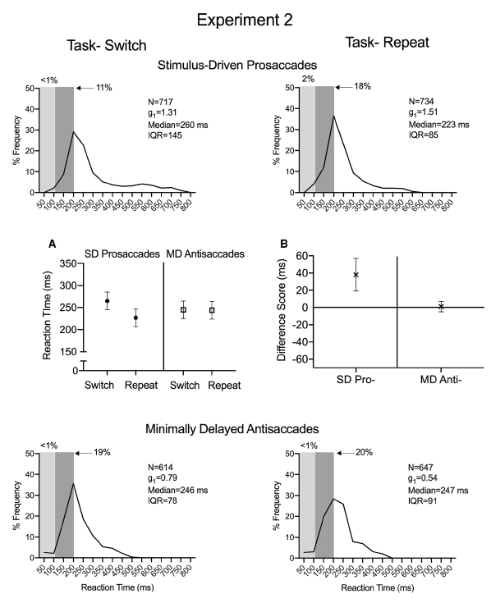
Fig. 4 Experiment 2 The main panels show reaction time (RT: ms) percent frequency histograms for stimulus-driven (SD) task-switch and task-repeat prosaccades (top panels) and minimally delayed (MD) task-switch and task-repeat antisaccades (bottom panels). The light and dark grey rectangles in each main panel denote anticipatory (i.e., < 100 ms) and short-latency (i.e., 100–200 ms) responses, respectively. The left inset panel (4a) shows group mean RTs for SD task-switch and task-repeat prosaccades and MD task-switch and task-repeat antisaccades with error bars representing 95% withinparticipant confidence intervals. The right inset panel (4b) shows RT difference scores (task-switch minus task-repeat) for SD pro- and MD antisaccades with error bars representing 95% between-participant confidence intervals. For this panel, the absence of overlap with an error bar with zero represents a reliable difference that can be interpreted inclusive to the null hypothesis
SD prosaccade task-switch trials had fewer anticipatory and short-latency responses than their task repeat trials; for MD antisaccades the frequency of each trial-type did not vary across task-switch and task-repeat trials.
Main effect of task-transition; task by task-transition interaction; higher RT’s for SD prosaccade task-switch trials; no significant RT difference for MD antisaccade task-switch/repeat

Slide 11
Main conclusions
SD prosaccade preceded by a MD antisaccade elicits a switch-cost;
MD antisaccades contribute to an oculomotor switch cost;
Response suppression imparts a task-set inertia that delays the planning of a subsequent SD prosaccade;
Executive demands of vector inversion do not contribute to a task-set inertia;
Response suppression engenders a task-set inertia and delays the planning of a subsequent standard and stimulus-driven response
(check out new Klein paper on ior)
Ask if they’ve taken ms into acc? Share data perhaps?

