Slide 1

Critical and Interpretative Approaches to Narrative
Victor Albert
Department of Public Policy

Slide 2
Approaches to Narrative
There can be many possible approaches to the examination of narrative
It was very popular in social science in the 1990s, but has since gone out of fashion somewhat
There are many possible reasons why it went out of fashion, but in part it is due to turns in the literature which locate narratives and discourses in a more complex array of social and political phenomena (practices, discourses, relations of power, “webs of significance”, performative and spatial approaches to policy, etc.)

Slide 3
What would be the possible criticisms of NPF
The quantification of narratives is, I will argue, inherently problematic
Rather than give a conventional critique you can find in the policy studies literature (or even in Roe 1994, Stone 1989, Hajer 1995), we will discuss more generally how narrative functions, how it is layered into existing structures of significance and interpretation, and how this is problematic for the NPF
It is important to recognise that narration is intrinsically intersubjective: there is no narration without the interpretation of meaning, which is a shared, dynamic enterprise that is made possible by linguistic competencies which develop through childhood and discursive content which has its own evolutions and historical path-dependencies
Consider the narrative of this political advertisement:
https://www.youtube.com/watch?v=C3UsWMbUpF4&ab_channel=JoeBiden

Slide 4
The political advertisement as narrative
Question: Why was Joe Biden running?
Biden was running, at least in part, in response to criticisms of his age and vitality. He was nicknamed “Sleepy Joe” by Trump. His campaign seemingly developed messaging which emphasised his vitality and energy.
How is this important to narrative analysis? You wouldn’t be able to understand the reasons for this narrative unless you were following US news. In other words semiosis (or interpretation) is dependent on existing understandings.
Not only that: the narrative itself was produced in response to other narratives, for example, about Joe’s age, about the authoritarian dispositions of President Trump, and so on.
So, the narrative was, first, embedded in and related to other narratives, and in order to interpret the narrative you too had to be apprised of these different narratives. If you weren’t following the US elections, it would not be obvious why he was jogging.

Slide 5
Identifying the Villain
Question: who was the “villain” in the video?
There were three associations with Trump in the video.
  “Races up steps while others take it slow”
  “He doesn’t need to be told Wall St didn’t build this country”
  “An idea is stronger than any dictator or tyrant”
In none of the cases was Trump explicitly mentioned, but his image was shown, so:
If we take the narrative to simply textual, then the association with Trump is implicit in the messaging
Of course, we were shown the images, which means that there was an explicit inference: we associated Trump with slowness, Wall St and with tyrants → but in a way that was still not literal

Slide 6
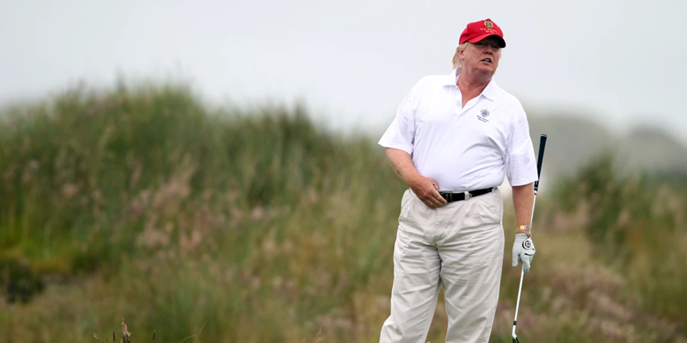
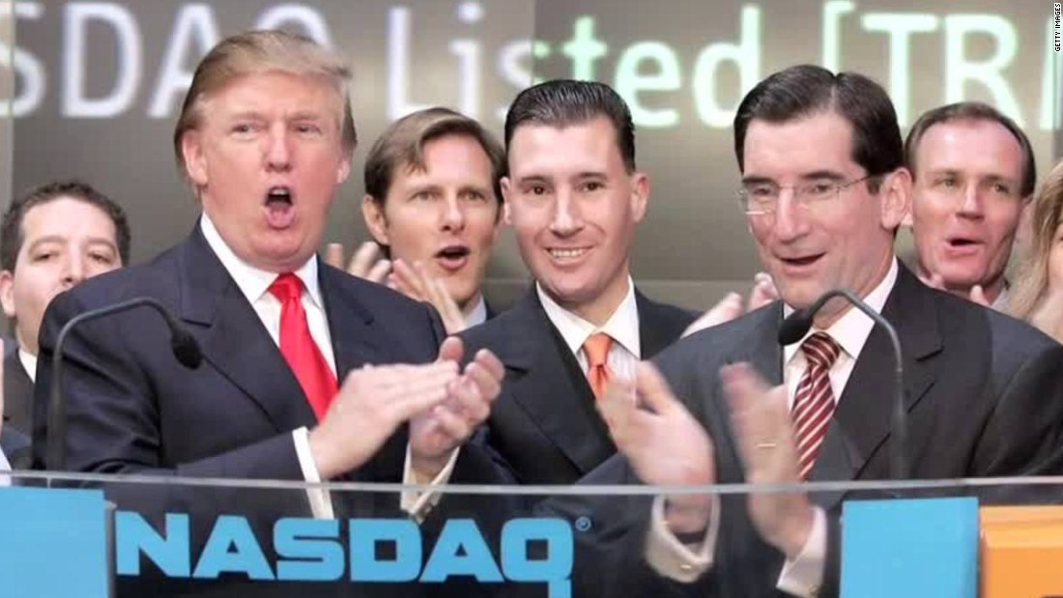
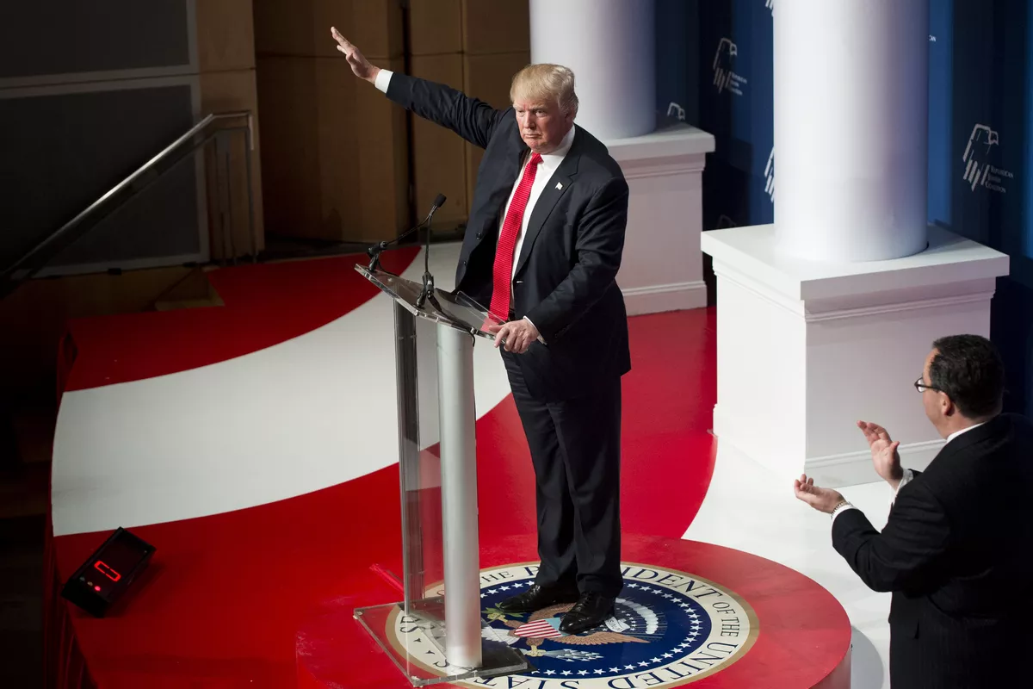
The narrative works even without the images
However: even if the image wasn’t shown many would still have these associations, since in previous commentary, analysis and so on, these associations have been made
So, narrative can make these inferences without explicit references

Slide 7
Narrative Dynamics
In order to be comprehensible, narratives depend on shared understandings of discursive content and comprehension of styles of narration
This is possible because we exist in cultures where narratives are dynamically employed in ways that are situationally specific, but have recognisable patterns (narrative tropes and genre chains, etc.)
Consider: how would you recount to your parents a narrative of how your day went; then consider how this narration would differ, if you were to tell this story to a friend → it would be fundamentally different
Narratives are highly related to the audience and a slew of other conditions

Slide 8
This is evident in the NPF literature itself
We can see the presentational dynamics of narratives even in the NPF literature itself. I.e.
“However, there are sideboards that we wish to impose to NPF research: alignment of your research approach with NPF assumptions, clarity with your level of analysis, and transparency with your model speciﬁcation (including NPF’s deﬁnition of policy narrative), research approach, and data so as to be “clear enough to be wrong”. (Shanahan, Jones and McBeth 2018: 343)

Slide 9
But in appeals to interpretative scholars
“As such, our article offers a demilitarized zone for those interested in pluralistic scholarship, hopefully allowing those within to return to the exhilarating pursuit of understanding.” (Jones and Radaelli 2016: 119)
So, while establishing “side-boards” and “alignment” was emphasized in a general article, the openness and “pluralism” of NPF was underscored in a critical policy studies article
My point is not to criticize this or that emphasis: it is that this is a generic property of all narratives, which are addressed to an audience, and can dynamically change

Slide 10
How does this all bear on the NPF?
I agree that the NPF: gives short shrift to the issue of interpretation, the performative dimensions of narrative (its direction towards an audience), the medium of the narrative, and the cultural dimensions of narration
I agree with Hugh Miller that ‘policy narratives are not fixed or static, but tend to be dynamic, episodic and evolutionary’ and that ‘narratives are context-dependent in that both meaning and its interpretation are contingent on the historical moment, cultural setting, and local environment’ (Miller 2020: 2, 5).
The NPF, for Miller, is ‘anti-contextual’ – I agree

Slide 11
Consequences for the NPF
Is this, for me, a fatal flaw for the NPF?: no, but it creates limitations insofar as narratives are divorced from their socio-political contexts; they will tend to lose the many senses that they have for competent interlocutors
Consider our project on narratives in Moscow: narratives, for example, from Facebook, do not account for the opportunities (and surveillance) that are possible on online forums; on existing power structures in Moscow; a media environment that is largely state-owned, and so on, to say nothing about how a local Moscovite might interpret a narrative compared with a foreigner
Or, as we argue in our paper, the policy subsystem, which is considered an “agora”, is subject to a number of constraints and power inequalities that are locally specific → How are they accounted for in the NPF? It is not just a question of Russian specificity, but refer to generic weaknesses in the approach

Slide 12
How can the NPF shed light on…
The strategic uses of narrative: how narrative is used at a certain spatial and temporal juncture to achieve a certain objective? How can the framework account for the way that narratives are evolutionary? That they may have implicit inferences, that they might be humorous or satirical?
In sum: the NPF can be helpful but it needs to account in a much more fulsome way the contexualised ways in which narrative is used and the dynamic processes of interpretation in which it is embedded and employed at all three “levels”

Slide 13
Coda: Cultures of Narratives
Lastly, the styles of narration are culturally specific
Studies of storytelling among children have shown that European American children tend to follow a temporal sequence (the Aristotlean ideal) and focus on one topic, whereas Japanese American children focus on many topics at the same time and are much less elaborate. Puerto Rican children, meanwhile, tended to recount narratives without a resolution or “moral of the story”. (McCabe 1997)
So, how are these different cultures of narration accounted for in the NPF?

