Slide 1

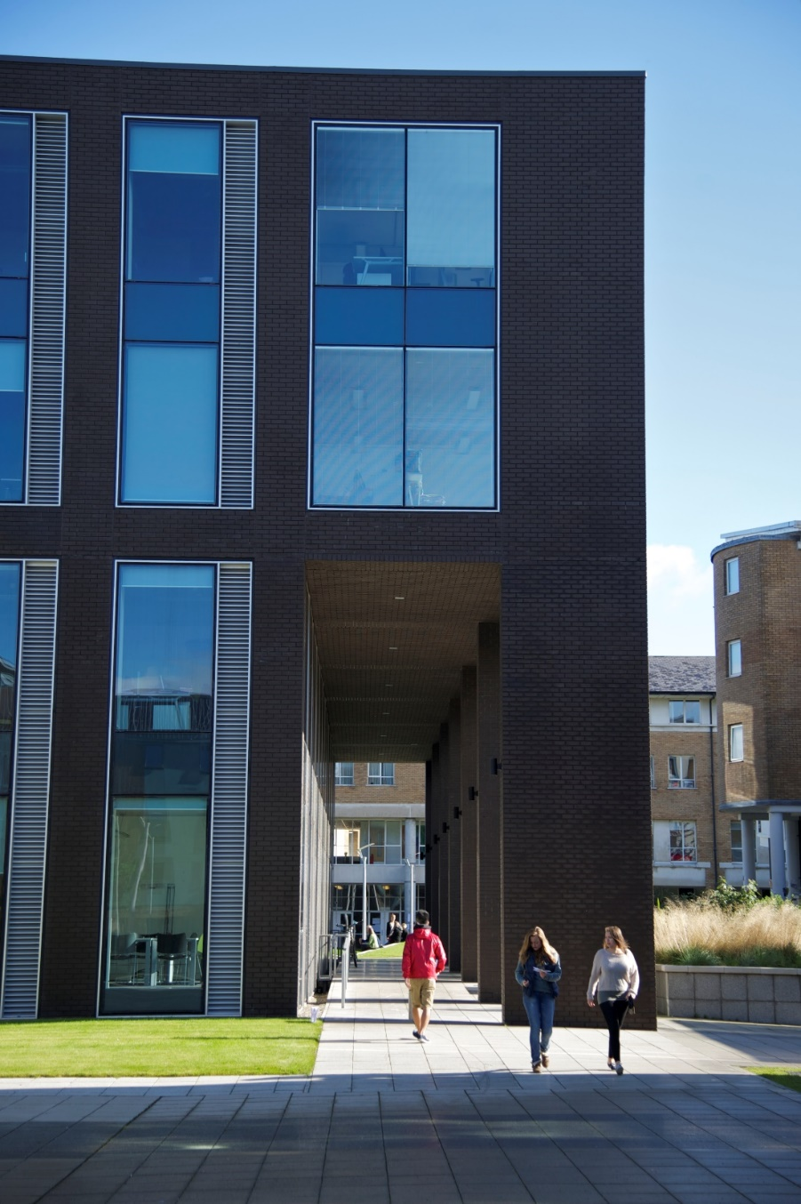

Lancaster University Management School
NOTE: IMAGE TO GO HERE
Mat Pitts and Claire Astle
Global Experience and Partnership Team
www.lancaster.ac.uk/askLUMS

Slide 2
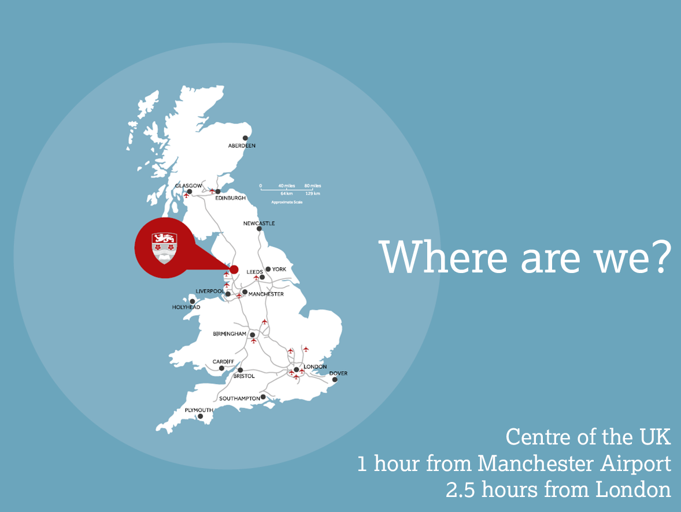
NOTE: IMAGE TO GO HERE

Slide 3
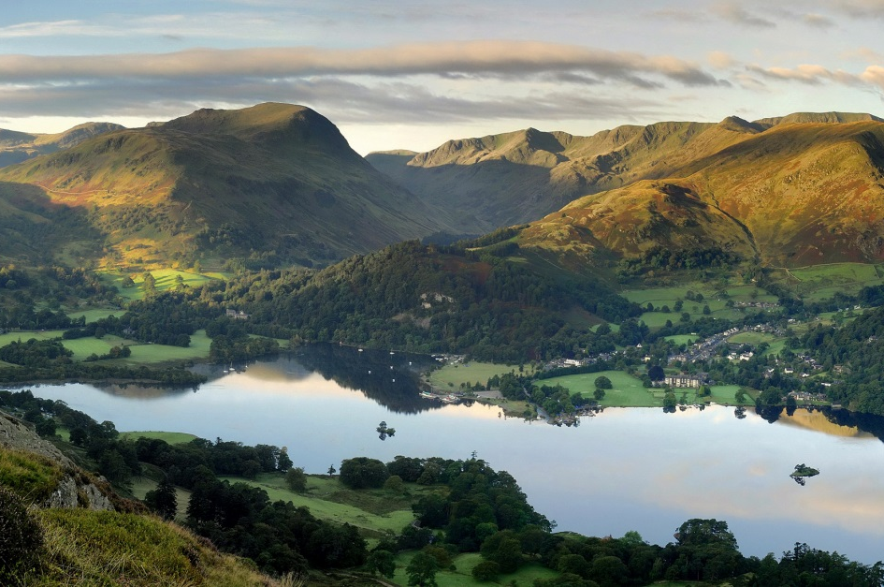
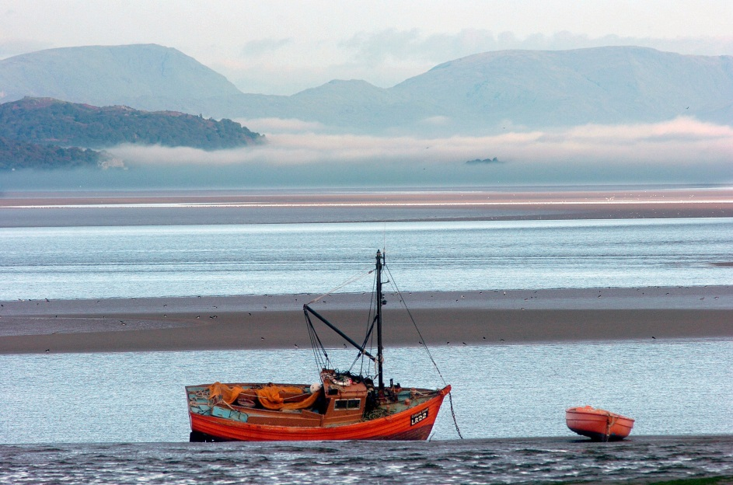
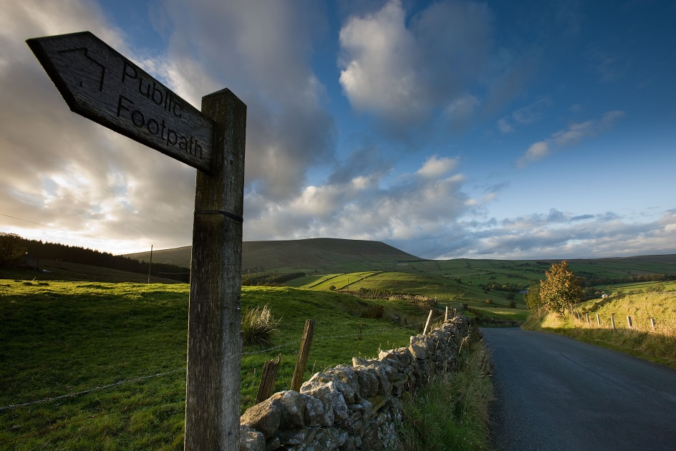
The City of Lancaster is set between Morecambe Bay and the picturesque Pendle Hills (right).
We are only 30 minutes from the Lake District National Park (top).

Slide 4
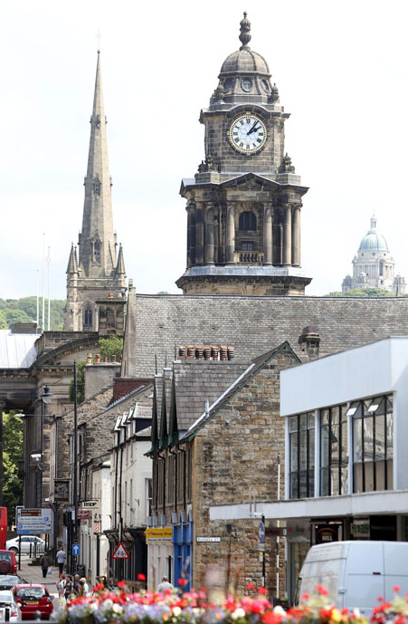
Lancaster
Historic
Dating back to the 12th century
With character
Theatres, museums, galleries, Williamson Park
Cosy and safe
144k inhabitants
Well connected
Rail links to major cities & Manchester Airport
Student city
One tenth of the population are students!
Notes:
Worth mentioning that the cost of living in Lancaster is generally cheaper than most other cities- I’ll cover this in more detail later!
What does it all mean?

Slide 5
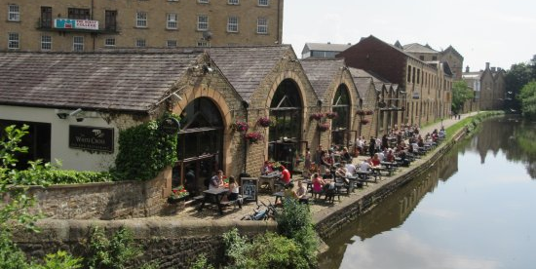
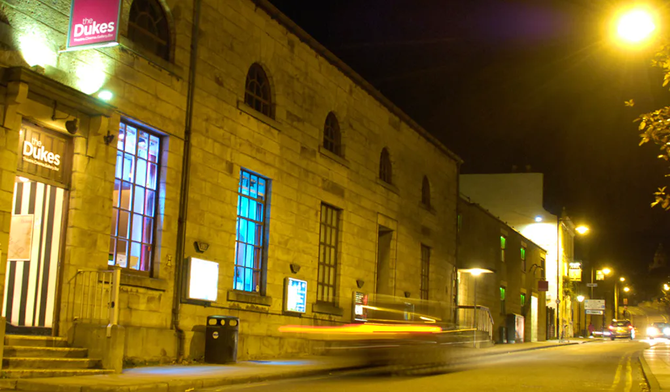
Lancaster
NOTE: IMAGE TO GO HERE
Notes:
A few of my favourite things in Lancaster. Clockwise top left: Atkinson’s coffee shop; the White Cross on the canal; The Dukes independent cinema & theatre; Ashton memorial in Williamson Park.

Slide 6
Lancaster University
An outstanding education, based on world leading research and delivering in an enjoyable and supportive learning environment
Notes:
Founded in 1964.
13,700 students- 70% UG, 30% PG
Bachelors, Masters and PhD programmes. Taught and research Masters.
280 undergraduate programmes
222 postgraduate taught programmes

Slide 7
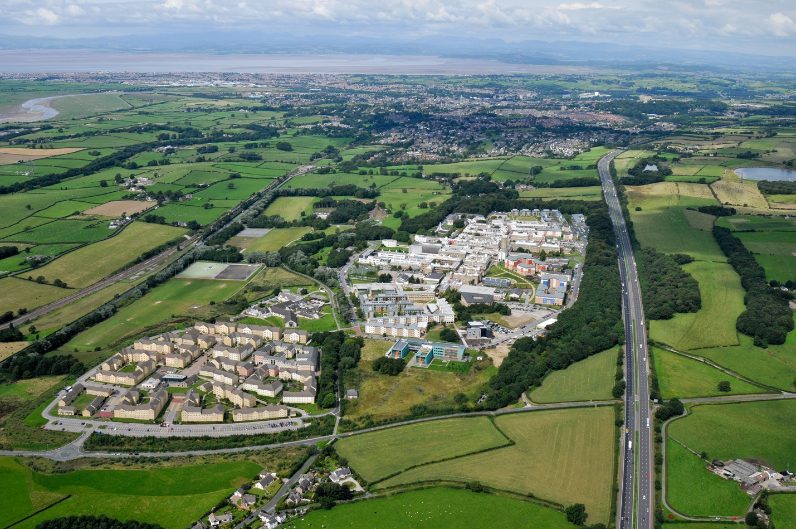
Our Campus
Notes:
560 acre campus. Fifteen minute bus journey from the centre of town. My commute is 20 minutes- leave the house at 7.55 and be in work at 8.15!
Morecambe Bay, south Lake District at the top.

Slide 8


Research and teaching
World-leading research
83% of research activity is world-leading or internationally excellent. It is the only one of the eight most research intensive universities in the North of England to have had research funding increased.
7th for Teaching Excellence in Europe
Lancaster University is among the best universities for teaching excellence in the Times Higher Education Europe Teaching Rankings 2019.

Slide 9
Lancaster University
Lancaster University Management School
Faculty of Arts & Social Sciences
NOTE: IMAGE TO GO HERE
Faculty of Science & Technology
Faculty of Health & Medicine
Notes:
Four faculties- obviously, we’re most interested in the top left, but you’ll be in a community of students across departments. We’re not just a management school! Visit seminars, research symposia, etc.

Slide 10
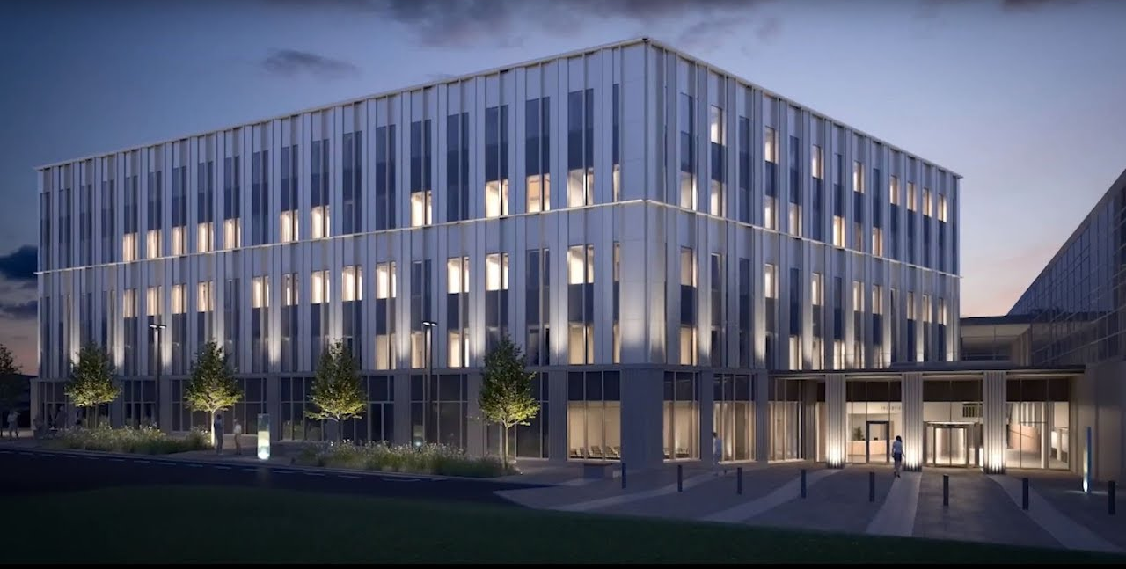
Lancaster University Management School
NOTE: IMAGE TO GO HERE
Notes:
-West wing of the new building. Due to complete 2020. Entirely new facilities- just for you! New lecture theatres, new social spaces, new café!
- Consistently ranked in top 10 in UK league tables

Slide 11

A mark of quality
International outlook
NOTE: IMAGE TO GO HERE
Collaboration partners
Student support
Notes:
AACSB - The leading American business school accreditation body, becoming global in its reach, which has accredited all of the USA's top business schools such as Harvard, Stanford and Wharton among others.
EQUIS - The leading European business school accreditation kitemark, managed by the European Foundation for Management Development (EFMD). The key focus includes internationalisation and strong organisational relationships.
AMBA - The association of MBAs, although UK-based in its origins, is the only accreditation body to focus on MBA programmes around the world. Our MBA, Executive MBA and MSc Management are all AMBA accredited.
Small business charter - The SBC is an award for the UK’s world-class business schools, celebrating those that play an effective role in supporting small businesses, local economies and student entrepreneurship and the impact they make.

Slide 12





Professional recognition
Notes:
Number of our degrees professionally recognised by various bodies. E.g., Accounting & Finance offers exemptions to ACCA papers; MSc Advanced Financial Analysis help to achieve CFA Level II.

Slide 13

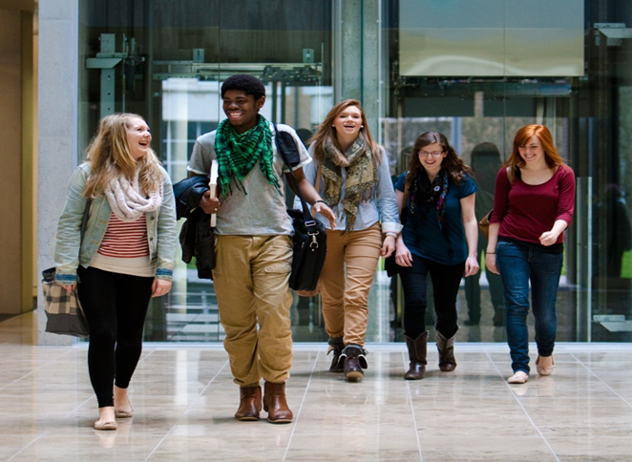
International community
University
We have been named International University of the Year by The Times and The Sunday Times Good University Guide 2020.
Students
85% of LUMS’ Masters students are from outside of the UK (2018/19). We have alumni in over 160 countries.
Study abroad
All postgraduate students can choose to study abroad.

Slide 14








Careers
“Graduate prospects are the best for any non-specialist university in the UK with employers falling over themselves to recruit Lancaster students.”
Alistair McCall, editor of The Times and Sunday 2019
Integrated careers workshops across all programmes
Dedicated postgraduate careers advisor, with subject-specific experts
Employer events, conferences and visits
Links to international employers
Regular drop-in clinics and workshops
Notes:
Entrepreneurs in residence scheme- link up with local entrepreneurs.
Lancaster University is 3rd in the UK for employment prospects – The Times and Sunday Times 2019.
Multiple award-winning: won the Abintegro 2019 overall award for developing digital employability skills, recognising the work undertaken by the Careers Team in developing bespoke digital employability resources.

Slide 15
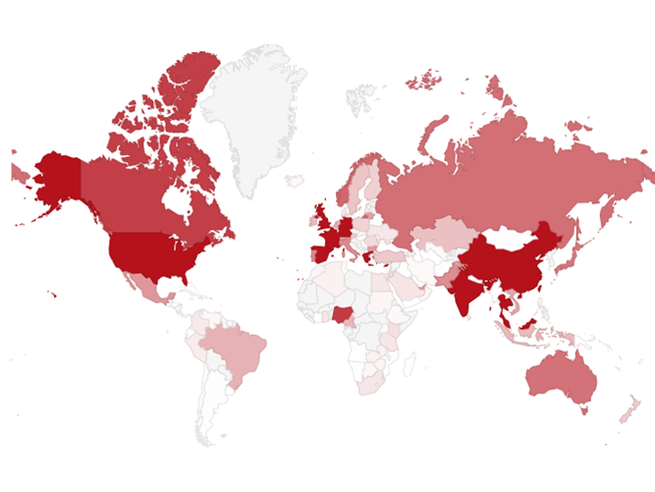
Alumni
Over 43,000 alumni in 164 countries.
Alumni profiles written by our graduates about their time at LUMS and subsequent careers
Network of LUMS Alumni (informal advice based on their own Lancaster experiences)
Guest speaker events (industry experts, careers)
Networking
Project and placement opportunities
Career mentoring and advice

Slide 16
LUMS Learning Development
Our Learning Development team have regular drop-in sessions, longer courses and workshops on academic skills for postgraduate study:
  Essay writing support- academic writing zone gives one-to-one advice
  Maths and Stats Help (MaSH) for drop-in sessions, specific workshops or tailored support plans
  Integrated academic skills modules in most Masters programmes, relating to the academic content of the programme

Slide 17





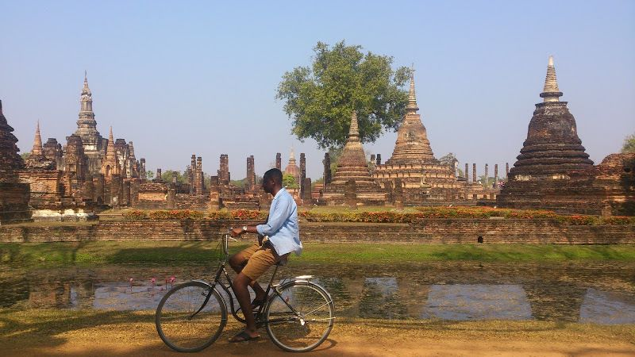



Study abroad options
One (extra!) term abroad
Notes:
Extra term is at the end of your degree- i.e., Michaelmas 2021.
No additional tuition fees- £500 admin fee, will need to cover accommodation, visa, living expenses, travel etc.
Range of partner destinations- a number in Europe (St Gallen, NHH, ESCP…) but further afield- Taiwan, Renmin, etc.
Can’t go to country you hold a passport for!

Slide 18

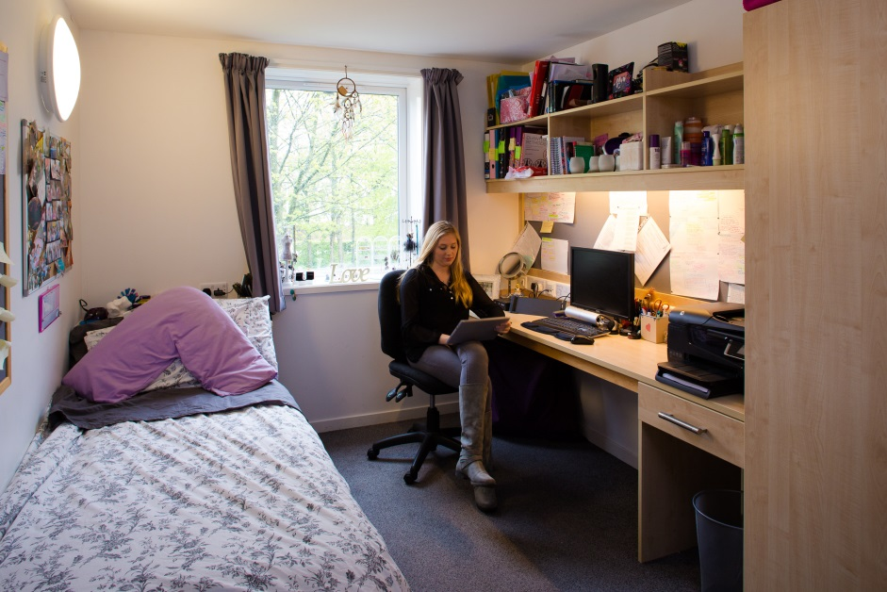
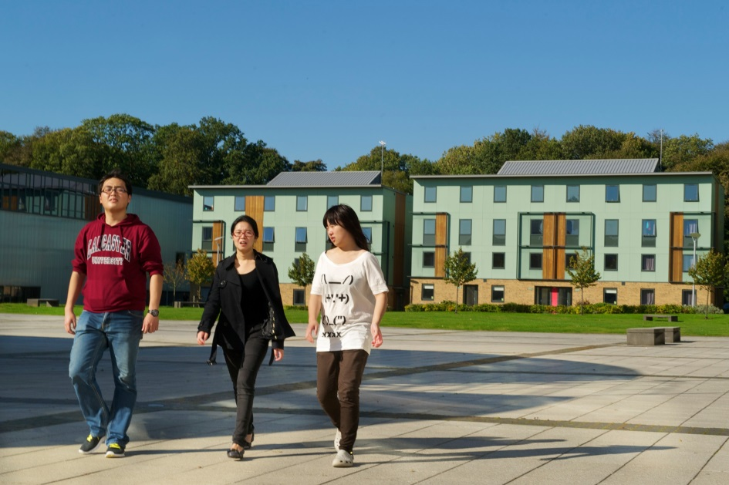
Self-catering or catered accommodation available
National Student Housing Awards 2019: Winner (Best University Halls)
Safe and secure environment
Low cost: From £107.03pw
Accommodation
Notes:
Lancaster has a collegiate system. All students are members of a college- a kind of university within the university. As postgrads, you will all be in Grad College. Physical space- the grad bar is renowned for its events!- but also a community. Regular events, coffee mornings, etc. What does it mean? You’ll be with like-mind, more mature students. Gets you away from the noisy undergraduates!
Those visiting for a term- can’t guarantee accommodation on campus, but we can provide support securing accommodation in the city.

Slide 19
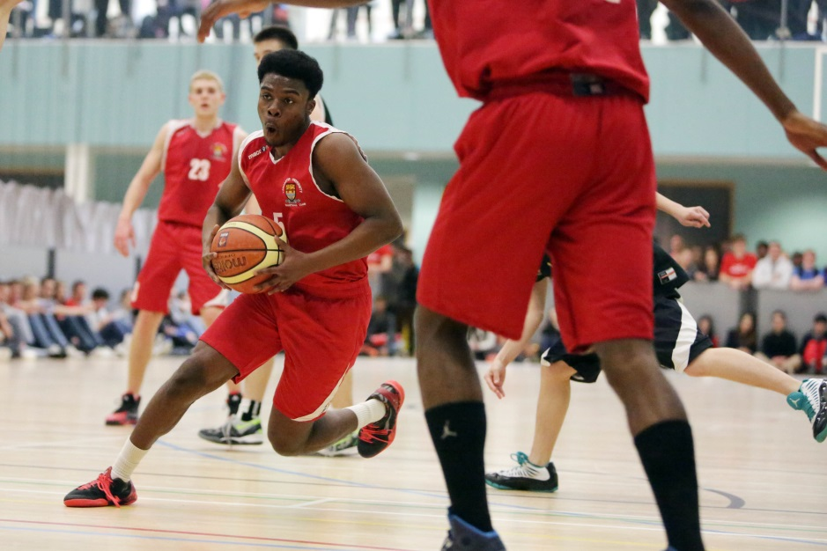
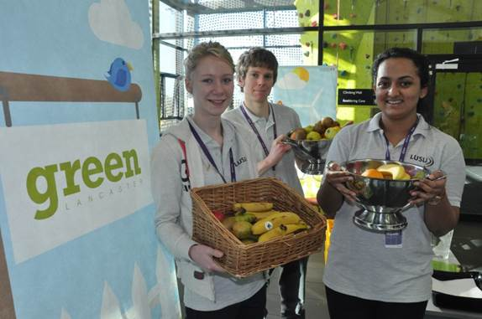

Headline
To Go Here
Our Students’ Union has more than 175 clubs and societies on offer, a highly qualified welfare and advice centre, and a nationally-respected volunteering unit.

Slide 20










Student societies
Notes:
Management School-specific/careers focused societies: Advertising Society, Finance society, Consulting.
Wide range of sports related societies, covering pretty much every sport you can name- from archery to yoga! We also have a dedicated Harry Potter Society, and I’ve included something close to my heart- student radio!

Slide 21
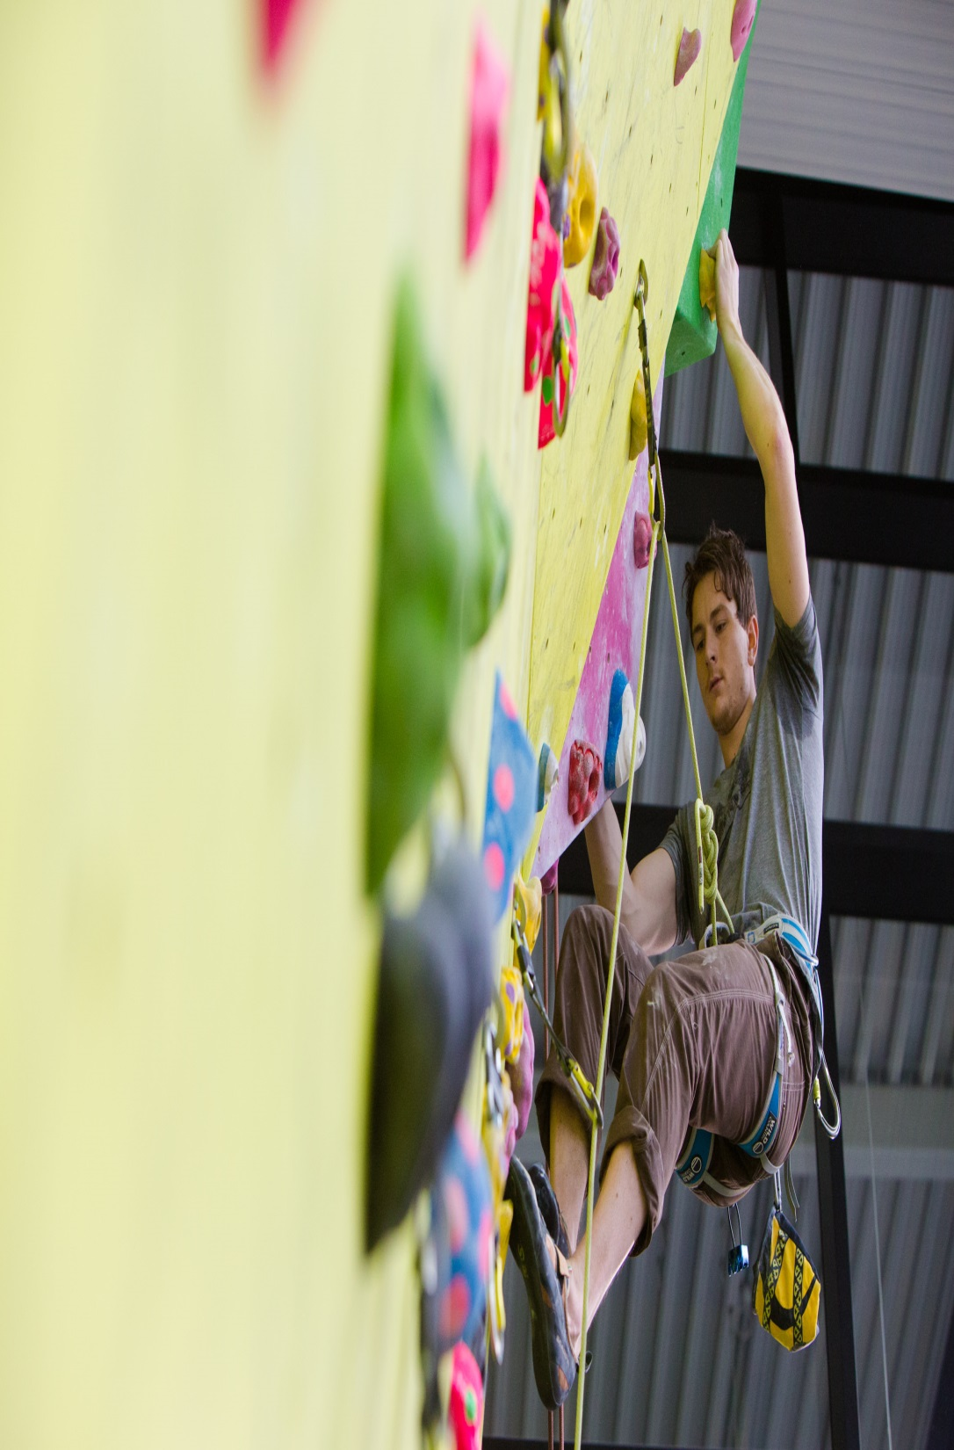
Facilities
Sports Centre with 25m swimming pool, climbing wall, sports hall, playing fields, sports courts, and 100-station gym
Multi-faith Chaplaincy Centre, Prayer Rooms, Health Centre, Dentist, Pharmacy, and Pre-School Centre
Theatre, cinema and art gallery
Post Office, banks, supermarkets, bookshop, hairdresser, plus many restaurants, cafés and bars
Notes:
Sports Centre is currently having an extension built- 1347m². Recently completed. Adds basketball court, eight badminton courts.
My favourite restaurant- Sultan’s. Amazing curry, and also great halloumi wraps. Best place on campus for coffee is Pizzetta- it’s a pizza restaurant that has amazing coffee!
HAND OVER TO CLAIRE- hopefully this has sold you on coming to Lancaster; Claire will talk in a bit more detail about the programme offering, scholarships and how to apply

Slide 22
Double Degree Progression Routes with HSE Faculty of Management
Project Management
MSc Project Management
HR Analytics
MSc Human Resource Management
MSc Advanced Marketing Management
Marketing Communications and Advertising
Notes:
If you are interested in any other masters that LUMS offer, then please speak to HSE about this in the first instance. We can consider other degree programmes on a case by case basis.

Slide 23
Double Degree Progression Routes with HSE Faculty of Management
Marketing
MSc Management Science and Marketing Analytics
E-Business
MSc Digital Business, Innovation and Management
MSc International Business and Strategy
International Management
Notes:
If you are interested in any other masters that LUMS offer, then please speak to HSE about this in the first instance. We can consider other degree programmes on a case by case basis.

Slide 24
Double Degree Progression Routes with HSE Faculty of Finance
Financial Analyst
Financial Markets and Financial Institutions
Strategic Corporate Finance
Financial Engineering
MSc Finance
MSc Money, Banking and Finance
MSc Quantitative Finance
Notes:
Need to add:
Applied Economics - to – Money, Banking and Finance
Financial Engineering – to the range of LUMS Finance programmes
Corporate Finance – to – MSc Finance and MSc Money, Banking and Finance

Slide 25
Double Degree Progression Routes with HSE Faculty of Finance
Corporate Finance
MSc Finance
MSc Money, Banking and Finance
Applied Economics
MSc Money, Banking and Finance
Notes:
If you are interested in any other masters that LUMS offer, then please speak to HSE about this in the first instance. We can consider other degree programmes on a case by case basis.

Slide 26
Scholarships & Funding
10% fee discount
Partnerships Scholarships - £10,000
Departmental Scholarships – generally £1000 - £4000, based on academic excellence
Notes:
You will receive a 10% fee discount. Double degree students will also receive a £10,000 partnership scholarship, as you are joining us on our programme with HSE. Departments may also top this up with an academic excellence scholarship.

Slide 27
Scholarships & Funding
Example 1: MSc Digital Business, Innovation and Management and MSc Human Resource Management
Tuition fees: £22,000
10% partnership discount £2,200
Partnership scholarship £10,000
£9,800 and also the possibility of departmental scholarships
Example 2: MSc Business Analytics, MSc Project Management
MSc Finance, MSc Quantitative Finance, MSc Money, Banking and Finance
Tuition fees: £24,150
10% partnership discount £2,415
Partnership scholarship £10,000
£11,735 and also the possibility of departmental scholarships

Slide 28
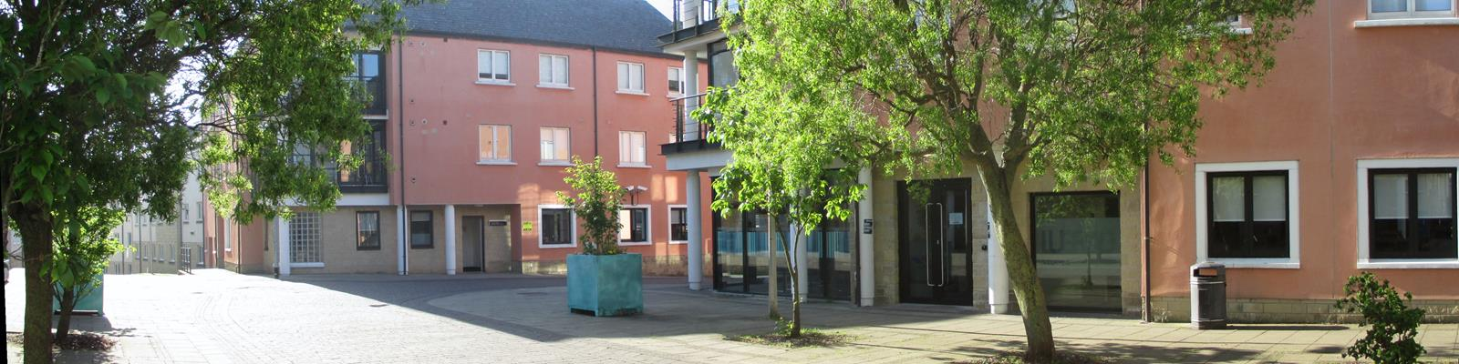
Living costs
Campus accommodation (12 months) 4,800 GB - 5,800 GBP (depending on type)
Food/ subsistence estimate 2,800 GBP
Books, stationery, clothes, local travel, entertainment etc. estimated at 2,000 GBP
More info on living costs available via student and education services:
https://www.lancaster.ac.uk/student-and-education-services/money/budgeting/living-costs/

Slide 29
Lancaster’s academic calendar
Michaelmas Term | 8th October 2021 – 17th December 2021 Welcome Week starts 4th October (compulsory) Exams: start of January 2022
Lent Term | 14th January 2022 – 25th March 2022 Exams: start of April 2022
Summer Term | 22nd April 2022 – 1st July 2022
Summer- dissertations | Variable submission dates- around August/September 2022
Notes:
Double degree students- summer is spent doing dissertation. Hand in August/September depending on department.

Slide 30
Entry Requirements & Funding
Entry Requirements:
Upper second class honours degree or equivalent in specified disciplines = GPA 4.0/5
English Language proficiency:
IELTS 7.0 (with at least 6.0 in each element)
iBTOEFL 100
Pearson Test of English (academic) 70 with at least 55 in each element
Cambridge Certificate of Proficiency in English (CPE) grade C or above
Notes:
GPA 4.0/5.0 or 7.0/10.0
Double degree students do pay fees to Lancaster (but not to HSE).

Slide 31
How to Apply?
You have to be nominated by HSE first
HSE will make the first selection and will notify Lancaster of selected candidates
Selected candidates will be asked to apply online by 15th March 2021 to be considered for the partnership scholarship and upload the following documents:
  Contact details of 2 referees (one must be academic)
  Bachelors degree transcript
  First semester HSE Masters transcript
  Language test certificate
  Personal motivation statement – max 2 pages
https://www.postgraduate-applications.lancaster.ac.uk/

Slide 32
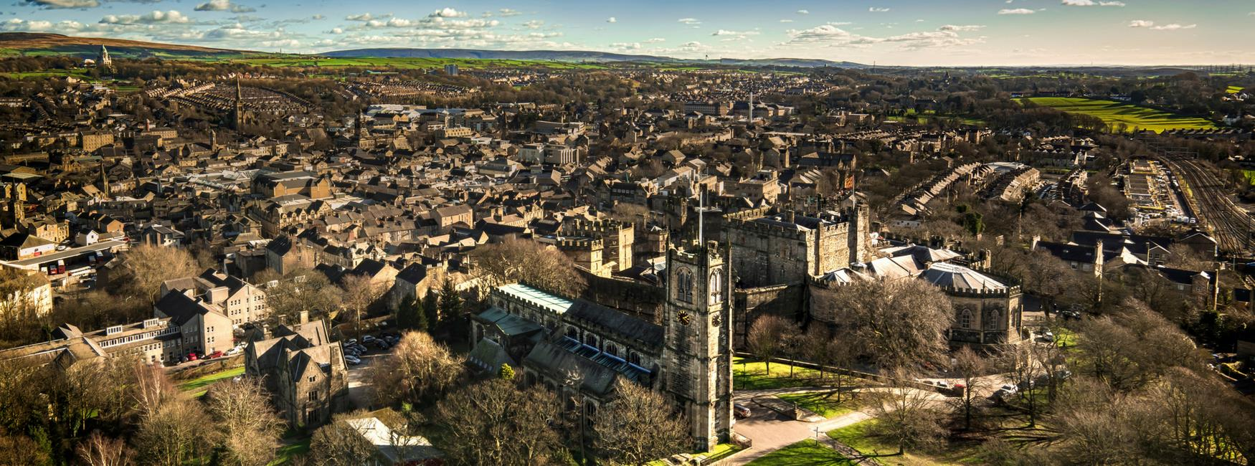

Slide 33

Any questions?
Global Experiences & Partnerships Team
exchangelums@Lancaster.ac.uk
Notes:
In order to apply initially, all you need is the transcript and motivation statement. The rest can come later on.

