Slide 1
Development of phonological and orthographic parafoveal processing during reading in Russian
Vladislava Staroverova¹, Nina Zdorova, Anastasiya Lopukhina
National Research University Higher School of Economics
¹staroverovavlada@yandex.ru

Slide 2
INTRODUCTION
Parafoveal region to the left and to the right of the foveal region
Phonological and orthographic information extracted during parafoveal processing facilitates foveal word processing.
From (Schotter, Angele & Rayner, 2012)

Slide 3
THE GAZE-CONTINGENT BOUNDARY PARADIGM
preview
target word
From (Rayner, 1998)

Slide 4
CHILDREN
Children who are learning to read initially rely on phonological information, whereas reliance on orthographic information develops later.
In languages with shallow orthographies (like German), 8-year-old children rely more on phonological information in the parafovea, whereas adults rely more on the orthographic information (Tiffin-Richards & Schroeder, 2015).

Slide 5
HYPOTHESES
During parafoveal processing
1) 8-year-old children will rely on phonological but not on orthographic information;
2) 11-year-old children and adults will rely more on orthographic but not on phonological information.

Slide 6
MATERIALS
60 target nouns: 5 letters long and with average frequency of 32 ipm (range 10-100)
5 preview conditions for each target word
control condition | reliance on phonological information |  | reliance on orthographic information
Identical (ID) | pseudohomophone (PsH) | control for pseudohomophone (Control.PsH) | transposed-letter (TL) | control for transposed-letter (Control.TL)
пирог pirog | пирок pirok | пироб pirob | приог priog | плеог pleog

Slide 7
MATERIALS
7-9 words in the sentences
Target nouns are preceded by adjectives (average length – 6.96 letters, average frequency – 61,7 ipm).
‘There was a sweet raspberry pie on the kitchen table’:
На кухонном столе стоял сладкий| пироб с малиной.
На кухонном столе стоял сладкий| пирог с малиной.

Slide 8
PARTICIPANTS
We plan to test:
-50 young adults (18-40-year-old)
-50 second graders (8-9-year-old)
-50 fourth graders (10-11-year-old)
Now:
-44 young adults
-11 second graders
-14 fourth graders
We include in the analysis children with normal hearing, IQ and reading skills.

Slide 9
PROCEDURE
Participants read 60 sentences presented on a monitor and answer questions after 20 of them
2 breaks

Slide 10
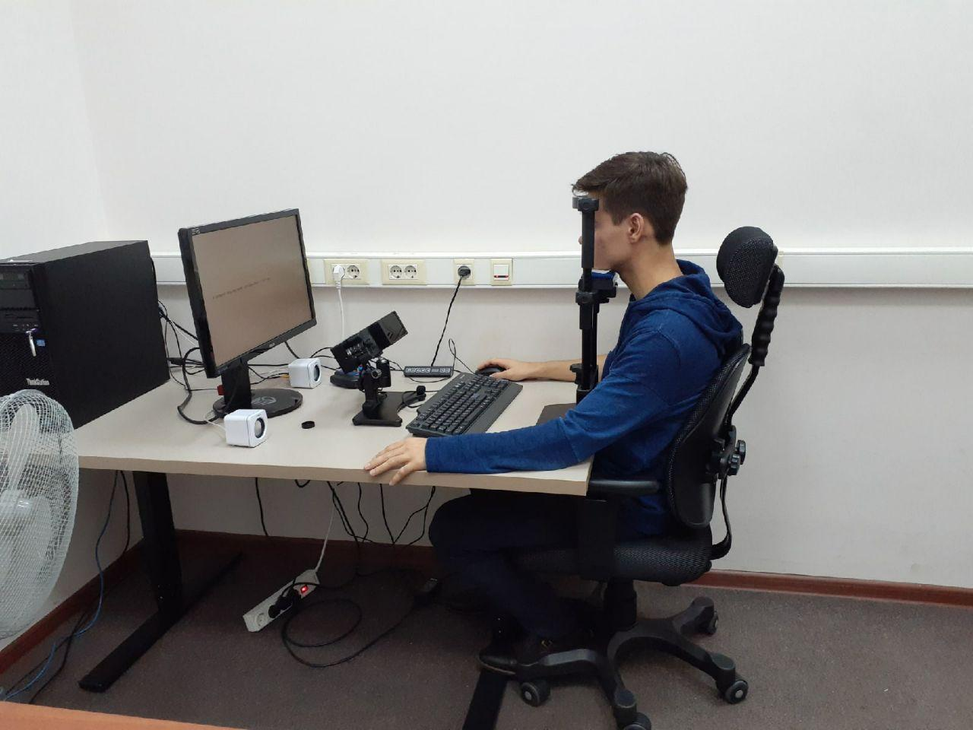
APPARATUS
An Eyelink 1000+ eyetracker (SR Research) with a sample rate of 1000 Hz
An Eyelink Portable Duo eyetracker (SR Research) with a sample rate of 1000 Hz
ASUS VG248QE monitor with a refresh rate of 144 Hz and resolution of 1920 х 1080 pixels

Slide 11
ANALYSIS (descriptive statistics)
Dependent measures:
- first fixation duration
- gaze duration

Slide 12
PRELIMINARY RESULTS FOR ADULTS

Slide 13
PRELIMINARY RESULTS FOR SECOND GRADERS

Slide 14
PRELIMINARY RESULTS FOR FOURTH GRADERS

Slide 15
THANK YOU FOR YOUR ATTENTION!

