Slide 1
The what, where, and why of priority maps and their interactions with visual working memory
Article by Gregory J. Zelinsky and James W. Bisley
Ulyana Chernova
VML Lab Meeting seminar
Feb 19th , 2021

Slide 2
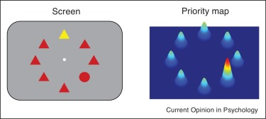
Mechanism of instantiation : a selective weighting of the low-level features matching the features representing a goal state
The weighting of features in visual space exists in the context of a spatial organization
Features and locations are inexorably bound, with the neural instantiation of this binding being activity over a priority map

Slide 3
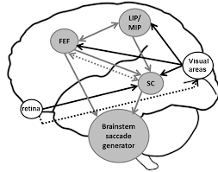
Where are the priority maps?
Some words about oculomotor system
Do the LIP, the FEF, and the superior colliculus have similar roles or do they work as a network to prioritize overt and covert movements of attention?

Slide 4
Why are the priority maps?
One function may be to serve as a sort of filter on the world, telling all downstream brain areas which bits of incoming information are important for a given task: too much information is arriving from the world, so some of it must be filtered out or attenuated
Another function may be to coordinate the different effector systems so as to achieve some goal
The third function maybe more basic function of priority maps may be to orient motor systems to specific locations

Slide 5
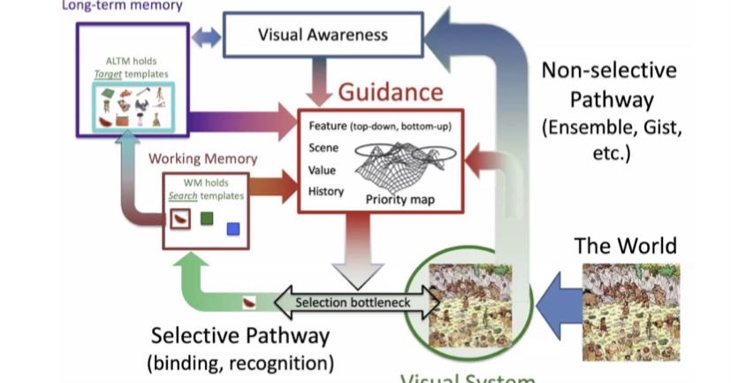
VWM is also important in sustaining the goal state so as to keep active an ongoing goal-directed behavior
When the task technically stops, it can be resume only when that goal state in working memory (WM) can reconstitute the proper sequence of priority settings
So a fundamental function of WM is to not only reinstate a goal state following an interrupt, but to prevent such interrupts from gaining priority in the first place

