Slide 1
Academic development of students at HSE St. Petersburg
HSE – Saint-Petersburg
Saint-Petersburg 2023

Slide 2
HSE Research Internship
HSE – Saint-Petersburg
Academic Development of students
HSE – Saint-Petersburg
Research Internship – Saint-Petersburg
Research intern
Who is a research intern?
An HSE student or postgraduate employed by an HSE research unit to work on a research project
Who can apply for an internship?
Any full-time undergraduate or graduate student
When do applications start?
In February, annually
What are the benefits of being an intern?
Start your academic career
Gain experience working with a research team
Take a part in solving research problems under the guidance of leading scientists
For further information we recommend contacting laboratory principals

Slide 3
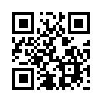
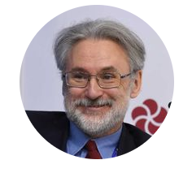
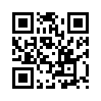
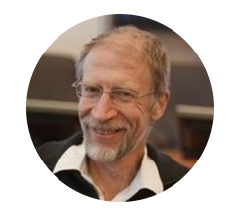
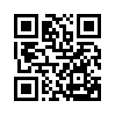
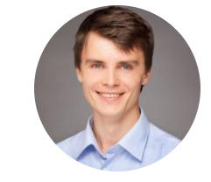
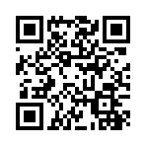
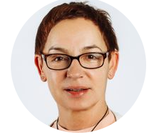
HSE – Saint-Petersburg
Academic Development of students
HSE – Saint-Petersburg
Structural subdivisions of HSE for research interns – Saint-Petersburg
Alexandrov Daniil
dalexandrov@hse.ru
Laboratory of Sociology in Education and Science
The Laboratory researches the school climate (bullying, cyberbullying), adolescent health, segregation in schools, and the situation of migrant children in Russian schools.
Center for Market Theory and Spatial Economics
The Center's research focuses on four areas: spatial economics of regions and cities, retail products in large cities, the Russian electricity market, and macroeconomics.
International Laboratory of Game Theory and Decision Making
The main research areas are the design of economic mechanisms and developing new applications for specific problems of resource allocation, the analysis of information effects for dynamic games, and the development of algorithmic game theory.
Center for Youth Studies
The Center's team is engaged in the research interests of the Center are youth cultures, subcultures, values, and the lifestyles of youth, interethnic and interreligious relations, growing up, age and life course, youth citizenship, labor market and employment, youth entrepreneurship and consumption, and youth policy.
Kokovin Sergei skokovin@hse.ru
Nesterov Alexandr
asnesterov@hse.ru
Omelchenko Elena
eomelchenko@hse.ru

Slide 4
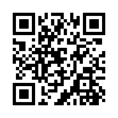
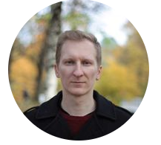
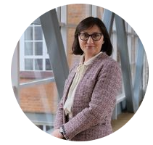
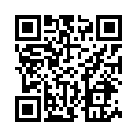
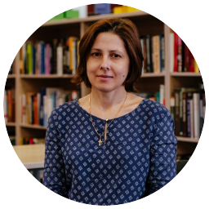
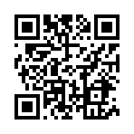
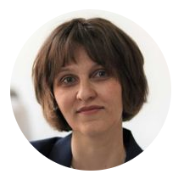
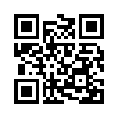
HSE – Saint-Petersburg
Academic Development of students
HSE – Saint-Petersburg
Structural subdivisions of HSE for research interns – Saint-Petersburg
Reznik Alexandr
areznik@hse.ru
Center for Historical Research
The mission of the Center is to systematically develop methodologies and approaches for global, comparative, and transnational history in various fields of historical research.
Strategic Entrepreneurship Center
The main scientific goal is to develop a new approach to understanding strategic entrepreneurship as an adaptation mechanism to turbulence in the external environment (at the level of firms and national economies).
International Laboratory of Quantum Optoelectronics
The Laboratory conducts advanced research and development in the field of photonics and nanoelectronics devices based on quantum effects.
Laboratory for Social and Cognitive Informatics
The Laboratory studies and models the interactions of individuals and groups with information, information technology, and other users.
Shirokova Galina
gshirokova@hse.ru
Krizhanovskaya Natalya
nkryzhanovskaya@hse.ru
Koltsova Elena
ekoltsova@hse.ru

Slide 5
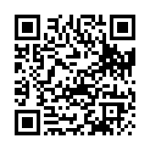
Employment as a research assistant
HSE – Saint-Petersburg
Academic Development of students
HSE – Saint-Petersburg
HSE - Employment
Who is a research assistant?
A research assistant is an undergraduate, graduate, or postgraduate student who assists academic staff in research activities
Research assistants facilitate the work of academic staff and acquire research skills that will be useful to them in the future
What is the spectrum of duties?
critical analysis of the relevant literature
data collection and processing
organizing and conducting experiments
conducting field research
the design and formatting of the texts of articles
What are the benefits?
becoming a part of science programs, research centers, or laboratories
the contract provides payment
Research assistant’s program

Slide 6
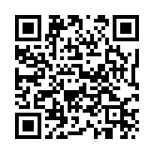
Conference participation
HSE – Saint-Petersburg
Academic Development of students
HSE – Saint-Petersburg
Conferences participation
What is a travel grant?
An opportunity to participate in a scientific conference, congress, or symposium with a paper or exhibit
What is a goal of this program?
To integrate young scientists into the global scientific community
Where can I go with this funding?
Funding is allocated for travelling to scientific events held in Russia, CIS countries, and further abroad
How can I apply?
Applications for participation in a scientific event abroad (including CIS countries) should be submitted no later than 45 days before the event.
Applications for participation in a scientific event in Russia shall be submitted no later than 30 days prior to the event.
Detailed information

Slide 7
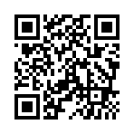
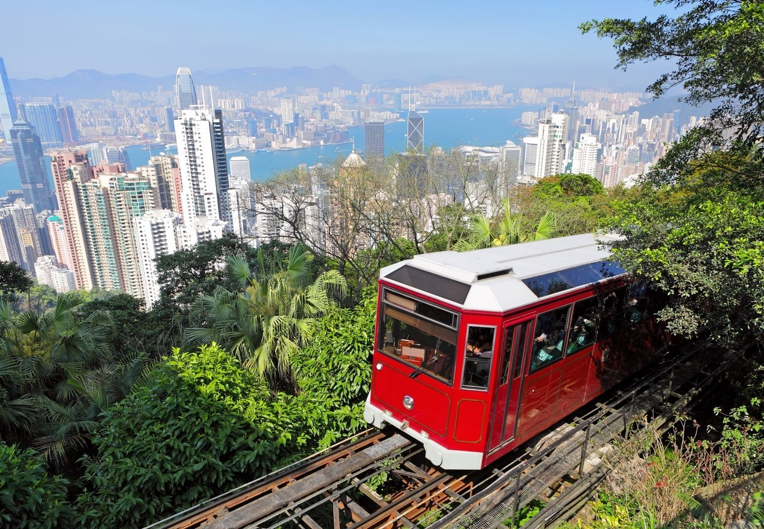
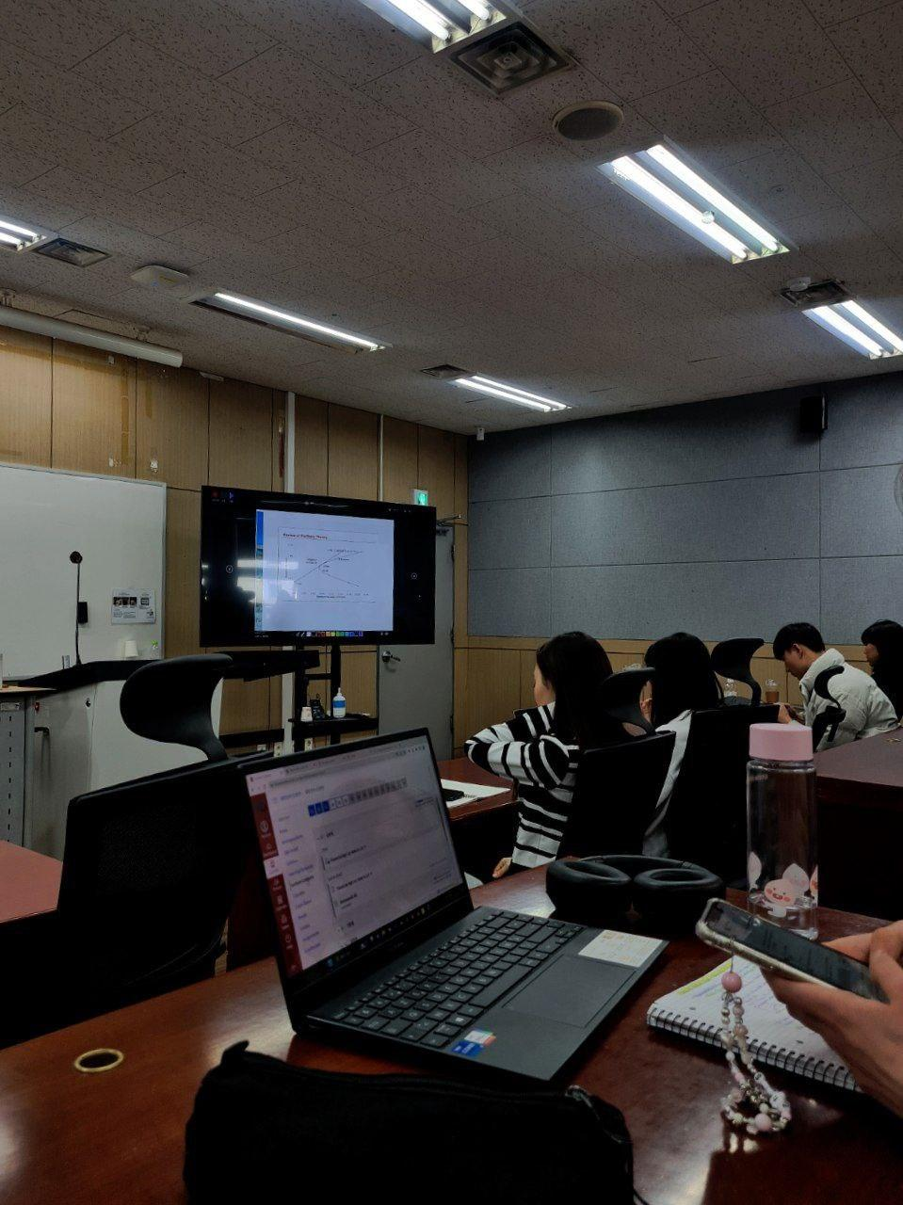
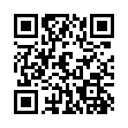
International academic programs
HSE – Saint-Petersburg
Academic Development of students
HSE – Saint-Petersburg
Foreign academic programs
These offer a unique scientific experience, an excellent investment in your future and the experience of living and studying in another country and developing intercultural communication and teamwork skills.
25+
COUNTRIES
Centre of the Student’s Foreign Mobility
75+ STUDENTS ON
EXCHANGE PROGRAMS
370+ PLACES PER YEAR FOR HSE STUDENTS
1000+ APPLICATIONS PER YEAR
International academic mobility HSE – Saint-Petersburg

Slide 8
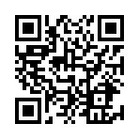
Student events: organizing and funding
HSE – Saint-Petersburg
Academic Development of students
HSE – Saint-Petersburg
Funding for events
What events are eligible for funding?
Students can receive funding for the organization of a thematic conference, seminar, master class, field research event, etc.
How it is allocated?
The Centre for Academic Development of Students allocates funding on a competitive basis in the amount of up to 300,000 rubles for the organization of an event
The funding is allocated based on the results of the competition and must be used within 3 months of approval and no later than 10 December of the year in which the event received support
What are deadlines for applying?
Applications shall be submitted no later than 30 days before the event
Competition of event funding

Slide 9
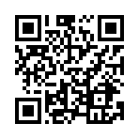
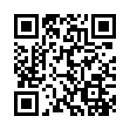
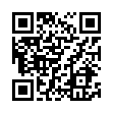
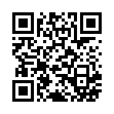
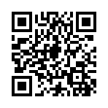
HSE – Saint-Petersburg
Academic Development of students
HSE – Saint-Petersburg
Student Scientific Society
The Student Scientific Society (SSS) is a voluntary association of HSE students, created to unite all those who are interested in scientific research and who want to take part in organizing and conducting various scientific, popular science, and science-educational events.
Student scientific community "Civilistics Club"
Historical and legal scientific society
Student scientific community "International Law Club”
Student Scientific Society of History Department
Student Scientific Society Institute of Oriental and African Studies

Slide 10
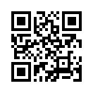
“Science Battles: HSE”
HSE – Saint-Petersburg
Academic Development of students
HSE – Saint-Petersburg
Popularizing Science
"Science Battles: HSE" is a place where any person interested in science can learn about the ongoing scientific research and ask questions to young scientists.
Each science battle consists of presentations by 4 participants.
How does it work?
Each participant has to give a talk about their scientific research and answer questions from the audience for 10 minutes
Restrictions and rules
No powerpoint – only public speaking skills and props
After all participants have spoken, a vote is taken among the audience and the jury
What is the prize?
The winner gets the opportunity to go to the finals and compete for the main prize of an academic travel grant
When?
The new season of academic battles will start in February

Slide 11
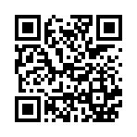
Student Research Paper Competition
HSE – Saint-Petersburg
Academic Development of students
HSE – Saint-Petersburg
Inner Academic Competition
What is it for?
To identify and support the most talented and creative students and graduates, to inspire them in their research work and their mastery of their educational programmes
Who can apply?
Bachelor's, specialist's, and master's students
Advantages of participation in the competition
A special scholarship for the winners in each category (20,000 rubles per month for 10 months);
A special certificate
Additional points for admission to a Master's program
Discounts on payment for admission to an HSE Master's program
An academic travelling grant for participation in a scientific event
What are main requirements?
Research papers are to be written in Russian or English
Papers for the competition are to be submitted from 1 September to 15 October annually

Slide 12
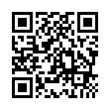
Team research project competition “Research Initiative”
HSE – Saint-Petersburg
Academic Development of students
HSE – Saint-Petersburg
Inner Academic Competition
The idea of Initiative
A grant competition
Who can participate?
Undergraduate and graduate students
Advantages
An opportunity to come up with and independently implement a team research project from scratch
students gain teamwork skills
An opportunity to collaborate and realize the most ambitious scientific ideas
An opportunity to conduct interdisciplinary research
Examples:
Creating experimental medical drugs
Creating databases of languages of the peoples of the Russian North
Applications for the team research project are collected annually from 8 February to 3 March.

Slide 13
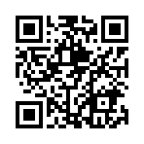
State Academic Scholarship
HSE – Saint-Petersburg
Academic Development of students
HSE – Saint-Petersburg
Increased State Academic Scholarship
An Increased Scholarship for achievements in research activities is awarded to students studying on a full-time state-funded basis
Who can apply
Winners of a research paper competition at HSE
Winners of a research paper competition held outside of HSE
Those receiving a grant for research paper fulfilment
Publication in a scientific (academic, scientific, educational and methodological) publication
How to participate
A student submits an application for the Increased Scholarship through the LMS educational information environment system
Documents for the competition are submitted in the LMS system within 20 calendar days from the date of the competition announcement
Competition announcements are posted on the website (see QR) no later than 15 May and 15 November of each academic year.

Slide 14
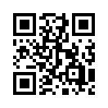
Grant competitions
HSE – Saint-Petersburg
Academic Development of students
HSE – Saint-Petersburg
Outer science competitions
Who can participate?
undergraduate students of universities located in St. Petersburg
postgraduate students of any university
branch and academic institutes located in St. Petersburg
Example competitions
Competition of student research on the problems of forming a tolerant environment in St. Petersburg (March)
Competition of business ideas, scientific and technical developments, and research projects under the motto "Young, Daring, Promising" (April–May)
Detailed information about these and other scientific competitions and grants are on the website of the Research Department of HSE St. Petersburg
Science

Slide 15
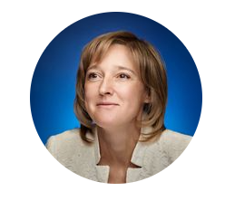
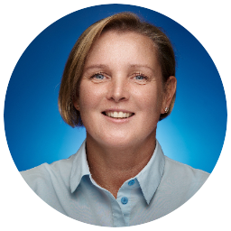
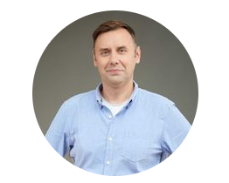
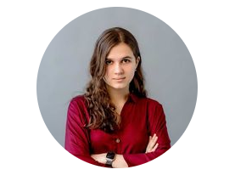
HSE – Saint-Petersburg
Academic Development of students
HSE – Saint-Petersburg
Contacts
Research Support Department
Academic Support Unit
HSE Saint-Petersburg
Borisova Elena, head of division
evborisova@hse.ru
Koltunova Veronica, lead specialist
vkoltunova@hse.ru
Centre for the Academic Development of Students — HSE Moscow
Kozhanov Andrey, principal of AD center
akozhanov@hse.ru
Makarova Tatyana, manager
tmakarova@hse.ru
Osipova Polina, manager
posipova@hse.ru

