Slide 1


International Laboratory for Applied Network Research
Master’s Programme Applied Statistics with Network Analysis
What is new:
MaSna specializations
Open Doors & Master Class
Moscow, June 15, 2020

Slide 2

Master’s programme Applied Statistics with Network Analysis
Focus of today’s open doors event
Starting with Fall 2020, MASNA will offer four distinct specializations:
Computational social sciences (PhD preparation track)
Business analytics (joint track with Master’s program “Management and analytics for business”)
Network-analytic track
Online-only track
Today, we focus on the first two

Slide 3
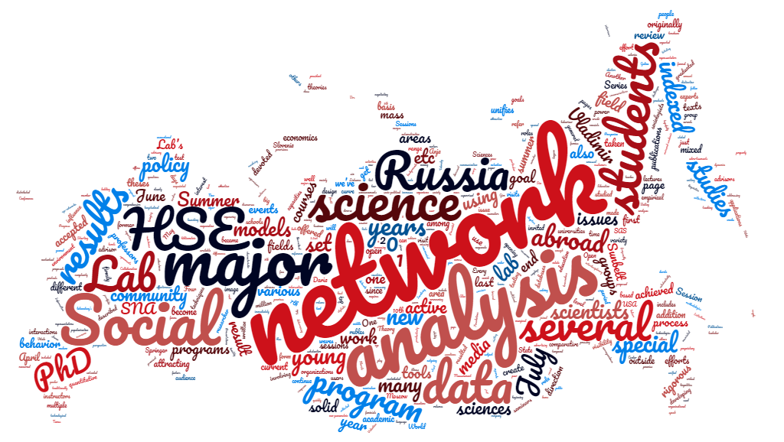
International Laboratory for Applied Network Research
Briefly about MASNA “home”

Slide 4



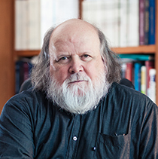
International Laboratory for Applied Network Research
FOUNDERS AND SCIENTIFIC ADVISORS
Valentina Kuskova
PhD Indiana University
Stanley Wasserman
PhD Harvard
Head of the Laboratory
Deputy First Vice Rector
Academic supervisor of MASNA
Scientific advisor in 2014-2017
Founder of several programs and departments in the US
Founding editor, Network Science
Anuška Ferligoj
PhD, Professor, Ljubljana University
Vladimir Batagelj
PhD, Professor Emeritus University of Ljubljana
Scientific advisor since 2017
Head, Center for Social Informatics and Methodology
Senior Research Fellow
Program Pajek for analysis and visualization of large network data

Slide 5



International Laboratory for Applied Network Research
ANR-Lab: an Integrated Analytical Center
Research
Education
Master’s programme “Applied Statistics with Network Analysis”
            Created using best international best practices and analogues
            Training in the newest and most advanced data analytic methods, including networks
            Professors – world-renowned international scholars
            Taught in English
            Fee-based, but highly sought
Short educational events in Russia and internationally
Development of school of applied network analysis
Several research groups:
networks in political science, sociology, management; methodology of network analysis and statistics
Popularization of network-analytic methods, starting with bachelor’s students
Tight integration into Russian and international academic community
Consulting
Applied (fee-based) consulting for business, governments and NGO
          Four high-level projects completed, several in the works
          Clients: SAS Russia, VW Group Rus, Rosatom, Peredvizhnaya Energetika
Analytical workshop: free consulting services for HSE students, faculty and community in general
Opened in October 2019, over 50 clients

Slide 6





International Laboratory for Applied Network Research
Official Partners

Slide 7
International Laboratory for Applied Network Research
Partnership with Ljubljana
More than scientific supervision
Anuška Ferligoj
Marjan Cugmas
Vladimir Batagelj
Anja Žnidaršič
Janez Demsar
Luka Kronegger
Ajda Pretnar
Mobility
Incoming and outgoing, for students of all levels and researchers
Collaboration
Research and publications
Editorship
Organizing of scientific and educational events
Education
MASNA professors
Starting with 2020: double-degree programs for students, including PhD

Slide 8
Master’s Programme Applied Statistics with Network Analysis

Slide 9
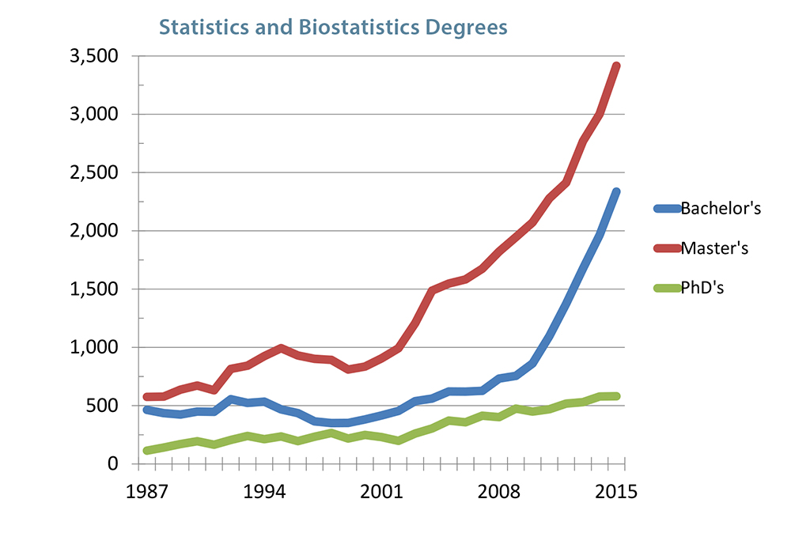
Master’s Programme Applied Statistics with Network Analysis
New Data Analysis programs opened recently

Slide 10
Master’s Programme Applied Statistics with Network Analysis
Why Applied Statistics?
Statistical courses are usually caught in math or economics departments:
  They are limited to mathematical courses, formulas and derivations.
  Such analysis may not be applicable to other fields such as Psychology, Sociology, Economics, Education, Informatics, and Biology, where there is a strong need for data analysis.
Without data, we can’t understand processes. Without theory, we can’t understand data.
This program offers the best of both worlds.
It is – really – the same as the big buzzword, Data Science
Data science, also known as data-driven science, is an interdisciplinary field about scientific methods, processes, and systems to extract knowledge or insights from data in various forms, either structured or unstructured, similar to data mining (Wikipedia)
Data science is a "concept to unify statistics, data analysis and their related methods" in order to "understand and analyze actual phenomena" with data.
When Harvard Business Review called it "The Sexiest Job of the 21st Century"[ the term became a buzzword, and is now often applied to business analytics, or even arbitrary use of data, or used as a sexed-up term for statistics.

Slide 11

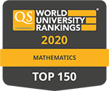
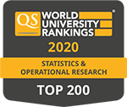


Master’s Programme Applied Statistics with Network Analysis
Where do we fit?
We are a part of a broader Faculty’s commitment to Data Science
Research
Education
International Laboratory for Applied Network Research
Other research labs and centers at the Faculty
Data culture: program for bachelor’s students
MASNA

Slide 12

Master’s Programme Applied Statistics with Network Analysis
Career Tracks
Data analysts in all fields
Statistical consultants
Researchers in major consulting firms
Background for future PhD studies

Slide 13
Master’s Programme Applied Statistics with Network Analysis
Why Applied Statistics?
Statistical courses are usually caught in math or economics departments:
  They are limited to mathematical courses, formulas and derivations.
  Such analysis may not be applicable to other fields such as Psychology, Sociology, Economics, Education, Informatics, and Biology, where there is a strong need for data analysis.
Without data, we can’t understand processes. Without theory, we can’t understand data.
This program offers the best of both worlds.
It is – really – the same as the big buzzword, Data Science
Data science, also known as data-driven science, is an interdisciplinary field about scientific methods, processes, and systems to extract knowledge or insights from data in various forms, either structured or unstructured, similar to data mining (Wikipedia)
Data science is a "concept to unify statistics, data analysis and their related methods" in order to "understand and analyze actual phenomena" with data.
When Harvard Business Review called it "The Sexiest Job of the 21st Century"[ the term became a buzzword, and is now often applied to business analytics, or even arbitrary use of data, or used as a sexed-up term for statistics.

Slide 14





Master’s Programme Applied Statistics with Network Analysis
World-Renowned Faculty
Stanley Wasserman
Vladimir Batagelj
Anuška Ferligoj
Program Academic Consultant
PhD Harvard, Rudy Professor of Statistics and Psychology, Indiana University
Professor of Discrete and Computational Mathematics, Department of Mathematics and Institute of Mathematics, Physics and Mechanics, Department for theoretical computer science, University of Ljubljana
Professor, Chair of Social Informatics and Methodology, Centre for Methodology and Informatics, Faculty of Social Sciences, University of Ljubljana
Tamás Rudas
Herwig Friedl
Janez Demšar
Erik Štrumbelj
Doctor of Science (Mathematics),
Eötvös Loránd University; Hungarian Academy of Sciences (Centre for Social Sciences); Affiliate Professor, University of Washington
Professor, Institute of Statistics
Graz University of Technology, Austria
Professor, Computer and Information Sciences, University of Ljubljana
Assistant Professor, Faculty of Social Sciences, University of Ljubljana

Slide 15
Master’s Programme Applied Statistics with Network Analysis
Quick facts
Full-time (but evening education)
2 years of study
Very competitive cost (relative to other world programs)
Language of study: English
Entrance requirements: Portfolio (Bachelor’s or Master’s degree in any field, Motivation letter, English language test)

Slide 16
Master’s Programme Applied Statistics with Network Analysis
MASNA Advantages
Educational components
Program blocks | Blocks of disciplines
Mathematical disciplines | Bayesian data analysis Exploratory data analysis Stochastic models | Nonparametric Theory and Data Analysis Multidimensional data analysis Nonparametric Theory and Data Analysis
Programming skills | Algorithms and databases Programming languages Internet technologies
Statistics and Network Methodology | Contemporary Data Analysis Contemporary Decision Sciences Methods | Multilevel models Random graphs
Applied Network Analysis | Mathematical: Social Network Analysis Advanced Topics in SNA Longitudinal data analysis Methods of Statistical Consulting | Applied: Social networks in education Business networks Organizational consulting

Slide 17

Master’s Programme Applied Statistics with Network Analysis
Sample courses
Contemporary Data Analysis: Methodology of Interdisciplinary Research
Contemporary Decision Sciences Methods: an Integrated Perspective
Statistical Learning Theory
Nonparametric Theory and Data Analysis
Applied Linear Models
Network Analysis with R
Advanced Topics in Network Analysis

Slide 18
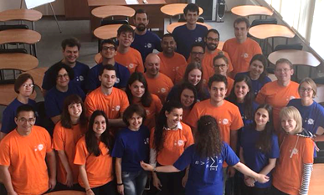
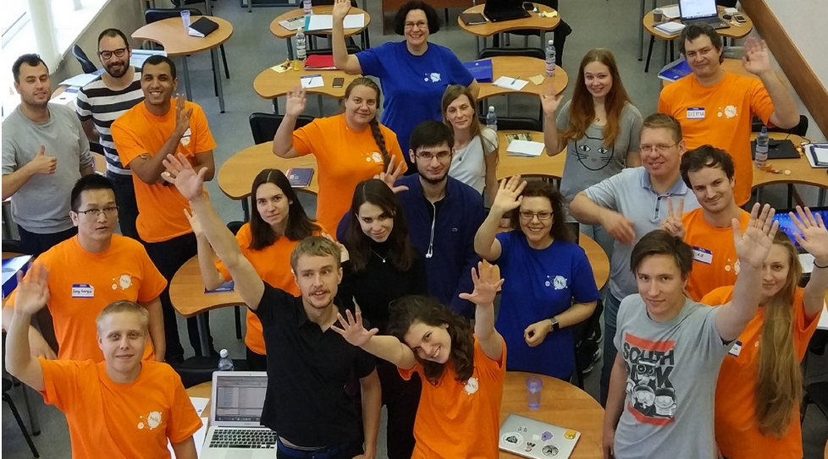
Master’s Programme Applied Statistics with Network Analysis
OUR STUDENTS
46 students, 6 international
Students background fields of study:
Psychology
Sociology
Management
Biology
Medicine
IT
Economics
Chemistry
Political Science
Law
Math
Statistics
Business Informatics
Technology

Slide 19



Master’s Programme Applied Statistics with Network Analysis
Our students’ success
Too many stories to share
First and second places at Kaggle competitions
Intellectual games winning
Two top places and a nomination at the HSE Student Research Paper competition

Slide 20
Master’s Programme Applied Statistics with Network Analysis
Career Opportunities for Students
Students who prefer the practical career track have an opportunity to complete their internships at companies where their analytical skills are needed.
Now our students are working in leading National and Global companies:
  Volkswagen Group,
  Thomson Reuters,
  Synergy Research Group,
  Ingosstrakh,
  CROC incorporated
Students oriented on academic carriers plan to pursue PhD after completing their Master’s and thus enjoys the research.
Three our second-year students have already enrolled PhD programs with scholarships:
Stepan Zaretskiy:
PhD program of Inter-university Center for Social Science Theory and Methodology (ICS) and the Department of Sociology of the University of Groningen.
Felipe Vaca:
PhD program in Network Science at Central European University, Budapest, Hungary
Mikhail Bogdanov:
entered HSE doctoral program in Sociology as a winner of the National Student Olympiad 'I am the Professional'

Slide 21
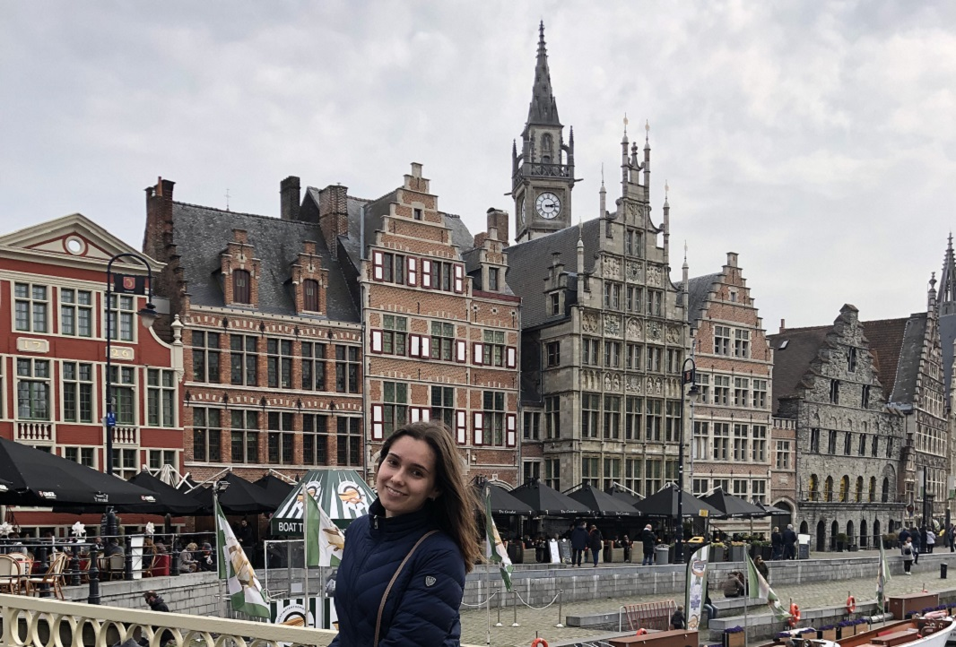
Master’s Programme Applied Statistics with Network Analysis
Academic mobility
Students have also an opportunity to enroll in an internship in Ljubljana University or be a part of Student Exchange Program HSE.
Some our students spent several months in famous European universities:
  Elena Beylina:
  Ghent University, Belgium
  Stepan Zaretskiy:
  University of Groningen, Netherlands
  Felipe Vaca, Lisa Chernenko
  Paco Arevalo:
  Ljubljana University, Slovenia

Slide 22

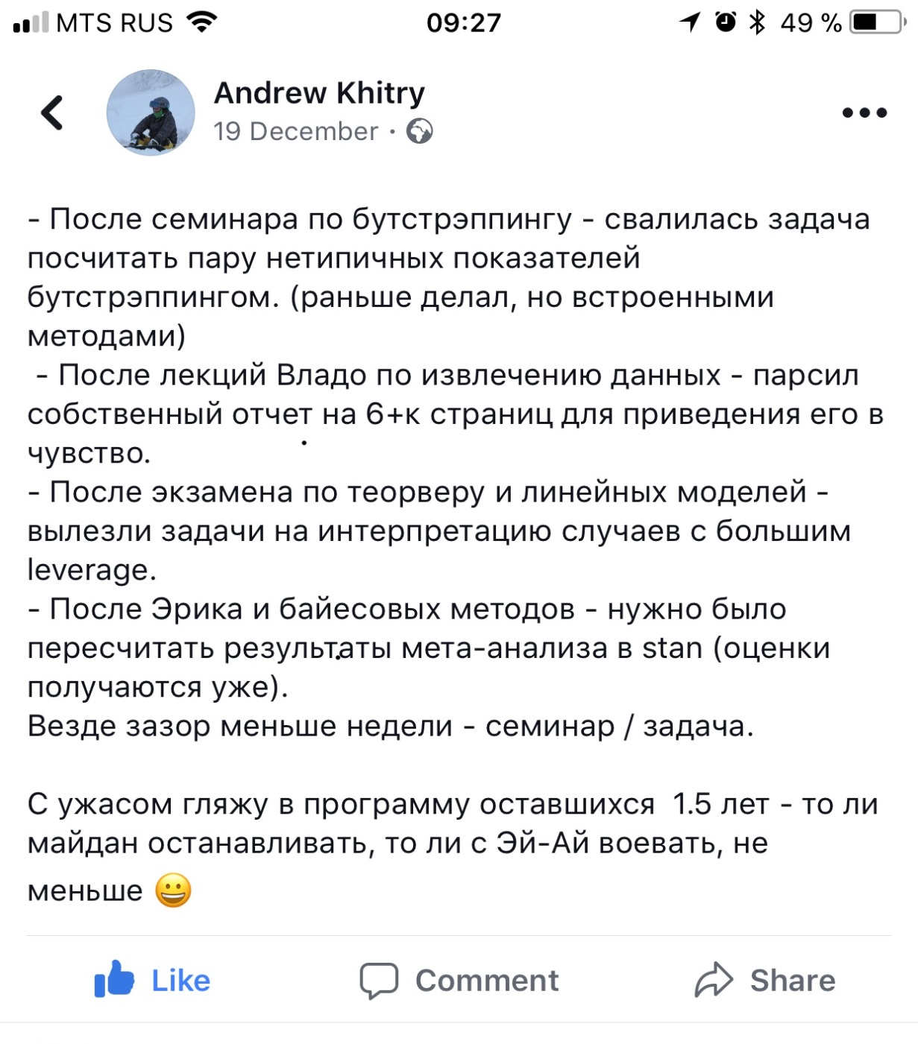
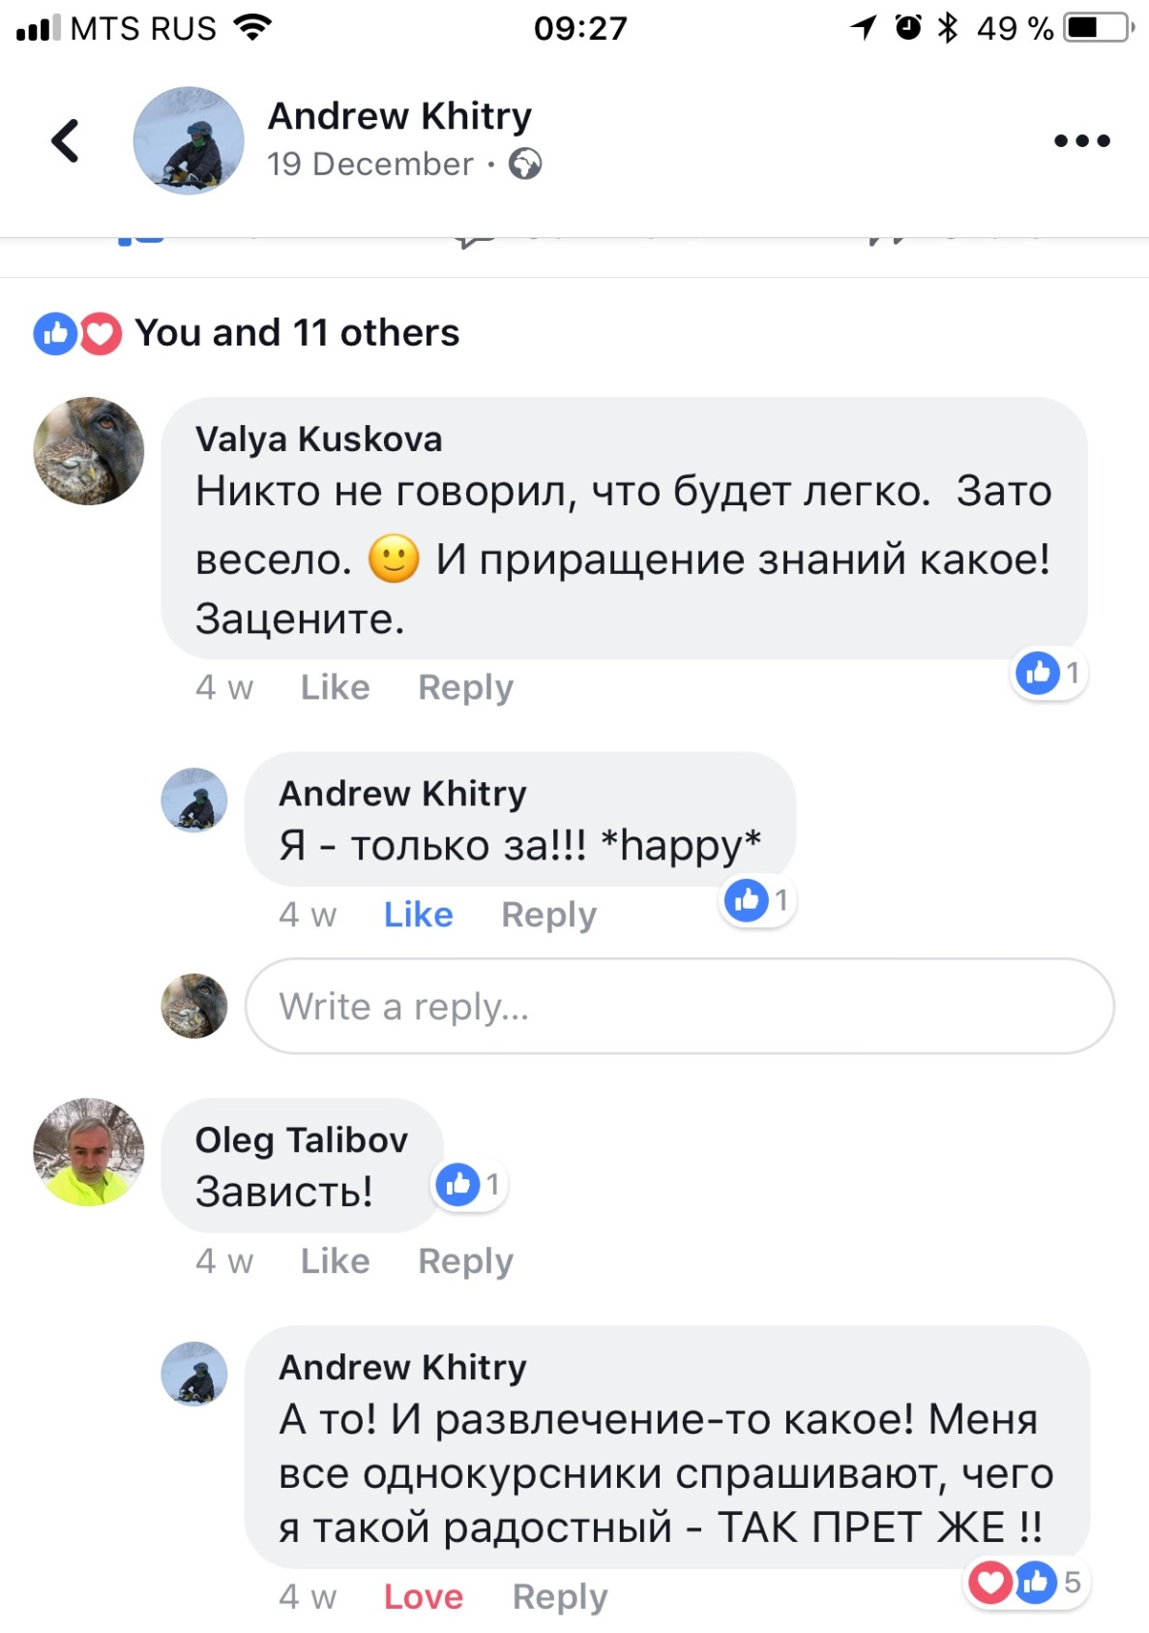
Master’s Programme Applied Statistics with Network Analysis
OUR GOSSIP

Slide 23
Master’s Programme Applied Statistics with Network Analysis
We want you to be the best you can be
…and we’ll do what it takes to help you get there
MASNA is unique in many ways, but when we say it’s the best program of its kind in Russia, we mean it.
Not because it’s the only one, through that’s true.
Because it offers the range of choices and opportunities simply not available anywhere else.
We give you the best career choice possible.

Slide 24
Master’s programme Applied Statistics with Network Analysis (MASNA)
Master’s programme Management and Analytics for Business
Business analytics track
Moscow, June 15, 2020

Slide 25

Master’s programme Applied Statistics with Network Analysis
Our focus
Preparation of world-class analysts for all areas of business
      Business analyst, data analyst, data-scientist – these are the demanded and competitive professions in business. This track will allow students to acquire techniques and skills for employment in business companies and corporations. We will learn to work with modern methods of data analysis, ways of machine learning, develop programming skills in different languages.
Our graduate, Alexander Alimov
"I work as a data scientist and analytical consultant at PWC. The most important thing about the Master's program was that it gave me a clear understanding of algorithms for working with absolutely different data. This allows me to be as flexible as possible when I receive many completely different tasks that cannot fit into a single template. All courses in the program form good understandings of data culture and techniques used for particular cases."

Slide 26
Master’s programme Applied Statistics with Network Analysis
Our focus
Preparation of world-class analysts for all areas of business
General business-related courses:
      Strategic Management
      Analytical Tools for Business (Google IQ; Yandex Metrica Expert)
      Applied Strategic Management

Slide 27
Master’s programme Applied Statistics with Network Analysis
Our focus
Preparation of world-class analysts for all areas of business
Specialization in People Analytics:
      People analytics: Prediction of Performance & Prescription Policy
      Talent Analytics: Data and Tools
      Performance Evaluation: Data and Tools
      Staffing Analytics Overview

Slide 28
Master’s programme Applied Statistics with Network Analysis
Our focus
Preparation of world-class analysts for all areas of business
Specialization in Customer Analytics:
      Consumer Behavior
      Database Marketing and Analytical CRM
      Advanced Marketing Models
      Social Network Analysis

Slide 29
Master’s programme Applied Statistics with Network Analysis (MASNA)
Center of Statistical Consulting & Analytics (SCAN-Center)
International Laboratory for Applied Network Analysis (ANR-Lab)
Computational social sciences
PhD Track
Moscow, June 15, 2020

Slide 30
Master’s programme Applied Statistics with Network Analysis
Our focus
Academic track:
to prepare students for leading Ph.D. programs at prestigious universities in the United States and Europe
to acquire the necessary skills and competencies to build academic careers and become successful researchers
Computational social sciences:
“Computational social science is a powerful tool for fostering our understanding of the complexities of real socio-economic systems, by building “virtual computational social worlds” that we can analyze, experiment with, feed with and test against empirical data on a hitherto unprecedented scale” (Conte, Rosaria, et al. "Manifesto of computational social science." The European Physical Journal Special Topics 214.1 (2012): 333)
“The era of big data has created new opportunities for researchers to achieve high relevance and impact amid changes and transformations in how we study social science phenomena. With the emergence of new data collection technologies, advanced data mining and analytics support, there seems to be fundamental changes that are occurring with the research questions we can ask, and the research methods we can apply … The changing costs of data collection and the new capabilities that researchers have to conduct research that leverages micro-level, meso-level and macro-level data suggest the possibility of a scientific paradigm shift toward computational social science. The new thinking related to empirical regularities analysis, experimental design, and longitudinal empirical research further suggests that these approaches can be tailored for rapid acquisition of big data sets. This will allow business analysts and researchers to achieve frequent, controlled and meaningful observations of real-world phenomena” (Chang, Ray M., Robert J. Kauffman, and YoungOk Kwon. "Understanding the paradigm shift to computational social science in the presence of big data." Decision Support Systems 63 (2014): 67)

Slide 31
Master’s programme Applied Statistics with Network Analysis
You will learn
Theory-driven approach:
                Systematize existing subject-matter knowledge
                Conceptualize and operationalize complex phenomena
                Learn to formulate scientific problems and research issues competently
                Create research design, set goals and objectives for future research
Data-driven approach:
                Collect and manipulate data
                Choose the method of data analysis appropriate for the question and the data
                Deal with measurement and data-related problems
                Test for data reliability and validity
Model building:
                Model complex social phenomena
                Interpret and Discover applicable results

Slide 32
Master’s programme Applied Statistics with Network Analysis
You will GET
To learn modern methods of data analysis and advanced statistical methodology
Your papers published in the best journals of the field of your interest
Your papers presented at best international conferences
Acceptance into the international scientific community
Employment in NRU HSE ANR Lab
Double PhD

Slide 33

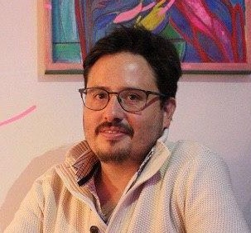


Master’s programme Applied Statistics with Network Analysis
Our graduates
Stepan Zaretskiy:
PhD program of Inter-university Center for Social Science Theory and Methodology (ICS) and the Department of Sociology of the University of Groningen.
Paco Arevalo:
PhD program in University if Ljubljana, Slovenia
Felipe Vaca:
PhD program in Network Science at Central European University, Budapest, Hungary
Miloude Lacheheb:
PhD program in Economics of Natural Disasters in Victoria University of Wellington in New Zealand

Slide 34




Master’s programme Applied Statistics with Network Analysis
Our graduates
Gregory Khvatsky:
entered HSE doctoral program in Sociology as a researcher of ANR Lab with PhD topic: “Methodology of Policy Efficiency Assessment using Computational Tools of Media Analysis”
Mikhail Bogdanov:
entered HSE doctoral program in Sociology as a winner of the National Student Olympiad 'I am the Professional'
Rustam Kamalov:
entered HSE doctoral program in Sociology as a researcher of ANR Lab with PhD topic: “Theory and Methodology for experts’ impact evaluation in education policy”
Polina Lushnikova:
entered HSE doctoral program in Sociology as a researcher of ANR Lab with PhD topic: “Theory and Methodology for Social Changes Modeling”

Slide 35

Master’s programme Applied Statistics with Network Analysis
WHAT IS computational social sciences
Growing availability of large amounts of unstructured data opens up new horizons for social sciences
However, social scientists often lack the expertise required to analyse these data
On the other hand, computer scientists often lack the domain knowledge to make actionable decisions based on data
Thus, an interdisciplinary collaboration is needed

Slide 36

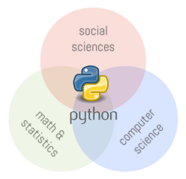

Master’s programme Applied Statistics with Network Analysis
What is computational social sciences

Slide 37
Master’s programme Applied Statistics with Network Analysis
Goals and objectives
The ultimate goal of this track is to bring together social and computer scientists in order to develop and refine new methodological approaches to social studies and learn to apply them to interdisciplinary research problems

Slide 38
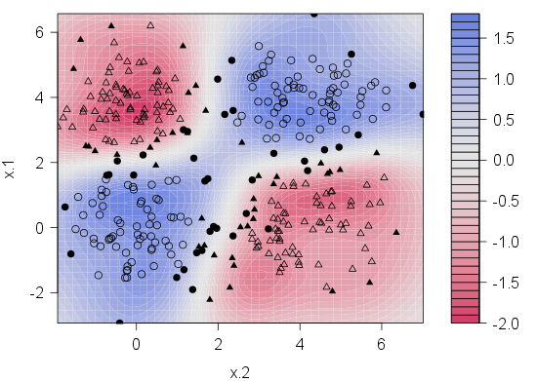
Master’s programme Applied Statistics with Network Analysis
Classical machine learning
For analysis of images, networks and texts
  SVM
  Clustering
  Regression
  Bayesian methods
Data extraction from unstructured sources

Slide 39
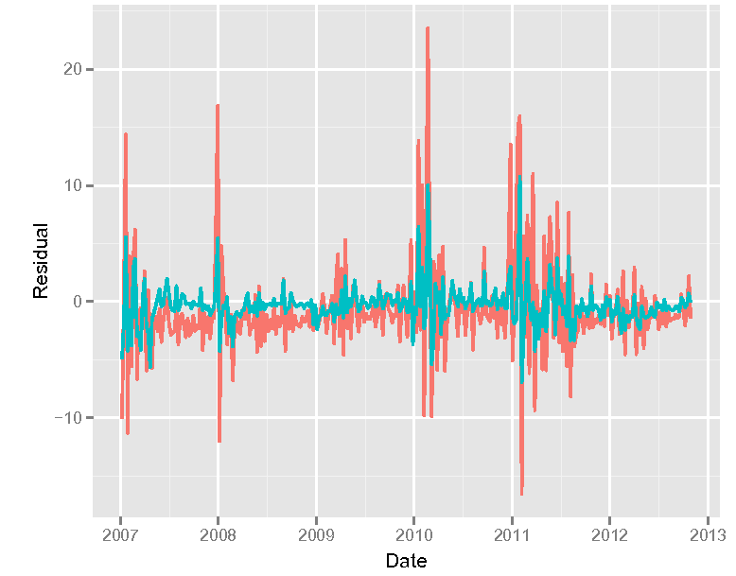
Master’s programme Applied Statistics with Network Analysis
Models for predictive analytics
Time series analysis for
  Finance
  Politics
Using both classical and deep learning approaches

Slide 40
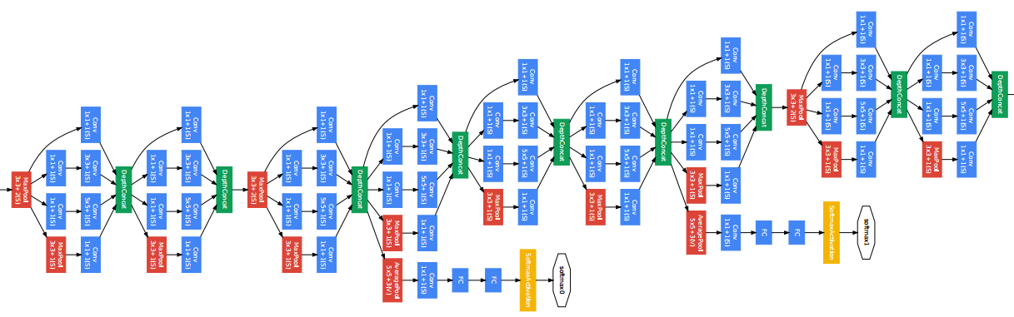
Master’s programme Applied Statistics with Network Analysis
Deep learning: neural networks
Convolutional and Capsule networks for image analysis
RNNs for text and temporal sequence analysis and prediction
Deep learning on graphs

Slide 41
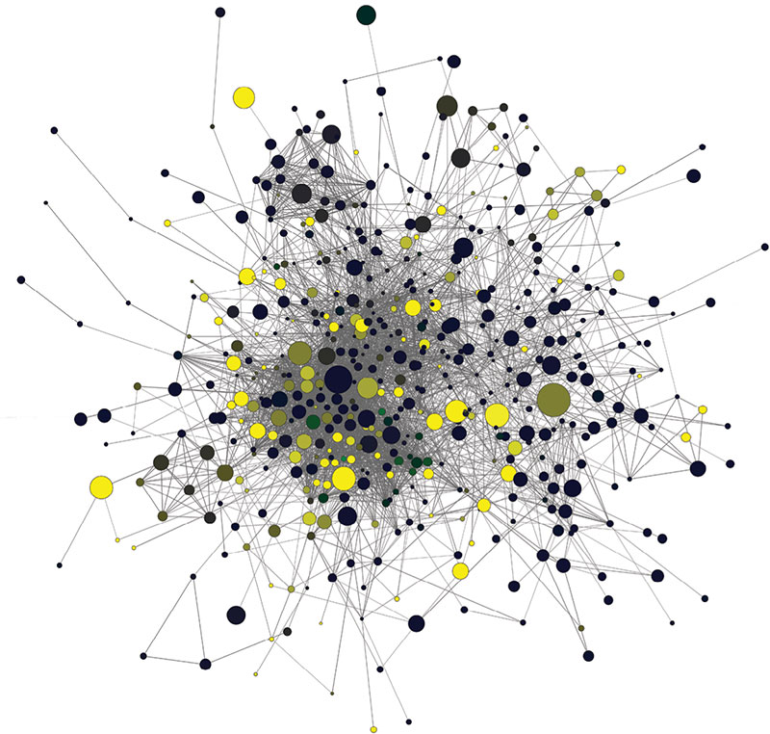
Master’s programme Applied Statistics with Network Analysis
Social network analysis
Network simulations
Dynamic network models
Centrality / Importance measures
Graph embeddings
Link prediction algorithms
Community detection algorithms
Games on graphs

Slide 42
SCAN-center analytical workshop

Slide 43
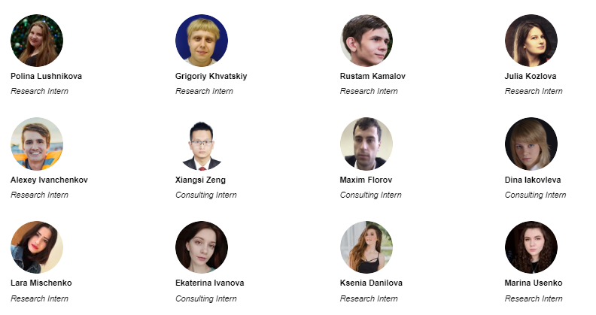
Master’s programme Applied Statistics with Network Analysis
Analytical workshop team

Slide 44
Anr-lab research groups

Slide 45
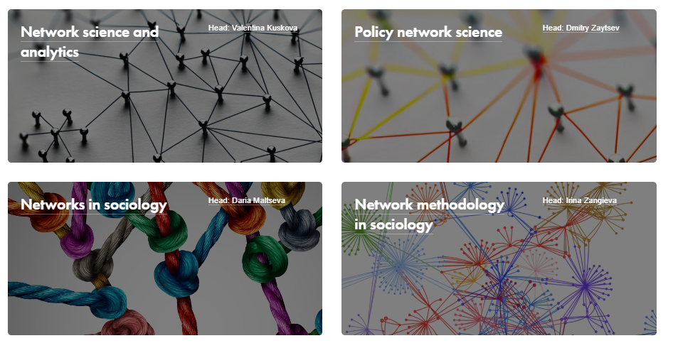
Master’s programme Applied Statistics with Network Analysis
ANR LAB research groups

Slide 46



CONTACT US:
www.hse.ru/en/ma/sna
email: anr@hse.ru
Address: Pokrovsky Boulevard, 11, Room М406, Moscow, 109028, Russia
www.facebook.com/anrlab
www. vk.com/hsemasna
www.instagram.com/masna.hse/

Slide 47
CONTACT US:
www.hse.ru/en/ma/sna
email: anr@hse.ru
Address: Pokrovsky Boulevard, 11, Room М406, Moscow, 109028, Russia
www.facebook.com/anrlab
www. vk.com/hsemasna
www.instagram.com/masna.hse/

