Slide 1
Профессор Л.В.Поляков Экономические санкции ЕС и российский ответ.
Игра с нулевой суммой?

Slide 2
«Европа – это сад, мы создали этот сад… Все [в Европе] работает, это лучшая комбинация политической свободы, экономической перспективы и социальной сплоченности… Остальной мир – это не совсем сад. Большая часть остального мира – это джунгли. А джунгли могут вторгнуться в сад» (Жозеп Боррель).

Slide 3
Первый пакет санкций ЕС против России от 23.02.2022 г.
In response to Russia recognising the non-government controlled areas of the Donetsk and Luhansk oblasts of Ukraine and its decision to send troops into the region.. These sanctions target:
the ability of the Russian state and government to access the EU’s capital and financial markets and services, to limit the financing of escalatory and aggressive policies
economic relations between the two non-government controlled regions and the EU, to ensure that those responsible clearly feel the economic consequences of their illegal and aggressive actions
individuals and entities who played a role in undermining or threatening the territorial integrity and independence of Ukraine. With these additions, the list comprises a total of 555 individuals and 52 entities

Slide 4
Второй пакет санкций ЕС против России от 25.02.2022 г.
Financial sector sanctions that will cut Russia's access to the most important capital markets, targeting 70% of the Russian banking market, but also key state-owned companies, including the field of defence Energy sector sanctions that will prohibit the sale, supply, transfer or export to Russia of specific goods and technologies in oil refining, and will introduce restrictions on the provision of related services Transport sector sanctions that will ban the sale of all aircraft, spare parts and equipment to Russian airlines. This will degrade the key sector of Russia's economy and the country's connectivity Technology sector sanctions imposing further restrictions on exports of dual-use goods and technology, as well as restrictions on exports of certain goods and technology which might contribute to Russia’s technological enhancement of its defence and security sector

Slide 5
COUNCIL REGULATION (EU) 2022/330 of 25 February 2022 amending Regulation (EU) No 269/2014 concerning restrictive measures in respect of actions undermining or threatening the territorial integrity, sovereignty and independence of Ukraine
Состав преступления: Крымский мост.
Энциклопедия Борхеса
Joint stock company «Gas Industry Insurance Company SOGAZ » insured the construction of the railway infrastructure connecting the bridge over the Kerch Strait and the Port of Taman and reinsured the construction of the bridge over the Kerch Strait. Therefore it supported the consolidation of the illegally annexed Crimean peninsula into the Russian Federation, which in turn further undermined the territorial integrity, sovereignty and independence of Ukraine.
(12) In view of the gravity of the situation, the Council considers that 26 persons and one entity should be added to the list of persons, entities and bodies subject to restrictive measures set out in Annex I to Regulation (EU) No 269/2014.
И.Сечин, Н.Токарев, А.Усманов, П.Авен, М.Фридман, С.Ролдугин, Д.Песков, Д.Чернышенко, И.Файзуллин, В.Савельев, А.Турчак, Т.Кеосаян, О.Скабеева, А.Пономаренко, М.Колеров, Р.Бабаян, Захар Прилепин, А.Красовский, А.Мамонтов, С.Пинчук, А.Авдеев, Р.Мурадов, Г.Тимченко, П.Мордашов, П.Фрадков (ПСБ),

Slide 6
А что здесь непонятно?!

Slide 7
Третий пакет санкций ЕС против России от 28.02.2022 г. (часть первая)
A ban on transactions with the Russian Central Bank, aiming at preventing the Russian Central Bank from accessing its large amounts of foreign reserves held in the EU – 23 млрд. евро
A ban on the overflight of EU airspace and on access to EU airports by Russian carriers of all kinds

Slide 8
Третий пакет санкций ЕС против России от 2.03.2022 г. (часть вторая).
Exclude key Russian banks from the SWIFT system, the world's dominant financial messaging system. This measure will stop these banks from conducting their financial transactions worldwide in a fast and efficient manner. Today's decision has been closely coordinated with the EU's international partners, such as the United States and the United Kingdom
Prohibit investing in projects co-financed by the Russian Direct Investment Fund
Prohibit the provision of euro-denominated banknotes to Russia
Prohibit state-owned media Russia Today and Sputnik' to broadcast in the EU

Slide 9
Четвёртый пакет санкций ЕС против России от 15.03.2022 г.
A full prohibition on transactions with certain Russian State-owned enterprises, with the exception of State-owned banks, railways and the maritime shipping register
Prohibit EU agencies to provide financial rating services to Russian companies
A ban on imports of iron and steel products currently under EU safeguard measures as well as new investments in the Russian energy sector, with the exception of nuclear energy and the transport of energy products
Prohibit the export of luxury goods

Slide 10
COUNCIL IMPLEMENTING REGULATION (EU) 2022/427 of 15 March 2022 implementing Regulation (EU) No 269/2014 concerning restrictive measures in respect of actions undermining or threatening the territorial integrity, sovereignty and independence of Ukraine
Брюссельский “обком” действует: «Персональное дело» Профессора Шохина
Перевода не требуется
Alexander Nikolayevich Shokhin is the president of the Russian Union of Industrialists and Entrepreneurs – a lobby group, which promotes the interests of business in Russia. He is also a Deputy Chairman of Mechel PAO’s Board of Directors – one of the leading Russian mining and metals companies, which generates a source of revenue for the Government of the RF. After the annexation of Crimea by Russia, Shokhin publicly expressed a need to direct more Russian investment to Crimea in order to override possible economic blockade by the West. On 24 February 2022, Shokhin attended a meeting of oligarchs at the Kremlin with Vladimir Putin to discuss the impact of the course of action in the wake of Western sanctions. The fact that he was invited to attend that meeting shows that he is a member of the inner circle of oligarchs close to Vladimir Putin and that he is supporting or implementing actions or policies which undermine or threaten the territorial integrity, sovereignty and independence of Ukraine, as well as stability and security in Ukraine. It also shows that he is one of the leading business persons involved in economic sectors providing a substantial source of revenue to the Government of Russia, which is responsible for the annexation of Crimea and the destabilisation of Ukraine.

Slide 11
Пятый пакет санкций ЕС против России от 8.04.2022 г.
Coal ban: An import ban on all forms of Russian coal Financial measures: A full transaction ban and asset freeze on four additional Russian banks. A prohibition on providing high-value crypto-asset services to Russia. A prohibition on providing trust services to wealthy Russians, making it more difficult for them to store their wealth in the EU Transport: A full ban on Russian and Belarusian freight road operators working in the EU. Certain exemptions cover essentials, such as mail, agricultural and food products, humanitarian aid as well as energy. An entry ban on Russian-flagged vessels to EU ports. Exemptions apply for medical, food, energy, and humanitarian purposes, amongst others Targeted export bans: Further targeted export bans which include, in particular, quantum computing, advanced semiconductors, sensitive machinery, transportation and chemicals Extending import bans: Additional import bans including cement, rubber products, wood, spirits (including vodka), liquor, high-end seafood (including caviar), and an anti-circumvention measure against potash imports from Belarus

Slide 12
COUNCIL IMPLEMENTING REGULATION (EU) 2022/581 of 8 April 2022 implementing Regulation (EU) No 269/2014 concerning restrictive measures in respect of actions undermining or threatening the territorial integrity, sovereignty and independence of Ukraine
АО Росэлектроника; АО «Арзамасский машиностроительный завод»; АО «Корпорация тактическое ракетное вооружение»; АО Концерн «Калашников»; АО ОДК-Климов; ООО «Военно-промышленная компания»; АО Судостроительный завод «Море»; АО ОМСКТРАНСМАШ; ООО «Русские машины»; АО Концерн «Созвездие»; Холдинговая компания АО «Научно-производственный концерн «Технологии машиностроения»; АО «Объединённая двигателестроительная корпорация»; Прибалтийский судостроительный завод «Янтарь»; Банк ВТБ; Новикомбанк; Совкомбанк; Государственная транспортная лизинговая компания.

Slide 13
Шестой пакет санкций ЕС против России от 3.06.2022 (часть первая)
Oil import restrictions Crude and refined oil embargo: These sanctions will come into force with immediate effect, and will phase out Russian oil imports in an orderly fashion. For seaborne crude oil, spot market transactions and execution of existing contracts will be permitted for six months after entry into force, while for petroleum products, these will be permitted for eight months after entry into force. Member States who have a particular pipeline dependency on Russia can benefit from a temporary exemption and continue to receive crude oil delivered by pipeline, until the Council decides otherwise. However, Member States benefiting from this exemption will not be able to resell such crude oil and petroleum products to other Member States or third countries
Due to its specific geographical exposure, a special temporary derogation until the end of 2024 has been agreed for Bulgaria which will be able to continue to import crude oil and petroleum products via maritime transport. In addition, Croatia will be able to authorise until the end of 2023 the import of Russian vacuum gas oil which is needed for the functioning of its refinery

Slide 14
Шестой пакет санкций ЕС против России от 3.06. 2022 г. (часть вторая)
Oil transport services:
After a wind down period of 6 months, EU operators will be prohibited from insuring and financing the transport, in particular through maritime routes, of oil to third countries.This will make it particularly difficult for Russia to continue exporting its crude oil and petroleum products to the rest of the world since EU operators are important providers of such services
Financial and business services measures:
An additional three Russian banks, Russia's largest bank Sberbank, Credit Bank of Moscow, and Russian Agricultural Bank - and the Belarusian Bank For Development And Reconstruction have been removed from SWIFT. These banks are critical for the Russian financial system and Putin's ability to further wage war. It will solidify the isolation of the Russian financial sector from the global system

Slide 15
Шестой пакет санкций ЕС против России от 3.06.2022 г. (часть третья)
The provision of certain business-relevant services - directly or indirectly – such as accounting, auditing, statutory audit, bookkeeping and tax consulting services, business and management consulting, and public relations services to the Russian government, as well as to legal persons, entities or bodies established in Russia are now prohibited
Broadcasting suspension
The broadcasting activities of another three Russian State outlets – Rossiya RTR/RTR Planeta, Rossiya 24/Russia 24, and TV Centre International – have been suspended. They are among the most important pro-Kremlin disinformation outlets targeting audiences in Ukraine and the EU, and disseminating propaganda in support of Russia's aggression against Ukraine
Several regulators in EU Member States have already taken action against those Russian state-controlled broadcasters and channels. They will now be barred from distributing their content across the EU, in whatever shape or form, be it on cable, via satellite, on the internet or via smartphone apps
The advertising of products or services on sanctioned outlets has also been prohibited

Slide 16
Седьмой пакет санкций ЕС против России от 21.07. 2022
Gold import ban: The import of all gold originating from Russia and exported from Russia into the EU or to any third country is prohibited. An exemption applies for gold jewellery of travellers for their personal use Reporting requirements strengthened: Sanctioned people are obliged to declare their assets, in order to facilitate the freezing of their assets in the EU/
Targeted export bans: Export controls on dual use and advanced technology is reinforced by extending the list of items which may contribute to Russia’s military and technological enhancement or the development of its defence and security sector/
Port access ban: Russian flagged vessels are banned to access locks to prevent the circumvention of sanctions Financial sanctions: The prohibition on accepting deposits is expanded to deposits from legal persons, entities or bodies established in third countries and majority-owned by Russian nationals or natural persons residing in Russia. Additionally, the acceptance of deposits for non-prohibited cross-border trade will be subject to a prior authorisation by the national competent authorities.

Slide 17
Восьмой пакет санкций ЕС против России 5.10.2022 (часть 1)
New export restrictions: Additional export restrictions have been introduced which aim to reduce Russia's access to military, industrial and technological items, as well as its ability to develop its defence and security sector. This includes the banning of the export of coal including coking coal (which is used in Russian industrial plants), specific electronic components (found in Russian weapons), technical items used in the aviation sector, as well as certain chemicals. A prohibition on exporting small arms and other goods under the anti-torture Regulation has been added.
New import restrictions: Almost €7 billion worth of additional import restrictions have been agreed. It includes, for example, a ban on the import of Russian finished and semi-finished steel products (subject to a transition period for some semi-finished), machinery and appliances, plastics, vehicles, textiles, footwear, leather, ceramics, certain chemical products, and non-gold jewellery.

Slide 18
Восьмой пакет санкций ЕС против России от 5.10.2022 (часть вторая)
Implementing the G7 oil price cap: Today's package marks the beginning of the implementation within the EU of the G7 agreement on Russian oil exports. While the EU's ban on importing Russian seaborne crude oil fully remains, the price cap, once implemented, would allow European operators to undertake and support the transport of Russian oil to third countries, provided its price remains under a pre-set “cap”. This will help to further reduce Russia's revenues, while keeping global energy markets stable through continued supplies. It will thus also help address inflation and keep energy costs stable at a time when high costs – particularly elevated fuel prices – are a great concern to all Europeans. This measure is being closely coordinated with G7 partners. It would take effect after 5 December 2022 for crude and 5 February 2023 for refined petroleum products, after a further decision by the Council.
Restrictions on State-owned enterprises: Today's package bans EU nationals from holding posts in the governing bodies of certain state-owned enterprises. It also bans all transactions with the Russian Maritime Register, adding it to the list of state-owned enterprises which are subject to a transaction ban.

Slide 19
Восьмой пакет санкций ЕС против России от 5.10.2022 (часть третья)
Financial, IT consultancy and other business services: The existing prohibitions on crypto assets have been tightened by banning all crypto-asset wallets, accounts, or custody services, irrespective of the amount of the wallet (previously up to €10,000 was allowed). The package widens the scope of services that can no longer be provided to the government of Russia or legal persons established in Russia: these now include IT consultancy, legal advisory, architecture and engineering services. These are significant as they will potentially weaken Russia's industrial capacity because it is highly dependent on importing these services.

Slide 20
Всемирный Банк: стабилизация экономики России после 2023 года
Russia’s economy will contract by 4.5 percent in 2022, less than initially expected thanks to the strong fiscal response and the surge in energy prices which helped increase fiscal revenues. The economy has experienced a sharp drop in imports, and a fall in real incomes. The recession will continue in 2023 due to the sanctions and reduced fiscal expansion. Thereafter the economy is expected to stabilize. However, medium to long-term growth is expected to be very low as Russia has lost access to key sources of productivity

Slide 21
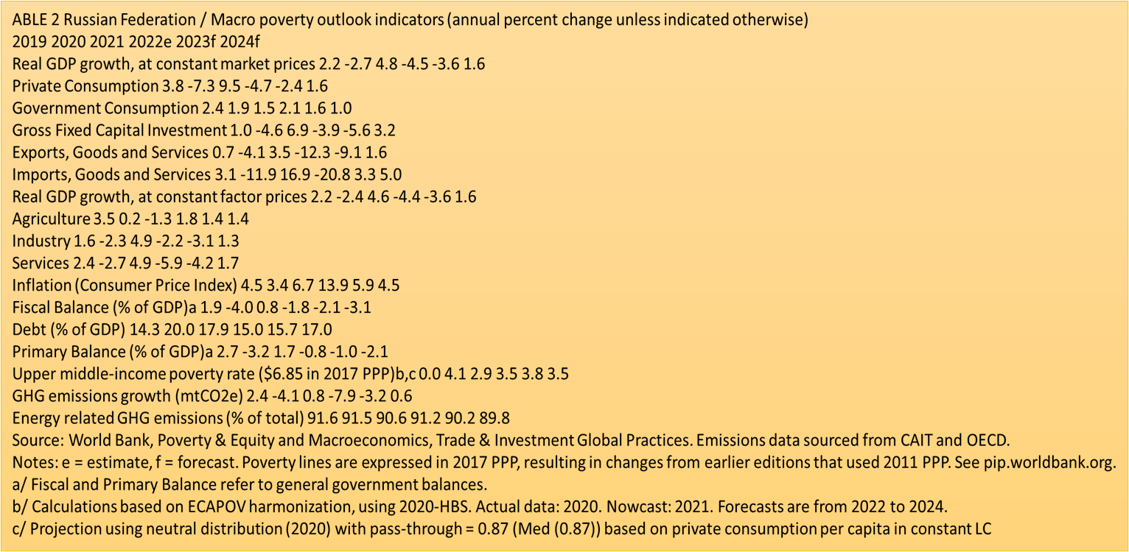

Slide 22
Стакан наполовину полон или пуст?
The sanctions imposed on Russia following its war in Ukraine are having significant adverse economic impacts, albeit less severe in the short term than first expected. The initial shock was mitigated by the authorities’ strong fiscal response (3 percent of GDP), capital controls, monetary tightening, swift action to stem financial sector risks, as well as high FX inflows driven by the surge in global commodity prices. The combination of smaller accessible international reserves (as half of Russia’s US$630bn international reserves were frozen because of sanctions), the suspension of its fiscal rule, and the reduction in domestic nonoil/gas revenues, all imply that Russia is now more exposed if fossil fuel prices and/or volumes fall as the global economy cools down. Moreover, the sanctions have led to a dramatic drop in total imports, restricting access to new technologies and equipment, and external financing, and thereby dampening
The outlook is developed under assumptions that the war and sanctions will continue as in recent months. GDP is expected to decrease by 4.5 percent in 2022 and by a further 3.6 percent in 2023, as the economy continues to contract due to the impact of sanctions, including those coming into force at the end of this year (notably the EU partial oil ban and to a lesser extent the oil price cap). A declining economic base and higher expenditure are expected to turn the general government surplus into a 1.8 percent deficit in 2022

Slide 23
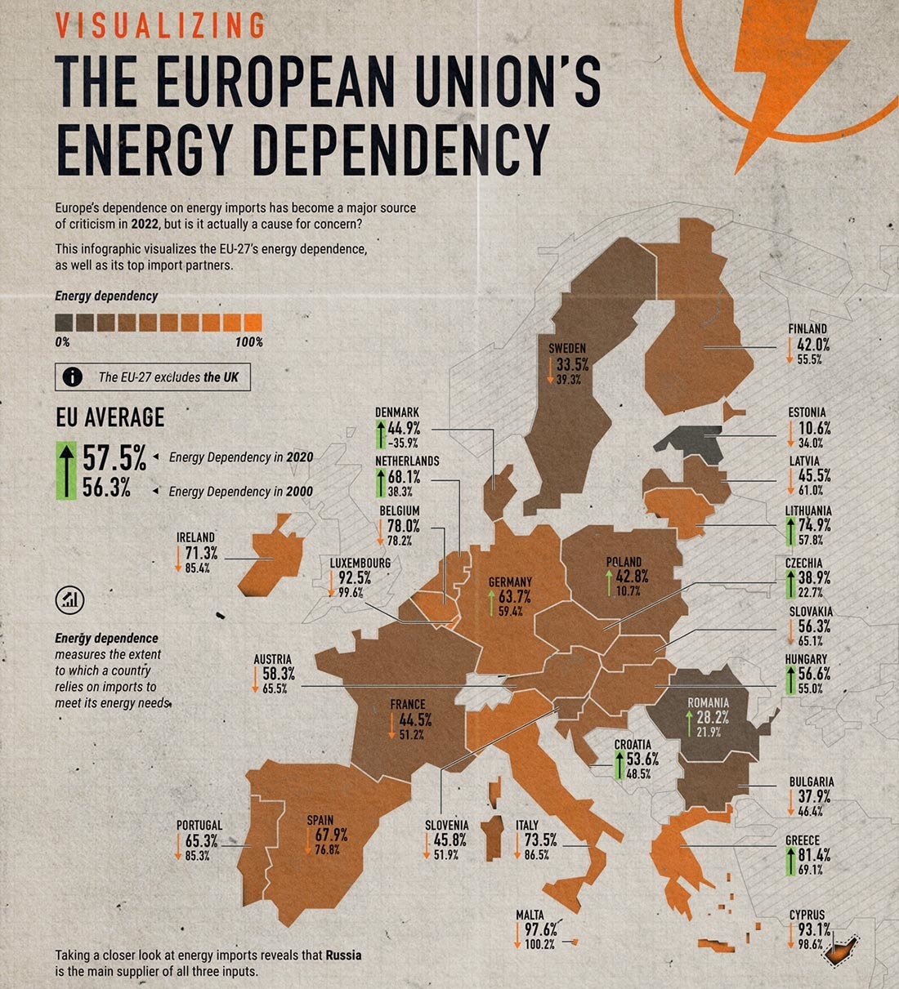

Slide 24
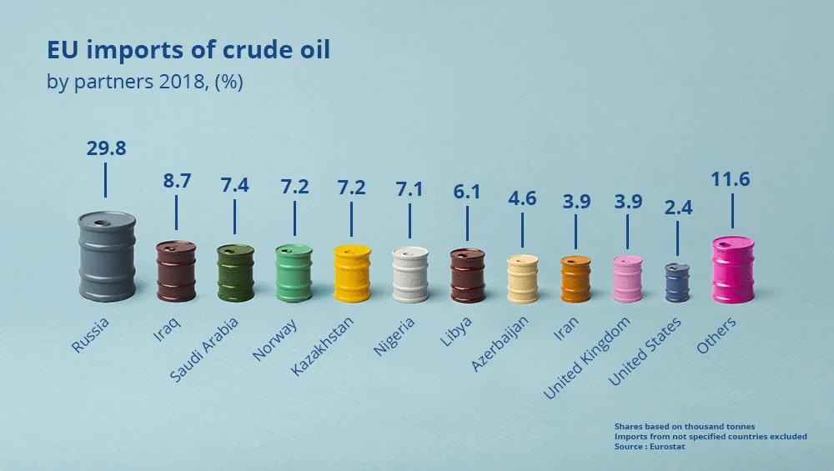

Slide 25
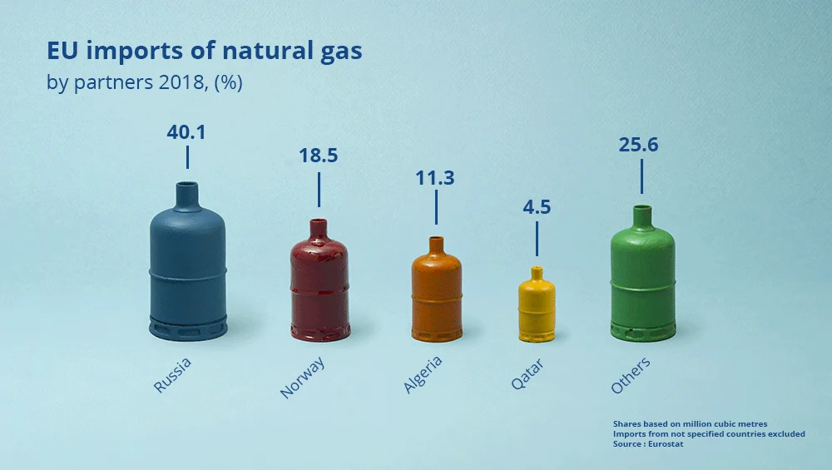

Slide 26
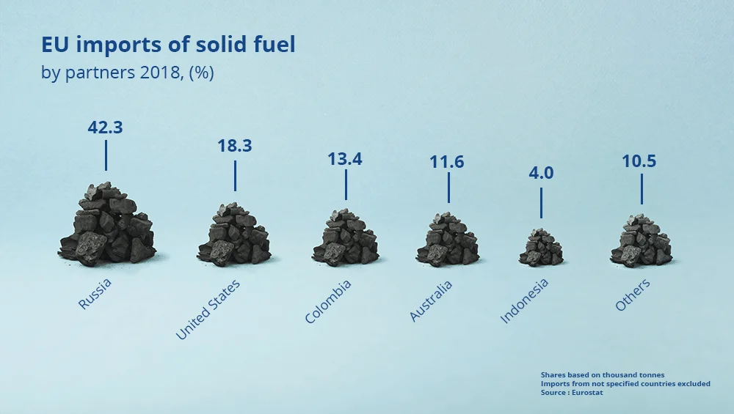

Slide 27
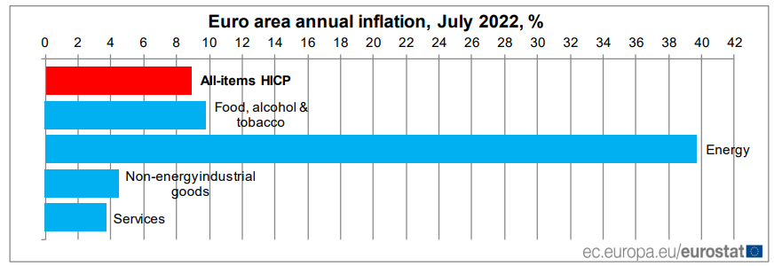

Slide 28
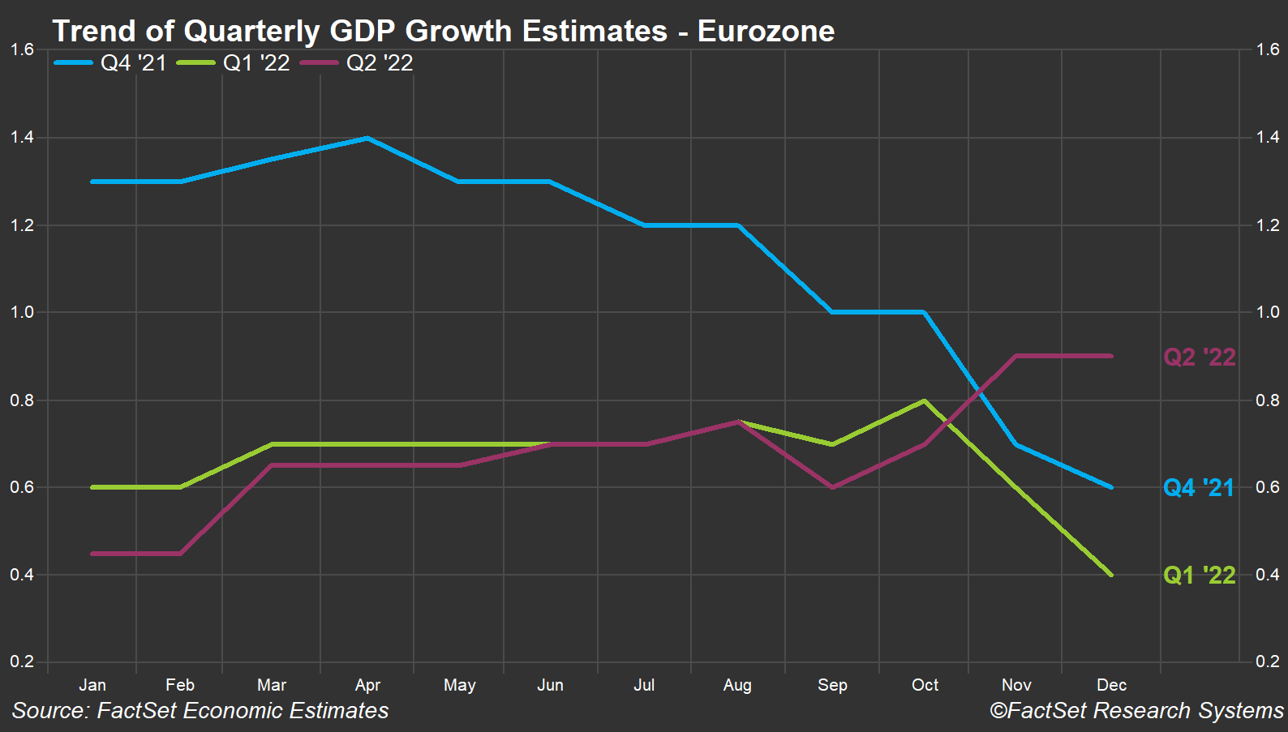

Slide 29
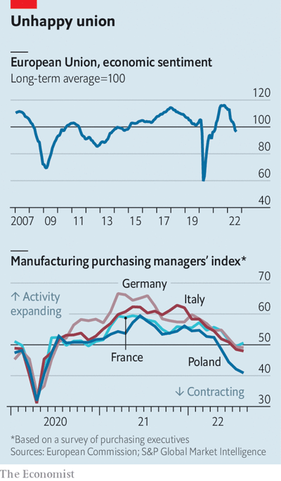

Slide 30
Когда санкций уже недостаточно
26 сентября 2022 г. Северный поток 1 и Северный поток 2
7 октября 2022 г.
Крымский мост

Slide 31
Ursula von der Leyen The president of the European Commission:
“Наша цель - не только заморозка, но и конфискация активов… для финансирования восстановления Украины. Это не просто с правовой точки зрения, предстоит много работы“ (25/10/2022)

Slide 32
Эмиссия на 2 триллиона рублей?
Евросоюз впервые назвал сумму активов российского Центробанка, которые были заморожены из-за санкций, — $24,5 млрд. Комиссар юстиции Дидье Рейндерс на пресс-конференции сообщил, что члены ЕС также арестовали активы российских бизнесменов на сумму около $10,7 млрд.

Slide 33
EU High Representative for Foreign Affairs and Security Policy Josep Borrell:
«This war will be won on the battlefield».

Slide 34
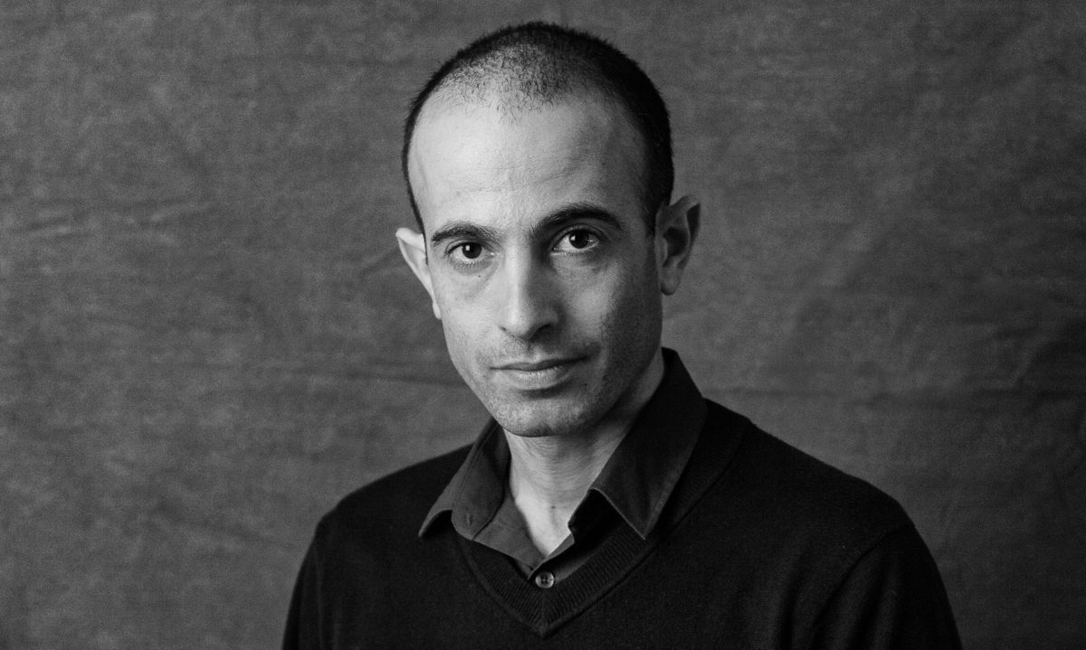
I don’t know what will happen in Ukraine. But as a historian I do believe in the possibility of change. I don’t think this is naivety—it’s realism. The only constant of human history is change. And that’s something that perhaps we can learn from the Ukrainians. For many generations, Ukrainians knew little but tyranny and violence. They endured two centuries of tsarist autocracy (which finally collapsed amidst the cataclysm of the first world war). A brief attempt at independence was quickly crushed by the Red Army that re-established Russian rule. Ukrainians then lived through the terrible man-made famine of the Holodomor, Stalinist terror, Nazi occupation and decades of soul-crushing Communist dictatorship. When the Soviet Union collapsed, history seemed to guarantee that Ukrainians would again go down the path of brutal tyranny – what else did they know? But they chose differently. Despite history, despite grinding poverty and despite seemingly insurmountable obstacles, Ukrainians established a democracy. In Ukraine, unlike in Russia and Belarus, opposition candidates repeatedly replaced incumbents. When faced with the threat of autocracy in 2004 and 2013, Ukrainians twice rose in revolt to defend their freedom. Their democracy is a new thing. So is the “new peace”. Both are fragile, and may not last long. But both are possible, and may strike deep roots. Every old thing was once new. It all comes down to human choices.
Yuval Noah Harari is a historian, philosopher and author of “Sapiens” (2014), “Homo Deus” (2016) and the series “Sapiens: A Graphic History” (2020-21). He is a lecturer in the Hebrew University of Jerusalem’s history department and co-founder of Sapienship, a social-impact company.

Slide 35
Никто не хотел уступать……

